Slide 1
Custom Named Entity Recognition (CNER)

Slide 2
Hello!
I am Yash Rajput
Roll No.: 31389
Division: TE-3
Guide: Dr. M. S. Takalikar

Slide 3
INDEX
Problem Definition
Introduction
Motivation
Literature Survey
Software and Hardware Requirement
Workflow
Implementation
Future Scope
Conclusion
References

Slide 4
To build a custom named entity recognition model in clinical text with spaCy in python that can recognize disease names.
Problem
Definition

Slide 5
Named Entity Recognition (also known as entity recognition, entity segmentation) is a subset of information extraction which aims to locate and classify named entities in text into relevant categories, such as people, organization, location, time expression, etc.
Named Entity Recognition is a fundamental component of natural language processing.
The term Named Entity was first introduce at the Message Understanding Conference (MUC-6) and research on NER has a history of more than 20 years.
Introduction

Slide 6
In the recent years, the internet and its use has gained a boom and each and everything can be done using internet.
As the world is emerging and the technology is reaching the heights, the volume of the data that is exchanged is increasing.
Collecting meaningful information from that data and applying it to their business to improve their productivity and efficiency so that they can give better and faster service to their customers.
The models were created with the goal of self-monitoring and predicting the named entity token in sentences such as people, organization, location, time expression, etc.
Motivation

Slide 7
Sr. No | Techniques | Methods | Dataset | Limitations
1 | Dictionary-Based | All the entities are stored in a dictionary gazetteer | NER Dataset | As new words are generated often, the same word stream can be recognised as different named entities.
2 | Rule-Based | Based on lexical rules, contextual rules, morphological lexicon of the language | NER Dataset | For language with morphologically rich features rule based approach fails as large number of gazetteer lists has to be maintained
3 | Machine Learning | HMM, MEM CRF, SVM | NER Dataset | Model performs well for trained data set but gives low accuracy for unseen data.
4 | Deep Learning | CNN, RNN, LSTM, Bi-LSTM | NER Dataset | RNN can have great impact on the speed and is an obstacle to parallelization
Literature
Survey

Slide 8
Software Requirement:-
I. Anaconda Navigator 3.0.1
II. SpaCy 2.0
III. NumPy 1.15.4
IV. Python 3.0
V. Matplotlib 3.0.3
------------------------------------
Hardware Requirements:-
I. Core i5 machine
Software
And Hardware
Requirements

Slide 9
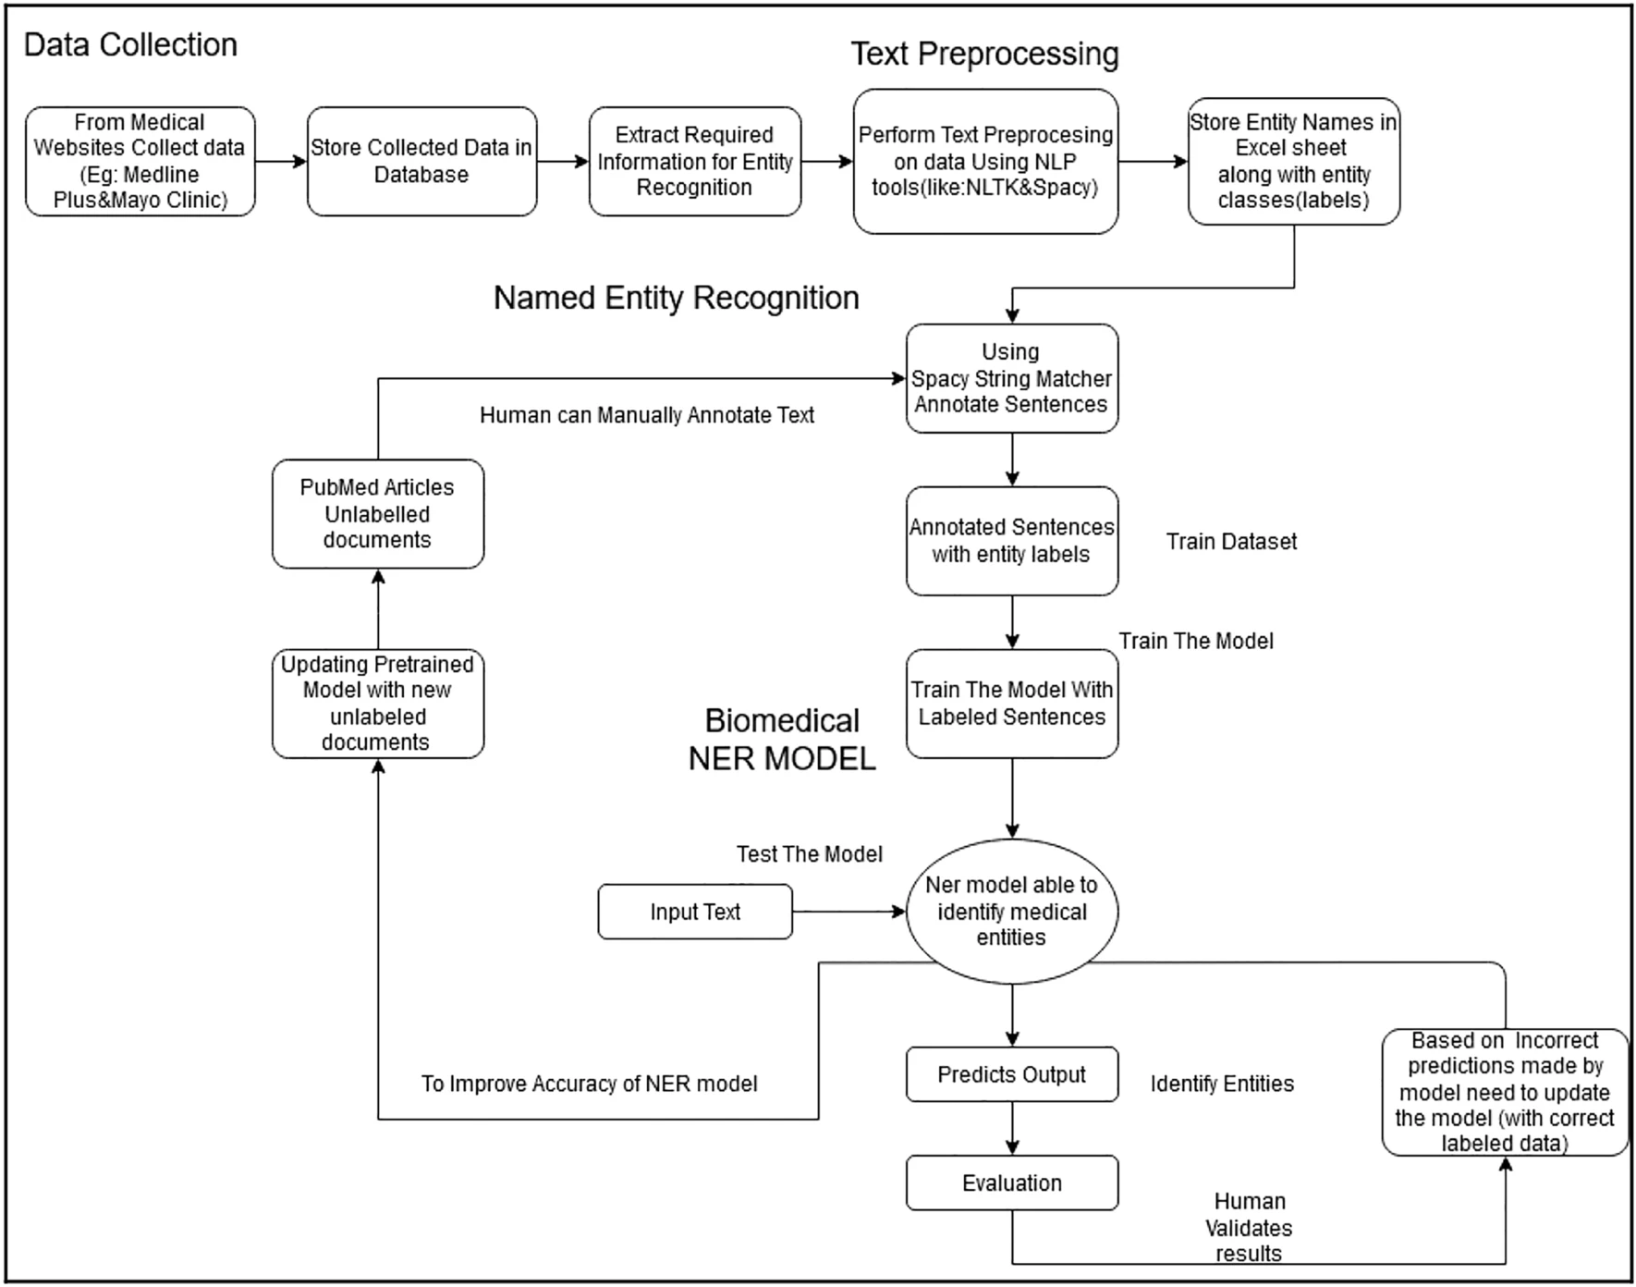

Workflow

Slide 10
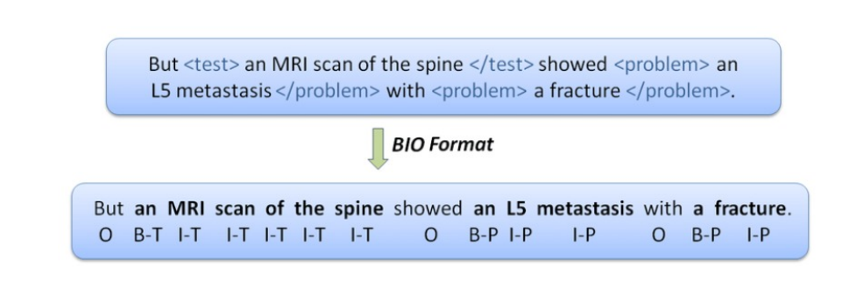
Dataset and Pre-Processing Steps
Loading the Dataset into Workplace available on kaggle and in different platforms NER Dataset.
Each dataset having the following files: train.tsv, test.tsv, dev.tsv and devel.tsv.
These are tab separated files each word is annotated using the BIO format.
In BIO format : B stands for begin of entity , I stands for inside entity and O stand for outside entity or any other word.
Implementation

Slide 11
Implementation
Training a Custom Named Entity(Disease Recognition in Clinical Text)
1] Let us define methods to compute Precision, Recall and F1-score
TP(True Positive) : Word predicted as either I Disease or B Disease and present in the data(train/test/validation) as either i Disease or B Disease.
FP(False Positive) : Word predicted as either I Disease or B Disease and not present in the data(train/test/validation) as either i Disease or B Disease.
FN(False Negative) : Word predicted in the data(train/test/validation) as either I Disease or B Disease and not predicted as either i Disease or B Disease.

Slide 12
Implementation
2] Matrix
Precision : Number of predicted entity string spans that line up exactly with spans in the evaluation data.
Precision = TP / (TP + FP)
Recall : Number of names in the evaluation data that appear at exactly the same location in the predictions.
Recall = TP / (TP + FN)
F1-score : This metric is the harmonic mean of Precision and Recall.
F1-score = 2 * Precision Recall / (Precision + Recall)

Slide 13
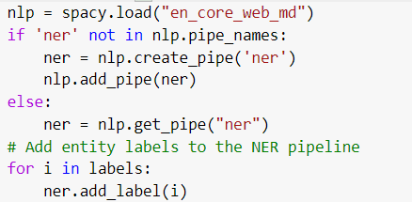
Implementation
I use an existing model ”en core web md”(English medium sized model). This is a CNN model. This model by default has POS tagger, Dependency parser and Named entity recognition functionalities. I only re-train the named entity recognition part of the model.
Dropout is a regularization technique for reducing overfitting in neural networks by preventing complex co-adaptations on training data. The term dropout refers to randomly ”dropping out”, or omitting, units (both hidden and visible) during the training process of a neural network. In our case if dropout = 0.5 there is a 50% dropping out omitting units during training process of our model.

Slide 14
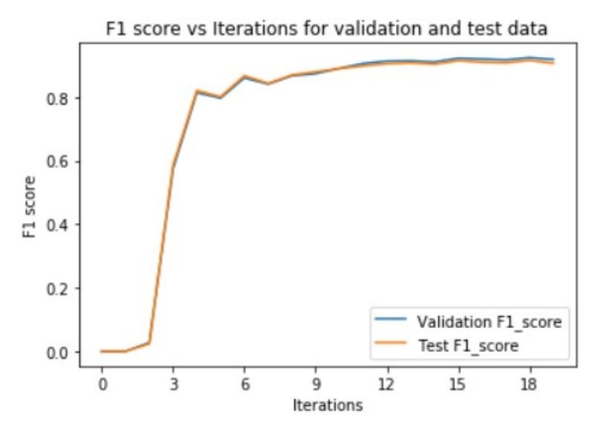
Results
 |  | Testing Accuracy | Testing Time
Iteration 0 | 0. 9935285 | 0.9935286 | 0.0399370
Support Vector Machine | 0.9987552 | 0.9987916 | 30.067269
Decision Tree | 0.9905829 | 0.9905230 | 0.0458767
Random Forest | 0.9999788 | 0.9996503 | 0.5462884

Slide 15
NER is a fascinating subject in natural language processing that has a wide variety of applications and scope.
To discover the text’s subject.
To discover relationships among entities.
Search : One of the most important is an online search. Search engines give better results when they comprehend the entities in a query. Google uses this same approach
Indexing documents : Another important one is cataloging or indexing text documents like web pages or online articles.
Product reviews : In a retail setting, a third use case is extracting product names or other significant entities from online reviews.
Future
Scope

Slide 16
Named Entity Recognition (NER) plays a key role in the detection and classification of entities in NLP applications. An end-to-end framework for Custom Named Entity Recognition was developed during the research process. As a result, our model achieved state-of-the-art performance in terms of F1 score, precision and recall. I successfully trained a custom named entity recognition model in clinical text with spacy to detect your custom entities. Here I successfully detect the disease entities with 0.91 or 91% F1-score and validation data. Although our model requires a large amount of memory and time.
Conclusion

Slide 17
J. Li, A. Sun, J. Han and C. Li, March 2020, ”A Survey on Deep Learning for Named Entity Recognition,” , in IEEE Transactions on Knowledge and Data Engineering, doi: 10.1109/TKDE.2020.2981314.
Ramachandran R, Arutchelvan K., March 2021, Named entity recognition on bio-medical literature documents using hybrid based approach. J Ambient Intell Humaniz Comput. 11:1-10. doi: 10.1007/s12652-021-03078-z. Epub ahead of print. PMID: 33723489; PMCID: PMC7947151.
C. Ronran and S. Lee, 2020, ”Effect of Character and Word Features in Bidirectional LSTM-CRF for NER,”, IEEE International Conference on Big Data and Smart Computing (BigComp), 2020, pp. 613-616, doi:10.1109 /BigComp48618. 2020. 00132.
J. Qiu, Y. Zhou, Q. Wang, T. Ruan and J. Gao,July 2019, ”Chinese Clinical Named Entity Recognition Using Residual Dilated Convolutional Neural Network With Conditional Random Field,” in IEEE Transactions on NanoBioscience, vol. 18, no. 3, pp. 306-315, doi: 10.1109/TNB.2019.29086
Erdmann, Alexander Wrisley, David Allen, Benjamin Brown, Christopher Cohen-Bod´en`es, Sophie Elsner, Micha Feng, Yukun Joseph, Brian JoyeuxPrunel, B´eatrice Marneffe, Marie-Catherine. (2019). Practical, Efficient, and Customizable Active Learning for Named Entity Recognition in the Digital Humanities. 2223-2234. 10.18653/v1/N19-1231.
References

Slide 18
Thanks!
Any questions?
You can find me at
yashrajputishu@gmail.com

