Slide 1
Group No.: 2
School security system using rfid (Radio-Frequency Identification)
Web Portal Name: WorryLess
Tagline: Blowing off your insecurities

Slide 2
Persons Behind
Guide:
Sir V.G.Ravindhren (HOD D.COM.E, Vice-Principal)
Team Members:
Rahulkumar Singh (A161419) (Team Leader)
A.Raja Mathiyazhagan (A161420)
S.Yogesh (A161431)
H.Mohamed Rizwan (A173442)

Slide 3
Story Behind
The main objective of developing this project is to ensure the security of the students and give the parents relief. School Security System (SSS) is a software which is helpful for students as well as the parents. In this present situation the parents remain unknown whether their ward have reached school or not. It makes the parents unsecured, uncomfortable and worried. Our School Security System informs the parents if their child have reached the school premises or not.
This project is beneficial for both the students and parents in keeping themselves safe and free from negative thoughts. The system designed is meant to detect the child’s presence in the school premises and inform their parents the in-time of the child. The parents will be informed by the means of SMS and they also can generate the attendance report by accessing the parents interface. This system also sends an alert message to their parents in case the students are not still present at the school start time. The system will also record all IN and OUT details of the student, which will also render a great help to the school’s administration.

Slide 4
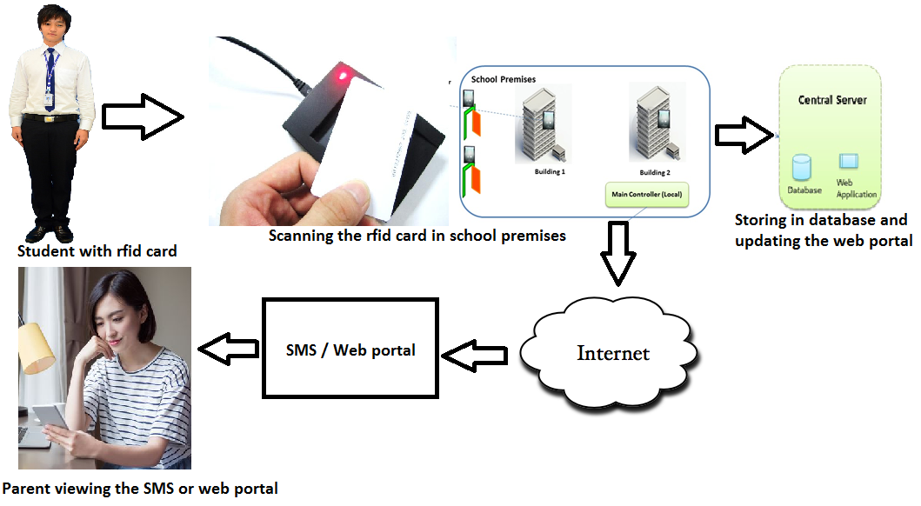
System Architecture

Slide 5
Hardware requirements :
Sl. No. | Component | Description | Quantity
 | RFID Scanner (RC522) | Used to scan the RFID card or RFID tag. | 1
2. | NodeMcu V3 with ESP8266 | Used to fetch RFID number from the scanner and sends the number to computer. | 1
3. | RFID Card | Contains the RFID number. | 1
4. | RFID Tag | Contains the RFID number. | 1
5. | Jumper Wire (Female to Female) | Used to connect the micro-controller and the scanner. | 7
6. | USB Cable | Used to give power supply to NodeMcu. | 1

Slide 6
Software requirements
Sl. No. | All-Inclusive | Software Name | Description
 | IDE | Arduino IDE | Used to code NodeMcu and RFID module.
2. | Programming and Scripting Language | PHP, C language, HTML5, CSS3, JavaScript, Bootstap | Used for Server Side Scripting, Client Side Scripting and programming NodeMcu
3. | Database and Web Server | MySQL, Apache (XAMPP) | Used as local Database and local web server
4. | Framework | WordPress | Used for Interface designing and code integration.
5. | API | TextLocal | Used to send SMS.

Slide 7
Database Structure
1. 2.
3. 4.
Table Name: login_parent
Field Name | Data type | Constraints/key
inst_id | Varchar(20) | Primary key
stud_id | Varchar(20) | Primary key
password | Varchar(100) | ­-
Table Name: login_teacher
Field Name | Data type | Constraints key
inst_id | Varchar(20) | Primary key
staff_id | Varchar(20) | Primary key
Pass | Varchar(100) | -
Table Name: dev_login
Field Name | Data type | Constraints key
username | Varchar(30) | Primary key
password | Varchar(100) | -
Table Name: institute_master
Field Name | Data type | Constraints key
institute_id | Varchar(20) | Primary Key
Name | Varchar(100) | Not null
contact_no | Varchar(20) | Not null
email_id | Varchar(100) | Not null
address | Varchar(1000) | Not null

Slide 8
5. 6.
8.
7.
Table Name: attendance_log
Field Name | Data type | Constraints key
Slno | Int | A.I.
institute_id | Varchar(20) | Not null
Rfid | Varchar(20) | Not null
Regno | Varchar(20) | Not null
Class | Varchar(10) | Not null
date1 | date | Not null
time1 | time | Not null
present_stat | Varchar(10) | Not null
msg_stat | Varchar(20) | Not null
Table Name: inst_working_days
Field Name | Data type | Constraints key
institute_id | Varchar(20) | Primary key
working_days | bigint | Not null
Table Name: student_master
Field Name | Data type | Constraints key
institute_id | Varchar(20) | Primary key
Rfid | Varchar(100) | Primary key
Regno | Varchar(20) | Primary key
Name | Varchar(50) | Not null
Class | Varchar(10) | Not null
section | Varchar(20) | Not null
f_m_name | Varchar(50) | Not null
address | Varchar(100) | Not null
contact_no | Varchar(10) | Not null
email_id | Varchar(100) | Not null
Table Name: working_days_log
Field Name | Data type | Constraints key
institute_id | Varchar(20) | Primary key
Date | Date | Not null

Slide 9
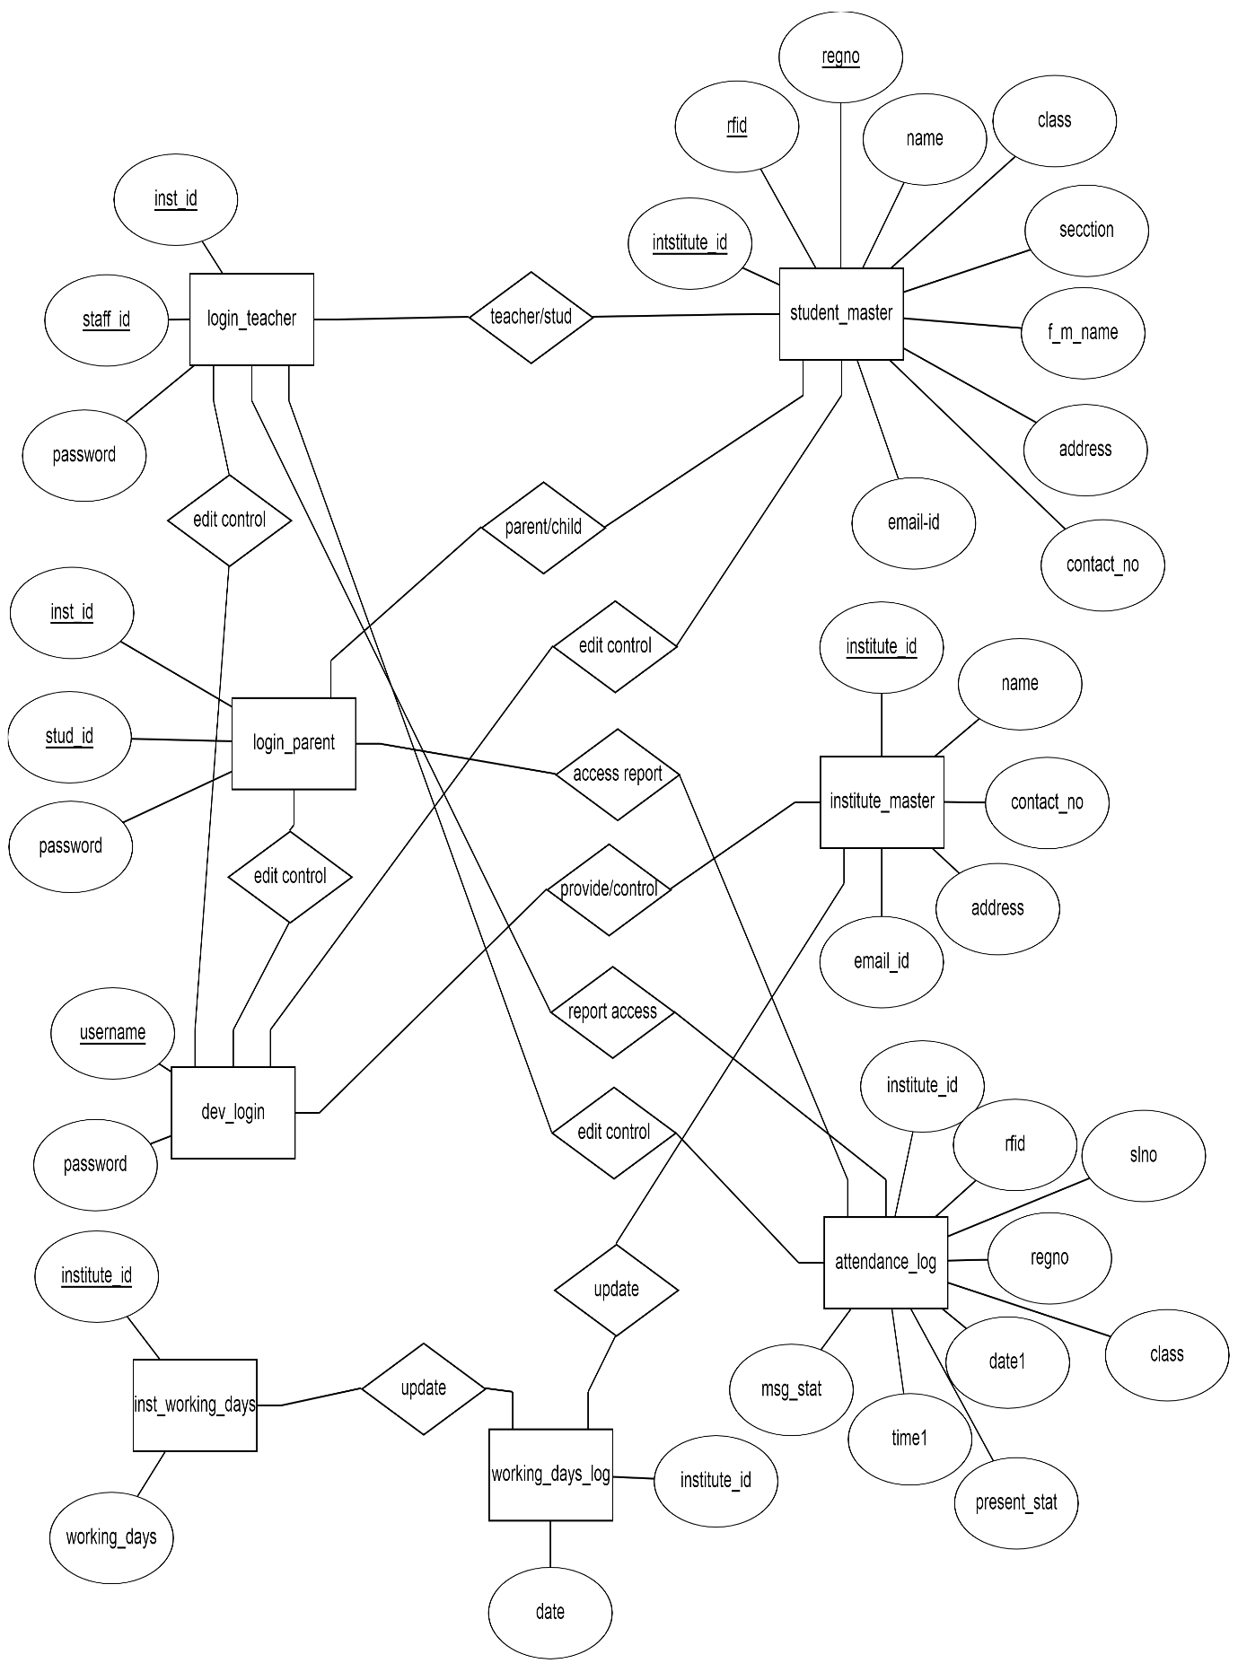
ER - Diagram

Slide 10
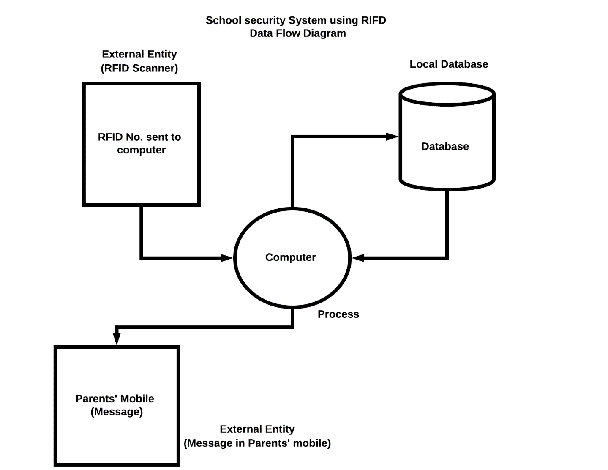
Data Flow Diagram

Slide 11
Modules: PARENTS LOGIN
STUDENT SUMMARY
REPORT GENERATOR
PARENTS EMERGENCY CONTACTS
PARENTS REQUEST ASSISTANCE

Slide 12
Modules: Institute LOGIN
STUDENT DATABASE VIEWER & EDITOR
DISPLAY ALL STUDENTS
SPECIFIC STUDENT REPORT GENERATOR
ATTENDANCE GENERATOR
ATTENDANCE EDITOR
SMS SENDER
INSTITUTE EMERGENCY CONTACTS
INSTITUTE REQUEST ASSISTANCE

Slide 13
Modules: DEVELOPER LOGIN
INSTITUTE DATABASE VIEWER & EDITOR
USER ACCESS DATABASE VIEWER & EDITOR
STUDENT DB MASTER
CONTACT DETAILS GENERATOR
DEVELOPER EMERGENCY CONTACTS

Slide 14
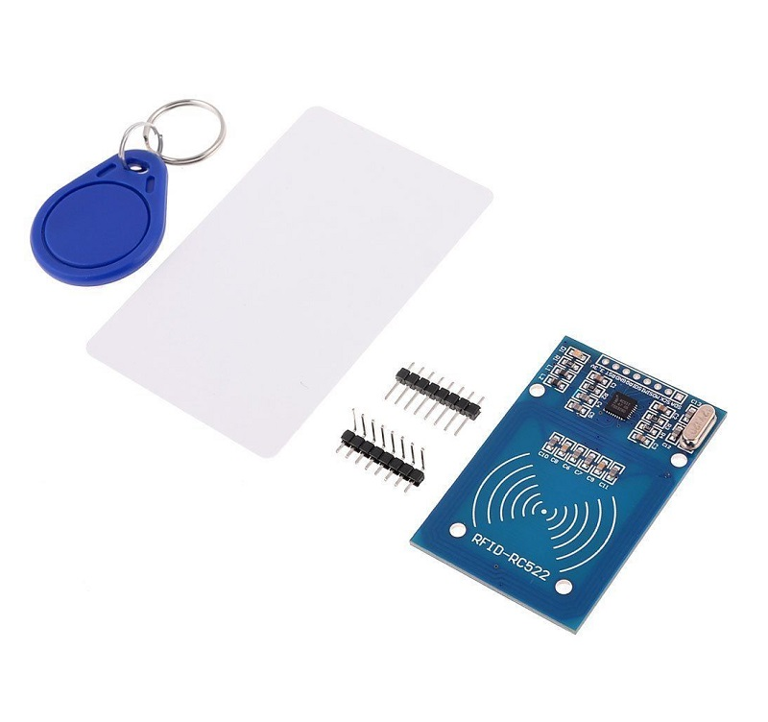
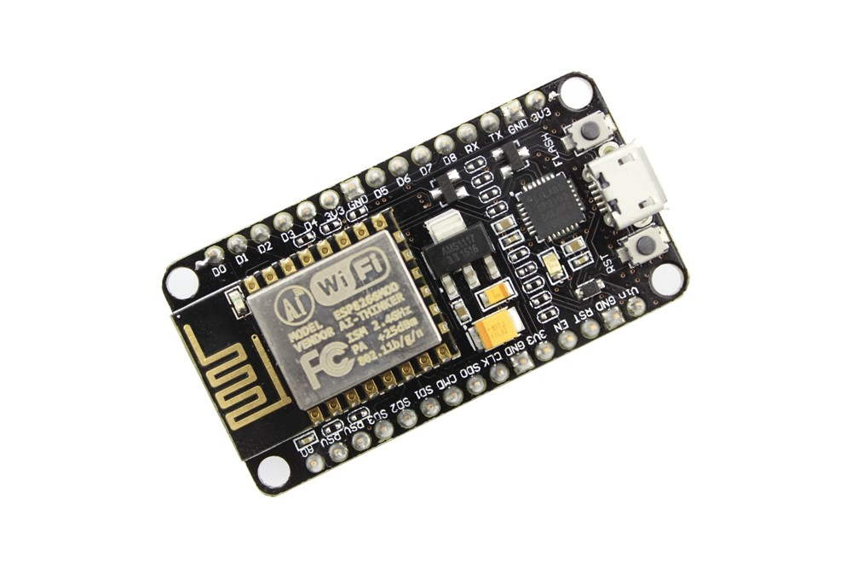
Modules: RFID & Nodemcu
Image of RFID Scanner and Tag/Card:
Image of NodeMCU:

Slide 15
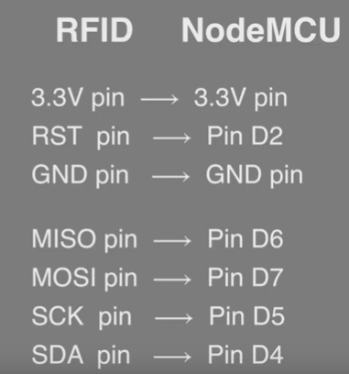
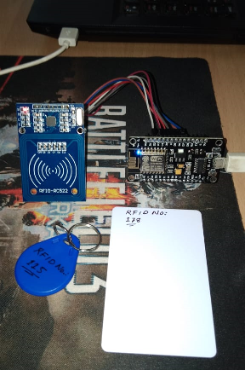
Connection Diagram:
After connection:

Slide 16
CONCLUSION
In this project, we have implemented a concept of intelligent security system for school children with the help of RFID. Identification has become a necessary process in almost all fields. Now days, all works are done by automation. Automation invention all are concentrated on the main theme that is to reduce human effort and effective utilization of time. Our project is also implemented to reduce the man power in the identification. Due to this, accuracy of identification is maintained. School Security System makes the parent free from being reluctant from sending their child to school. They feel relief knowing that their child have reached school safely. School Security System can be used by schools and colleges to not only inform the parents that their child reached safely but also to keep record of the students’ going out and coming in. Other methods of communicating can result to waste of time and money, and can be expensive and tiresome, therefore School Security Systems proves to be more efficient than the primitive methods. Surely, this identification system will enhance the needs of identification in other fields in our developing modern world. We, a team of four members took a step by step approach in order to reach our goal.

