Slide 1
Software Development Life-cycle (SDLC)

Slide 2
Software Development
Life-cycle (SDLC)

Slide 3
Overview of SDLC
SDLC Process
SDLC Phases
SDLC Models

Slide 4
Software Development
Life-cycle (SDLC)

Slide 5
INTRODUCTION
Planning
Software Development Life-cycle (SDLC) is a process consisting of a series of planned activities to develop or maintain software products
Also referred to as Software Development Process
At a high-level it consists of following stages:
Define and analyze requirements
Design the system
Implement or build the system
Test and deploy
Maintenance

Slide 6
PHASES
Activities involved in Software Development Life-Cycle phases are:
Plan/Define Project Scope
Conduct preliminary analysis
Propose alternative solutions
Describe the cost and benefits
Requirements Analysis
Collect various facts
Study existing system
Analyze proposed system
Prepare requirement specifications
System Design
‘How’ part of the system: Details of screens, business rules, pseudo-code, etc.
Test planning
Plan/Define Project Scope
Maintenance or Disposal
Requirement Analysis
Deployment
System Design
Testing
Development
Notes:
Before starting any project, the client will do the initial analysis to assess if the new system is really required. For example, if the client requires a system to keep track of the complaints they receive about their products, first thing is to check if they already have a similar system to handle it. If not, is there any alternative method to do the needful like an existing similar system or a ready-made product. If yes, measure the pros and cons of either using the alternative solution or going for the new system. Going for a new system may cost more than using an alternative solution. However, this solution may be short-lived, may not cater to all the needs and may be in an outdated technology. Accordingly, the client takes a go-or-no-go decision about the new system.
Once it's decided to go ahead with the new system, it's time to define its clear cut requirements. Various facts have to be collected (studying the work flow, existing system, relevant data points, how they are stored), analyzed (feasibility, priority, the need) and appropriately captured in the requirements specification document.
While the requirements focuses on the 'what' aspect of the system, the design focuses on 'how' to convert these business needs into technical know-how. It involves designing of screens, architecture, hardware / software platforms, their connectivity, security, pseudo-code, to list a few. How to test the system once it's ready, also have to be decided at this stage.

Slide 7
PHASES
Activities involved in SDLC (contd..):
Development
Actual implementation of the system (coding)
Testing
Test system using various techniques in various stages
Deployment (Installation)
Installing the software in the final environment
Maintenance
Taking up any enhancements and fixing any existing defects
OR
Disposal
Stop using it when it becomes obsolete or no longer needed
May be replaced with a new system
Plan/Define Project Scope
Maintenance or Disposal
Requirement Analysis
Deployment
System Design
Testing
Development
Notes:
After defining the clear-cut requirements and coming with their design components, it's time to actually build the system using these design specifications. Appropriate high-level language is used to write the source code.
The code has to be verified to check if it meets the original requirements by testing it at various phases (Unit, Integration, …). If not, all defects (those features which are not working as per the requirements) have to be fixed and tested again to ensure defect free software.
Once all kinds of testing is complete (decided during project planning), the system is deployed in the final (production) environment. It involves installing all the source codes, initial data setup, user setup, data migration (if existing data have to be used), user training (in certain cases) and other activities.
Maintenance phase is the longest phase in SDLC. Once the system is deployed in production environment and users start using it, some defects may surface up which went undetected during testing stage. Users also may come up with some enhancements to the system. Fixing the defects, incorporating the enhancements are some of the major activities done during maintenance.
Users may also decide to stop using the system where it needs to be disposed of. Organizational changes, change in business needs, new technologies, new systems are some of the reasons where the current application may have to be disposed of. All hardware and network setup used by the application will be released back once it gets disposed of.

Slide 8
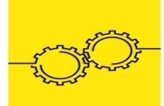

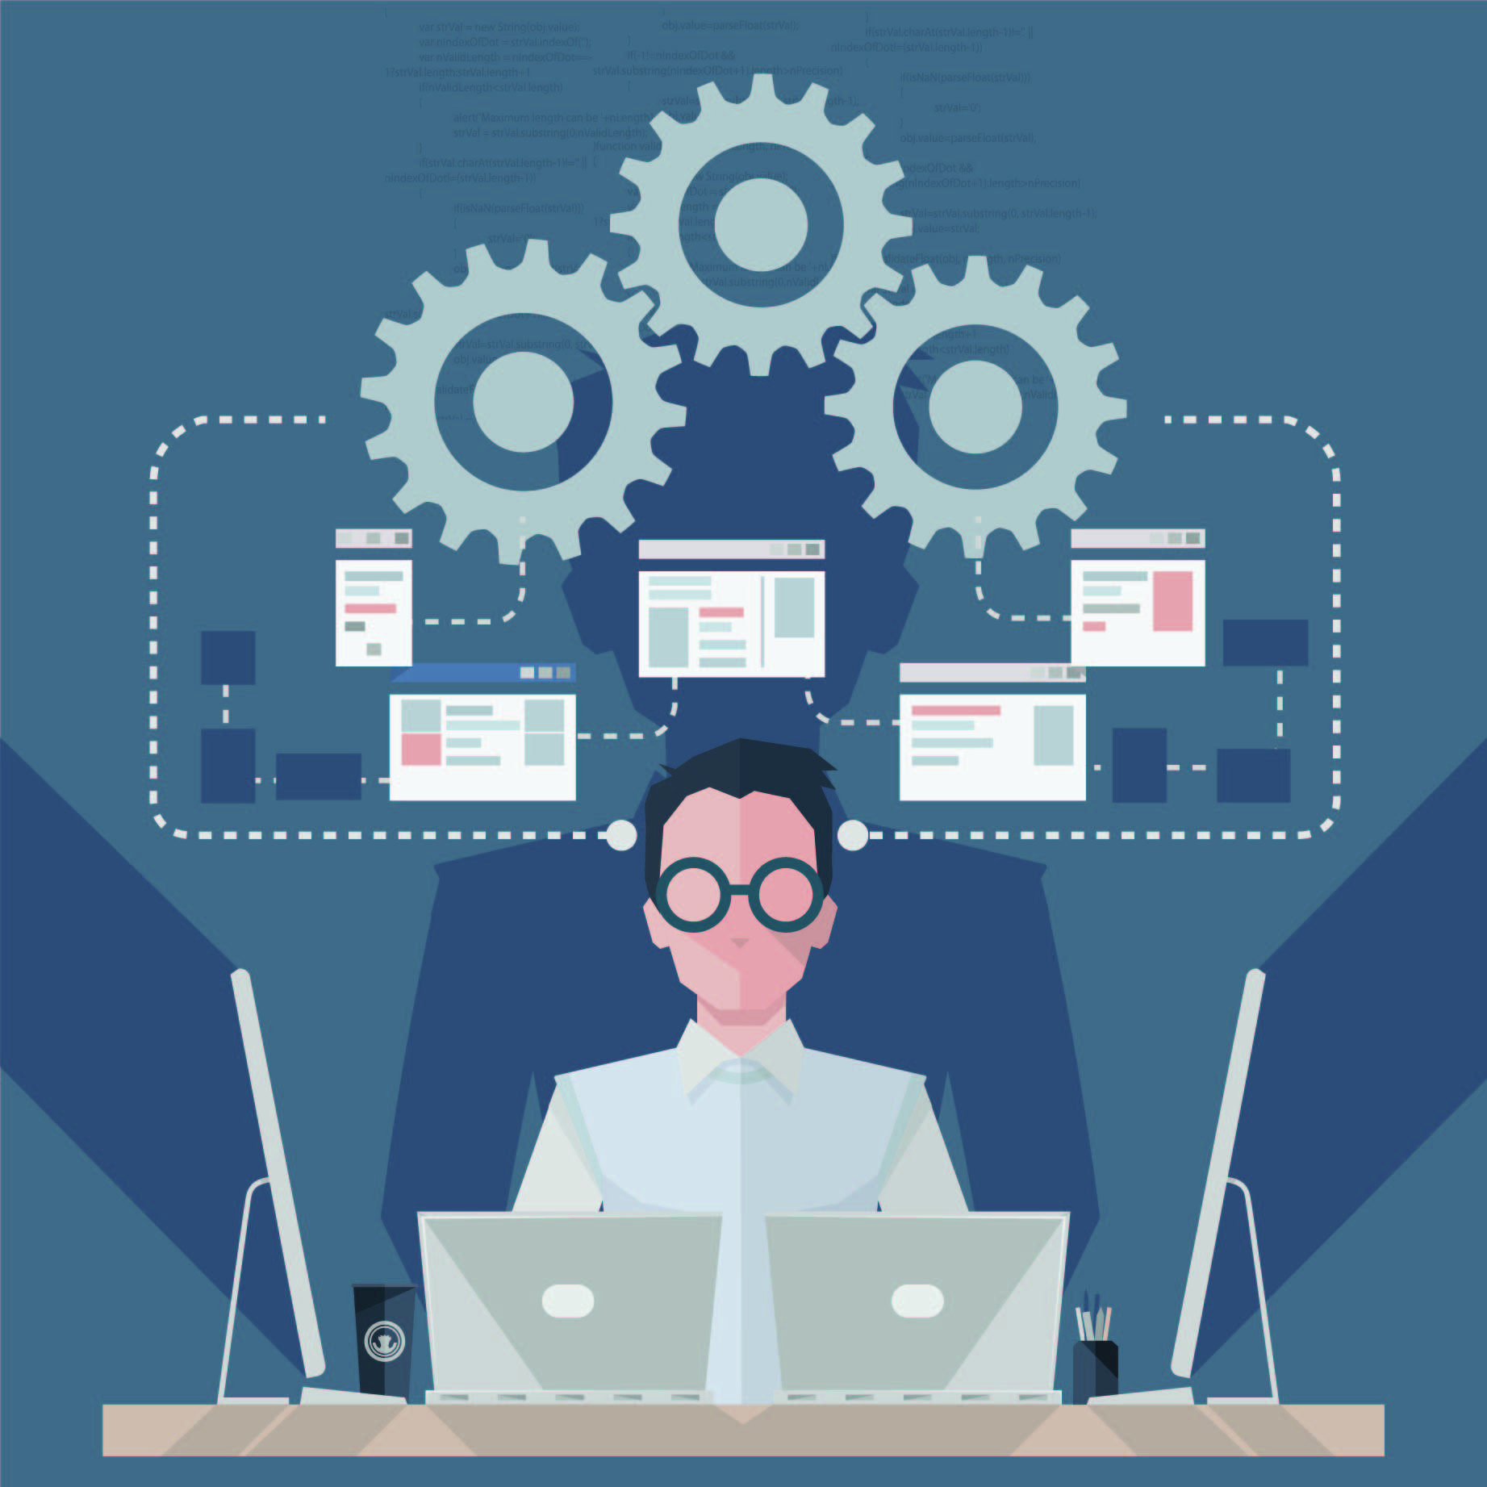

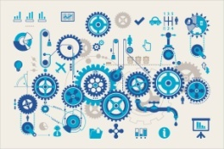





PHASES
Operations and Maintenance
Disposition
Integration and Testing
Implementation
Describes end-of-system activities. Emphasis is given to proper preparation of data.
Describes tasks to operate and maintain information systems in a production environment includes Post-Implementation and In-Process Reviews.
Development
Includes implementation preparation, implementation of the system into a production environment, and resolution of problems identified in the integration and Test Phases.
Requirement Analysis
Design
Demonstrates that developed system conforms to requirements as specified in the functional requirements document. Conducted by Quality Assurance staff and users. Produces Test Analysis Reports.
System Concept Development
Converts a design into a complete information system. Includes acquiring and installing systems environment; creating and testing databases, preparing test cases procedure, preparing test files, coding, compiling, refining, programs; performing test readiness review and procurement activities.
Planning
Transforms detailed requirements into complete, detailed Systems Design Documents. Focuses on how to deliver the required functionality.
Analyses user needs and develops user requirements. Creates a Detailed Functional Requirements Document.
Initiation
Develops a Project Management Plan and other planning documents. Provides the basic for acquiring the resources needed to achieve a solution.
Defines the scope or boundary of the concepts. Includes: systems boundary document, cost benefit analysis, risk management plan and feasibility study.
Begins when a sponsor identifies a need or an opportunity. Concept Proposal is created.

Slide 9
SOFTWARE PROCESS
Quality encompasses all activities involved in a project
Project management includes managing people, tasks, various project phases, stages, etc.
Transactions beyond project helps to improve the overall quality of the whole system
Quality systems (ISO, CMMi, Six Sigma, Lean)
Transactions beyond project –
Contract, CSAT, Complaints, Process Improvements
Project Management
Process / SDLC
Plan / Scope
Requirement Specs
Project team
Umbrella activities
Status Reports, Config. Mgmt, Metrics, etc.
Design
Implementation
Testing
Types of SDLC:
V, Waterfall, RAD etc.
Notes:
The diagram above captures the working of overall software development project. Managing a project is an art. It requires good amount of experience, innovative mind-set, people handling skills, eye for details, quality focus, process orientation and more. Goal of any project is to successfully complete it to meet (or exceed) customers' requirements.
Based on the type of project, application and other parameters, the project will have various stages. Appropriate software development life cycle (SDLC) process is followed for a smooth transition of the project into its final stage. While there are many activities in each stage of the SDLC, certain common activities like status reporting, configuration management, data measurement, etc. are done across many stages of a project. They are referred as umbrella activities.
Every activity of the whole project is governed by a quality system (as per any of the standards ISO, CMM, etc. which would have been decided earlier by the project team).
Recall the PDCA cycle. The 'Act' stage focuses on the improvement part of the whole process by gathering various results and feedbacks about the project. Once the users start using the application, getting to know how satisfied they are with the application is very important from the improvement perspective. This can be collected using CSAT (Customer SATisfaction) surveys, complaints system and other mechanisms. The inputs thus collected have to be analyzed and inferences should be drawn from it to appropriately incorporate them back into the process for further improvement.

Slide 10
QUIZ QUESTION
Which of the following defines 'evolution', one of the four fundamental software process activities?
Changes made to the software that meet changing design needs
Changes made to the software that meet user’s changing needs
Changes made to the software that meet manager's needs
Changes made to the software that meet new needs of all users
Notes:
Answer: Changes made to the software that meet user’s changing needs

Slide 11
QUIZ QUESTION
In which phase of SDLC is the existing system studied?
Design
Maintenance
Testing
Requirements analysis
Notes:
Answer: Requirements analysis

Slide 12
QUIZ QUESTION
One of the key reasons to 'dispose of' a software is:
Changes to org. chart
Technological advancements
Obsolescence
People movement
Notes:
Answer: Obsolescence

Slide 13
SDLC Models

Slide 14

SDLC MODELS
Generic software process models
Waterfall model
Evolutionary models
Prototyping model
Spiral model
Incremental models
Iterative model
RAD model
Agile models
Extreme Programming (XP)
Rational Unified Process (RUP)
Scrum
Notes:
Process models or development lifecycle models are some kind of frameworks which contain a set of processes or methodologies that are being selected for the development of the projects depending on the project's aims and goals. There are various development lifecycle models to achieve different required objectives. The models specify the various stages of the process and the order in which they are carried out.
For example, does a civil engineer always use a same methodology to construct various types of buildings? Of course not. Based on the size, strength requirement and complexity of the building, she has to employ different methodologies to build it.
Similarly, there are different software development lifecycle models available to develop the system based on various parameters like timeline, project scope, project type, clarity about requirements, user involvement and more.

Slide 15
WATERFALL MODEL
Classical life cycle and linear sequential model is widely used
Suggests a systematic sequential approach:
Conception & Initiation
Analysis
Design
Construction
Testing
Deployment
Maintenance / Support
Operation and Maintenance
Integration and Testing
Implementation
Design
Requirements specifications
Analysis
Notes:
Classical, linear-sequential model. One phase has to be completed before another phase activities are taken up. As can be seen in the diagram, one phase provides inputs to the next phase, next one to its next phase and so on which looks like a water flowing down through a set of steps, hence the name Waterfall model.
Once the initiation is complete, its inputs are taken to elaborate the requirements and analyze them, which further provides inputs to the design phase and so on.

Slide 16
WATERFALL MODEL
Phases of Waterfall Model
Initial analysis
Specifying the problem background, business goals and success criteria
Requirement analysis and definition
The goals and constraints of the system to be developed are established in consultation with system users
They are then defined in detail and serve as a system specification
System and software design
Partitions the requirements to either hardware or software
Software design involves identification of necessary fundamentals of the software requirement and their relationship with those systems
Implementation
Whole of software components are integrated as a set of programming units

Slide 17
WATERFALL MODEL
Phases of Waterfall Model (contd …)
Unit testing
Involves verifying that each unit meets its necessary requirement
Integration and system testing
The individual program units are integrated and tested as a one complete system to ensure that all the necessary requirements have been met.
Deployment/installation
After testing the system is installed in the final environment
Operation and maintenance
Longest life cycle phase
Involves correcting the encountered errors which were not discovered at earlier stages
Also by enhancing the systems services, new requirements are discovered

Slide 18
WATERFALL MODEL
Traditional Model
Practitioner’s Model
Operation and Maintenance
Integration and Testing
Implementation
Design
Requirements specifications
Analysis
Requirements
Analysis
Design
Coding
Testing
Deployment & Maintenance
Notes:
As it is known, in a traditional waterfall model, one phase has to complete before the next phase starts. For some reason, if it's found that activities done in an earlier phase is incorrect or inappropriate (e.g. if it's found that requirements were not captured properly in the testing phase), this model doesn't suggest any procedure to go back to that phase.
In the revised, practitioner's model this constraint is handled by allowing to go back to a previous stage from any stage to fix any problems that was introduced during an earlier stage.

Slide 19

WATERFALL MODEL
Advantages
Easy to understand and Implement
Widely used and known
Reinforces good habits: define-before-design
Identifies deliverables and milestones
Document driven
Works well on mature products and weak teams
Fits other engineering process models

Slide 20
WATERFALL MODEL
Disadvantages
Idealized, doesn’t match reality well
Does not reflect iterative nature of exploratory development
Unrealistic to expect accurate requirements early in the project
Delays discovery of errors
Difficult to integrate risk management
Difficult to accommodate change after the process is underway
One phase has to be competed before moving to the next phase.
Difficult and expensive to make changes to document

Slide 21
WATERFALL MODEL
When to use?
Requirements are very well known
Product definition is stable
Technology is understood
Creating a new version of an existing product
Porting an existing product to a new platform

Slide 22
PROTOTYPING MODEL
Allows users of the software to evaluate developers' proposals for the design of the final product by actually trying them out by means of a prototype of the screens
Avoids the hardship of end users having to interpret and evaluate the design based on descriptions
Users review and provide feedback on changes required for the prototype
This is repeated until all requirements of system are identified
Identify basic requirements
Develop initial prototype
Review
Revise & Enhance
Plan & Design
Notes:
A prototype is like a working model of a software with limited functionality. The focus is to show how the screen looks like and how the transition happens across screens. There will be no business logic built into it. Such models help users give clear requirements (for human beings can understand more clearly the things which they can see rather than only hear).
Once the requirements are gathered, more functionality can be built into this prototype model itself with appropriate business logic to evolve into the final product. Such prototypes are referred as evolutionary prototypes. Web applications are a good candidates to this model; HTML based screens can be evolved further to develop the complete system.
Throwaway prototypes are the ones which are used for showing how the screens look like and later discarded once the requirements are clear.

Slide 23
PROTOTYPING MODEL
Advantages
Users are actively involved in the development
Errors can be detected much earlier
Quicker user feedback is available
Missing functionality can be identified easily
Confusing or difficult functions can be identified

Slide 24
PROTOTYPING MODEL
Drawbacks
Leads to implementation and then repairing way of building systems
Practically this methodology may increase the complexity of the system, as scope of system may expand beyond original plans
Incomplete or inadequate problem analysis

Slide 25
PROTOTYPING MODEL
When to use?
Requirements are unstable or have to be clarified
As the requirements clarification stage of a waterfall model
Develop user interfaces
Short-lived demonstrations
New, original development

Slide 26
SPIRAL MODEL
Combines the idea of iterative development with the systematic, controlled aspects of waterfall model.
Has four phases:
Planning - requirements gathering phase (initial and also in subsequent spirals)
Risk analysis - identification of risk and alternative solutions. Creation of prototype at the end of this phase
Engineering - Development, testing & delivery of software
Evaluation - Evaluation of the software by the customer before the project continues to the next spiral
Notes:
The spiral model is iterative in nature. It combines this idea with the aspects of the waterfall model. So spiral model is a combination of iterative development process and the linear waterfall model with more focus on risk analysis.
Example: a car rental company wants to automate is complete operations – renting the car, managing returns, managing the insurance, accessories, interfacing with airlines, hotels and other travel agents, customer relationship management and many such operations.
Planning stage involves identifying the initial set of requirements (usually top priority ones). In the subsequent spirals as the application matures, identification of requirements, subsystem requirements and unit requirements are all done in this phase.
In the risk analysis phase, explore other alternatives for implementing the requirements. (E.g. ready made software). What are the risks involved in the select approach and how to mitigate them. Monitoring technical feasibility and management risks, such as schedule slippage and cost overrun are also considered during this phase. A prototype of the system is created at the end of risk analysis phase.
Once all the risks are analyzed and their mitigation plan is in place, it's time to design and build the system – Engineering phase. Remember in each spiral only part of the system in implemented. Every spiral takes the application towards complete system.
Once the application is installed and the users start using it, gather all kinds of data about the system – it's performance, difficulties phased, any incorrect / inconsistent requirements, etc. Are the front-desk clerks facing any issues while renting out a car? Consolidate all these issues and plan to go ahead with the next spiral with additional set of requirements.

Slide 27
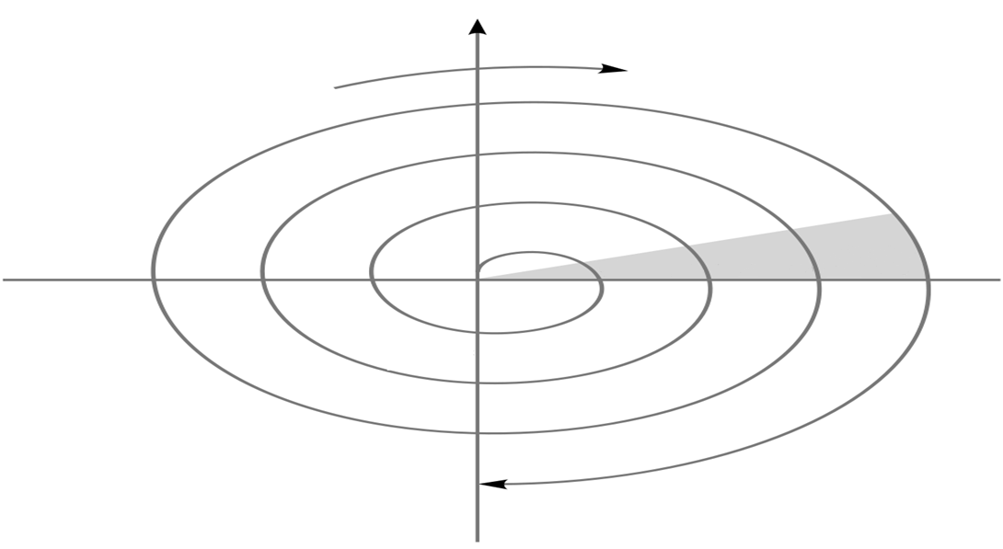
SPIRAL MODEL
Cumulative Cost
Progress
Determine Objectives
Identify and resolve risk
Review
Requirement
Plans
Prototype 1
Prototype 2
Operational Prototype 2
Concepts of operations
Concepts of requirements
Draft
Detailed Design
Requirements
Development Plans
Verification and validation
Test Plans
Verification and validation
Code
Integration
Implementation
Test
Release
Plan the next iteration
Development and Testing
Notes:
Refer to the explanation in the previous slide w. r. t. this diagram.

Slide 28
SPIRAL MODEL
Advantages
High amount of risk is resolved
Software is produced at an early stage in the software life cycle
Good for large and mission-critical projects
Strong approval and documentation control

Slide 29
SPIRAL MODEL
Disadvantages
It may be difficult to convince customers that the evolutionary approach is controllable
It demands considerable risk assessment
Can be a costly model to use
Does not work well for small projects

Slide 30
SPIRAL MODEL
When to use?
When creation of a prototype is appropriate
When costs and risk evaluation is important
For medium to high-risk projects
Long-term project commitment is unwise because of potential changes to economic priorities
Users are unsure of their needs
Requirements are complex
New product line
Significant changes are expected (research and exploration)

Slide 31
INCREMENTAL MODELS
Build 1
Iterative model
Development begins by specifying and implementing just part of the software, which can then be reviewed in order to identify further requirements
The process is then repeated, producing a new version of the software for each cycle of the model
The basic idea is to develop a system through repeated cycles (iterative) and in smaller portions at a time (incremental)
Design & Development
Testing
Implementation
Build 2
Requirements
Design & Development
Testing
Implementation
Build 3
Design & Development
Testing
Implementation
Notes:
As the name suggests, incremental models plan to deliver the product in a series of releases called increments.
Iterative process starts with taking a subset of a larger requirement and implementing it in multiple increments. Thus it iteratively enhances the evolving versions until the complete system is implemented.
Take the example of car rental application – assume customers can rent the car via multiple ways viz., online, telephonic, directly in the rental office. One release may implement over-the-counter car rental booking feature, another increment can take up, car rental booking via online method and so on.
It's important to note that during the development process, more than one iteration (incremental cycle) may be in progress simultaneously. Each iteration goes through a mini waterfall process. (Requirements, design, build, etc.) Every release adds up to the previous release which is continued till the complete system is ready.

Slide 32
INCREMENTAL MODELS
Team #3
RAD (Rapid Application Development) model
Components or functions are developed in parallel as if they were mini projects
The developments are time boxed, delivered and then assembled into a working prototype
This can quickly give the customer something to see and use and to provide feedback regarding the delivery and their requirements
Phases involved in RAD model:
Business modeling
Data modeling
Process modeling
Application generation
Testing and turnover
Team #2
Business Modelling
Team #1
Business Modelling
Data Modelling
Business Modelling
Data Modelling
Data Modelling
Process Modelling
Process Modelling
Process Modelling
Application Modelling
Application Modelling
Testing & Turnover
Application Modelling
Testing & Turnover
Testing & Turnover
60-90 days
Notes:
As the name suggests, RAD (Rapid Application Development) model is an incremental model that focuses on short development cycles. This model also uses waterfall techniques in each increment. However it uses minimal planning in favor of rapid prototyping. Here the prototype is working version of the software which is equivalent to a component of the product. Such functional modules are developed in parallel as prototypes, are integrated to make the complete product for faster product delivery. This can quickly give the customer something to see and use and to provide feedback regarding the delivery and their requirements.

Slide 33
INCREMENTAL MODELS
When to use?
Low to medium risk projects
An early need to get the product to the market
Projects that have lengthy development cycles
Projects implementing new technologies
When it is risky to develop the whole system at once

Slide 34
COMPARISON OF VARIOUS SDLC MODELS
Model / Features | Waterfall | Prototype | Spiral | Incremental / Iterative | RAD
Clear-cut requirements | Yes | No | No | No | Yes
User involvement | Only during requirements phase | Pretty high | Yes | Yes (intermediate) | During initial stages
Risk analysis | During initial stages | Not really | Yes, in a separate phase | No | Low
Implementation time | Long | Quick | Long | Long | Quick
Cost | Low | High | Expensive | Low | Low
Change management | Difficult | Easy | Easy | Easy | Easy
Simplicity | Simple | Simple | Moderate | Moderate | Simple
Flexibility | Rigid | Moderately Flexible | Flexible | Less flexible | High

Slide 35
QUIZ QUESTION
In which SDLC model, end-users also are actively involved in the development?
Agile model
Waterfall model
Incremental model
Prototyping model
Notes:
Answer: Prototyping model

Slide 36
QUIZ QUESTION
Which model enables the software to be produced at an early stage in the software life cycle?
Waterfall model
Prototyping model
Spiral model
Agile model
Notes:
Answer: Spiral model

Slide 37
QUIZ QUESTION
Which is the best model to employ when the requirements are clear and product definition is stable?
Waterfall model
Spiral model
Incremental model
Agile model
Notes:
Answer: Waterfall model

Slide 38
Overview of SDLC
SDLC Process
SDLC Phases
SDLC Models

