Slide 1



19 January 2015
How to be Successful as a Sole Practitioner

Slide 2


Welcome to this webinar – hosted by:
Gordon Gilchrist – Marketing Director, 2020 Innovations
Ian Fletcher – Managing Director, 2020 Innovations
How to be Successful as a Sole Practitioner

Slide 3
Marketing! Marketing! Marketing!
“Business is Great…
And We’re Looking For More!”
- Frederiksen

Slide 4
Elements of Marketing
Focus
Methodologies
Resources and activities

Slide 5
Marketing Methodologies
“There is method in my madness!”

Slide 6
Marketing Methodologies - Content
Pull
Push

Slide 7
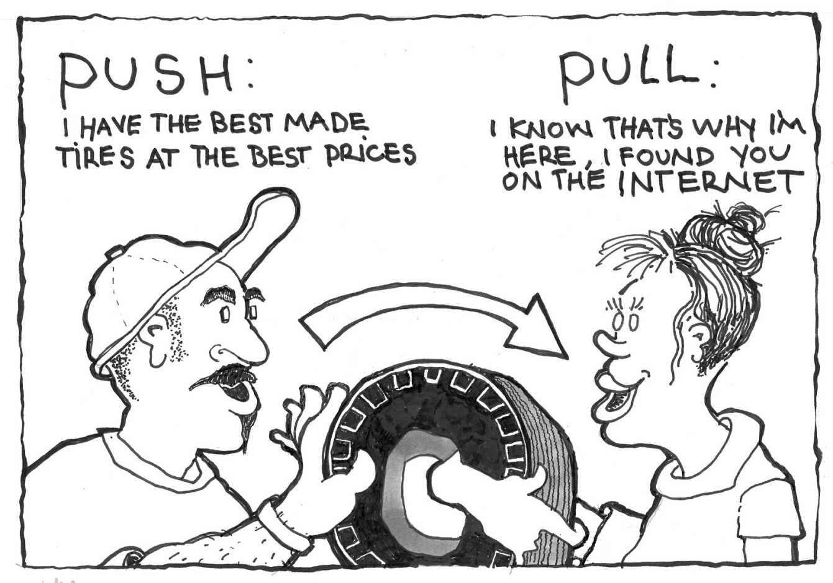
Push vs Pull

Slide 8
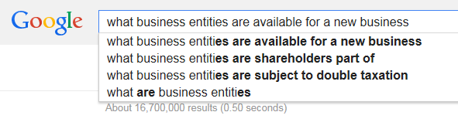
What’s Driving the Change?

Slide 9
So What?
“You need to control how your customers and prospective customers think and feel about your business in comparison to other, similar businesses competing for their attention.”
- Dan Kennedy

Slide 10
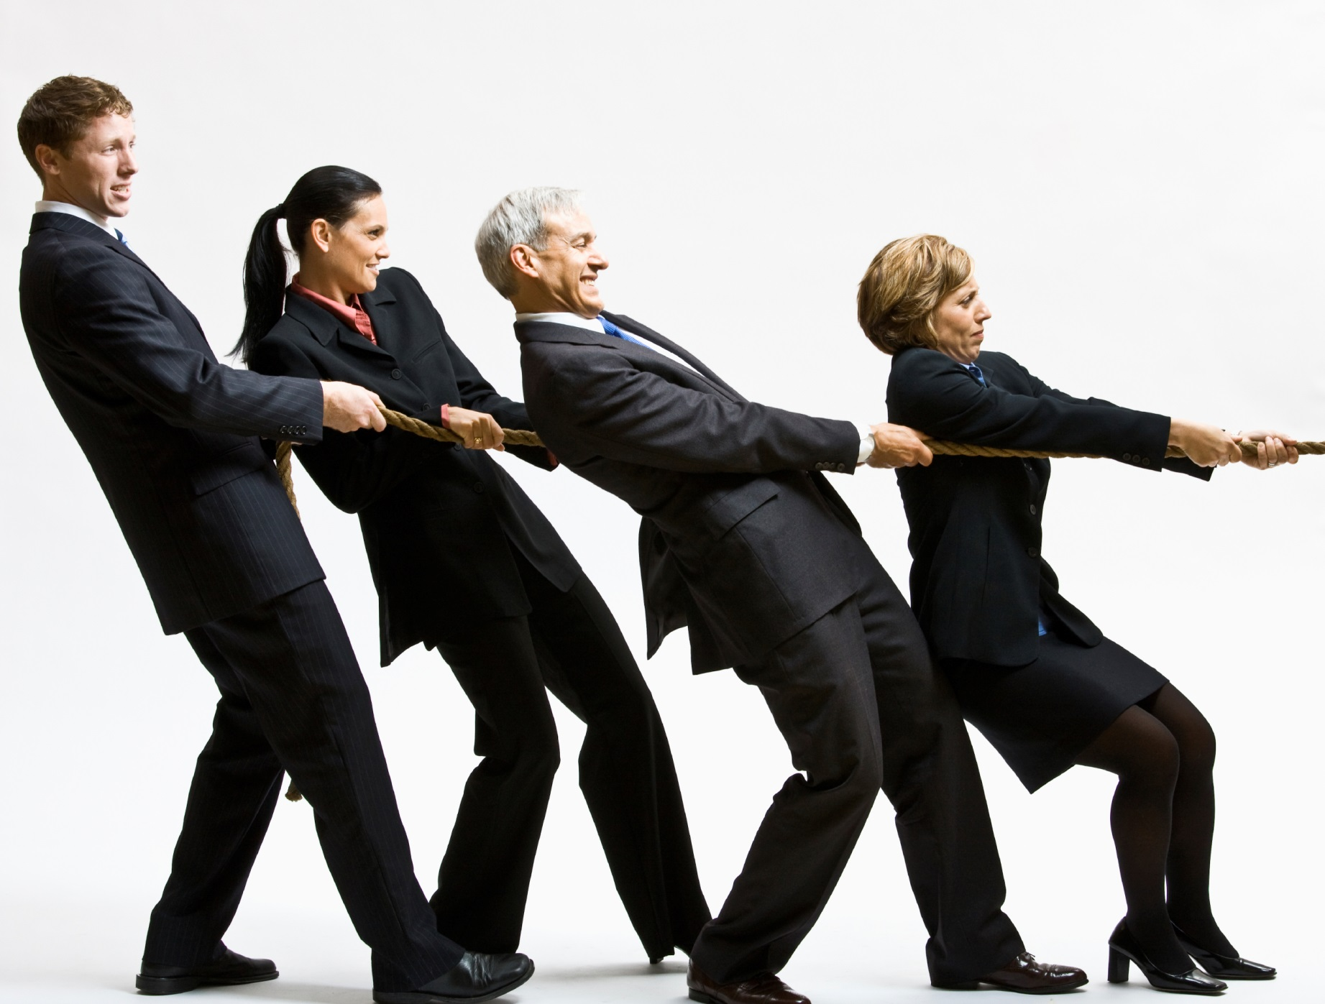
Pull
Customer-led
Research
Interactive
Reputation
Inbound

Slide 11
Your Website
Web Footprint
Content
Activity
Reputation

Slide 12
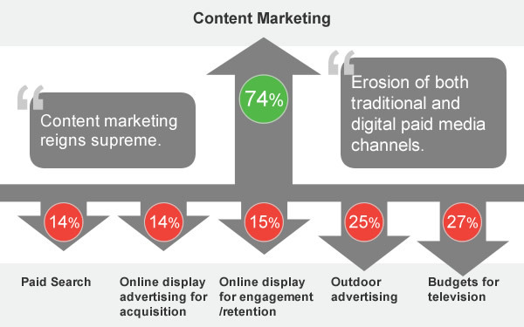
Content is King!
Investment in Content Marketing and Earned Media

Slide 13
Pull Activities
Video and audio
Interviews
Pod cast
Blogs
1 per week
FAQ’s
Interviews
Boosts SEO
Increase in leads

Slide 14
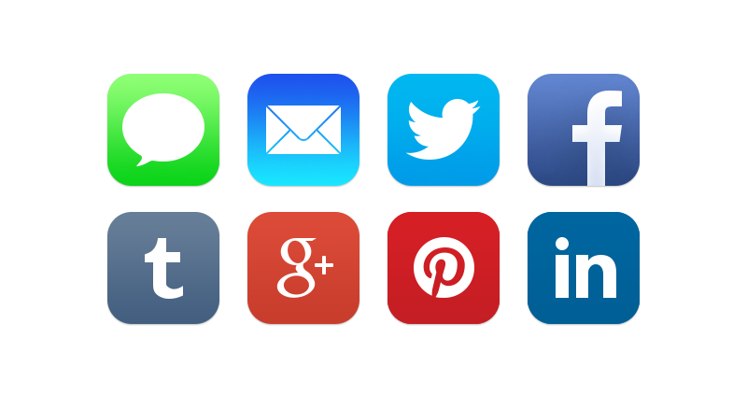
Social Media Activity
Share
Like
Follow
Retweet

Slide 15

Reputation
Testimonials
Agenda, “May I have…”
Video
Pictures
Client newsletter
Success stories

Slide 16
Nurture Your Prospects
Drip, drip, drip
Create the campaign
Fire and forget!
Monitor, measure, react

Slide 17
Website Automation
Welcome to the firm
Newsletter
Download a free report
Follow us on social media
Watch this video
Attend this webinar

Slide 18

Going Mobile
You MUST be MOBILE
57% WON’T recommend companies with a poor mobile website

Slide 19
Pull Measurement
Reach
Visits, fans, followers
Act
Shares, comments, likes
Interact
Download, request info
Convert
Purchase
Engage
Repeat, refer

Slide 20

Push Marketing
Direct Mail
Newsletters
Telemarketing
Yellow Pages
Advertising

Slide 21
Direct Mail
Target the Audience
Unique Call to Action
57 Ways to Grow Your Business
Industry Report
Free Download
Seminars
Phone follow up

Slide 22
Direct Mail
Name and address
Salutation
Opening Paragraph
Why we do what we do
Freebies, links
Call to Action
Signatures
P.S.
Inserts, Attachments

Slide 23
Email
Target the audience
Unique call to action
57 Ways to Grow Your Business
Industry report
Seminars and webinars
Very measureable

Slide 24
Marketing Methodologies - Summary
Pull
Push

