Slide 1


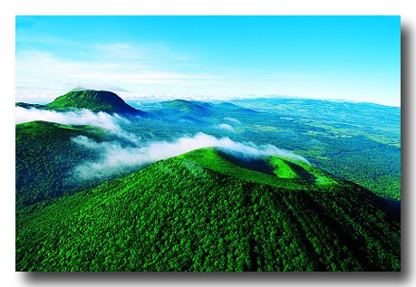
Project Presentation
Student’s networking in London – Master CCA

Slide 2
Overview
Who are we ?
Where about ?
Why ?
When are we coming ?
A mutually beneficial partnerships ?
Contacts

Slide 3
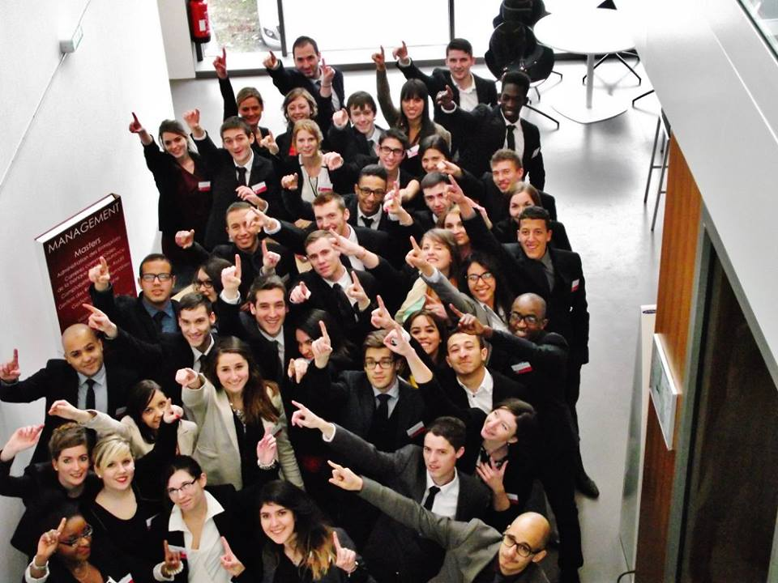
I. Who are we?
Master’s Degree in Accounting, Controls and Audits students
2 years of studies
Located in Clermont-Ferrand
About 120 Students
Graduation in summer 2016
Study’s trip organised by the CCA student society

Slide 4


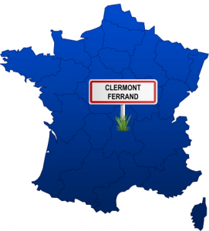

A. Clermont-Ferrand?
I. Who are we?
Medium-sized city in the Center of France
262 000 inhabitants
38 000 students
Well-connected city through its geographic situation

Slide 5

B. CCA student society?
I. Who are we?
Our missions:
Help students to have access to a professional network
Organize job-dating sessions
Promote the Master at the national and international level
Fund and develop the CCAlumni Association that gathers our former students
CCAlumni

Slide 6
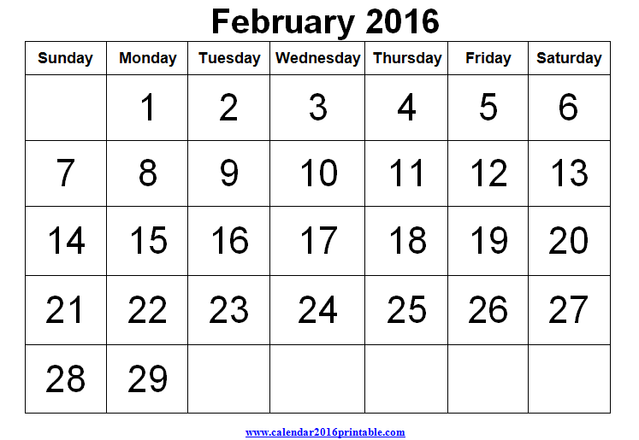

II. When?
24th to 28th of February 2016
5 days and 4 nights

Slide 7
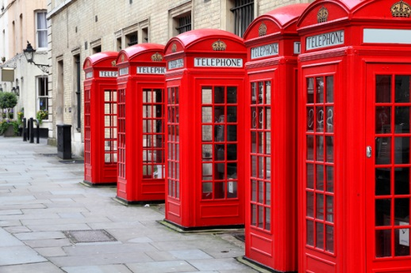
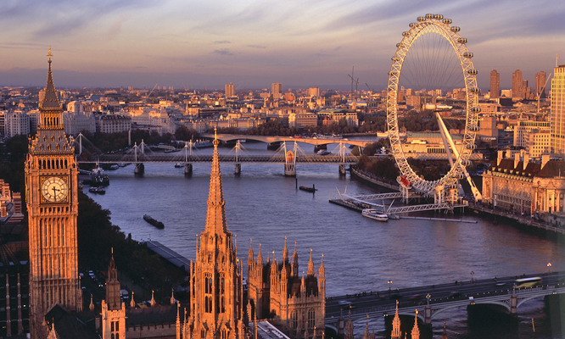
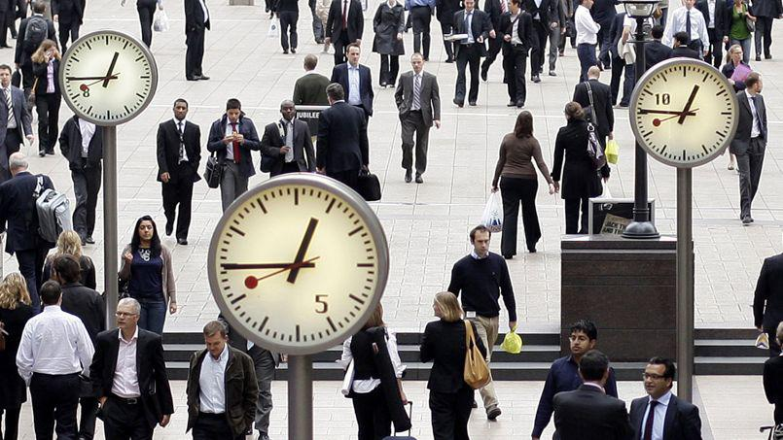
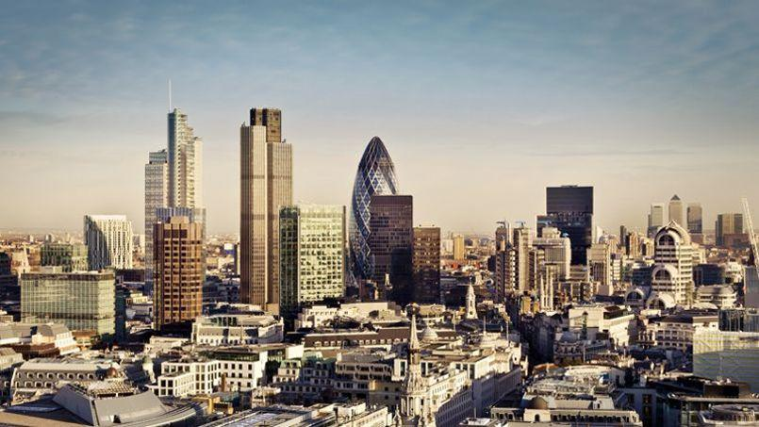
III. Where?
London : major financial center
Dynamic business environment
Touristic city
A city that provides opportunities to mature as international professionals

Slide 8


IV. Why?
Discover the city
Learn from London-based accounting firms and companies
Enhance group cohesiveness
Get contacts and create opportunities to see the facts on the ground
Get to know a well-known organization
CCAlumni

Slide 9

V. Mutually beneficial partnership?
What do you do?
How does it works?
Do you work with frenchies?
How is it organised?
Can you explain?

Slide 10
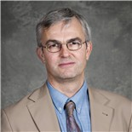
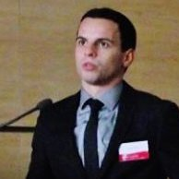
VI.Contacts
Stéphane BELLANGER
Chartered Accountant and auditor
Member of the Oui-Global Alliance
bellanger_s@hotmail.com
+33 153 364 400
+33 143 551 523
François SALLA
Student of CCA Master &
President of the CCA Association of Clermont-Ferrand
francois.salla@etu.udamail.fr
+33 607 695 171

