Slide 1

ZETA: exact, live analytics for 100 store databases
Z-set Exact Tenant Aggregator · hackathon prototype · 10 million orders on one laptop
Notes:
ZETA gives a company that owns 100 online stores live, exact dashboards across all of them, without loading the stores' own databases.

Slide 2
ZETA keeps every dashboard number live and exact without loading the shops' databases
What it is
A service that follows each store database's change log, keeps running totals in memory, and answers dashboard questions from those totals instead of from the database.
Who uses it
The company owner (all stores together) and each store owner (only their own store), through two dashboards and an API.
10M
1–6 ms
orders in 100 store databases
per dashboard query (p50)
~10 ms
100%
from order to dashboard
of checks match the database
Notes:
Headline numbers, all measured on the 10M dataset: 1-6 ms median per query, about 10 ms freshness, every correctness check exact.

Slide 3




100 stores, one owner, and dashboards that would slow down checkout
Each store has its own Postgres database
Dashboards on direct SQL, measured at 10M orders
orders, order items, products, customers; a few stores are far bigger than the rest
4.7 s
for the owner's top-10 products (30 days, 100 databases)
One owner needs all 100 stores together
revenue, orders by status, trends, top products, store health
+133%
slower app queries (p99) while 4 dashboards refresh
Each store owner sees only their own store
isolation is a hard requirement
100
database connections per dashboard user
Checkout must not slow down
dashboards may not load the databases the shops run on
Notes:
The setting from the problem statement, and what happens if the dashboards just query the store databases: seconds per query, the shops' app slows down, and every user needs a connection to every database.

Slide 4
The targets: fast, fresh, safe, exact and flat as data grows
What we measure | How | Good | Great
Query speed | time per dashboard query at 10M records | under 1 second | under 200 ms
Freshness | time from adding an order to seeing it in the numbers | under 5 minutes | under 30 seconds
Database safety | normal app query time with and without dashboard load | less than 25% slower | less than 10% slower
Correctness | compare our numbers with a direct database query | matches on most queries | matches on all queries
Growth | query speed at 1M vs 10M records | less than 5× slower | less than 2× slower
Runs easily | judges start it by following the README | README | Docker Compose is a plus
Data: 1M records / 10 stores (test run) and 10M records / 100 stores (main run), a few stores much bigger than the rest.
Notes:
The organisers' scorecard. We aimed for the Great column on every row.

Slide 5



We skipped the usual stack because Postgres already provides what it is for
Kafka / Debezium
Cron + summary tables
Redis cache
ClickHouse / DuckDB
an ordered, replayable log of changes
recompute totals every few minutes
keep old answers so queries skip the database
scan billions of rows fast
ZETA instead
ZETA instead
ZETA instead
ZETA instead
Postgres's own WAL, read through one logical replication slot per database. The slot remembers our position.
Update on every commit, as it arrives. Fresh in milliseconds; Postgres never re-scans.
Keep the structures answers are computed from, updated per change. Nothing goes stale; any time range works.
Don't scan at all: running sums make each question about log n steps.
Notes:
Each household tool solves a problem this design avoids. The database log is already a durable ordered stream; incremental sums replace both caching and scanning.

Slide 6
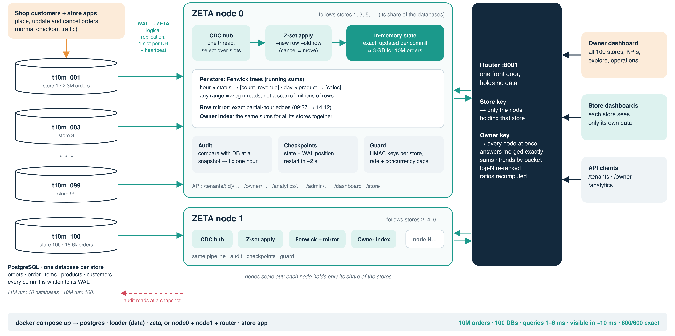
Architecture: database log → ZETA nodes → router → dashboards
Notes:
Left: one Postgres database per store. Each streams its WAL into a ZETA node over a logical replication slot. A node applies every change as +new/-old to running sums, audits itself, checkpoints, and checks keys. Nodes each hold a share of the stores; the router sends a store's request to its node and adds up owner answers exactly.

Slide 7


Three ideas make it both exact and fast
1 Read the database's own log
2 Every change is +new, −old
3 Store running sums, not rows
Every commit is already in Postgres's write-ahead log.
One logical replication slot per store database: ordered, durable, resumable.
No triggers, no polling, no second write path in the shop's app.
A cancel subtracts the order from “placed” and adds it to “cancelled” in its hour.
Inserts, updates, deletes, late cancels and back-dated orders are the same operation.
So totals never drift (a “Z-set”).
Fenwick trees per store: hour × status [count, revenue], day × product [sales].
A 90-day question reads about a dozen numbers, not 2 million rows.
Partial hours (09:37–14:12) come exact from an in-memory row copy.
Notes:
These three ideas are the whole trick: the log gives us every change in order, +new/-old keeps the totals exact under any kind of change, and prefix sums make every range query a few lookups.

Slide 8

One cancelled order reaches every dashboard in about 10 ms
Customer cancels
Postgres commits
ZETA reads the slot
Sums updated
Dashboards update
the shop runs UPDATE orders SET status = 'cancelled'
WAL holds the old row and the new row
−1 “placed”, +1 “cancelled” in that order's hour
store's Fenwick trees and the owner index, ~log n steps
store owner and company owner, live
Measured: order visible 9.6 ms after commit (p50), 27 ms p99 under 300 writes/s. In the live demo every order and cancel showed up in the store's numbers and the owner's all-store total within 8–20 ms, and both matched SQL at every step.
Notes:
Walk through a single cancel. The shop's app does nothing special; the change flows out of Postgres's log into ZETA and into both dashboards in milliseconds.

Slide 9




Built to be trusted, shared fairly and run anywhere
Self-audit
Restarts in ~2 s
Store isolation
Compares itself with each database at a consistent snapshot; finds a wrong hour in ~15 queries and repairs only that hour.
Checkpoints save state + log position per database; a restart replays only what is new (10M: 2.5 s even after a crash).
A store's key only ever returns that store. Owner key sees all. 246 automated checks, 0 failures.
Fair use per store
Scale-out
One command
Cost-based budget per store tier, plus a cap on queries running at once; extra requests get 429.
Nodes each follow a share of the stores; a router sends store queries to the right node and adds up owner answers exactly.
docker compose up: Postgres, data loading and ZETA. Or ./setup.sh without Docker. New stores are picked up live.
Notes:
Beyond speed: it checks itself against the database, survives restarts, keeps stores isolated and limited, scales out to more nodes, and starts with one command.

Slide 10
At 10M orders ZETA answers in milliseconds; direct SQL takes up to seconds
Median time per query at 10M orders, milliseconds (log scale)
Direct SQL
ZETA
Up to 1,580× faster
owner 90-day trend: 2 ms vs 3.2 s
All under 9 ms p99
store and owner queries, 10M orders
Owner = 100 DBs
SQL figure = the same question run in every store database and added up
Store count, 7 days
23.5 ms
1.4 ms
Store top-10, 90 days
722 ms
1.57 ms
Owner count, 7 days
768 ms
1.69 ms
Owner trend, 90 days
3,215 ms
2.03 ms
Owner top-10, 30 days
4,736 ms
6.12 ms
1
10
100
1,000
10,000
Notes:
bench.py latency, 10M orders, 100 store databases. Log scale because the gap is two to three orders of magnitude.

Slide 11
From 1M to 10M orders, store queries slow down less than 1.5×
Slowdown from 1M to 10M orders, per query
9 of 11 under 2×
every store query, and owner count and trend across all stores
Two owner queries: Good
by-store returns 10× more rows (100 stores vs 10); top-10 reads every item sold on the two partial days at its edges. Fix planned: hourly per-product subtotals.
5×
Good
under 5×
4×
3.88×
3×
2.44×
2×
Great
under 2×
1.46×
1.26×
1.22×
1.44×
1.43×
1.22×
1.16×
1.19×
1.19×
1×
0×
Count
7d
Count
90d
Status
30d
Trend hr
3d
Trend day
90d
Top-10
30d
Top-10
90d
Count
7d
Trend
90d
By-store
30d
Top-10
30d
Store queries (biggest store)
Owner (all stores)
Notes:
Growth target is query speed at 1M vs 10M. Store queries depend on the time range, not on how many orders exist.

Slide 12
Scorecard: Great on four targets, Good-to-Great on two
Target | Great means | What we measured (10M orders, 100 stores) | Verdict
Query speed | under 200 ms | 1–6 ms median, under 9 ms p99, store and owner queries | Great
Freshness | under 30 s | 9.6 ms median; 27 ms p99 under 300 writes per second | Great
Correctness | matches on all | 1150/1150 after 2000 live writes; 720/720 through the router; 600/600 in Docker | Great
Database safety | under 10% slower | app p50 −9%, p99 −11% with ZETA (direct SQL: +133%); p99 varies ±13% between runs | Good–Great
Growth 1M→10M | under 2× | store queries 1.16–1.46×; owner by-store 2.44×, top-10 3.88× | Good–Great
Runs easily | README + Docker | docker compose up (tested 1M and 10M), or ./setup.sh | Great
Notes:
Honest verdicts. Database safety: median is clearly within 10%; p99 sits at the line within run-to-run noise. Growth: all store queries Great, two owner queries Good.

Slide 13
What's next, and where this design fits
Next steps
Where it fits
Hourly per-product subtotals: owner top-10 growth under 2×
Replica nodes so the router fails over when a node is down
Metric validator: reject metrics that can't be updated exactly (median, distinct count)
State on disk for stores larger than memory
Multi-tenant SaaS with known dashboards: merchant, restaurant or seller analytics
Exact live numbers with only Postgres and one service to run, instead of Kafka + Flink + ClickHouse + Redis
At Uber or LinkedIn scale the same idea runs on Kafka, Flink and Pinot: shared log, state on disk, replication
Could Uber or LinkedIn use it? The idea, yes: it is how they already work. This code, no: they need one shared log for many consumers, state on disk, replicas with failover and ad-hoc OLAP queries.
Notes:
Be clear about limits: memory-bound per node, no failover yet, fixed metric set. The pattern is the same one large companies use; our version trades generality for exactness and simplicity.

Slide 14

Exact numbers, live, in milliseconds, on just Postgres
Try it: docker compose up --build -d → http://localhost:8000/dashboard
Notes:
Close: one command to run it, and the numbers on the scorecard.

