Slide 1
Making KV Movement Agent-Aware
Coding agents naturally pause during tool calls, then resume with tight latency expectations. Current memory movement paths are largely context-agnostic: they can move KV pages, but they do not know which agent needs them, when they are needed, or whether missing the deadline will stall replay. This project quantifies that gap and prototypes hint-guided KV movement as a path toward smarter DMA engines, KV-aware memory scheduling, and hardware/runtime co-design.
•
Core problem: memory movement sees bytes, not agent deadlines.
•
Research target: make KV movement deadline-aware and session-aware.
•
Hardware angle: smarter DMA queues, KV metadata, residency protection, and telemetry.
Agent-aware KV movement
01
Notes:
Opening slide. Keep the framing hardware-facing: software can provide hints, but hardware/runtime support can make those hints enforceable.
Goal: Coding agents naturally pause during tool calls, then resume with tight latency expectations. Current memory movement paths are largely context-agnostic: they can move KV pages, but they do not know which agent needs them, when they are needed, or whether missing the deadline will stall replay. This project quantifies that gap and prototypes hint-guided KV movement as a path toward smarter DMA engines, KV-aware memory scheduling, and hardware/runtime co-design.
[Sources]
Local report: /Users/oluwolejaiyeoba/Documents/GitHub/agentic_hardware/sglang_direct_kv/artifacts/results/latest_master_report.html
Synthetic report: /Users/oluwolejaiyeoba/Documents/GitHub/agentic_hardware/sglang_direct_kv/artifacts/results/latest_synthetic_master_report.html
Backup report: /Users/oluwolejaiyeoba/Documents/GitHub/agentic_hardware/backups/latest_master_report-1.html

Slide 2
The testbed has controlled and real traffic
Controlled runs expose mechanisms; real traces keep the workload credible.
•
Controlled synthetic path: prompt size, tool wait, filler pressure, and replay deadline are known.
•
Real coding-agent path: SWE-bench / AgentBench traces feed DeepAgents and SGLang.
•
Both paths measure the same question: was useful KV ready before replay?
agent task → tool wait → replay → KV ready?
Agent-aware KV movement
02
Notes:
This slide replaces the earlier card-heavy setup with plain points.
Synthetic runs give clean control. Real DeepAgents/SWE-bench traces preserve coding-agent behavior.
[Sources]
Local report: /Users/oluwolejaiyeoba/Documents/GitHub/agentic_hardware/sglang_direct_kv/artifacts/results/latest_master_report.html
Synthetic report: /Users/oluwolejaiyeoba/Documents/GitHub/agentic_hardware/sglang_direct_kv/artifacts/results/latest_synthetic_master_report.html
Backup report: /Users/oluwolejaiyeoba/Documents/GitHub/agentic_hardware/backups/latest_master_report-1.html

Slide 3
Experiment Testbed Setup
The real-request path is intentionally simple.
SWE-bench
traces
→
DeepAgents
tool loop
→
SGLang
server
→
KV/cache
observations
•
DeepAgents produces model turns and tool-call gaps.
•
SGLang serves the model and exposes KV/cache behavior through our hooks.
•
Reports compare replay timing, H2D movement, recompute, and prefetch readiness.
Agent-aware KV movement
03
Notes:
This slide is deliberately sparse. It should be easy to explain in one sentence.
The user asked to remove extra hardware/context-length details from this setup slide.
[Sources]
Local report: /Users/oluwolejaiyeoba/Documents/GitHub/agentic_hardware/sglang_direct_kv/artifacts/results/latest_master_report.html
Synthetic report: /Users/oluwolejaiyeoba/Documents/GitHub/agentic_hardware/sglang_direct_kv/artifacts/results/latest_synthetic_master_report.html
Backup report: /Users/oluwolejaiyeoba/Documents/GitHub/agentic_hardware/backups/latest_master_report-1.html

Slide 4
Today’s DMA engines move bytes, not intent
That limits how well software hints can be enforced.
•
They do not know which KV belongs to which agent session.
•
They do not know when the agent will replay after a tool call.
•
They do not know whether evicting prefetched KV wastes the hint.
•
They do not expose enough semantic telemetry: useful, late, wasted, or evicted-before-use.
Hardware opportunity: add KV/session context to the memory movement path.
Agent-aware KV movement
04
Notes:
This is the core problem slide. Keep it concise and hardware-focused.
Do not argue software cannot do this. The claim is that hardware can make enforcement cheaper, more predictable, and scalable.
[Sources]
Local report: /Users/oluwolejaiyeoba/Documents/GitHub/agentic_hardware/sglang_direct_kv/artifacts/results/latest_master_report.html
Synthetic report: /Users/oluwolejaiyeoba/Documents/GitHub/agentic_hardware/sglang_direct_kv/artifacts/results/latest_synthetic_master_report.html
Backup report: /Users/oluwolejaiyeoba/Documents/GitHub/agentic_hardware/backups/latest_master_report-1.html

Slide 5
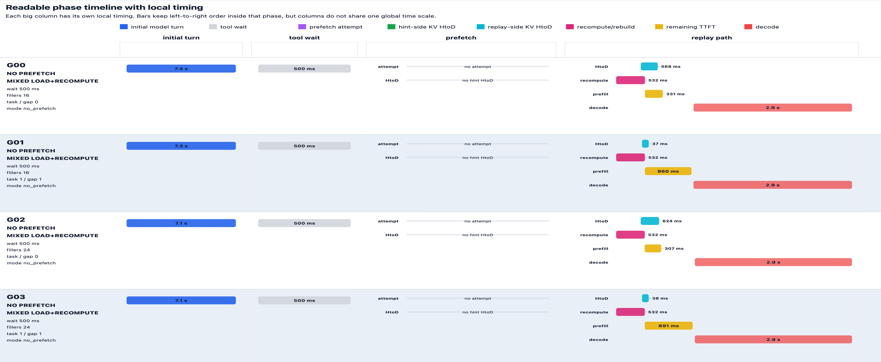
Replay path exposes the bottleneck
Each row is one tool-gap replay; the replay path shows where time goes before the first token.
... more replay gaps observed in the full report
Agent-aware KV movement
05
Notes:
This is the main timeline slide. It now shows a readable crop of G00 through G03 instead of compressing all rows.
The cropped chart shows initial model turn, tool wait, replay path, H2D, recompute, prefill, and decode.
The full timeline remains available in latest_master_report.html.
[Sources]
Local report: /Users/oluwolejaiyeoba/Documents/GitHub/agentic_hardware/sglang_direct_kv/artifacts/results/latest_master_report.html
Synthetic report: /Users/oluwolejaiyeoba/Documents/GitHub/agentic_hardware/sglang_direct_kv/artifacts/results/latest_synthetic_master_report.html
Backup report: /Users/oluwolejaiyeoba/Documents/GitHub/agentic_hardware/backups/latest_master_report-1.html

Slide 6
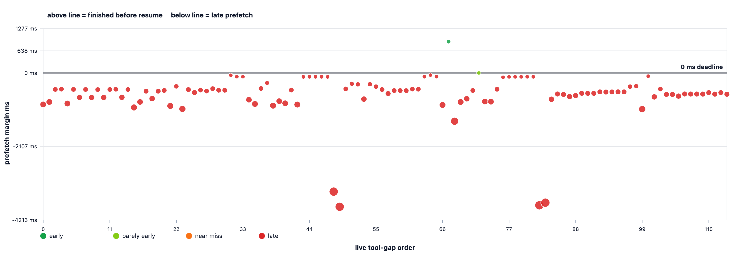
Software prefetch often missed replay
In the live prefetch-margin run, almost every hint completed after replay was due.
112 / 114
prefetch attempts were late
98.25%
missed the replay deadline
Meaning: hints alone are not enough when the movement path cannot act predictably.
Agent-aware KV movement
06
Notes:
Global prefetch margin evidence: 114 matched attempts, 112 late, 98.25% late.
This chart is useful for showing deadline misses at a glance.
[Sources]
Local report: /Users/oluwolejaiyeoba/Documents/GitHub/agentic_hardware/sglang_direct_kv/artifacts/results/latest_master_report.html
Synthetic report: /Users/oluwolejaiyeoba/Documents/GitHub/agentic_hardware/sglang_direct_kv/artifacts/results/latest_synthetic_master_report.html
Backup report: /Users/oluwolejaiyeoba/Documents/GitHub/agentic_hardware/backups/latest_master_report-1.html

Slide 7
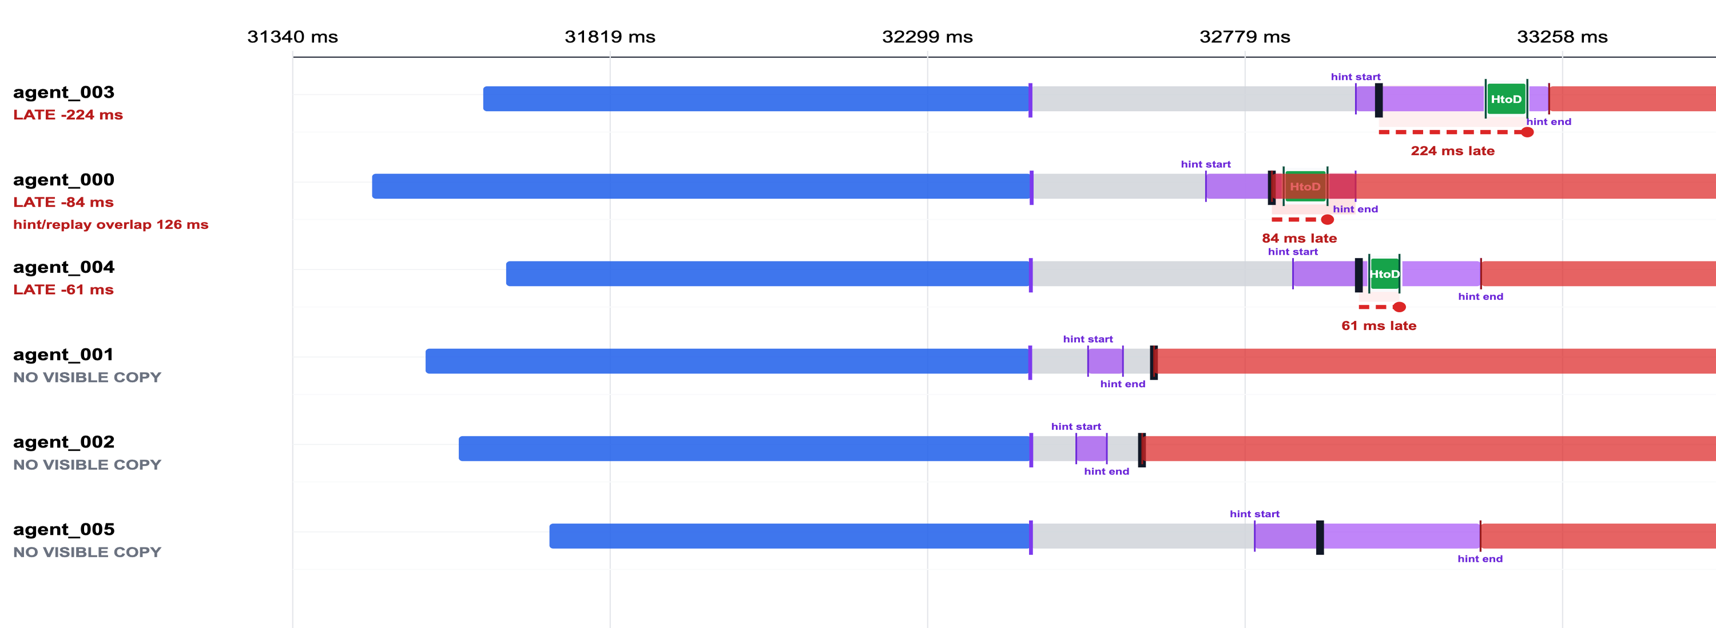
Mechanism traces explain the miss
The hint existed, but KV readiness still landed too late for replay.
•
0 / 6 ready before replay
•
3 / 6 visible CUDA HtoD
•
6 / 6 replay reloaded KV
Use this as mechanism evidence, not clean TTFT evidence.
Agent-aware KV movement
07
Notes:
This is profiled synthetic mechanism evidence.
It supports the claim that software/runtime scheduling and residency behavior can defeat a correct hint.
[Sources]
Local report: /Users/oluwolejaiyeoba/Documents/GitHub/agentic_hardware/sglang_direct_kv/artifacts/results/latest_master_report.html
Synthetic report: /Users/oluwolejaiyeoba/Documents/GitHub/agentic_hardware/sglang_direct_kv/artifacts/results/latest_synthetic_master_report.html
Backup report: /Users/oluwolejaiyeoba/Documents/GitHub/agentic_hardware/backups/latest_master_report-1.html

Slide 8
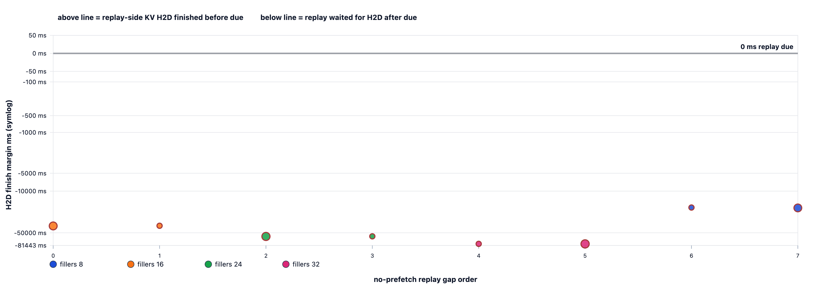
Replay-side KV loads missed the deadline
For this controlled no-prefetch run, visible H2D loads finished after replay was due.
8 / 8
visible replay-side H2D loads finished late
Meaning: the memory movement happened, but not early enough for the replay deadline.
Agent-aware KV movement
08
Notes:
Aggregate no-prefetch evidence: 8 visible replay H2D gaps and 8 late H2D finishes.
This supports the deadline-aware scheduling argument.
[Sources]
Local report: /Users/oluwolejaiyeoba/Documents/GitHub/agentic_hardware/sglang_direct_kv/artifacts/results/latest_master_report.html
Synthetic report: /Users/oluwolejaiyeoba/Documents/GitHub/agentic_hardware/sglang_direct_kv/artifacts/results/latest_synthetic_master_report.html
Backup report: /Users/oluwolejaiyeoba/Documents/GitHub/agentic_hardware/backups/latest_master_report-1.html

Slide 9
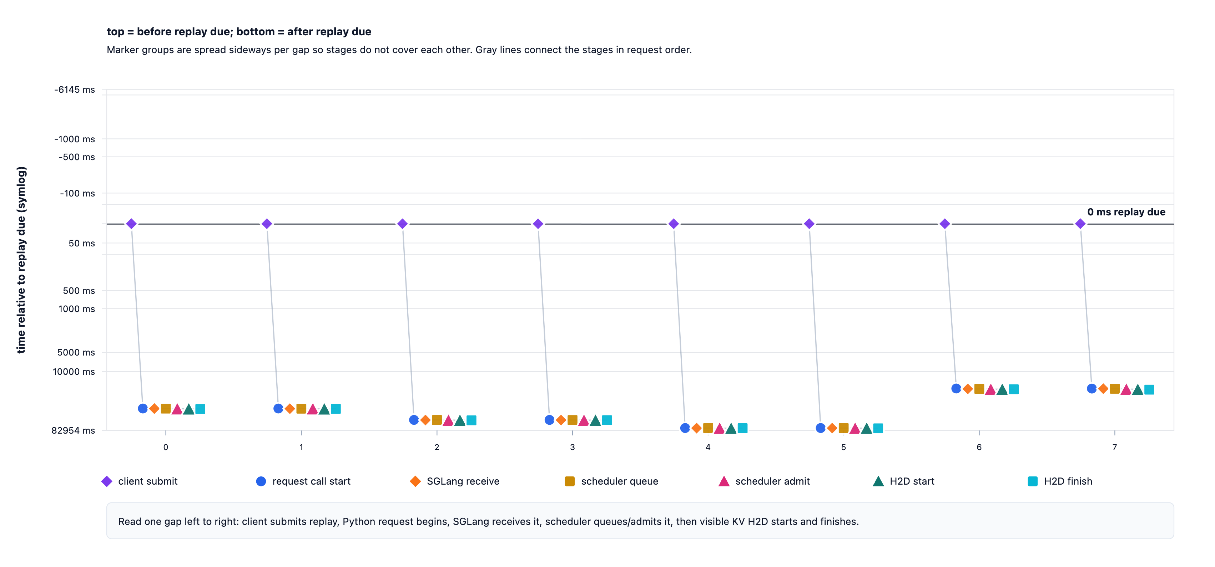
The delay is not just copy time
The request passes through normal runtime scheduling before visible KV H2D begins.
Stage markers separate client submit, SGLang receive, scheduler queue/admit, H2D start, and H2D finish.
Agent-aware KV movement
09
Notes:
This chart separates queue timing from H2D timing.
Manager takeaway: a hint-aware system should affect admission, ordering, priority, and residency, not just copy calls.
[Sources]
Local report: /Users/oluwolejaiyeoba/Documents/GitHub/agentic_hardware/sglang_direct_kv/artifacts/results/latest_master_report.html
Synthetic report: /Users/oluwolejaiyeoba/Documents/GitHub/agentic_hardware/sglang_direct_kv/artifacts/results/latest_synthetic_master_report.html
Backup report: /Users/oluwolejaiyeoba/Documents/GitHub/agentic_hardware/backups/latest_master_report-1.html

Slide 10
Key findings make the hardware case
The pattern points to missing context, deadlines, residency control, and telemetry.
•
Agent tool gaps can be very short.
•
Correct hints can still finish late.
•
Visible copy time is only part of end-to-end delay.
•
KV can be written to host, evicted from GPU, then lost from host before replay.
•
Replay-side H2D movement can miss the deadline even when the replay request exists.
Conclusion: this is a scheduling and enforceability problem, not just a bandwidth problem.
Agent-aware KV movement
10
Notes:
Use this slide as the synthesis of the research so far.
The finding list is intentionally short enough to present without reading dense boxes.
[Sources]
Local report: /Users/oluwolejaiyeoba/Documents/GitHub/agentic_hardware/sglang_direct_kv/artifacts/results/latest_master_report.html
Synthetic report: /Users/oluwolejaiyeoba/Documents/GitHub/agentic_hardware/sglang_direct_kv/artifacts/results/latest_synthetic_master_report.html
Backup report: /Users/oluwolejaiyeoba/Documents/GitHub/agentic_hardware/backups/latest_master_report-1.html

Slide 11
Potential hardware impact
Simple targets for tool-heavy coding-agent workloads.
1.
Faster agent resume after tools
Target: 10-30% lower post-tool latency
Why: our traces show the next model turn can wait because useful KV is not ready when the agent resumes.
2.
Fewer wasted memory movements
Target: 20-50% fewer late or wasted KV reloads
Why: memory movement can finish too late, or useful KV can be moved but not reused in time.
3.
More predictable tail latency
Target: lower p95/p99 agent-resume stalls
Why: urgent agent KV currently competes with ordinary memory traffic without deadline or priority context.
Hardware support to test
KV/session metadata, deadline-aware movement queues, temporary KV protection, and useful/late/wasted telemetry.
Agent-aware KV movement
11
Notes:
This slide intentionally avoids internal terms such as H2D and replay-prefill on the visible canvas.
Translate for technical discussion: faster agent resume corresponds to lowering post-tool replay latency when KV is ready earlier.
Fewer wasted memory movements corresponds to reducing late prefetches, evicted-before-use KV, and redundant reloads.
More predictable tail latency corresponds to reducing p95/p99 stalls caused by context-agnostic memory scheduling.
Potential benefit ranges are conservative internal proposal targets based on observed late prefetch/replay H2D patterns and expected gains from deadline-aware KV movement.
[Sources]
Local report: /Users/oluwolejaiyeoba/Documents/GitHub/agentic_hardware/sglang_direct_kv/artifacts/results/latest_master_report.html
Synthetic report: /Users/oluwolejaiyeoba/Documents/GitHub/agentic_hardware/sglang_direct_kv/artifacts/results/latest_synthetic_master_report.html
Backup report: /Users/oluwolejaiyeoba/Documents/GitHub/agentic_hardware/backups/latest_master_report-1.html

Slide 12
Hardware support can make hints enforceable
Treat KV as deadline-sensitive memory, not generic bytes.
•
KV page/session metadata: which agent owns this KV and how urgent is it?
•
Deadline-aware migration queue: move urgent KV before less urgent traffic.
•
Residency protection: keep useful prefetched KV from being evicted too early.
•
Telemetry: count useful, late, wasted, and evicted-before-use movement.
Research question: how much replay latency and wasted movement can be avoided when KV movement has session context, priority, deadline, protection, and telemetry?
Agent-aware KV movement
12
Notes:
Closing slide. Translate the evidence into concrete hardware support candidates.
These ideas map to the hardware proposal: KV metadata, semantic prefetch queue, priority-aware migration, residency protection, and telemetry.
[Sources]
Local report: /Users/oluwolejaiyeoba/Documents/GitHub/agentic_hardware/sglang_direct_kv/artifacts/results/latest_master_report.html
Synthetic report: /Users/oluwolejaiyeoba/Documents/GitHub/agentic_hardware/sglang_direct_kv/artifacts/results/latest_synthetic_master_report.html
Backup report: /Users/oluwolejaiyeoba/Documents/GitHub/agentic_hardware/backups/latest_master_report-1.html

