Slide 1
Repetition in Programming
for (int i=0; i<6; i++) { System.Console.WriteLine(array1[i].ToString());
}

Slide 2

Repetition-sometimes called LOOPING

Slide 3
Purpose
To provide programmers with the ability to repeat single or multiple lines of code

Slide 4
Benefits
Efficient programming
Less code
Faster execution

Slide 5
Types
Conditional
Counted

Slide 6
Conditional Loops
2 main types
while(){}
do{}while();

Slide 7
while(){}
Called a pre-condition loop
Pre-condition loops decide whether or not to repeat themselves at their start
Format:
while(condition is true){
\\do this
}

Slide 8
Example Code:
int x=0;
while(x<3){
x=x+1;
Messagebox.Show(Convert.toString(x));
}
What is the output?

Slide 9
Answer
X | Condition | What Happens?
0 | 0<3=T | add 1 to x X is now 1 Show 1
1 | 1<3=T | Add 1 to x X is now 2 Show 2
2 | 2<3=T | Add 1 to x X is now 3 Show 3
3 | 3<3=F | Exit loop
int x=0;
while(x<3){
x=x+1;
Messagebox.Show(Convert.toString(x));
}

Slide 10
do{}while();
referred to as a post condition loop
The condition is checked at the end of the first iteration of the loop
As a result, the body of a post-condition loop is always executed at least 1 time

Slide 11
Example
int sum=10;
do{
sum=sum-3;
}while(sum>2);
How many times will this loop iterate?

Slide 12
Answer
int sum=10;
do{
sum=sum-3;
}while(sum>2);
sum | Condition | What Happens?
10 | none | subtract 3 from sum sum is now 7
7 | 7>2=T | subtract 3 from sum sum is now 4
4 | 4>2=T | subtract 3 from sum sum is now 1
1 | 1>2=F | Exit loop
3 times!!!

Slide 13
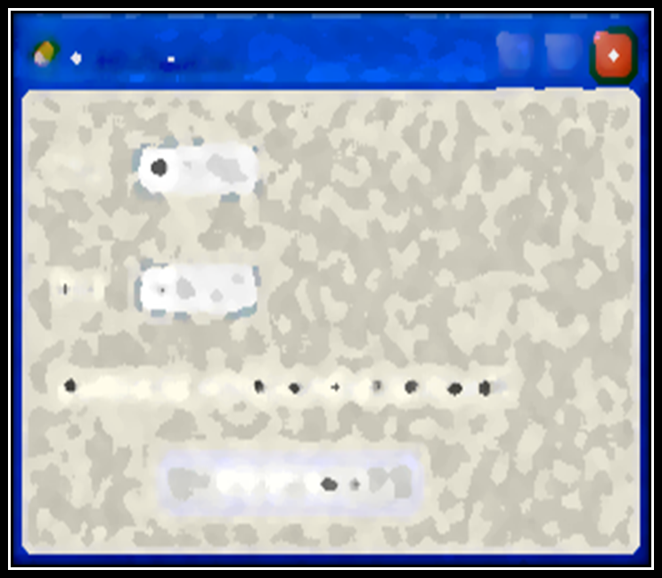
Exercises-create each program using a conditional loop. Zip your project and post it to your class website under unit 2.
Create an application that adds all the numbers between any given range of numbers. Your program should look as follows:

Slide 14
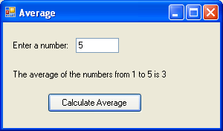
2. Create a program that sums all numbers from 1 to any given number and then finds the average of those numbers:

Slide 15
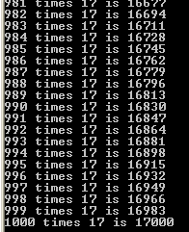
3. Write a JS program that asks you for a number then prints out the first 1000 terms of that number’s times table. You can use document.write(“data”); to print to a web page.

Slide 16
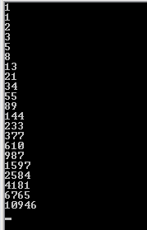
4. The Fibonacci sequence works by each term being the sum of the previous two terms added together.
E.g. 1,1,2,3,5,8,13, 21
Write a JS program that displays
the first 20 numbers of the
Fibonacci sequence.
If it works you should see this
output.

