Slide 1
Modular Programming

Slide 2
What is it?
A method for reusing blocks of code

Slide 3
Why use it?
Efficient programming
Code is more readable and easier to understand
Smaller file size, therefore faster
Easier to make changes and debug problems

Slide 4
How is it done?
By creating functions
A function is a block of code that is associated with a name
Some functions return a value and some do not

Slide 5
Function Format
returnType name(parameters (if any)){
Body
}
Example:
void sayHi(){
MessageBox.Show(“Hi”);
}

Slide 6
What happens?
Every place the command sayHi() is used, the code inside the body of this function is executed!
void sayHi()
{
MessageBox.Show("Hi");
}
private void button1_Click(object sender, EventArgs e)
{
sayHi();
}
private void button1_Click_1(object sender, EventArgs e)
{
sayHi();
}

Slide 7
Another Example
void sum(){
int n1=Convert.toInt16(txtNum1.text);
int n2=Convert.toInt16(txtNum2.text);
int answer=n1+n2;
lblAnswer.text=Convert.toString(answer);
}

Slide 8
Using the sum() function
I can now use this function anywhere in the class that it was made, as long as that class has the textboxes and labels referred to in the function:
private void button1_Click(object sender, EventArgs e)
{
sum();
}

Slide 9
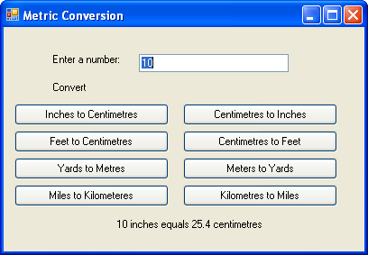
Practice
Recreate the following program. Create a separate function to make each of the necessary conversions:

Slide 10
Another exercise
Create the following program (see next slide for GUI).
The program checks for valid entries in each textbox. Create a ValidInt() function that checks to check that the number entered is between 1 and 5.It responds with an appropriate message. Create 2 other functions to do the same for the other 2 entries.

Slide 11
