Slide 1
Common C# String Functions

Slide 2
Programming is all about processing data
Numbers and strings contain most of the data we are accustomed to as human beings
As a result much of what we do in programming is to process these types of data
Math is often used to process numbers
Functions are often used to process strings

Slide 3
For more info on the String Class/Object search for “C# string api”
Click the first link to see the following page:

Slide 4
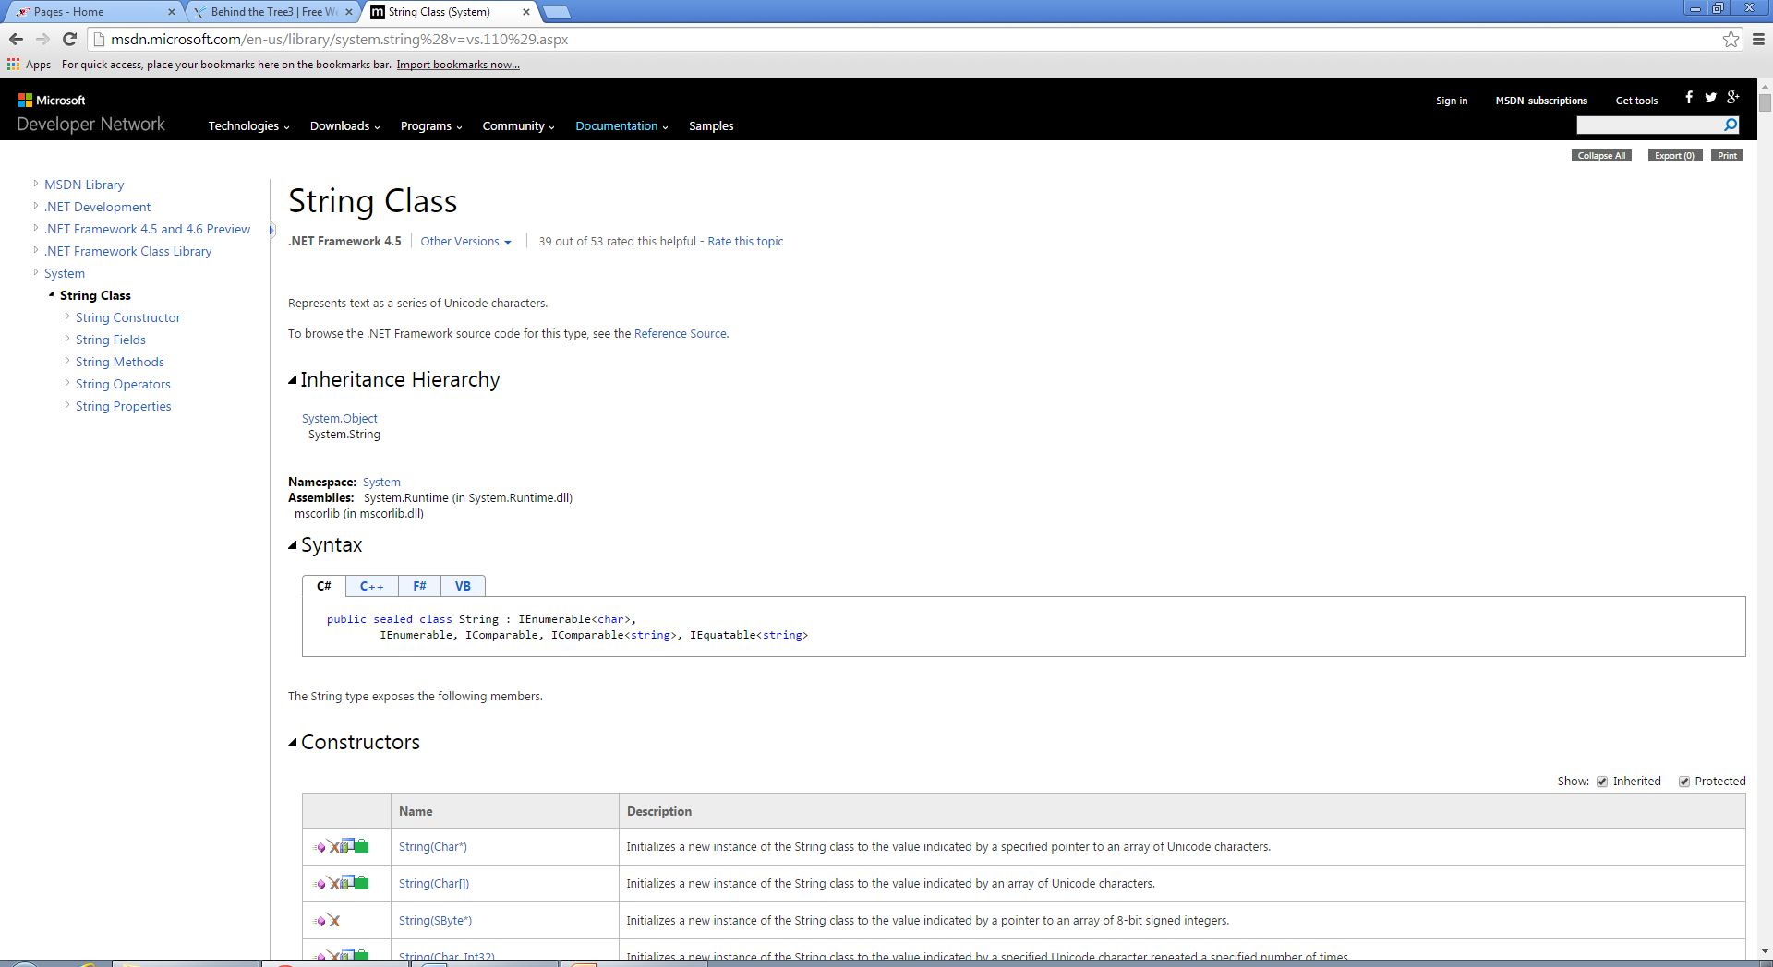

Slide 5
Look for its namespace. This indicates in which package the string class can be found. Answer:System
A namespace acts like a container for groups of related classes. A class acts as a container for a group of related properties and functions/methods.

Slide 6
Look at the table of properties. How many properties does a string object have? Answer:2, Length and Chars
What’s the format for accessing a string object’s property?Answer: name.property;
Example:
string data=“abc”;
int n=data.Length;
//n contains 3

Slide 7
Look at the methods table. The second column gives you the name of the function and its list of parameters(its header - all the info needed to call the function)
The first column contains a list of icons
The icon we need to look for is the orange S
This means that the function is static and therefore it can be called directly from the String class and not from a String object

Slide 8
Example:
string s1 = "Animal"; //string object
string s2 = "animal"; //string object
int result=String.Compare(s1, s2, true));//String class
What does result contain?Answer:0
Why? Read the API on the Compare (string,string, boolean) function

Slide 9
If a function is non-static then it must be called from a string object
Example:
string data=“abc”;
string subData=data.substring(1,2);
What does subData contain?Answer:”bc”
Why?Read the API for info on the substring(int,int) function!

Slide 10
Static function: called from the String class
Object function: called from an object of a String class
An object is a variable that contains a copy of the String class ex. string info=“hello”;
info contains the string object

Slide 11
COMMONLY USED STRING FUNCTIONS

Slide 12
Compare(String, String)
Static
Compares two strings
Returns 1 if the first string is greater than the second, 0 if they are equal and -1 if the first is less than the second
int r=0;
r=String.compare(“a”,”b”);
//r contains -1

Slide 13
Compare(String, String, Boolean)
Static
Compares two strings and ingnores the case if the boolean arguement is true
Returns 1 if the first string is greater than the second, 0 if they are equal and -1 if the first is less than the second
int r=0;
r=String.compare(“Hat”,”dog”,true);
//r contains 1 because h (ignores case) greater less than d
r=String.compare(“Hat”,”dog”,false);
//r contains -1 because h is greater than d (false makes its case sensitive)

Slide 14
Concat(String, String)
Static
Takes two string and combines them into one string that it returns
Returns a string that includes the combination of the string arguements
String a=“x”;
String b=“y”;
String r=String.concat(a,b);
//r contains “xy”

Slide 15
Concat(String, String, String)
Takes three strings and combines them into one string that it returns
String x=String.Concat(“a”,”b”,”c”);
//x contains “abc”

Slide 16
Contains (String)
Non-static
Takes a single string arguement and returns a boolean indicating if the arguement exists in the string
String x=“abcde”;
Boolean b=x.Contains(“cd”);
//b contains true
b=x.Contains(“xy”);
//b contains false

Slide 17
EndsWith(String)
Non-static
Takes a single string arguement and returns a boolean indicating if the string ends with the arguement
String a=“abcde”;
Boolean x=a.EndsWith(“de”);
//x contains true
Boolean x=a.EndsWith(“def”);
//x contains false

Slide 18
IndexOf(String)
Non-static
Takes a string arguement and returns its index position in the calling string
String a=“abcde”;
int p=x.IndexOf(“cd”);
//p contains 2

Slide 19
IndexOf(String, Int32)
Non-static
Takes a string and an integer arguement and returns the position of the first arguement in the calling string by starting the search at the position defined by the integer arguement
String a=“abcdefghijdcde”;
int p=x.IndexOf(“cd”,5);
//p contains 11

Slide 20
Insert (int,String)
Non-static
Inserts the String arguement into the calling string at the position defined by the integer argument
Returns the new string
String x=“abcdef”;
String y=x.Insert(2,”xx”);
//y contains “abxxcdef”

Slide 21
LastIndexOf(String)
Non-Static
Returns the last position of the String arguement found in the calling String
String a=“abcdefdef”;
int x=a.LastIndexOf(“d”);
//x contains 6

Slide 22
Replace(String, String)
Non-static
Replaces all instances of the first string arguement in the calling string with copies of the second string arguement
Returns the new string
String a=“abcdeabcd”;
String x=a.Replace(“d”,”x”);
//x contains abcxeabcx

Slide 23
Substring(Int32, Int32)
Non-Static
Returns a portion of the calling string starting at the first integer arguement and whose length is defined by the second integer arguement
String a=“abcdefr”;
String b=a.Substring(2,3);
//b contains cde

Slide 24
ToLower()
Non-static
No parameters
Returns the calling string in lowercase
String a=“Hello”;
String b=a.ToLower();
//b contains hello

Slide 25
ToUpper()
Non-static
No parameters
Returns the calling string in lowercase
String a=“Hello”;
String b=a.ToLower();
//b contains HELLO

Slide 26
Trim()
Non-static
No parameters
Returns the calling string trimmed of any white space
String a=“ car “;
String b=a.Trim();
//b contain “car” i.e. without the spaces around it

Slide 27
ICS 3U String Manipulation and Predefined Function Exercises
Instructions:
Create a program for each of the following problems using the concepts covered on the Strings and Predefined Functions Worksheet. Note that some of the programs or parts of programs are Level 4 programs and should only be done after all of the other programs are complete.
1. Create a program that will ask the user to input a word. The program will then tell the user if there is an "s" in the word.
2. a) Create a program that will ask the user to input their full name (first, middle and last), one
textbox at a time. The computer should then output the user’s initials separated by a period(.).
b) Have the computer output the initials of any name (ie. multiple 1st, middle or last names, no
middle name, etc.) without asking the user how many names they have. (Level 4)
3. Create a program that will ask the user to input a sentence. The computer should determine if the last letter is punctuation (i.e. a period, an exclamation mark or a question mark) and output an appropriate message. If the punctuation is not correct, output an appropriate message.
4. Create a program that will allow the user to input a word and will output the reverse of the word (i.e. the reverse of RUN is NUR).

Slide 28
5. Create a program which will output the total number of characters (including blanks) in a series of words inputted by the user. It should then output the average number of characters in each word.
Hint: 1) Count the number of spaces to calculate the number of words. 2) Remember that you cannot include the spaces when calculating the average length of the
words.
6. Create a program that will allow the user to input a string of any size. It should then allow the user
to choose to do one of the following:
1) Output the entire string in lower case letters
2) Output the entire string in capitals
3) Output the entire string with only the 1st letter of each word capitalized (Level 4)
7. a) Create a program which will allow the user to input a string. The program should then output the same string in a "secret code" which will be unreadable.
b) Add a section to your program which will decode any message created by your program in (a).
c) Improve your program so that the user is asked whether they wish to code or decode the word after they input it.

Slide 29
9. a) Create a program which will have the user input string of three or more words. The program should then calculate and output the length of the longest and shortest word in the string.
b) Improve your program so that the longest and shortest words are outputted as well.
10. Write a program to solve each of the following problems:
a) input a word. Isolate the first letter and output it as a capital.
b) input a sentence. Count the number of spaces and determine the number of words in the sentence.
c) input a sentence. Convert the sentence to Uppercase letters and output.
input a word. Create a new word containing the letters of the original word in the reverse order. For example, “bread” will become “daerd”.
11. Write a program that prompts the user to enter a word using only uppercase letters. The program is to display the location of the first*vowel in the word and the vowel itself. If the word does not contain a vowel, then an appropriate message should be output to the screen. For example,
Sample Input: VISUAL
Sample Output: The first vowel is “I” and it is in position 2.

Slide 30
12. Write a program which prompts the user to enter a word and a search pattern. The program is to display the word along with the beginning position of the search pattern in the word. Give an appropriate response if the pattern does not exist in the word.
Sample Input: Enter a word: KALAMAZOO
Enter a search pattern: AZ
Sample Output: The pattern “AZ” starts at position 6.
13. Write a program that accepts a sentence from the user. The output is to be the frequency of each of the vowels used in the sentence. This should not be case sensitive.
Sample Input: Enter a sentence: I love Visual Basic
Sample Output: VOWEL FREQUENCY
A 2
E 1
I 3
O 1
U 1
Write a program to check the spelling rule “i before e except after c” for a word entered by the user. If “cie” occurs, rebuild the word with the proper spelling of “cei”. You may want to look at other special occurrences: for example “height” is not i before e even though there is no c.

Slide 31
16. Enhance #3 so that your program counts the number of occurrences of a the pattern.
Sample Input: Enter a word: abracadabra
Enter a pattern: ab
Sample Output The pattern “ab” occurs 2 times.
17. Write a program that accepts a sentence from the user in lowercase letters only. The program will search for any of these letters m n s t w and replace these with the number corresponding to the position of the letter in the string “mnstw”. For example, the sentence “visual basic is the best” would be coded “vi3ual ba3ic i3 4he be34” because the s is the 3rd letter in the string “mnstw” and t is the 4th letter. The program will display the original sentence as well as the coded sentence.

Slide 32
Create a single program with different group boxes to organize these individual exercises. Most of the them will require a textbox for input, a button to process the input and then a label to display the output.

