Slide 1


Recursion
Just another tool in the programmer’s toolbox!

Slide 2
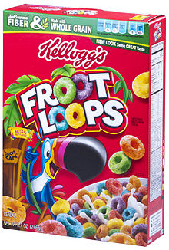

What is it?
It is not an algorithm
It is simply another way to solve a problem that can usually be solved by using loops
Then why use it?
Because there are problems whose solutions are better implemented with recursion.

Slide 3
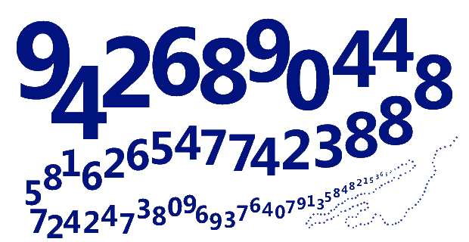
Let’s Solve a Problem!
Finding the factorial of a number!
5!=5x4x3x2x1
Without recursion the solution is...
int f=5;
int answer=1;
for(int x=f;x>=1;x--)
{
answer*=x;
}
With recursion the solution is...
int factorial(int f)
{
if(f==1)
{return f;}
else
{return f * factorial(f-1);}
}

Slide 4
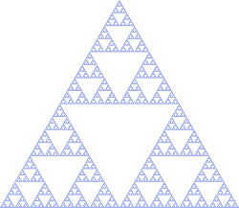
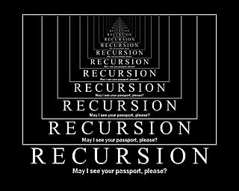
Analysis
How is recursion better in this case??
It’s not necessarily better in this case!!
It is better when solving something like Quick Sort (as you’ll find out in grade 12!!)...good luck trying to implement Quick Sort using only loops!!
What makes what we saw recursion?
Recursion is a function that calls itself!

Slide 5


Recursion-Self Calling Functions!
int factorial(int f)
{
if(f==1)
{return f;}
else
{return f * factorial(f-1);}
}

Slide 6

How Does It Work?
To analyze any function, you trace a call to it
Let’s trace factorial(5)
int factorial(int f)
{
if(f==1)
{return f;}
else
{return f * factorial(f-1);}
}

Slide 7
Result
factorial(5)
int factorial(int f)
{
if(f==1)
{return f;}
else
{return f * factorial(f-1);}
}
5*factorial(4)
4*factorial(3)
3*factorial(2)
2*factorial(1)
1
5*4*3*2*1=120

Slide 8
Notes
All recursive functions must make a call to themselves
All recursive functions must have one or more BASE cases where they stop calling themselves
int factorial(int f)
{
if(f==1)
{return f;} //BASE CASE
else
{return f * factorial(f-1);}
}

Slide 9
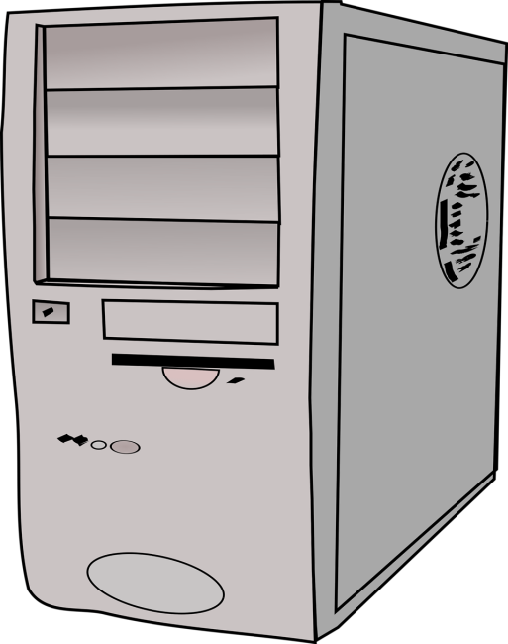
Other Examples
int p1(int n)
{
if(n<=1)
{return 0;} //BASE CASE
else
{return 1 + p1(n-2);}
}
What does p1(8) and p1(13) equal?

Slide 10
int p1(int n)
{
if(n<=1)
{return 0;} //BASE CASE
else
{return 1 + p1(n-2);}
}
p1(13)
p1(8)
1+p1(11)
1+p1(6)
1+p1(9)
1+p1(4)
1+p1(7)
1+p1(2)
1+p1(5)
1+p1(0)
0
1+p1(3)
1+1+1+1+1+1+0=6
1+p1(1)
1+1+1+1+0=4
0

Slide 11
Other Examples
int p1(int m, int n)
{
if(m==n)
{return m;} //BASE CASE
else if(m<n)
{return p2(n-m,m);}
else
{return p2(m-n,n);}
}
What does p1(12,8) and p1(18,24) equal?

Slide 12
p1(12,8)
int p1(int m, int n)
{
if(m==n)
{return m;} //BASE CASE
else if(m<n)
{return p2(n-m,m);}
else
{return p2(m-n,n);}
}
p1(18,24)
p1(4,8)
p1(6,18)
p1(4,4)
p1(12,18)
4
p1(6,12)
p1(6,6)
6

Slide 13
Practice
Download and complete the handout titled: “RecursionWorksheet.doc”

Slide 14
Some More Practice
int identity(int num){
if(num < 1){
return 10;
}else{
return num + identity(num - 2);
}
}

Slide 15
int negative(int num){
if(num >= 20)
{
return -5;
}
else
{
return negative(num + 4) + 2 * num;
}
}

Slide 16
int product(int num)
{
if(num > 20)
{
return -1;
}
else
{
return num * product(-2 * num);
}
}

