Slide 1
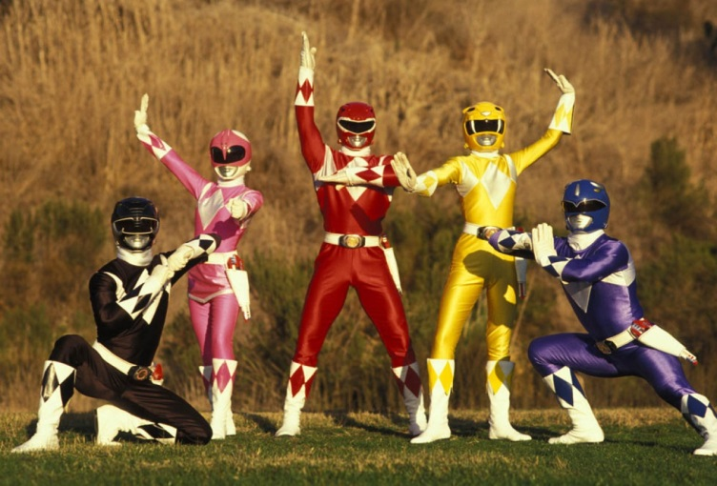
Dynamic Arrays and Arrays in Functions
Even More Power in your Hands!

Slide 2
The Problem With Arrays
An array, once made, can not be resized.
You can however, find out how big an array needs to be before you make it and then make it.
Example:
int howMany=Convert.toInt16(txtHowMany.Text);
int[] speeds=new int[howMany];
or
int[] speeds;
private void event()
{
int howMany=Convert.toInt16(txtHowMany.Text);
speeds=new int[howMany];
}

Slide 3
Arrays in Functions
As learned earlier, functions play critical roles in the development of software by allowing us to reuse code.
As such, we can create functions that work with Arrays.
Function can accept Arrays as arguements as well as return Arrays.

Slide 4
Sample Function-Average
double average(int[] arr)
{
double result;
double total;
for(int x=0;x<arr.Length;x++)
{
total+=arr[x];
}
result=total/arr.Length;
return result;
}
int[] marks={66,76,58,98,95,43,64,57,88,84};
double classAverage=average(marks);

Slide 5
Sample Function 2-Who’s Made the Cutoff?
int cutOff(int[] arr, int value)
{
int total;
for(int x=0;x<arr.Length;x++)
{
if(arr[x]>=cutOff)
{ total++;}
}
return total;
}
int[] marks={66,76,58,98,95,43,64,57,88,84};
int howMany=cutOff(marks,90);

Slide 6
Sample Function 3-User’s Password
String[] userNames={“g123”,”fred2x2”,”smithW99”,”larry98”,”roger4On”};
String[] passwords={“234”,”643”,”567”,”235”,”474”};
String usersPassword(String[] users, String user)
{
String userPassword=“”;
for(int x=0;x<users.Length;x++)
{
if(arr[x]==user)
{ userPassword=passwords[x];}
}
return userPassword;
}

Slide 7
Exercise 1
Make sure that you design a program to test each of the following functions:
Create a function that takes any array of numbers and returns the average of all its numbers.

Slide 8
Exercise 2
Create a function that takes an array of random numbers and returns the largest number.
Create another function that takes an array of random numbers and returns the smallest number.
Create a third function that takes an array of random numbers and a boolean value. If the boolean value passed as an arguement is false find and rteurn the largest number, otherwise return the smallest.

Slide 9
Exercise 3
Create a function that takes an array of words of words and returns a random one from the list.

Slide 10
Exercise 4
Create a function that takes a word and and letter as arguments. It then returns the number of times that letter appears in the word.

Slide 11
Exercise 5
Create a function that takes a String representing a sentence and returns the number of words in it.

Slide 12
Exercise 6
Create a function that takes two arrays of Strings and returns true if any word in the first array is found in the second array, otherwise it returns false.

