Slide 1
CSS Part 2
Using the Box Model

Slide 2
Margins and Padding
margin and padding are the two most commonly used properties for spacing-out elements. A margin is the space outside something, whereas padding is the space inside something.

Slide 3
h2 {
font-size: 1.5em;
background-color: #ccc;
margin: 20px;
padding: 40px;
}
This leaves a 20-pixel width space around the secondary header and the header itself is fat from the 40-pixel width padding.

Slide 4
The four sides of an element can also be set individually:
margin-top, margin-right, margin-bottom, margin-left, padding-top, padding-right, padding-bottom and padding-left

Slide 5
The Box Model
Margins, padding and borders (see next page) are all part of what’s known as the Box Model. The Box Model works like this: in the middle you have the content area (let’s say an image), surrounding that you have the padding, surrounding that you have the border and surrounding that you have the margin.

Slide 6
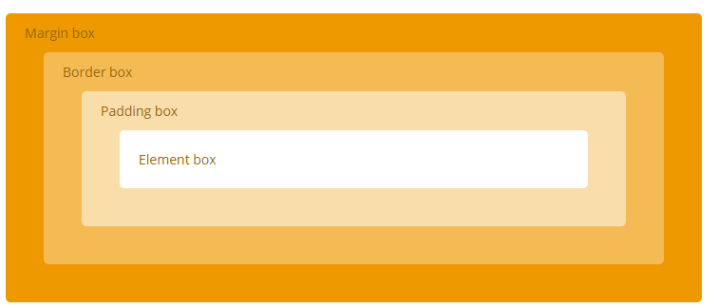

Slide 7
Borders
Borders can be applied to most HTML elements within the body.
border-style:solid, dotted, dashed,double, groove, ridge, inset and outset;
border-width:width of the border;
There are also properties for border-top-width, border-right-width,border-bottom-width and border-left-width
border-color:color;

Slide 8
h2 {
border-style: dashed;
border-width: 3px;
border-left-width: 10px;
border-right-width: 10px;
border-color: red;
}

Slide 9
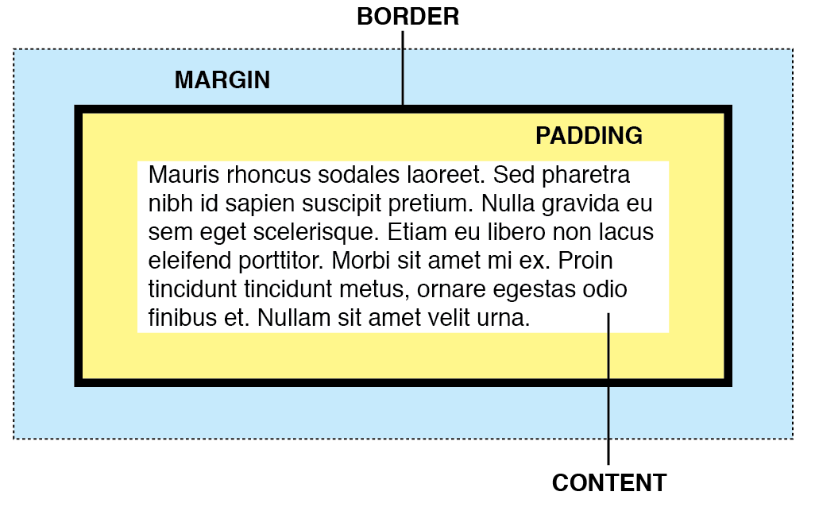
Exercises
Modify your site’s external css file to include changes to the padding, border and margin of all tags/selectors
For example all paragraphs might looks as follows:
Make sure any extra pages in your site that have not been mentioned in a previous powerpoint or handout have the external style rules applied to them

