Slide 1
Web Page Layouts

Slide 2
Applying Styles
The alternative to applying styles to tags as a group involve the use of the class selector
In an HTML document, CSS class selectors match an element based on the contents of the element's class attribute.
Example:
.classy { background-color: DodgerBlue; }
<span class="classy">Here's a span with some text.</span>
<span>Here's another.</span>

Slide 3
The ID Selector
In an HTML document, CSS ID selectors match an element based on the contents of that element's id attribute, which must match exactly the value given in the selector.
Example:
#identified { background-color: DodgerBlue; }
<span id="identified">Here's a span with some text.</span>
<span>Here's another.</span>

Slide 4
Class and ID Selectors
Class selector styles can be applied to any group of tags while id selector styles to only be applied to the tag with the same unique id

Slide 5
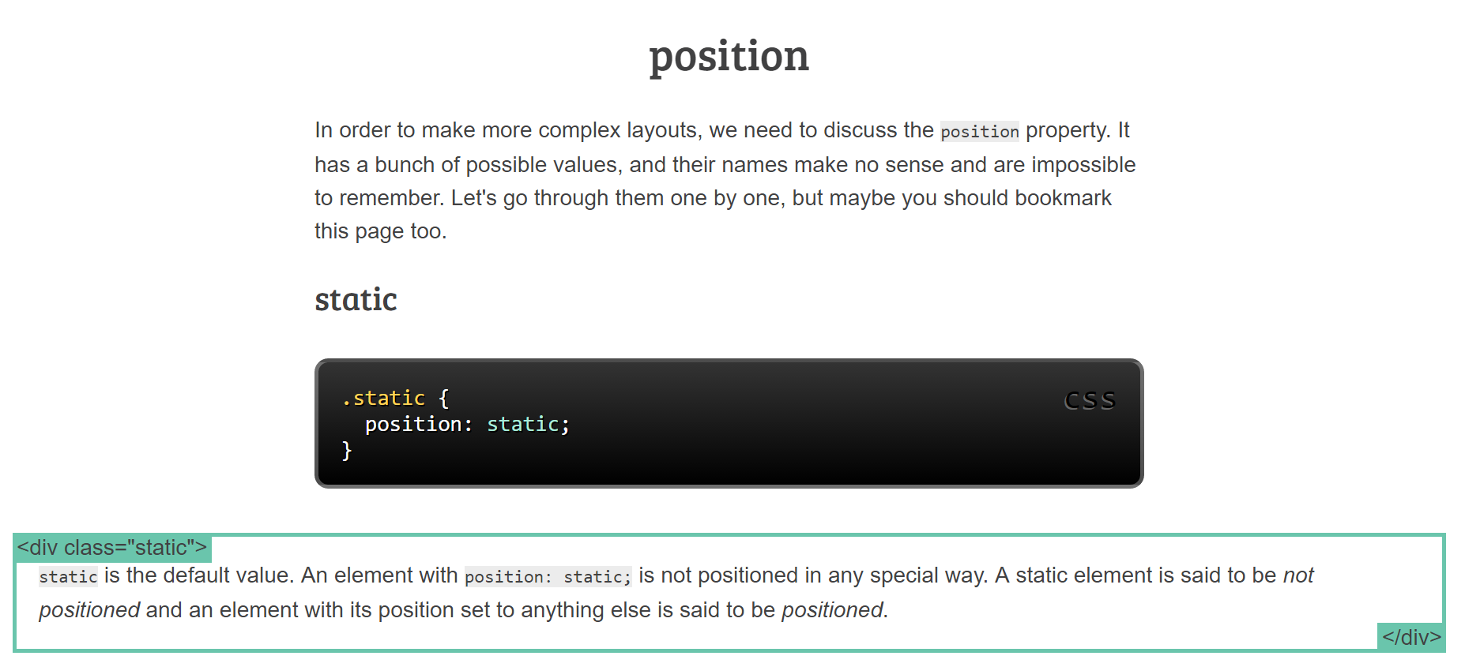
Static Positioning

Slide 6
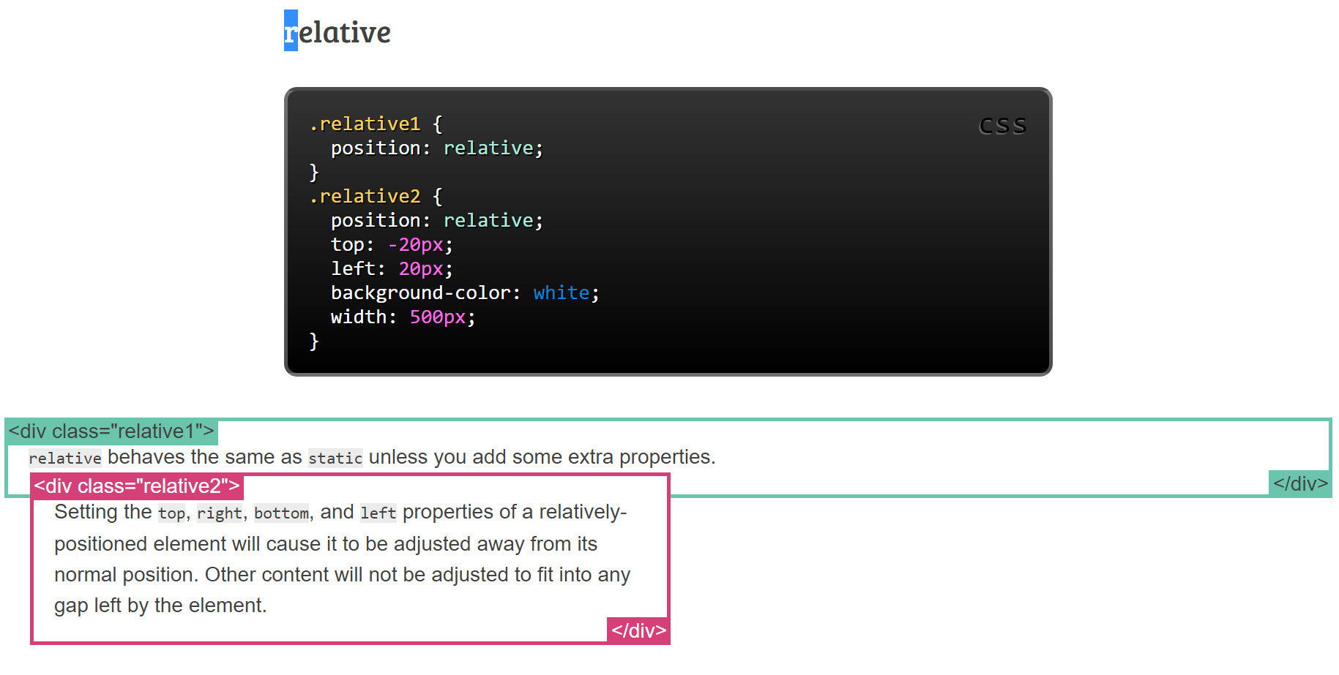
Relative Positioning

Slide 7
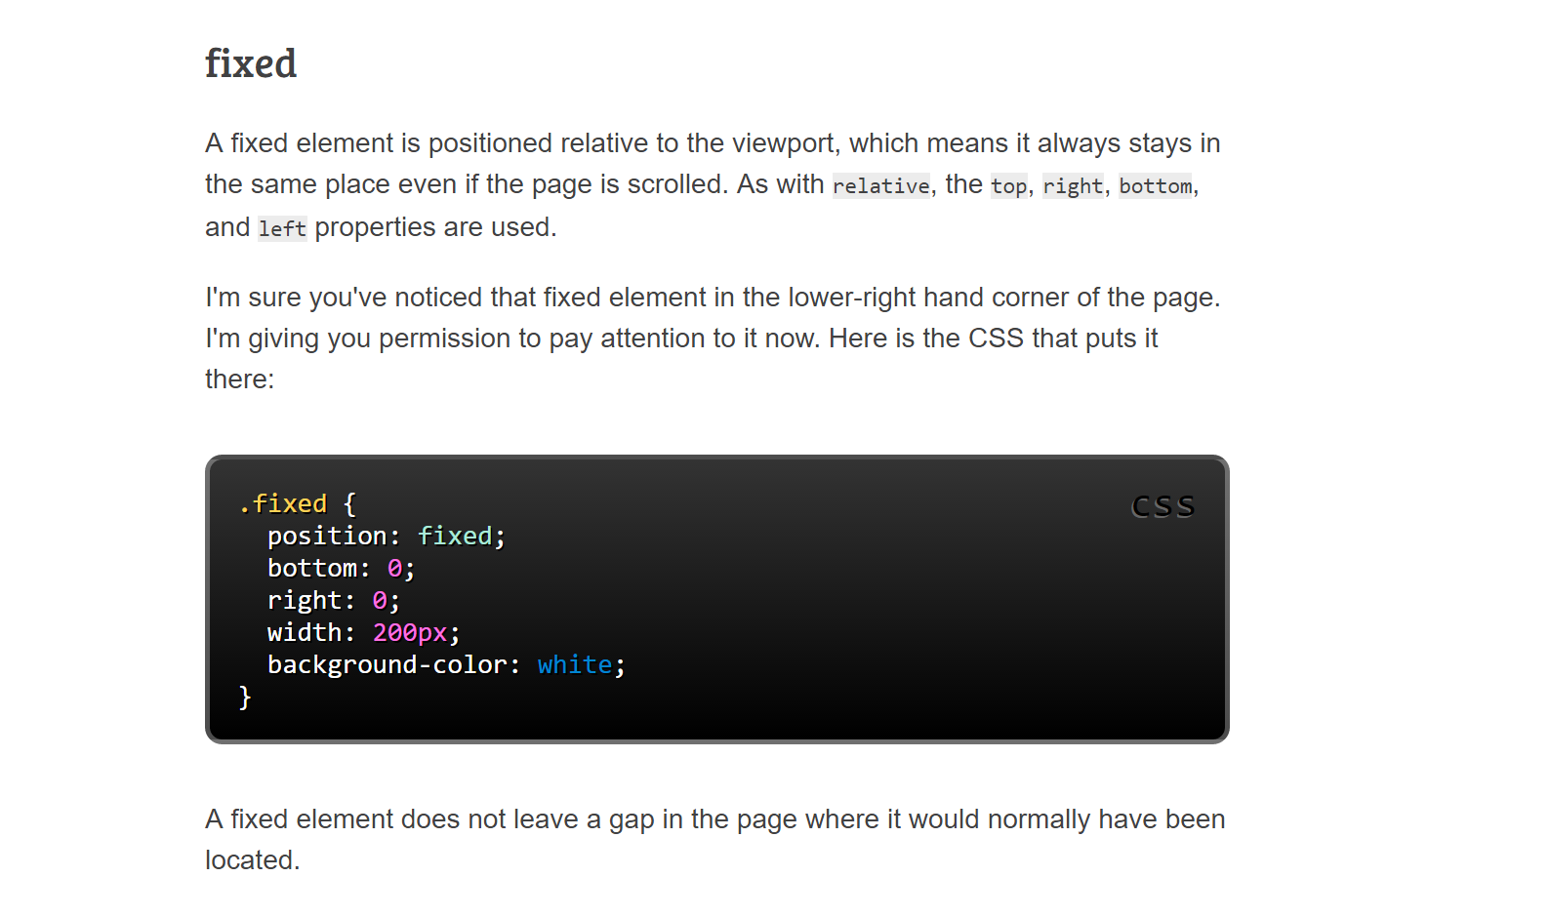
Fixed Positioning

Slide 8
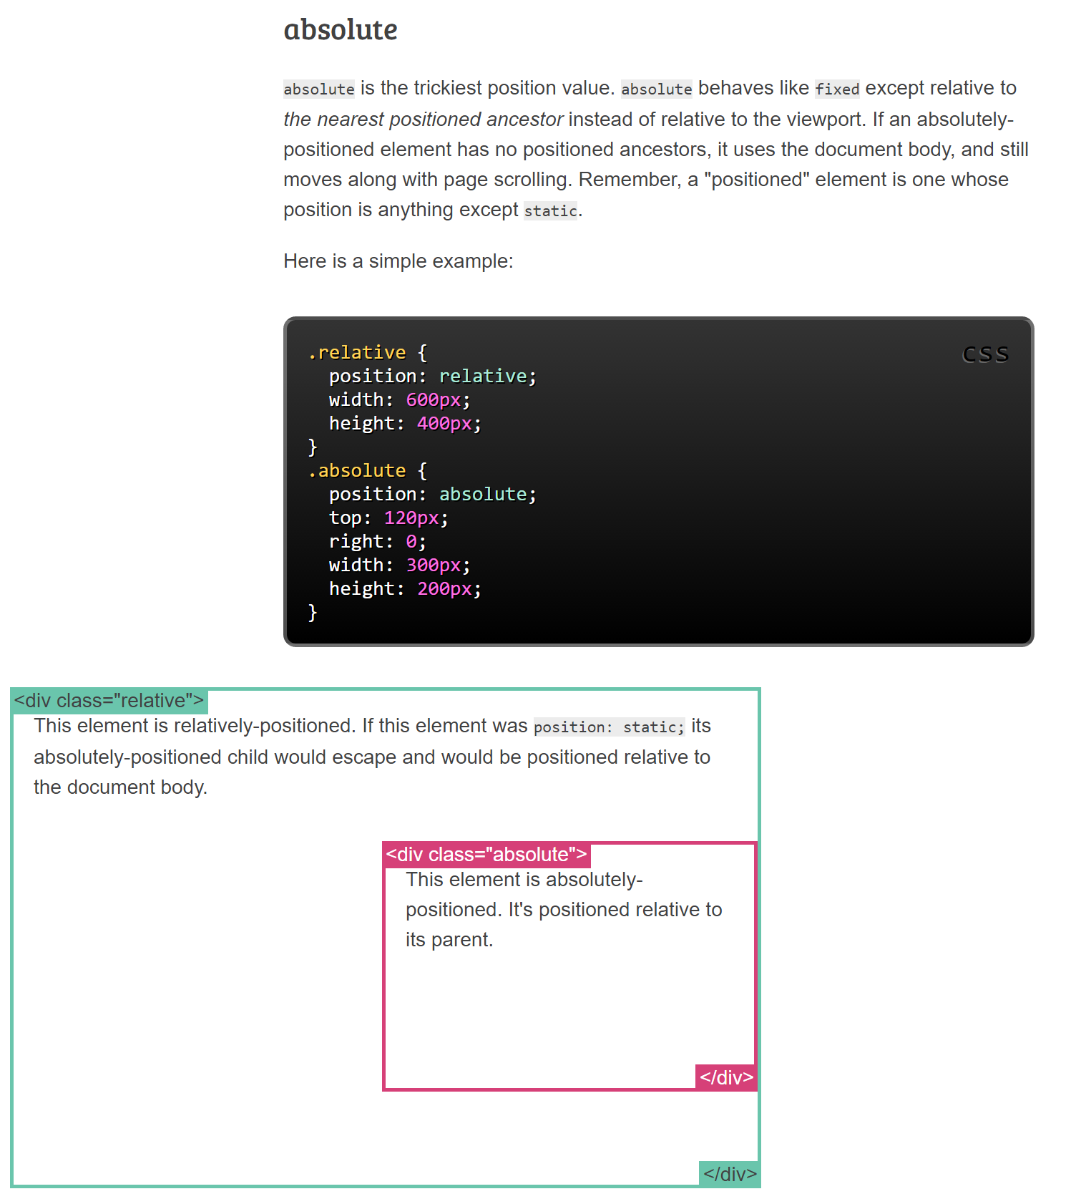
Absolute Positioning

Slide 9
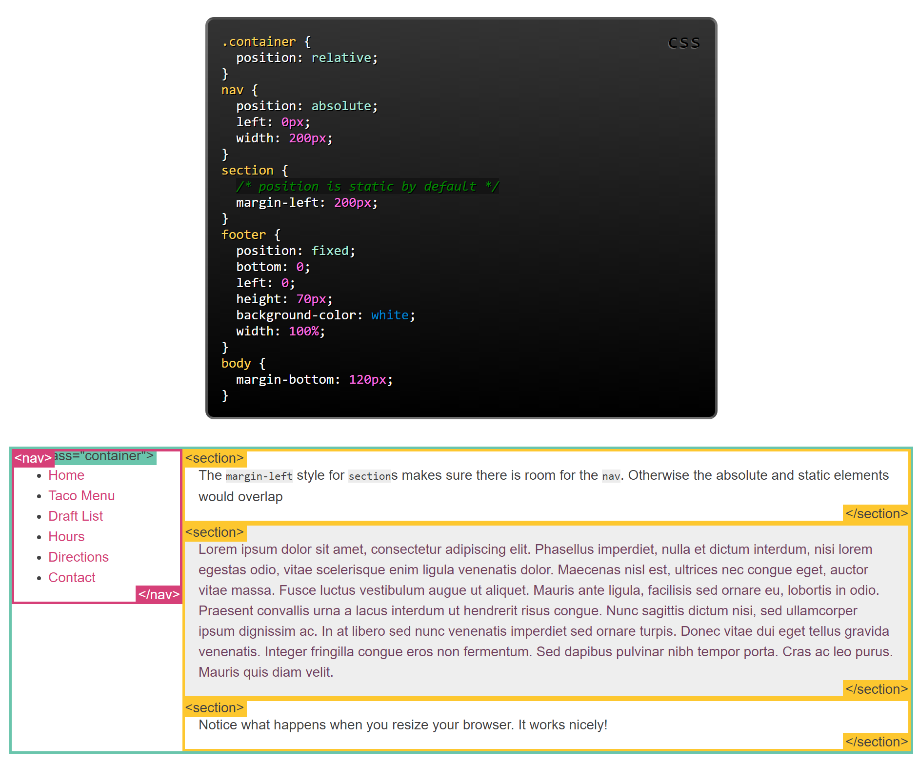
Sample

Slide 10
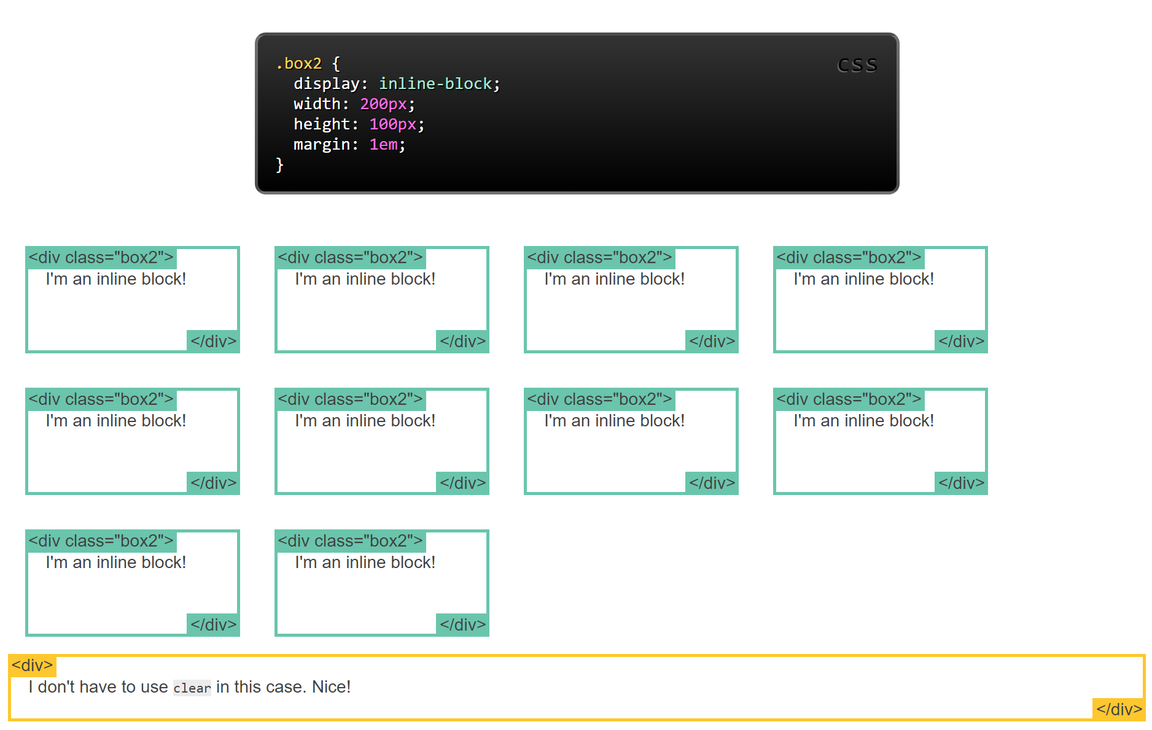
Inline-block
Inline-block is used to layout boxes in a web page horizontally (so that it avoids the default of being vertically placed)

Slide 11
Exercises
Use class and id selectors, along with your knowledge of positioning and CSS layouts to refine the look of your website. Make sure you have a consistent theme through out your site in terms of both colours and layout. Use the layout design on the following page as a guideline. Every page must have these sections. In the Header place the title of your page, the nav bar should contain your list of links, the footer a copyright message ex. ©A. Krnic, all rights reserved. The middle section should include a subheading and possibly sub-footer as well as a description of the main information to be found in the page i.e. the unit description and the side bar should contain miscellaneous info ex. Links to your work, resources etc.

Slide 12
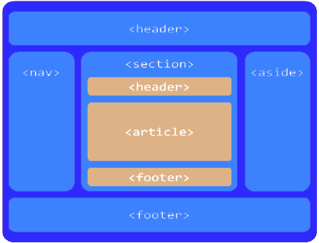
Basic Class Website Layout

