Slide 1

Intro to Java

Slide 2
Simple Java Program
Here is an example Java program. It is about as small as a Java program can be. When it runs, it writes Hello World! on the computer monitor.
class Hello {
public static void main ( String[] args ) { System.out.println("Hello World!");
}
}

Slide 3
Java Source File
This program can be created using a text editor such as the Notepad editor that comes with Windows. The program will be in a text file on the hard disk, named Hello.java.
A source program is a text file that contains a program (such as above) written in a programming language. Since it contains ordinary text (stored as bytes) it can not be directly executed (run) by the computer system. As a text file, you can print it, display it on the monitor, or alter it with a text editor.

Slide 4
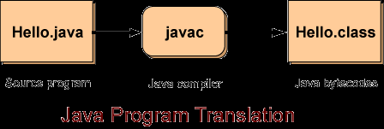
Bytecodes
To run a Java program the source file is first translated into a file of bytecodes.
A Java bytecode is a machine instruction for a Java processor. A file of bytecodes is a machine language program for a Java processor.

Slide 5
Java Program Translation
The source program Hello.java is examined by a program called javac running on your computer. The javac program is a compiler (a translator) that translates the source program into a bytecode file called Hello.class.
Important Idea: The bytecode file will contain exactly the same bytecodes no matter what computer the javac compiler runs on.

Slide 6
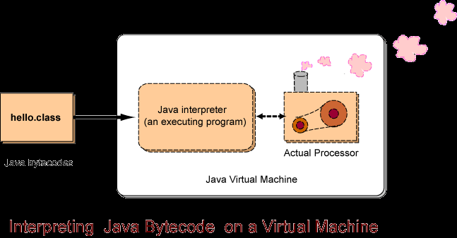
Java Virtual Machine

Slide 7
The Java Virtual Processor
People do not have hardware Java processor chips. They have ordinary PCs and Macintoshes.
Now for the clever part: the Java processor can be implemented as software! It is implemented as a program that reads the bytecodes and performs the operations they specify. This is another type of interpreter. Some interpreters run source code written in a high level language like Basic; others (like the Java interpreter) run bytecodes.
The "Java interpreter" in the picture is an executable program that is running on an ordinary computer system, such as a desktop Intel system. Each type of computer system has its own Java interpreter that can run on that system. The "Actual Processor" is the actual hardware processor chip of that computer system.
When a Java program is translated into bytecodes, the bytecodes are the same no matter what computer system is used.
A Java source program (such as Hello.java) can be written and compiled on one computer (say a Windows computer) to produce bytecode (say Hello.class). Now that bytecode can run on any computer that has a Java interpreter.

Slide 8
Using an IDE
Although we can create a java program simply by using the JDK (java development kit) which comes with the java compiler and java interpreter), it is much easier to use an IDE, like eclipse.
Your teacher should provide you with a copy of eclipse or at least point you to a location where you can download it.

Slide 9
Eclipse
Eclipse is an open source IDE for programmers using a variety of languages.
There are many different versions and optional features.
To avoid having to install all the extras, try and get your teacher’s copy which will come preconfigured with all the necessary tools.

Slide 10
A Java Project in Eclipse
We’ll start off by making simple single class java applications.
To do this start eclipse.
Make sure you can see the Project Explorer (Select Window→Show View→Project Explorer)…this displays all your projects and their folders and files
Next, click File→New Java Project

Slide 11
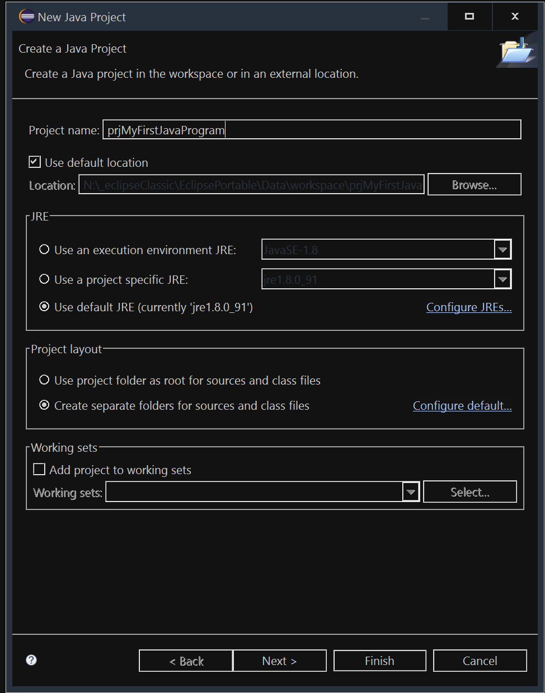
New Java Project Dialog Box

Slide 12
New Java Project
In the New Java Project dialog box, enter a project name “prjMyFirstJavaProgram”, set a location for your project or leave it to its default, and then make sure to select the default JRE (the Java Runtime Environment or Java Virtual Machine/Interpreter).
Leave all settings to their default and then click Finish.

Slide 13
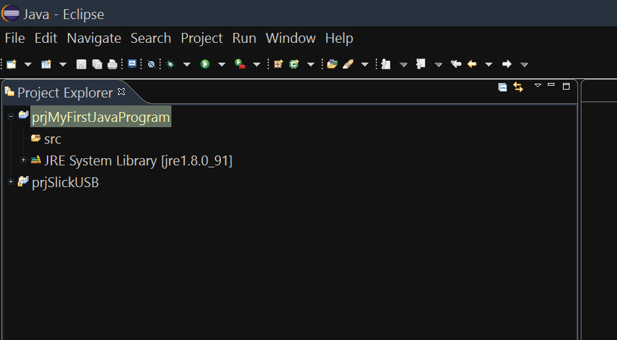
Your Project

Slide 14
The Project Workspace
You’ll notice that project is made up of two folders 1. src and 2. JRE System Library.
The src folder will contain your source files.
The other folder contains all the java related library files you need to create a java program.
Only concern yourself with src.
Right click src, then select Class.

Slide 15
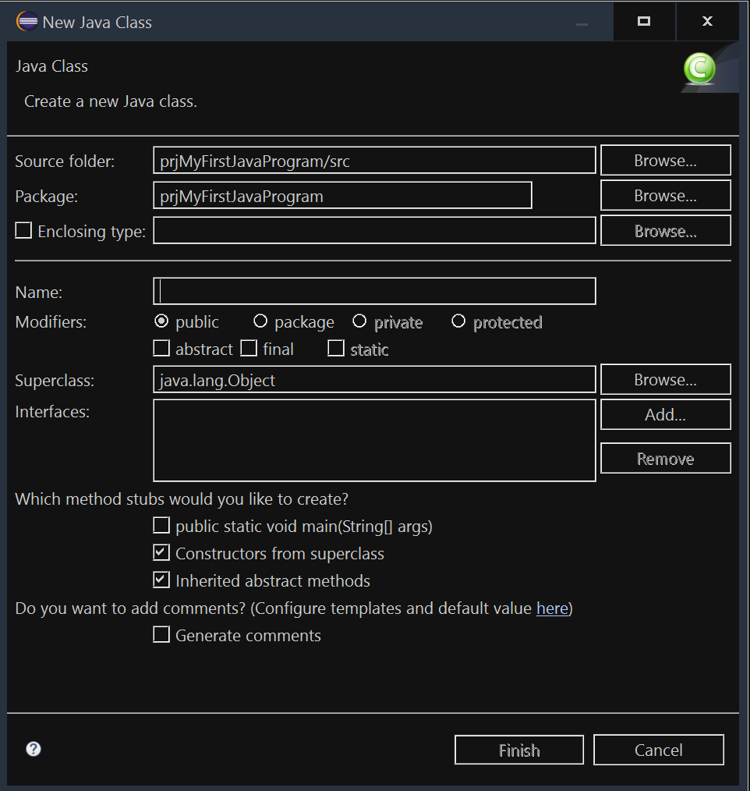
The New Java Class Dialog Box

Slide 16
Settings
In the new Java Class Dialog Box we only need to provide a name for our class and then select the public static void main(String[] args)
This last option asks eclipse to automatically include this base function into our class.
Remember, all java programs start off by running a main method.
Your project only need one of these functions, unless of course you want to start off a program from another class in the same project.
Let’s give this class the name sample.
Click Finish once you are done.

Slide 17
Code Analysis
package prjMyFirstJavaProgram;
public class sample {
public sample() {
// TODO Auto-generated constructor stub
}
public static void main(String[] args) {
// TODO Auto-generated method stub
}
}

Slide 18
Code Analysis
Packages are used to organize groups of related classes (we’ll get back to this later) into folders.
The class name “sample” matches the file name exactly.
The source file ends in .java
public sample(){} is the class constructor (we’ll come back to this later)
Finally the most important part at this time is the main method. This is where we start our program. It’s the function that gets called by the jre when we run our program.

Slide 19
Hello World!
Let’s write our Hello World! Program.
Add the following to your code’s main function (sometimes called method):
System.out.println("Hello World!");

Slide 20
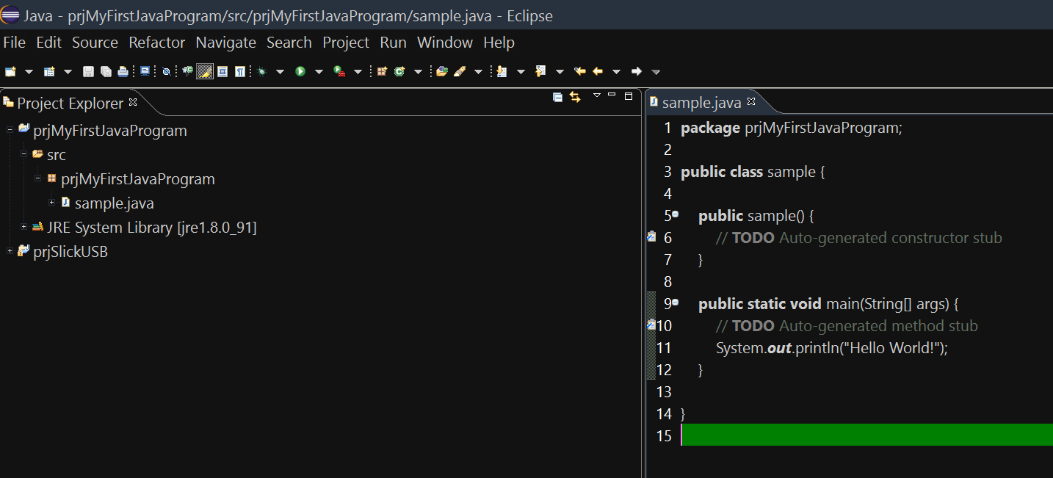
Run Your Program
On your toolbar there should be an icon that looks like a green ball with a white arrow in it.
Press it to run your code.

Slide 21
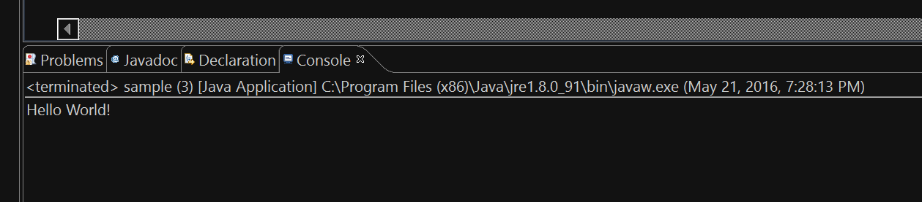
Output
Your output will display in the Console window located at the bottom of the IDE
Any Problems will display in the Problems window located in the same area

Slide 22
Syntax and Logic Errors
Don’t forget that Syntax errors will prevent your program from compiling while Logic errors (or bugs) will compile but not perform their intended actions.

Slide 23
Comments
A comment is a note written to a human reader of a program. A comment starts with the two characters // (slash slash). Those characters and everything that follows them on that one line are ignored by the java compiler.
Often you want to write a comment that spans several lines, as above.
With this style of comment, everything between the two characters /* and the two characters */ are ignored by the compiler.

Slide 24
Exercises
Practice using your IDE and running your programs by creating the following classes (on the following slides), each with their own main method. Make sure to select the class you want to run prior to clicking the Run button on the toolbar. Also don’t forget to name the files to match the class names.

Slide 25
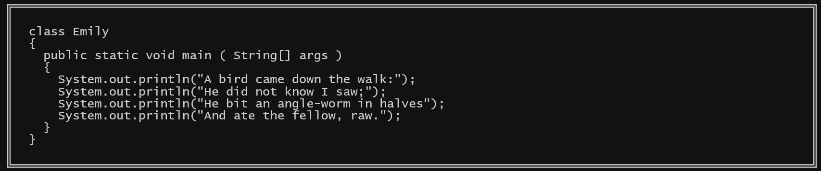

Slide 26
