Slide 1

Object Data, Input and Output and Floating Point

Slide 2
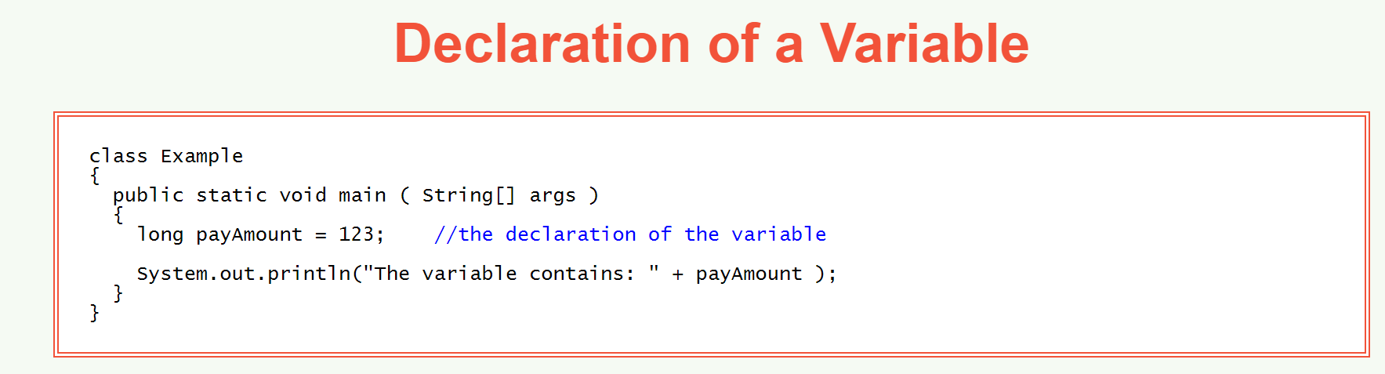
Variables
variable — a named location in main memory which uses a particular data type to hold a value.

Slide 3
Syntax of Variable Declaration
There are several ways to declare variables:
dataType variableName; This declares a variable, declares its data type, and reserves memory for it. It says nothing about what value is put in memory. (Later in these notes you will learn that in some circumstances the variable is automatically initialized, and that in other circumstances the variable is left uninitialized.)
dataType variableName = initialValue ; This declares a variable, declares its data type, reserves memory for it, and puts an initial value into that memory. The initial value must be of the correct data type.
dataType variableNameOne, variableNameTwo ; This declares two variables, both of the same data type, reserves memory for each, but puts nothing in any variable. You can do this with more than two variables, if you want.
dataType variableNameOne = initialValueOne, variableNameTwo = initialValueTwo ; This declares two variables, both of the same data type, reserves memory, and puts an initial value in each variable. You can do this all on one line if there is room. Again, you can do this for more than two variables as long as you follow the pattern.

Slide 4
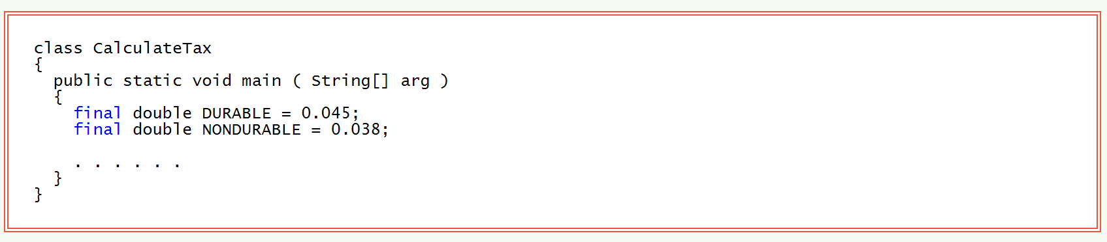
Constants
The reserved word final tells the compiler that the value will not change.
Constants make your program easier to read and check for correctness.
If a constant needs to be changed (for instance if the tax rates change) all you need to do is change the declaration of the constant. You don't have to search through your program for every copy of a specific number.

Slide 5
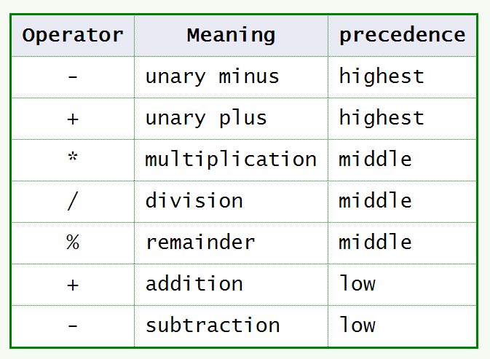
Arithmetic Operators
Operators of higher precedence are done first. The table shows the precedence of some Java operators.
When both operands (the numbers) are integers, these operators do integer arithmetic. If one operand or both operands are floating point, then these operators do floating point arithmetic. This is especially important to remember with division, because the result of integer division is an integer.
For example:
5/2 is 2 (not 2.5)5/10 is 0 (not 0.5).However,
5.0/2.0 is 2.55/10 is 0.5 .

Slide 6
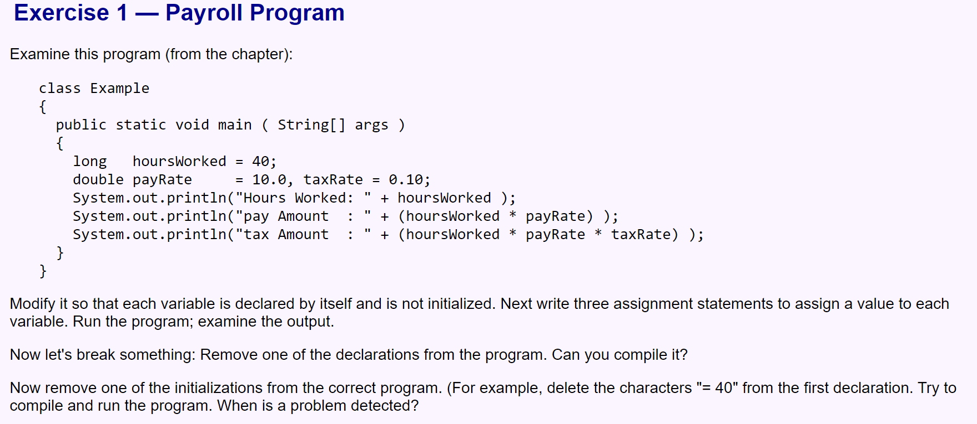
Exercises

Slide 7
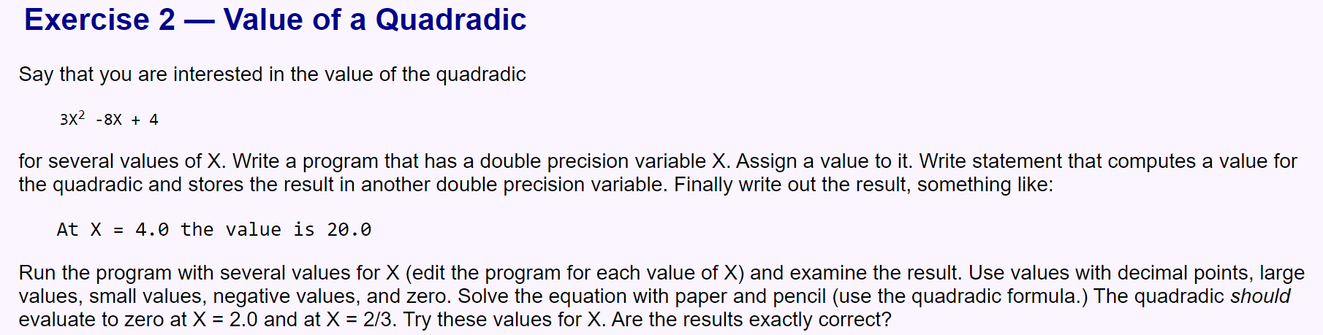

Slide 8
