Slide 1
Sorting Through Recursion

Slide 2
Quick Sort and Recursion
Recursion is a tool used to solve computer science problems
Some problems can be best solved by recursion
For example, there are many sorting algorithms that can be developed with the help of recursion
Quick Sort is one example
Why another algorithm for sorting?
Because QuickSort is considered to be much faster than bubble or insertion sorts
Its average Big O is O(n log(n)) vs. O(n^2) for bubble and insertion sorts
Big O is used by programmers to indicate the efficiency of an algorithm

Slide 3
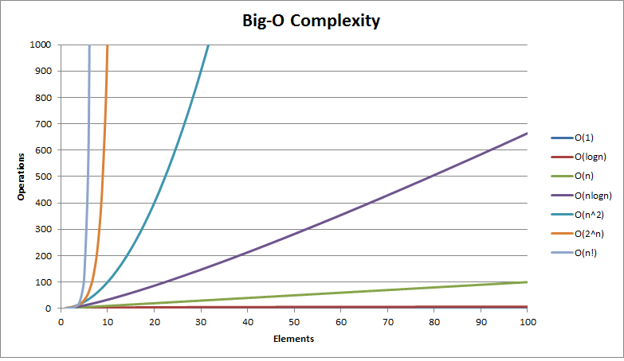
Big o complexity
The following graph illustrates the time it takes(y-axis) for an algorithm to complete depending on the number of elements it has to process (x-axis)

Slide 4
Big o complexity
An algorithm that simply does one thing regardless of its input size is said to have a Big O of O(1) i.e. the time it takes to process its data is constant and therefore a straight line

Slide 5
Big o complexity
If we compare the Big O for QuickSort O(nlogn) versus that of the insertion or bubble sort O(n^2) we can clearly see that as the number of elements required to process increases, the amount of time required increases drammatically

Slide 6
QuickSort
This algorithm begins by identifying three key components: 1. a left marker 2. a right marker 3. a pivot
The left marker starts out at the left element and the right at the right
The pivot is the element that will be compared to other elements
This can be any element
In our example we’ll select the first element as our pivot
L
R
5
2
7
3
6
P

Slide 7
QuickSort
The algorithm works by comparing values to the left of the pivot and making sure those are smaller than the pivot and if not we swap positions so that the pivot is always to the right of a smaller element
After a swap we check values to the left of the pivot are smaller otherwise we again make a swap
Swaps are carried out to make sure elements are always on the correct side of the pivot

Slide 8
Since the pivot starts where the left marker is we’ll start by checking the values to the pivot’s right are larger
We start checking where the right marker is i.e. is R>P?
Since 6 is larger there’s no swap
We then move the right towards the left i.e. R=R-1
Keep track or where L and R starts off at as we’ll use this when making our sub-arrays (more on that later)
L
R
5
2
7
3
6
P

Slide 9
Again we check that R is greater than the P i.e. is R>P?
In this case it isn’t…remember all values to the right of the pivot must be greater in value
As a result we need to swap
The pivot moves to R and takes it’s value with it
L
R
5
2
7
3
6
P

Slide 10
After the swap our pivot is a new position i.e. where R is
As a result we start checking that all elements to its left are smaller i.e. is L<P?
L has a value of 3 and we leave it alone as its on the correct side of the pivot
L
R
3
2
7
5
6
P

Slide 11
We then move L towards the pivot i.e. L=L+1
Again we check is L<P?
Again, it is as 2 is less than 5 so we move L again
L
R
3
2
7
5
6
P

Slide 12
Once again we check if L<P?
This time it’s not so we need to swap
L
R
3
2
7
5
6
P

Slide 13
Once again we check if L<P?
This time it’s not so we need to swap
Since L is at P we start checking that all elements to the right are larger
Since 7 is, we move R towards the pivot (just like we did at the start)
L
R
3
2
5
7
6
P

Slide 14
We’ve now reached an important step in the algorithm i.e. where L=R=P
At this point the pivot has been put in its permanent place i.e. it is sorted
5 will not be moved from now
The Quick Sort algorithm ‘s sole purpose is to move the pivot to its rightful place in the sorted list/array
As a result we simply need to apply the algorithm again to the array on the left side and the right side of the pivot (we treat these as separate sub arrays)
L
R
3
2
5
7
6
P

Slide 15
We simply need to call the algorithm recursively on the remaining sub-arrays
The sub-arrays are identified as follows:
Left Sub-Array: startingLeftLocation…pivot-1
Right Sub Array: pivot+1….startingRightLocation
We’ll start by examining the left sub-array
As before we check that the elements on the right are larger
Since 2 is not we swap
5
L
R
L
R
3
2
7
6
P
P

Slide 16
Now we check the left elements are smaller
Since 2 is smaller we move L i.e. L=L+1
5
L
R
L
R
2
3
7
6
P
P

Slide 17
L now moves to R and as before we reach the condition where L=R=P
This again means the pivot, 3, is in its rightful place
Since there are no elements to the right of the pivot we can not divide it further into a new sub-array to sort but can however sort the left sub-array
5
L
R
L
R
2
3
7
6
P
P

Slide 18
Since L=R=P!!!! This pivot is already in its right place and since there are no more elements on the right or left of the pivot (no more non-pivot elements) we stop sorting recursively
We still haven’t completed the earlier far right sub array
3
5
L
R
L
R
2
7
6
P
P

Slide 19
We check that the elements to the right of P are larger and in this case the only one there, 6, is not and so we swap
2
3
5
L
R
7
6
P

Slide 20
We check that the elements to the right of P are larger and in this case the only one there, 6, is not and so we swap
Then we check the left elements and because 6 is now less than the pivot and in its correct place we move L
2
3
5
L
R
6
7
P

Slide 21
L=R=P and so the pivot (7) is in it’s rightful place
2
3
5
L
R
6
7
P

Slide 22
There is a sub-array on the left of the pivot so we recursively sort it
Since it is only one element long the L=R=P
The pivot is in its correct place immediately and since there are no more sub-arrays left the sorting is complete!
2
3
5
7
L
R
6
P

Slide 23
There is a sub-array on the left of the pivot so we recursively sort it
Since it is only one element long the L=R=P
The pivot is in its correct place immediately and since there are no more sub-arrays left the sorting is complete!
2
3
5
6
7

Slide 24
exercise
Work with a partner and write the recursive function for quickSort
Make sure to test your code
Hints/guides are provided on the following slides
Use these only out of desperation! You learn best by trying to figure things out yourself first!
Post your program and source in your Unit 3 web page.

Slide 25
Hint #1
Start by watching a video on quick sort:
https://www.youtube.com/watch?v=3OLTJlwyIqQ
Create an array with 10 elements that hold random numbers

Slide 26
Hint #2
Create a function called quickSort

Slide 27
Hint #3
Assign to the function three parameters: 1. the array to sort 2. the starting left marker position 3. the starting right marker position

Slide 28
Hint #4
Start the function by assign the pivot to the left marker’s position
Assign to a left and right variable the starting left and right marker’s positions

Slide 29
Hint #5
Start checking the pivot’s value is less than or equal to the right element as well as the left and right are not the same number
If it is then reduce the right value by 1
Repeat this until this is no longer true (loop) or the right has reached the pivot
Once this is no longer true you should be out of the loop where you’ll then swap the pivot and the element it was just compared to
Now check that the pivot is greater than or equal to the left marked element as well as the left and right are not the same number
If not move the left marker over 1 to towards the pivot
Repeat this until this is no longer true (loop) or the left reaches the pivot
Once this is no longer true you should be out of the loop where you’ll then swap the pivot and the element it was just compared to
Remember, review each step of the algorithm as you write the code (trace your code through the steps of the algorithm)
Finally repeat this whole process again and again until the left marker matches up with the right marker (loop again)

Slide 30
Hint #6
Once you are out of big loop that moves the left and right markers to each other you will need to call this function again (recursively) to quick sort the sub-arrays
The base case will be when the starting left and right markers are the same i.e. when the sub array has only 1 element
Otherwise, check to see if the starting right marker is greater than the pivot and therefore we have a right sided sub-array and so call the function on itself again for that right sub array and do the same for the left sub-array i.e. check to see if the starting left marker is less than the pivot and therefore call the function recursively on the left sub-array

