Slide 1
Decisions
The If Statement
The Single Brach If Statement
Boolean Expressions

Slide 2

Outline of a Two-way Decision

Slide 3
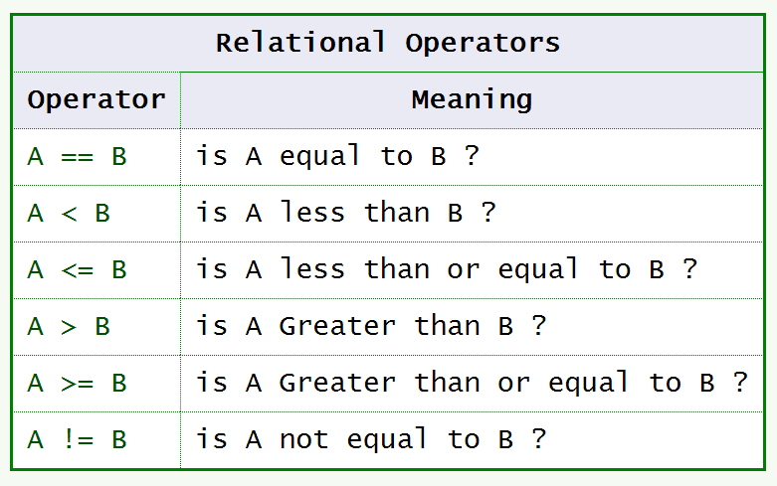
Boolean Expressions

Slide 4
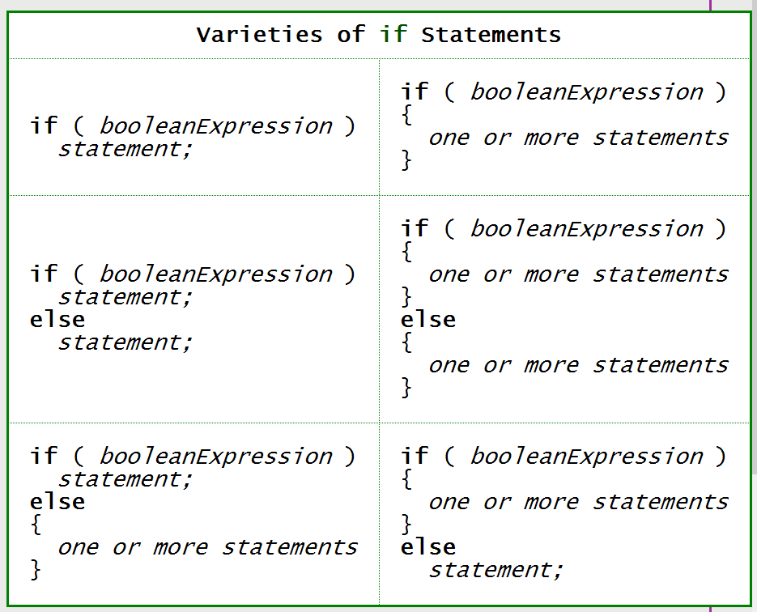
Varieties of if Statements

Slide 5
Logical Operators
&& AND
|| OR
! NOT

Slide 6
Precedence of NOT
The NOT operator has high precedence, so it is done before arithmetic and relational operators unless you use parentheses.

Slide 7


Console IO
The line import java.util.Scanner; says to use the Scanner class from the package java.util.

Slide 8

Exercises

Slide 9
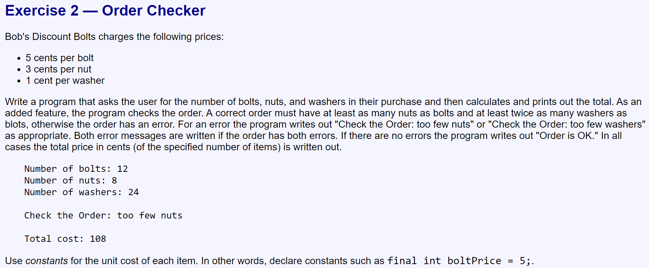

Slide 10
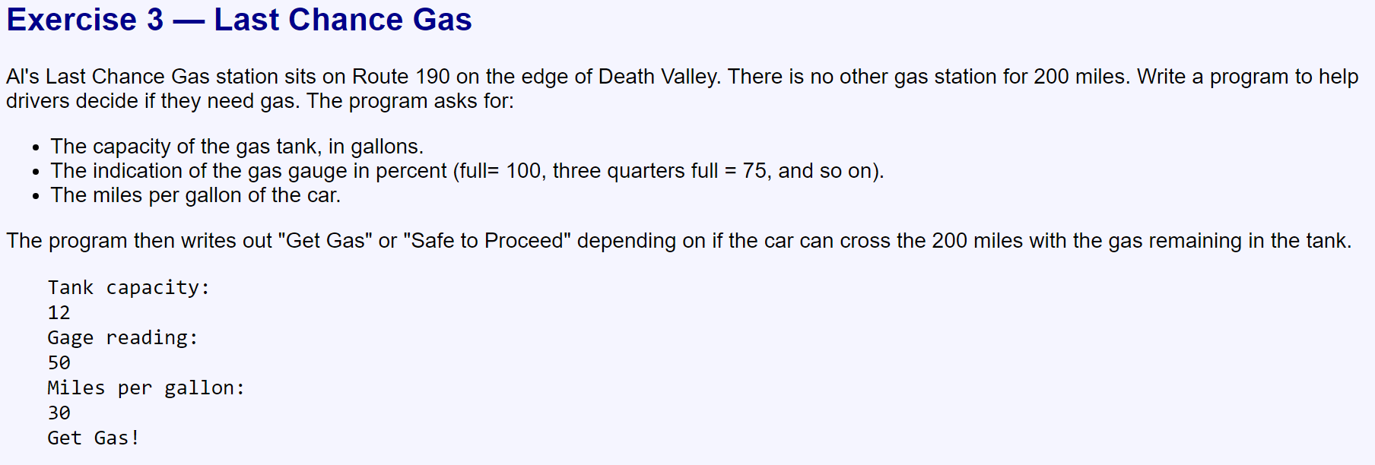

Slide 12
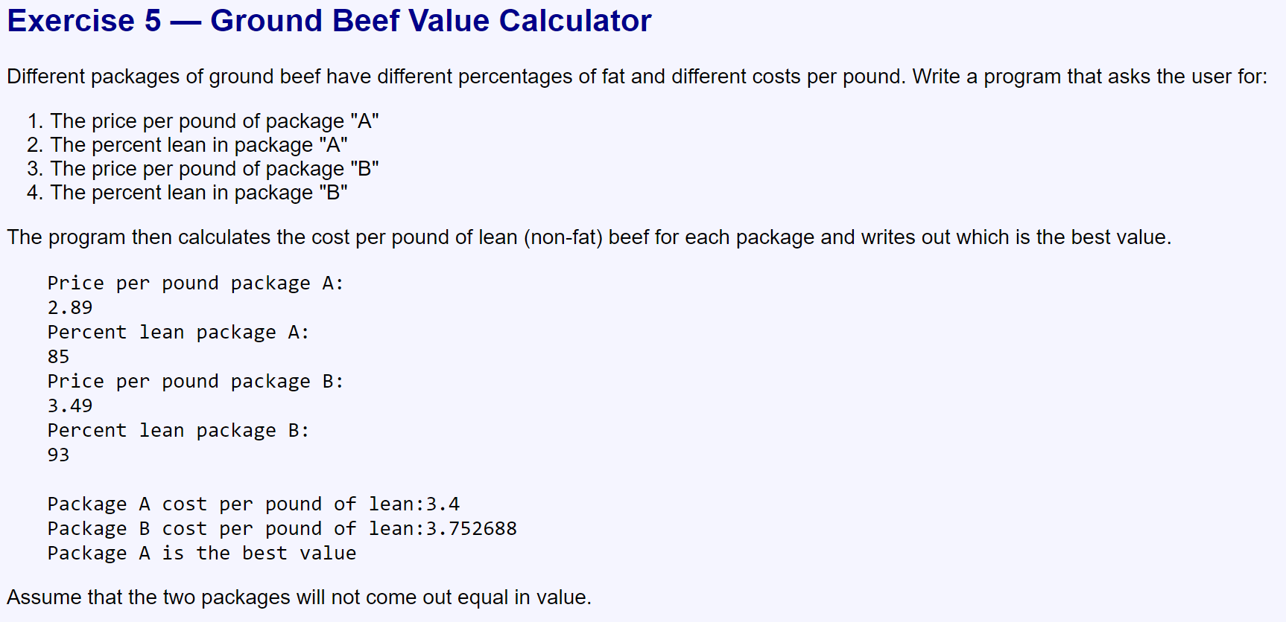

Slide 13
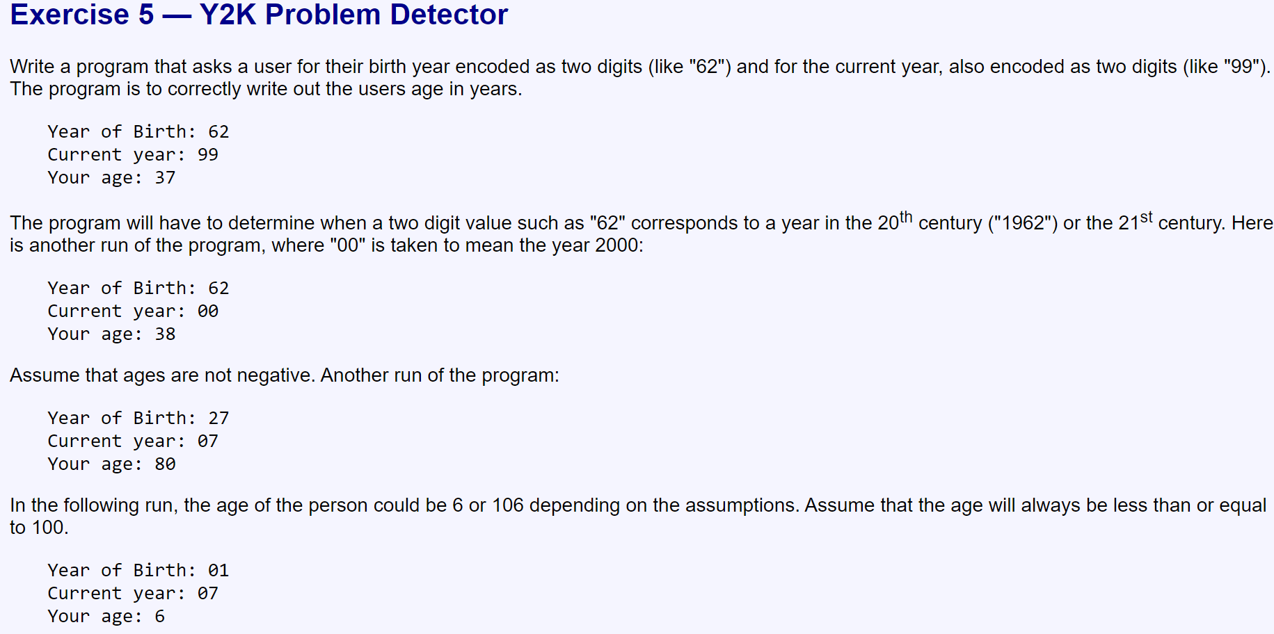

Slide 14


Slide 15


Slide 16


Slide 17


Slide 18

Part 2

Slide 19


Slide 20


Slide 21
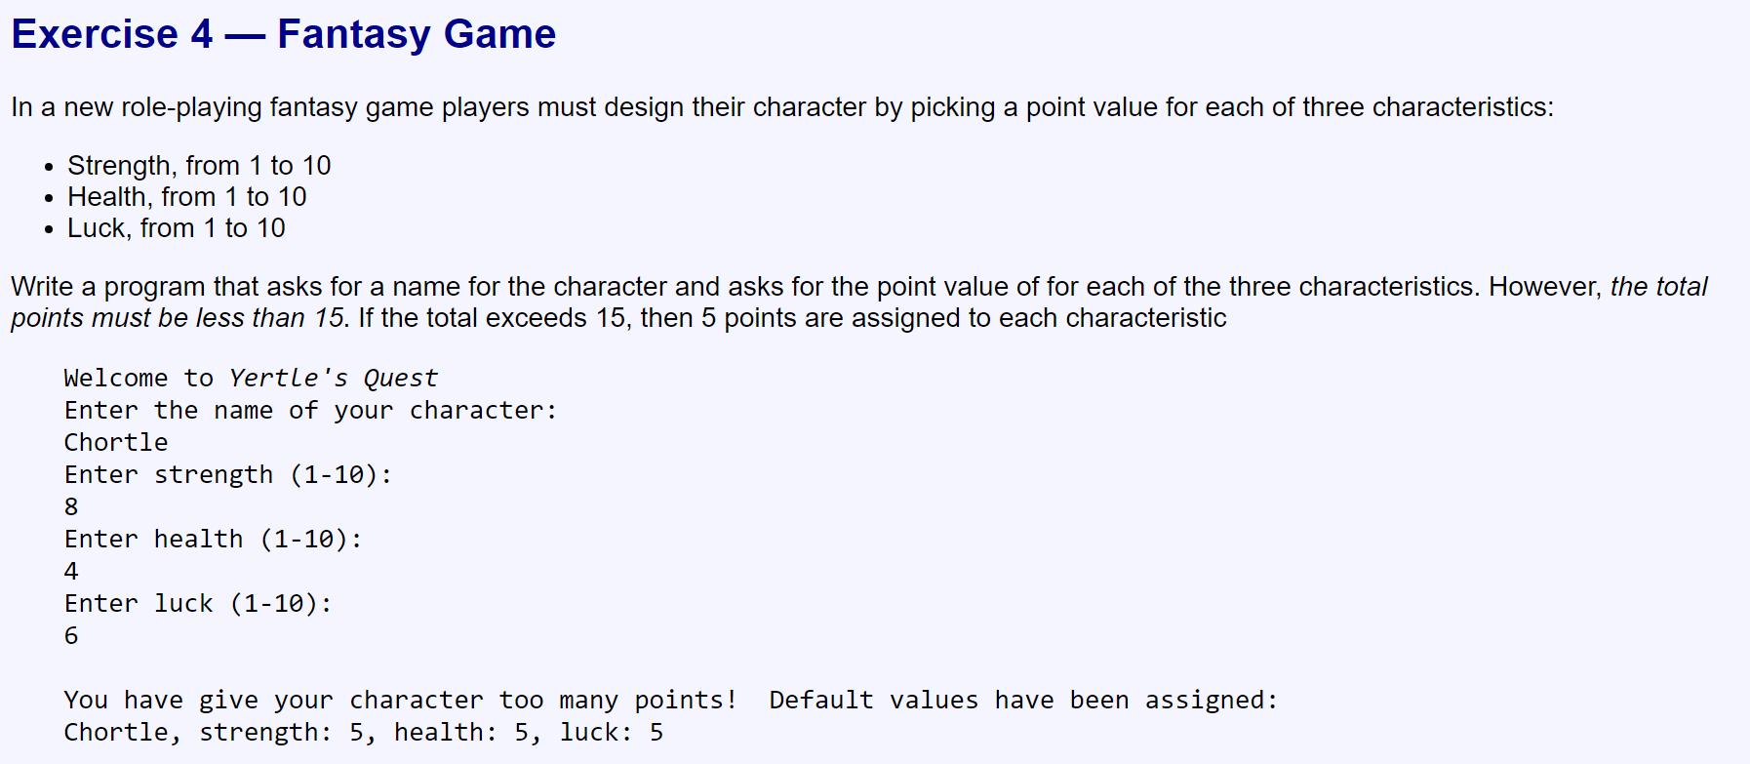

Slide 22

Part 3

Slide 23


Slide 24
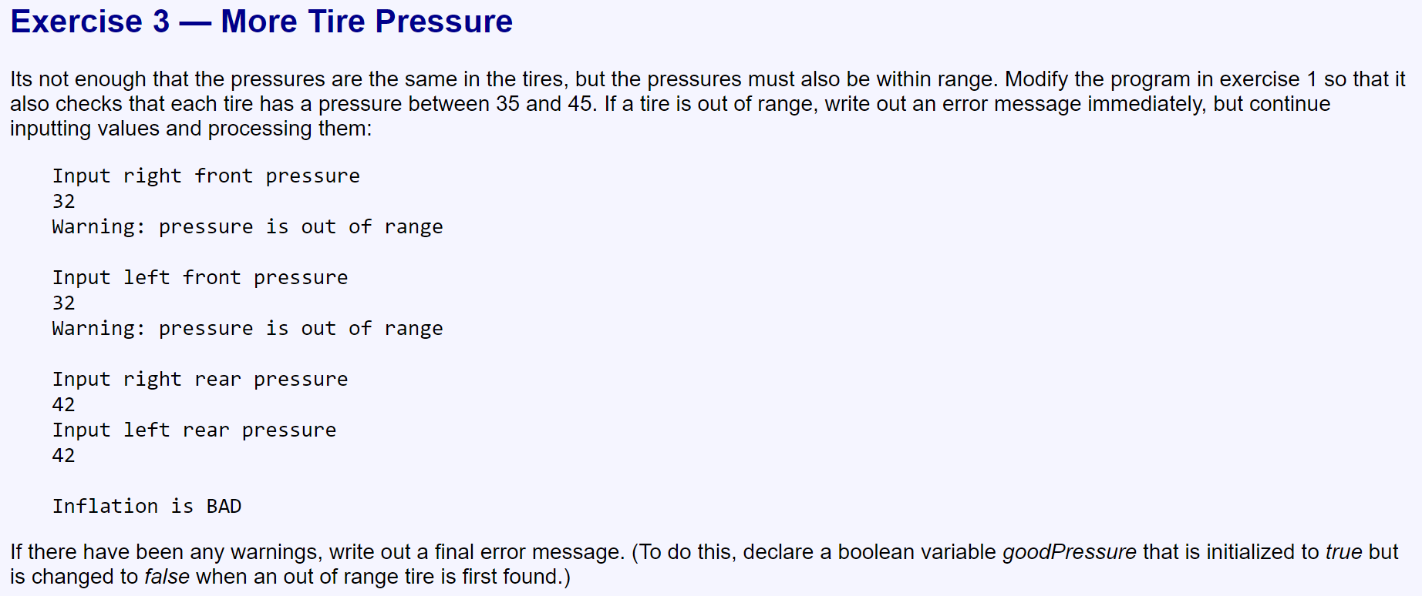

Slide 25


