Slide 1
Arrays
Introduction to Arrays
Common Array Algorithms
Arrays as Parameters
MultiDimensional Arrays

Slide 2
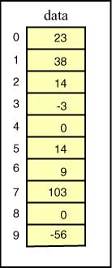
Picture of an Array
An array is an object that is used to store a list of values. It is made out of a contiguous block of memory that is divided into a number of cells.
Each cell holds a value, and all the values are of the same type. Sometimes the cells of an array are called slots.
In the example array pictured at right, each cell holds an int.
The name of this array is data.
The cells are indexed 0 through 9.
Each cell can be accessed by using its index. For example, data[0] is the cell which is indexed by zero (which contains the value 23). data[5] is the cell which is indexed by 5 (which contains the value 14).
The value stored in a cell of an array is sometimes called an element of the array.
An array has a fixed number of cells.
The values in the cells (the elements) can be changed.

Slide 3
Arrays aren’t Objects
Array declarations look like this:
type[] arrayName;
An array is an object, and like any other object in Java, it is constructed out of main storage as the program is running.
The array constructor uses different syntax than other object constructors:
new type[ length ]
Once an array has been constructed, the number of cells it has does not change. Here is an example:
int[] data = new int[10];
This statement creates an array of 10 ints, puts a zero into each cell, and puts a reference to that object in data.

Slide 4
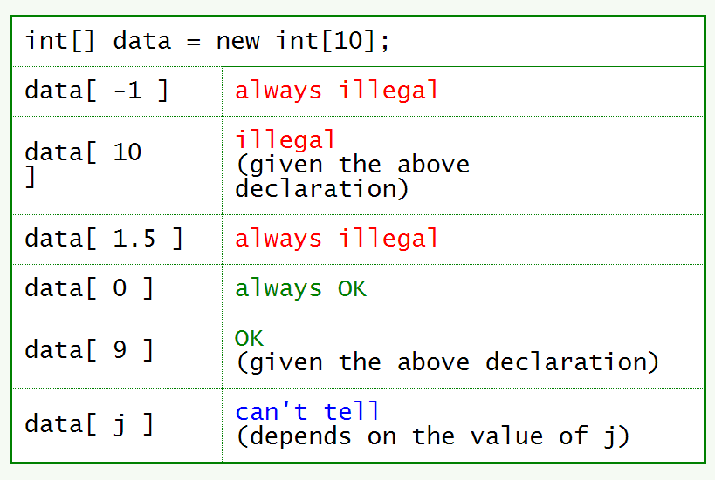
Bounds Checking
The length of an array is how many cells it has.
An array of length N has cells indexed 0..(N-1)Indexes must be an integer type.

Slide 5
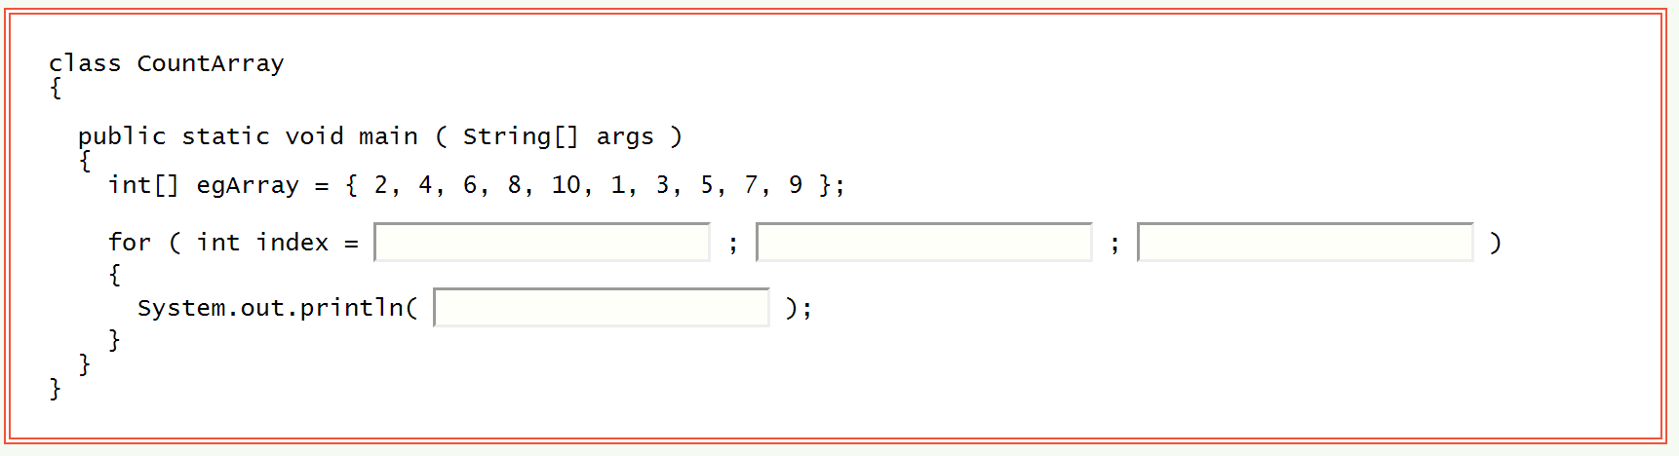
Common Array Algorithms
Counting Loops and Arrays

Slide 6
The length of an Array
The length instance variable of an array is the number of cells it has.

Slide 7
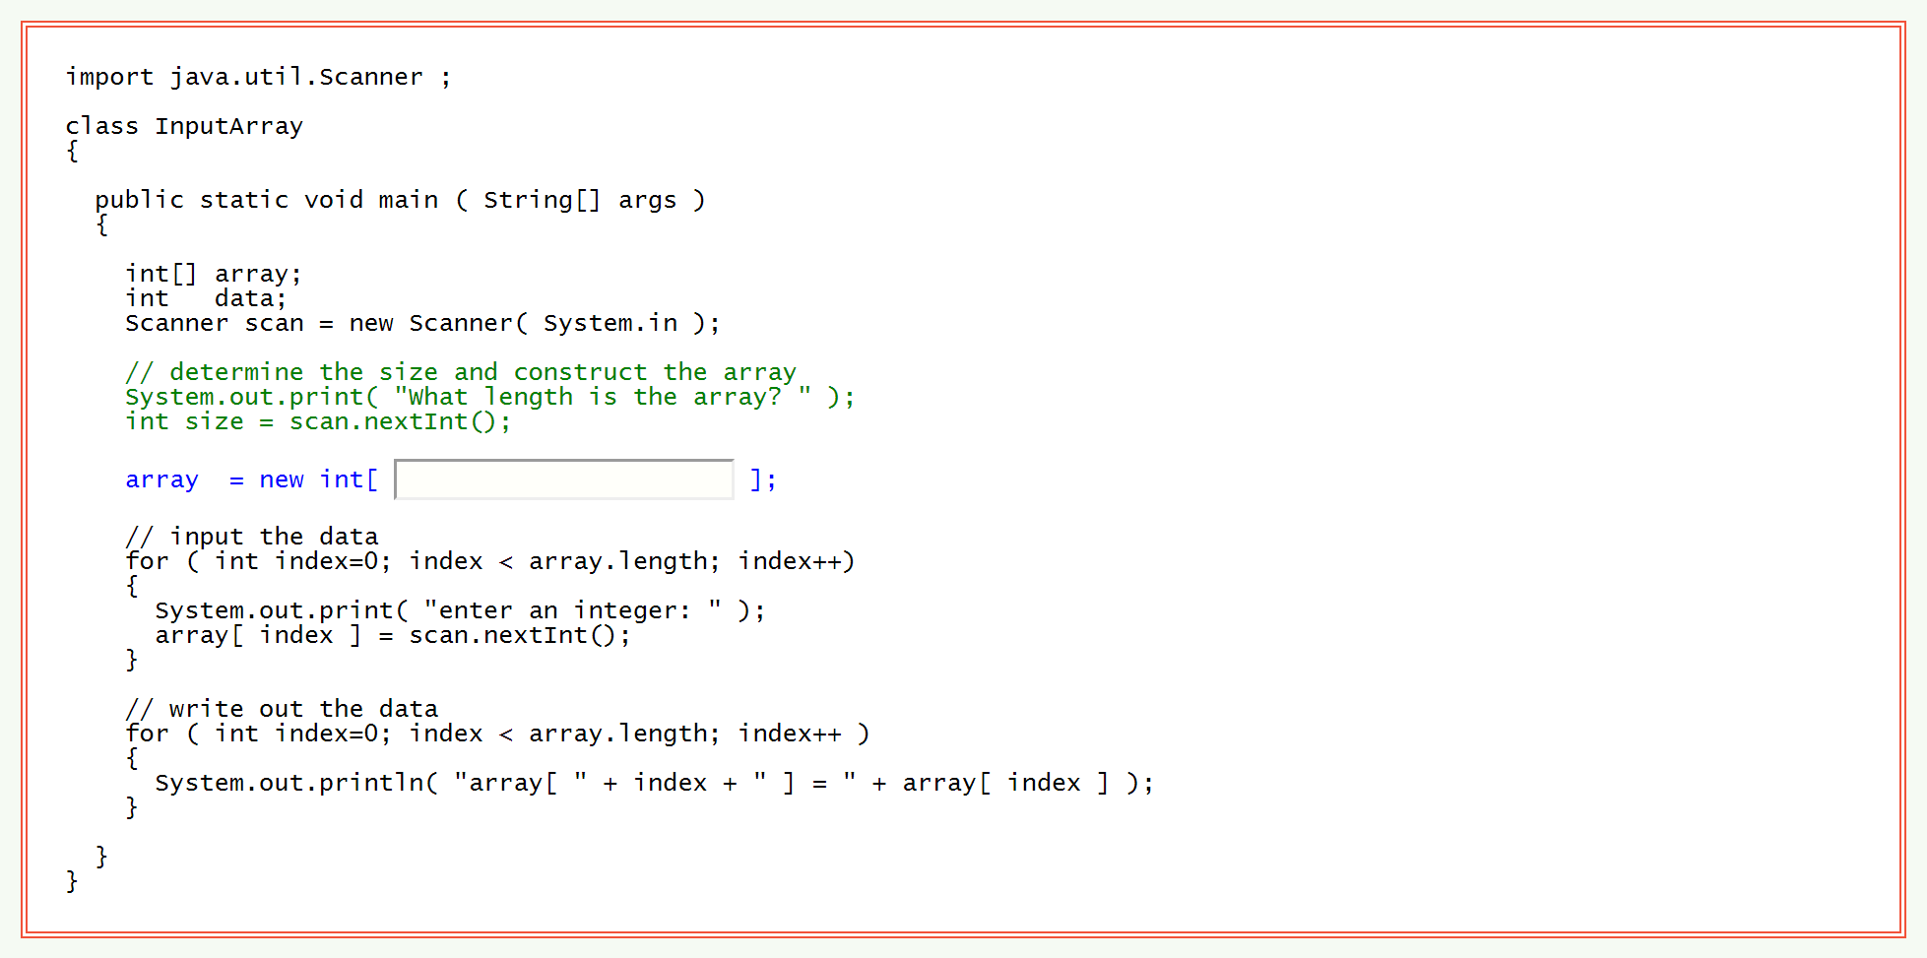
Run-time Array Length

Slide 8
Minimum and Maximum
The largest integer in a list of integers is the maximum value.
The maximum may occur several times, but no other integer in the list is larger.
Similarly, the smallest integer in the list is the minimum.
The minimum may occur several times.

Slide 9
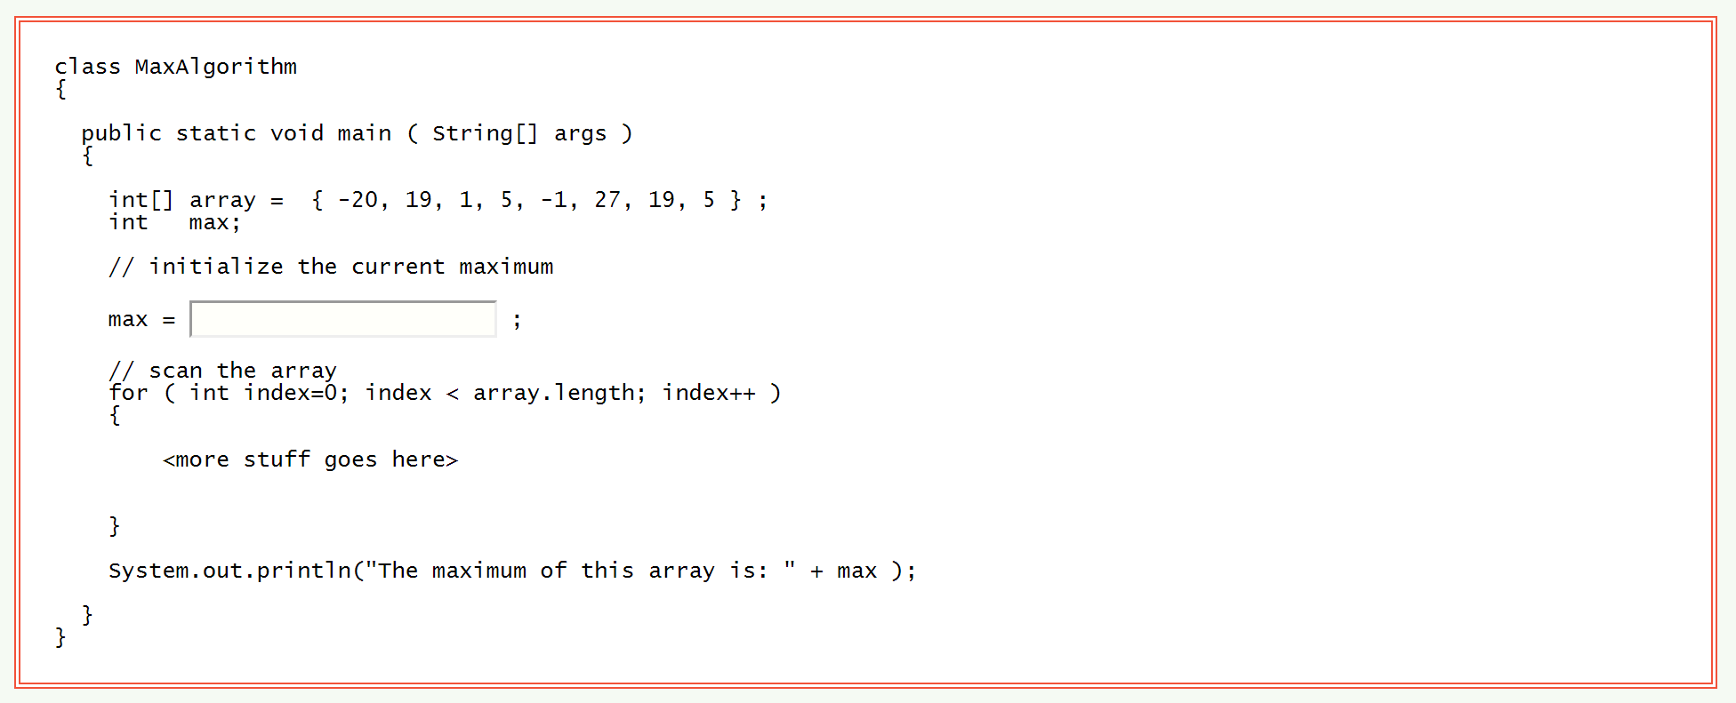
Finding the Maximum of an Array
A systematic procedure used to compute something is called an algorithm.
An algorithm is a description of how to do something.
It is not tied to any particular language.

Slide 10
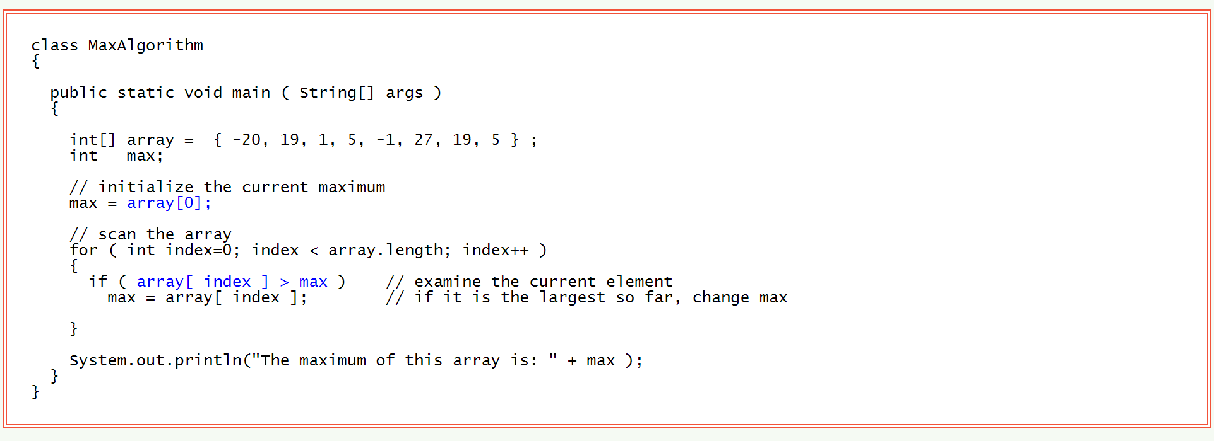
Complete Max Program

Slide 11
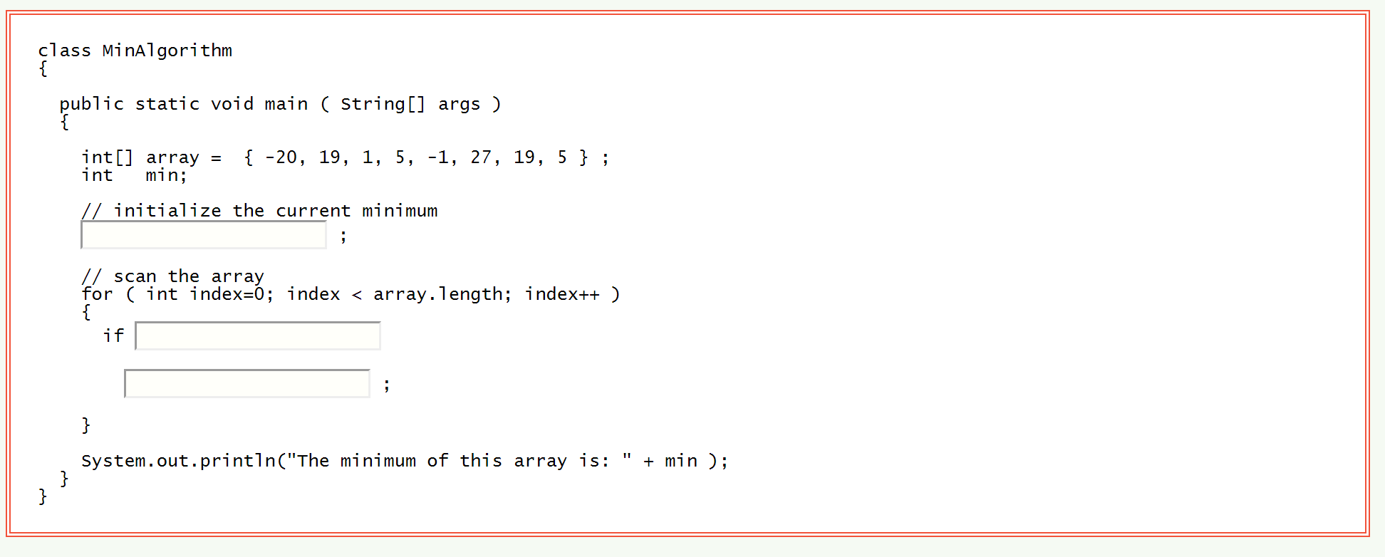
Finding the minimum in an Array

Slide 12
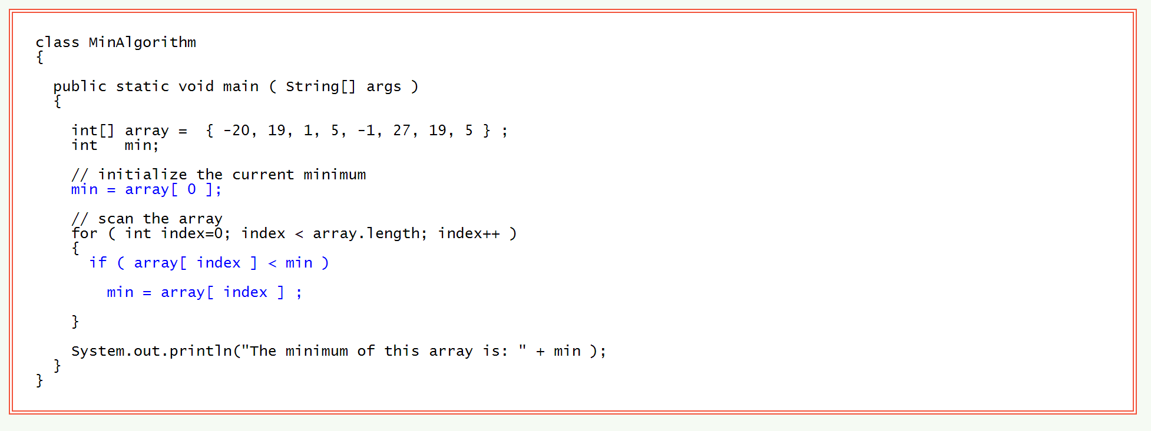
Complete Minimum-finding Program

Slide 13
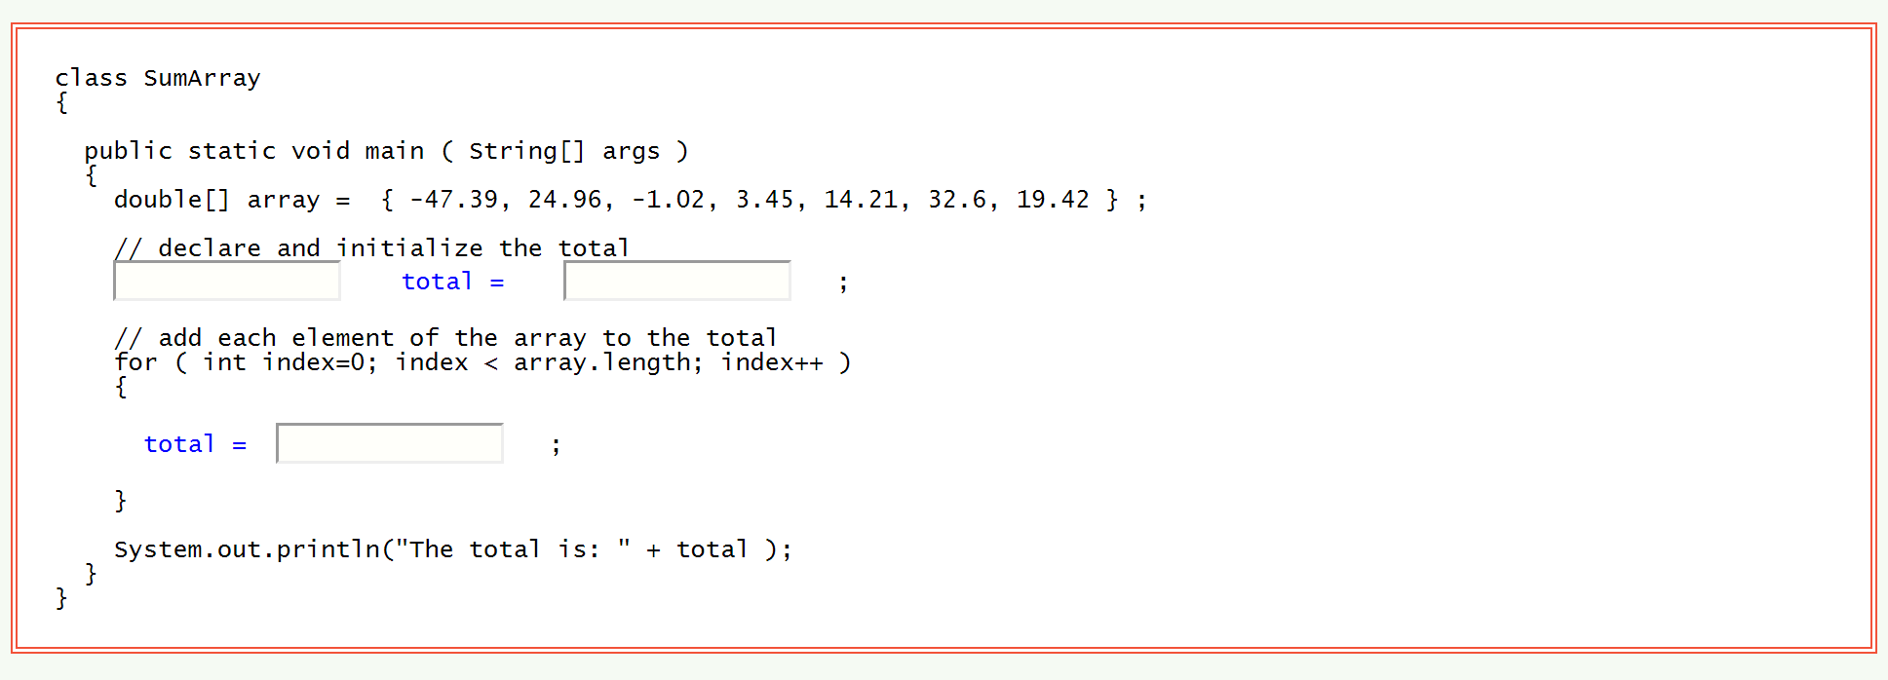
Summing the numbers in an Array

Slide 14
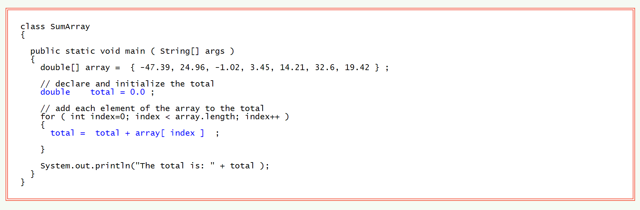
Complete Summing Program

Slide 15
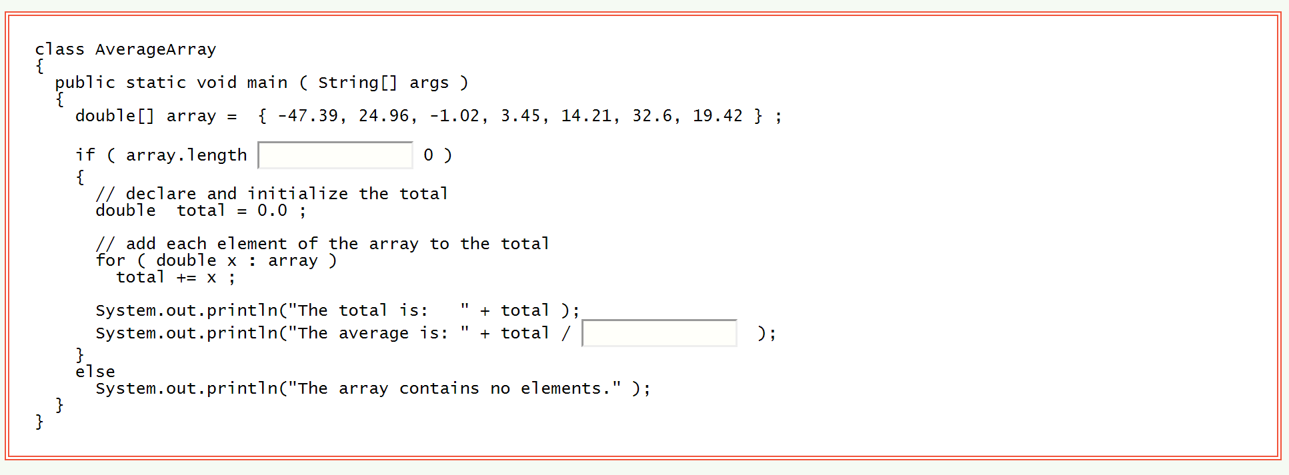
Computing the Average

Slide 16
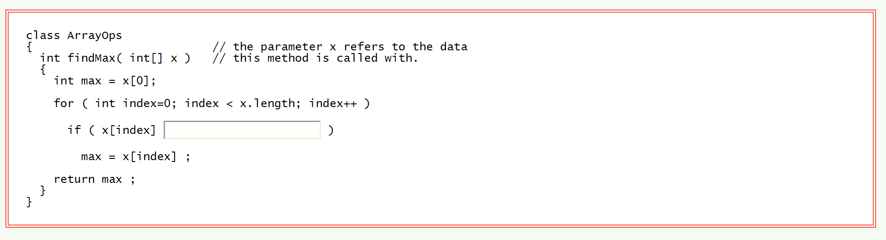
Maximum-finding Method

Slide 17
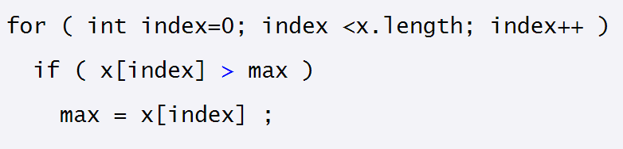
Answer

Slide 18
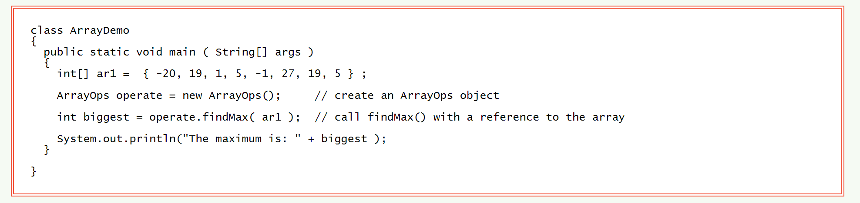
Using the Method

Slide 19
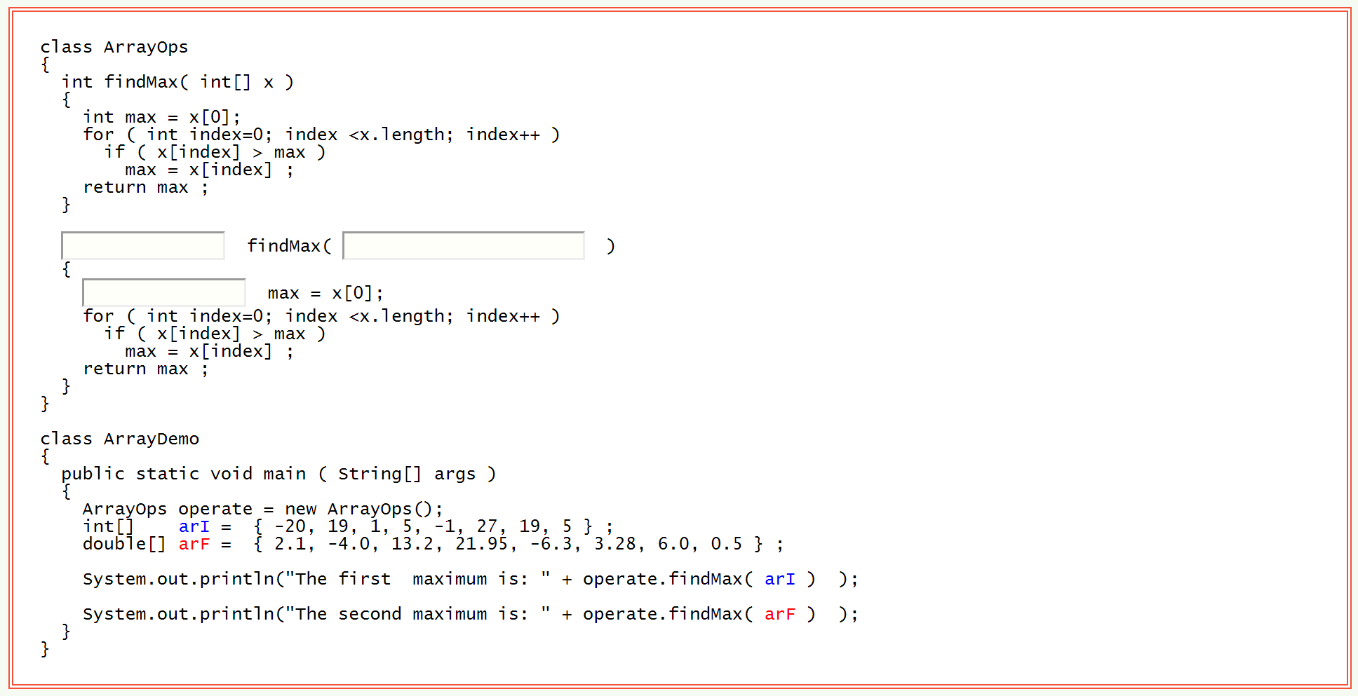
Overloaded Method
It would be useful to have a method that finds the maximum of an array of double.
Here is a start on this method;

Slide 20
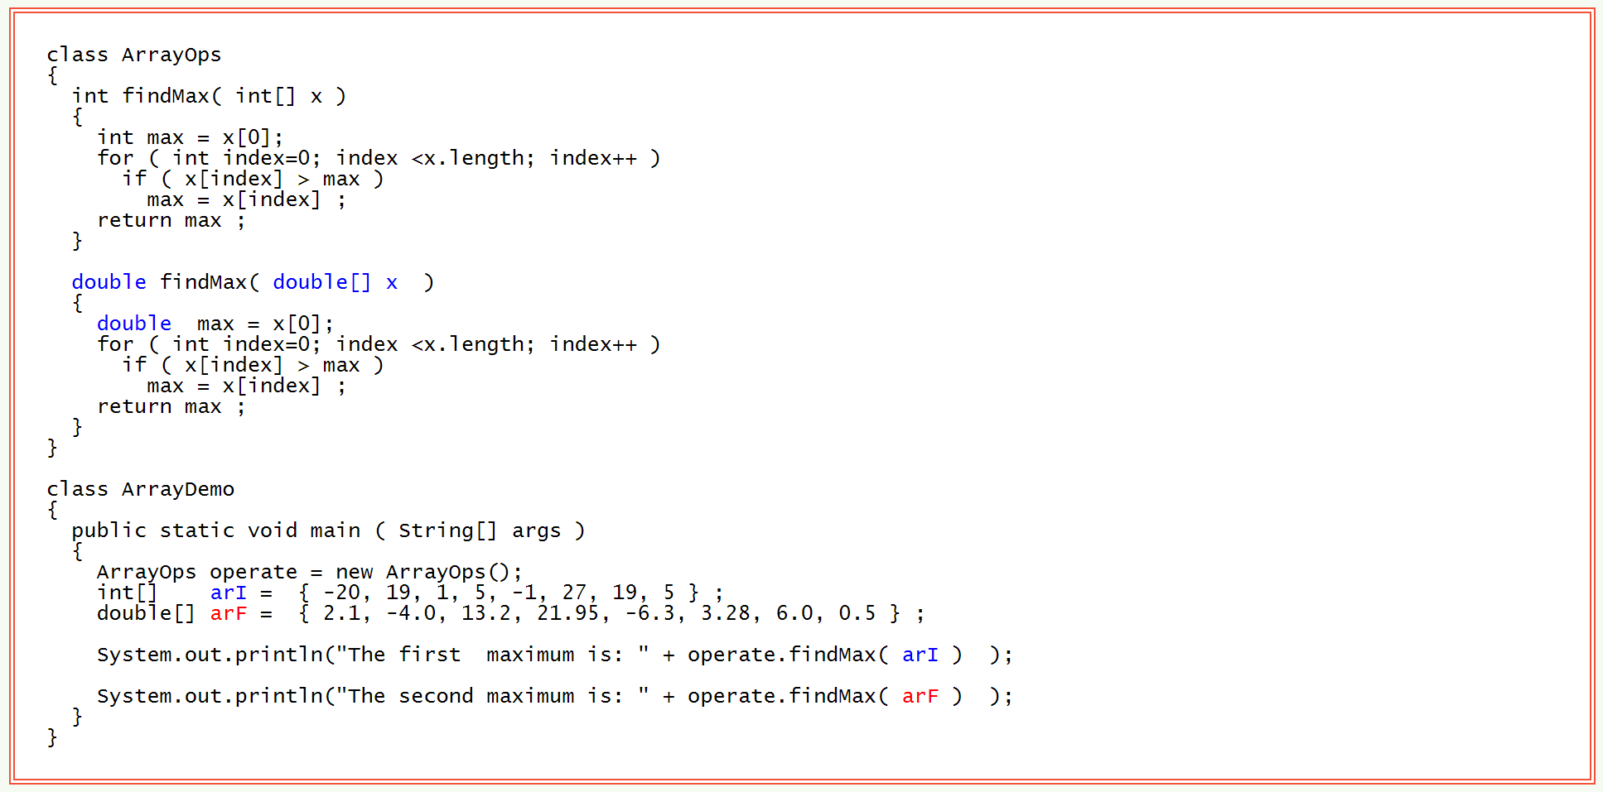
Overloaded Method

Slide 21
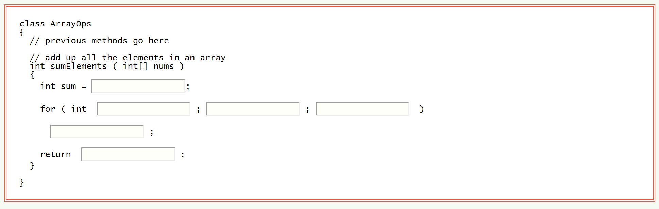
Sum Method

Slide 22
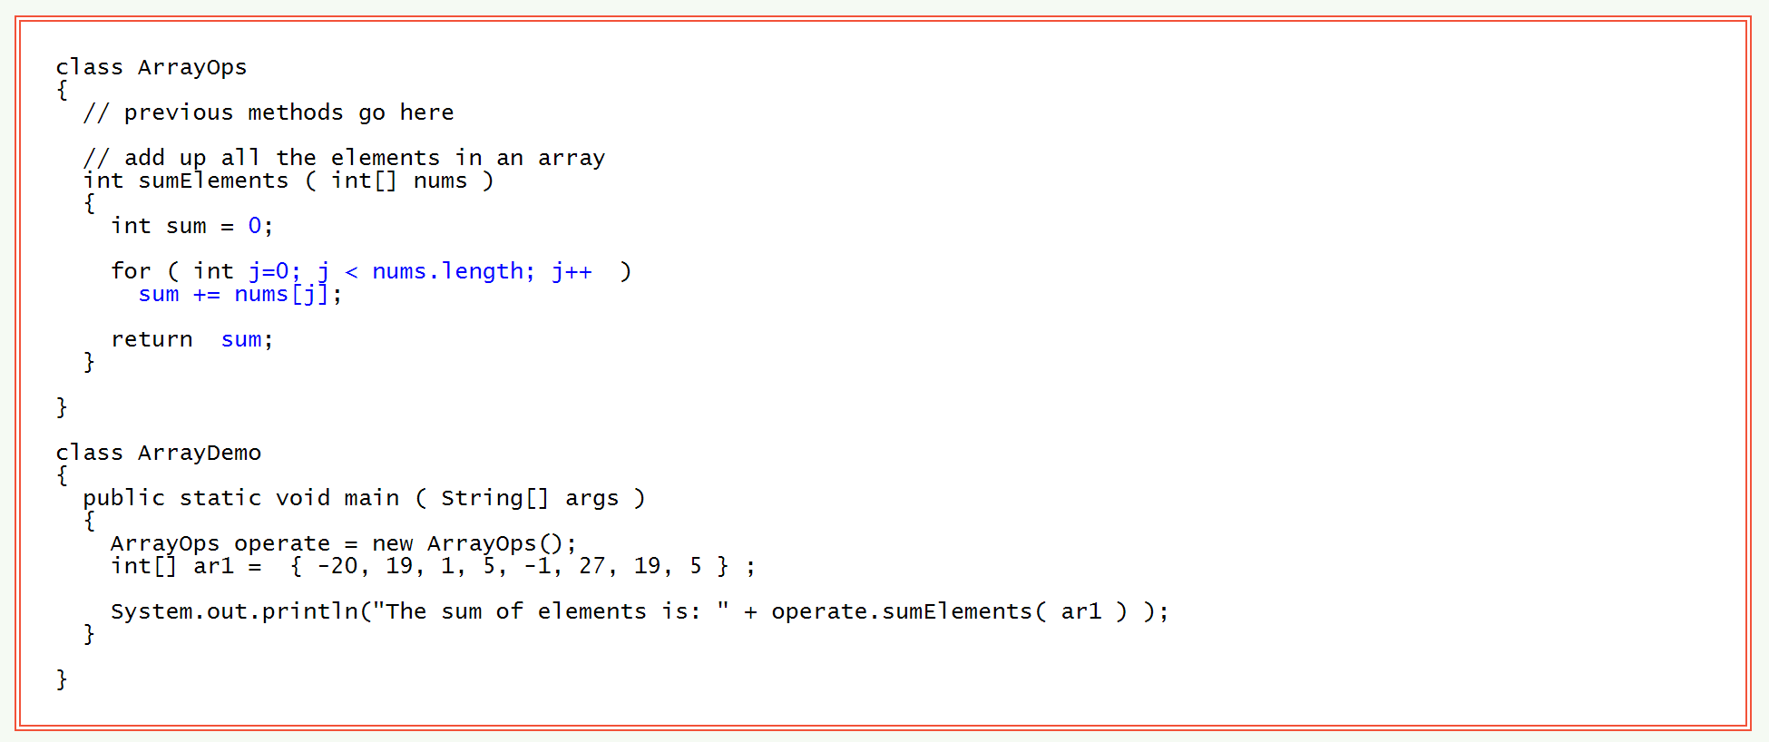
Complete Sum Method

Slide 23
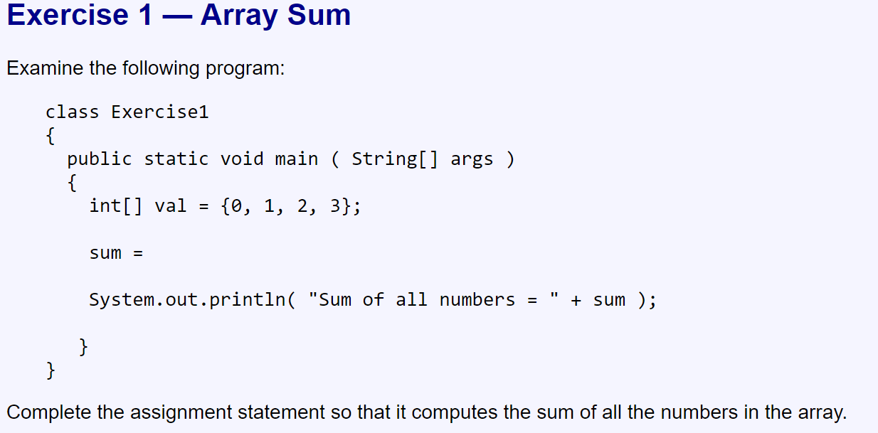
Exercises

Slide 24
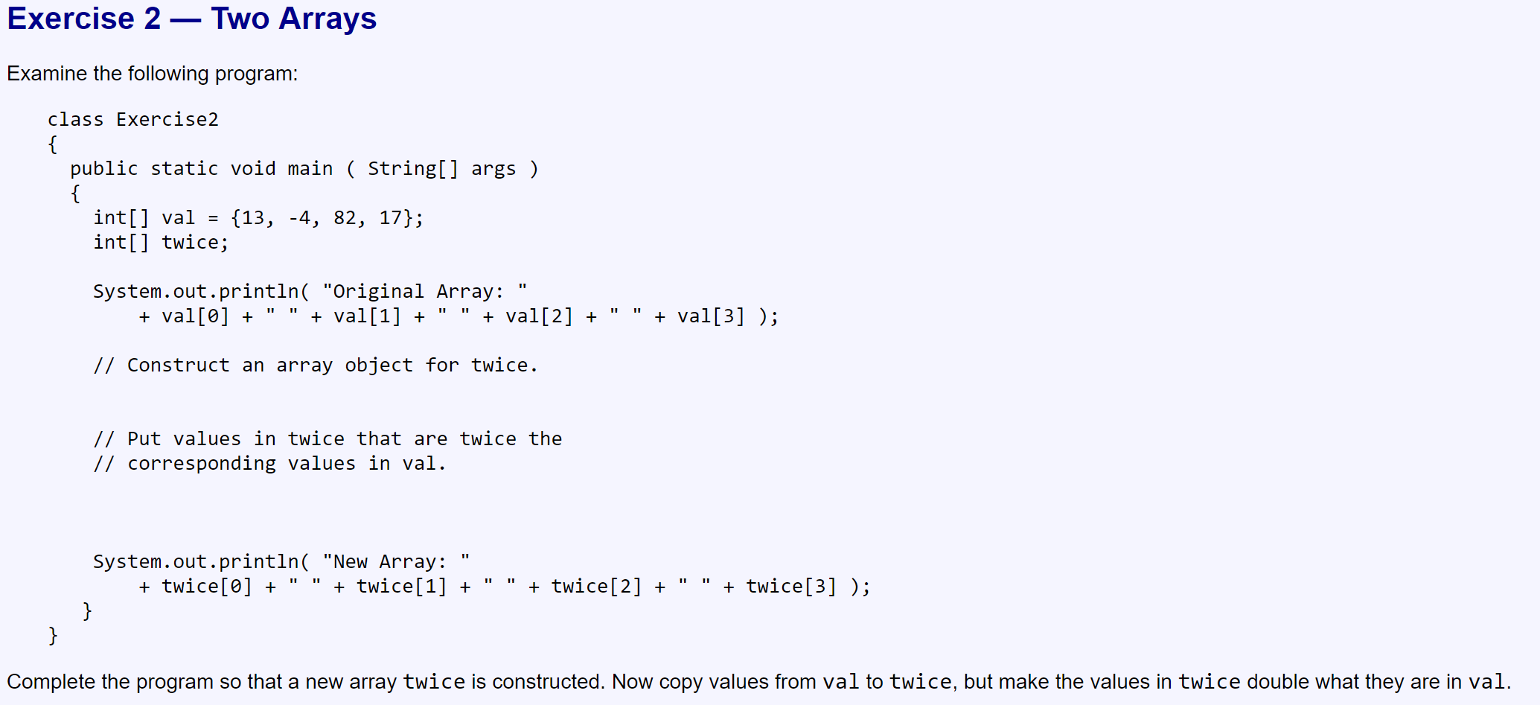

Slide 25
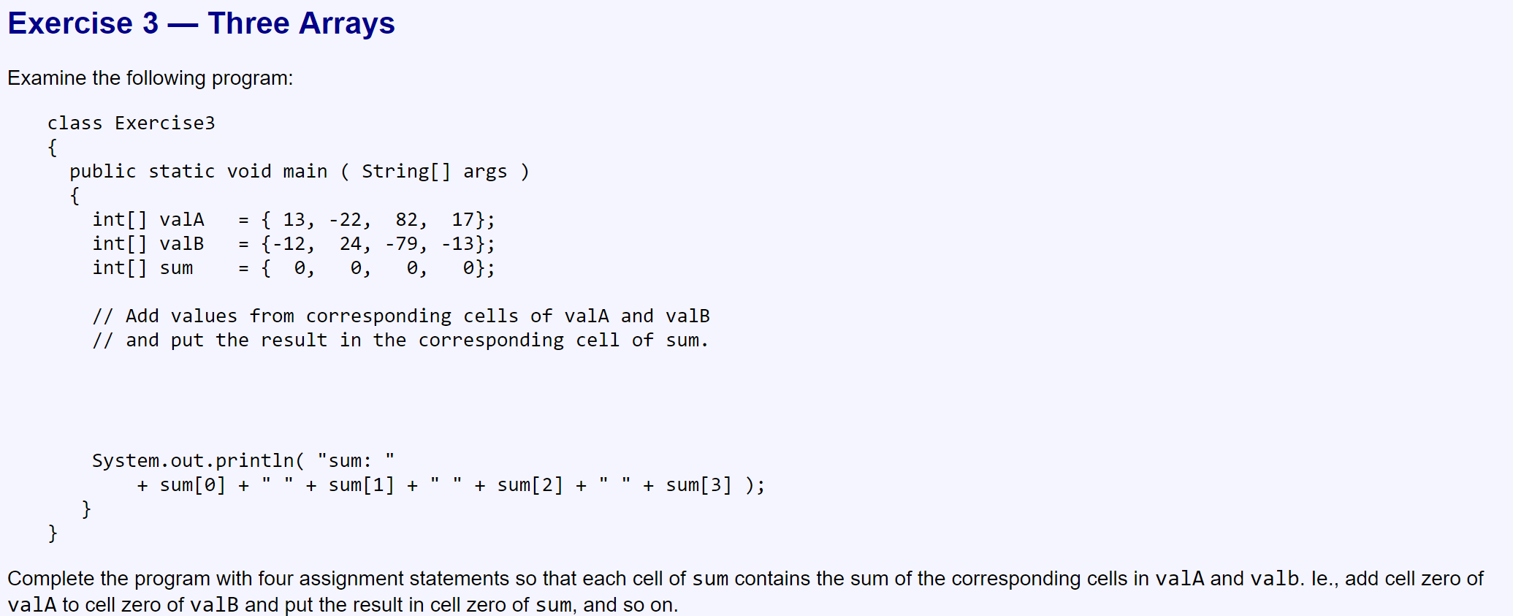

Slide 26
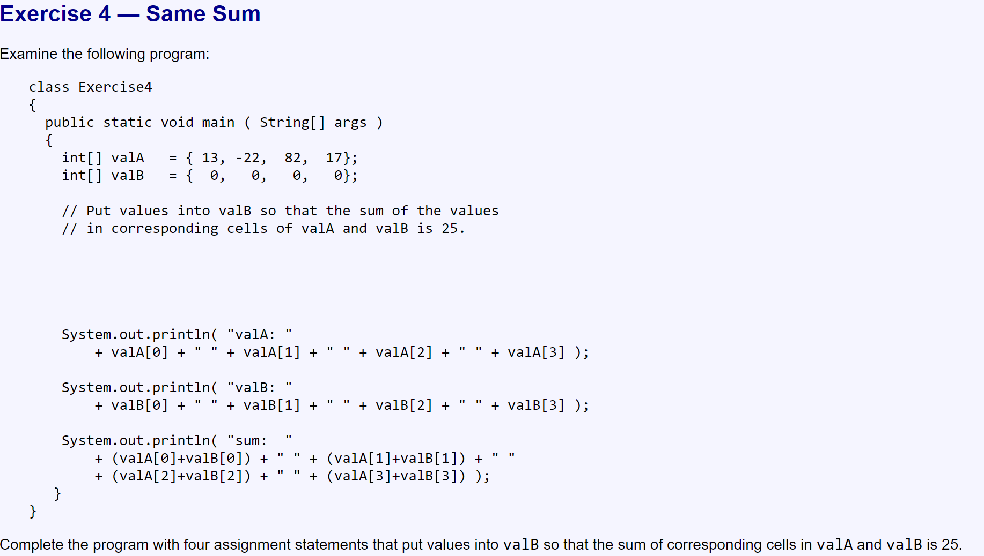

Slide 27
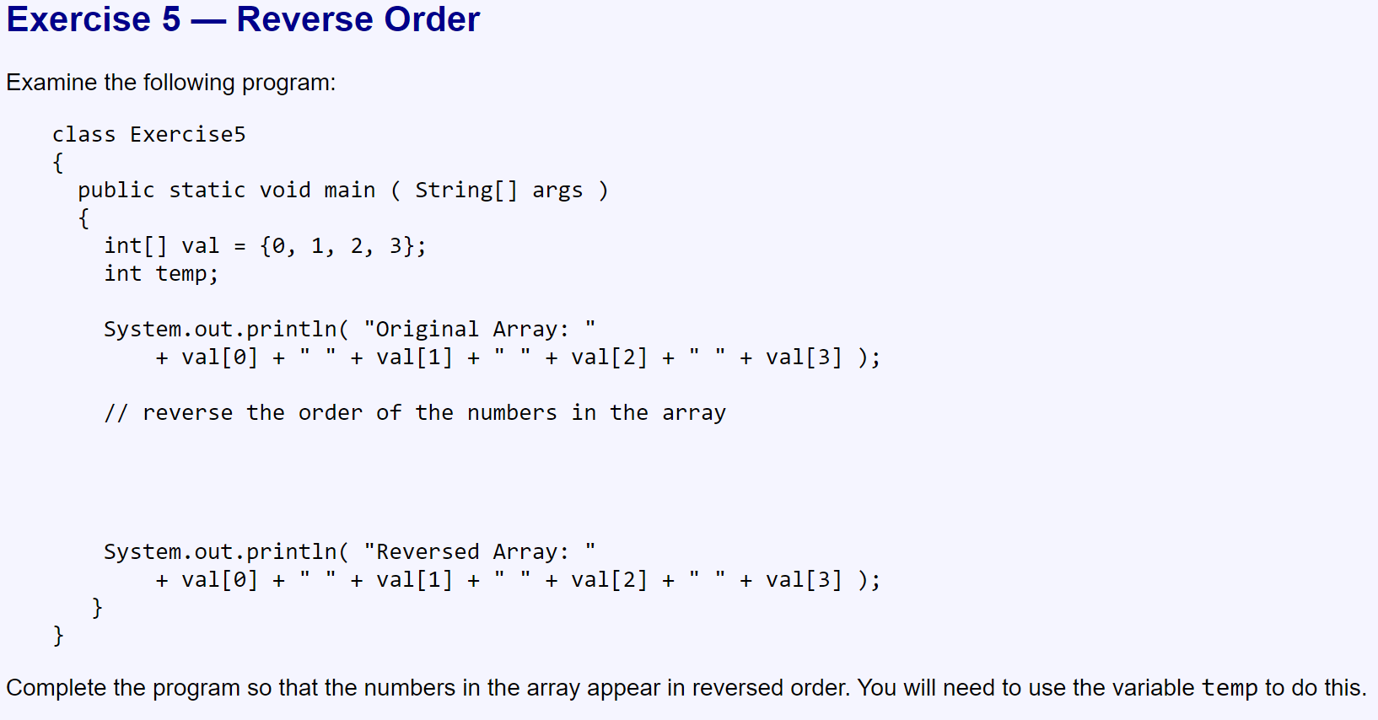

Slide 28
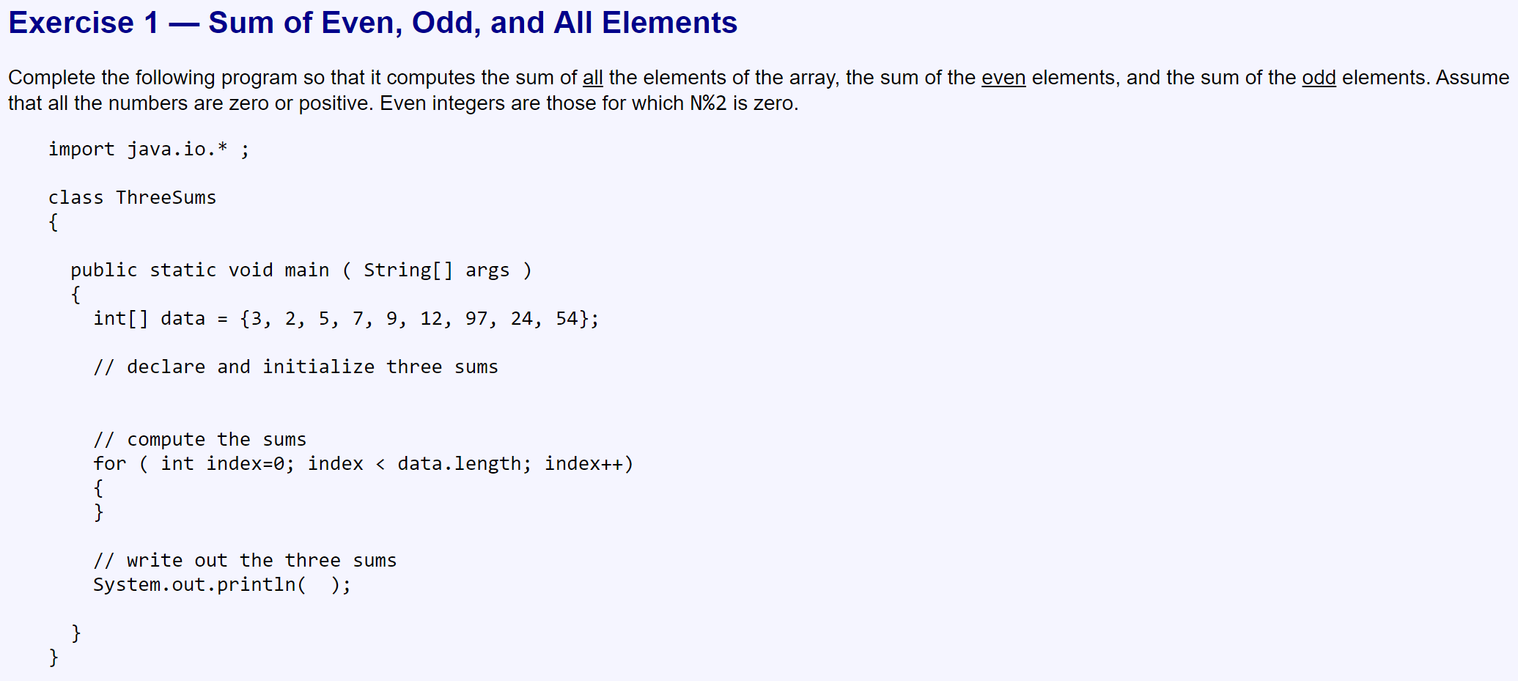
Part 2

Slide 29
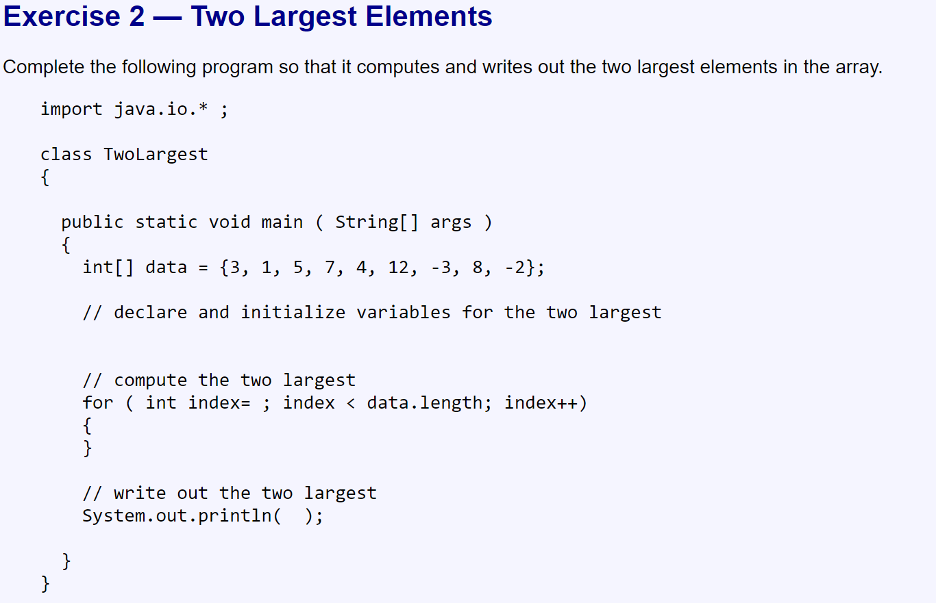

Slide 30
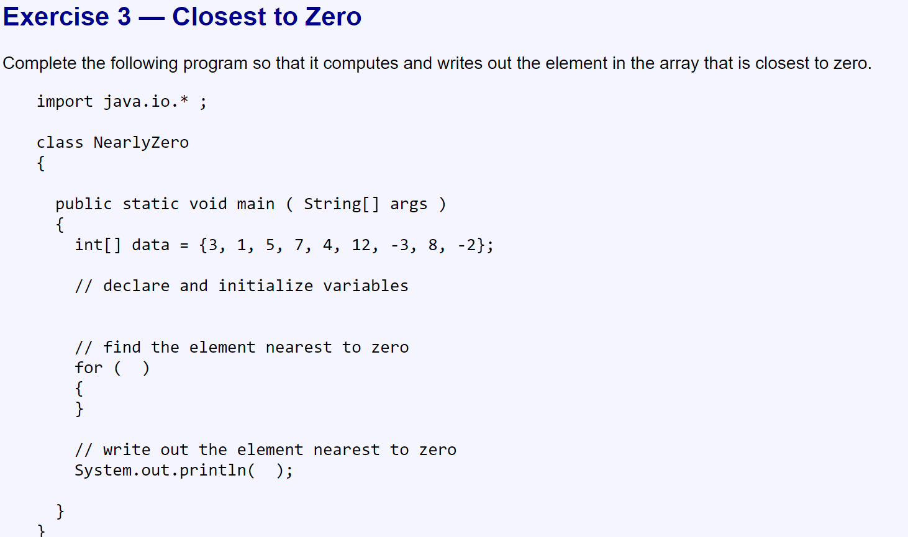

Slide 31
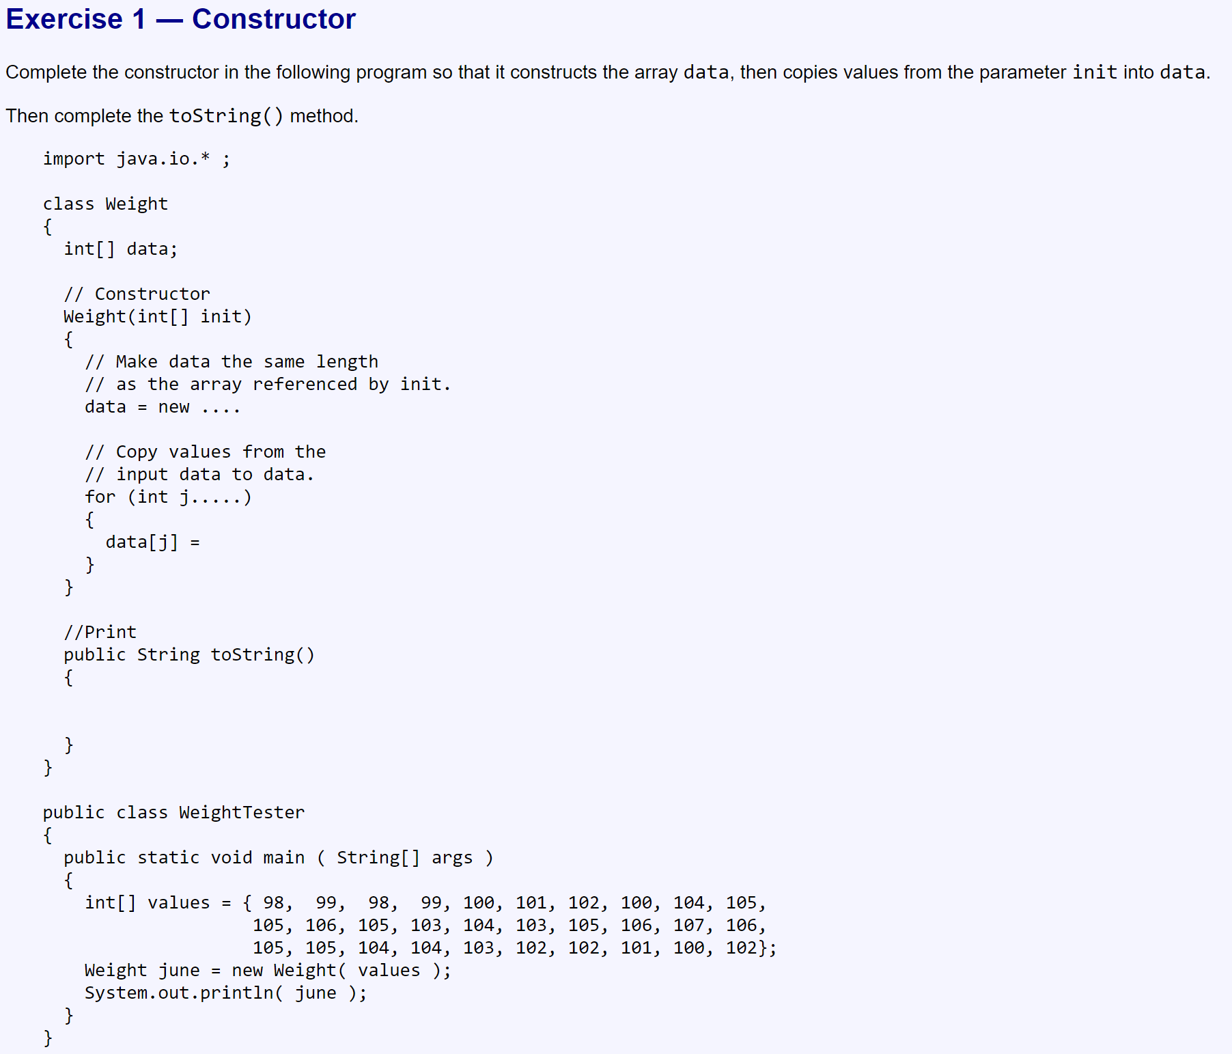
Part 3

Slide 32
