Slide 1
Search Algorithms
Sequential Search (Linear Search)
Binary Search
DATA STRUCTURES USING AS3

Slide 2


SEQUENTIAL SEARCH
A sequential search of a list/array begins at the beginning of the list/array and continues until the item is found or the entire list/array has been searched
DATA STRUCTURES USING AS3

Slide 3
SEQUENTIAL SEARCH FUNCTION
boolean function LinSearch(int[] x, int item){
int n=x.length;
for(int i=0;i<n;i++)
{
if(x[i]==item) return true;
}
return false;
}
DATA STRUCTURES USING AS3

Slide 4
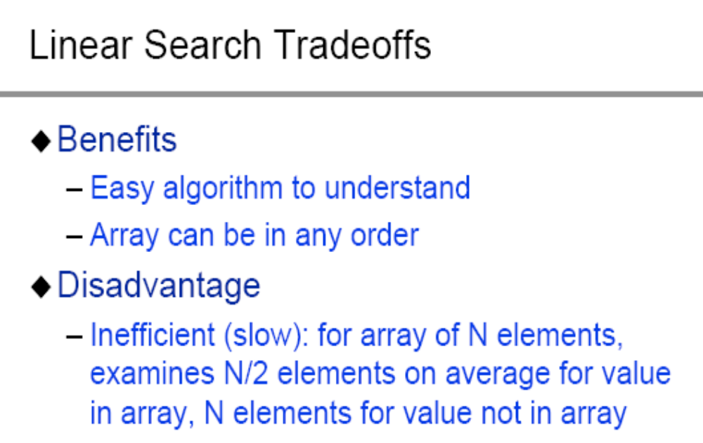
SEARCH ALGORITHMS
DATA STRUCTURES USING AS3

Slide 5
BINARY SEARCH
A binary search looks for an item in a list using a divide-and-conquer strategy
DATA STRUCTURES USING AS3

Slide 6
BINARY SEARCH
  Binary search algorithm assumes that the items in the array being searched are sorted
  The algorithm begins at the middle of the array in a binary search
  If the item for which we are searching is less than the item in the middle, we know that the item won’t be in the second half of the array
  Once again we examine the “middle” element
  The process continues with each comparison cutting in half the portion of the array where the item might be
DATA STRUCTURES USING AS3

Slide 7
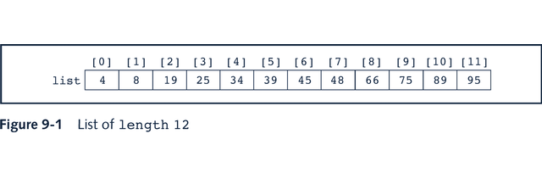
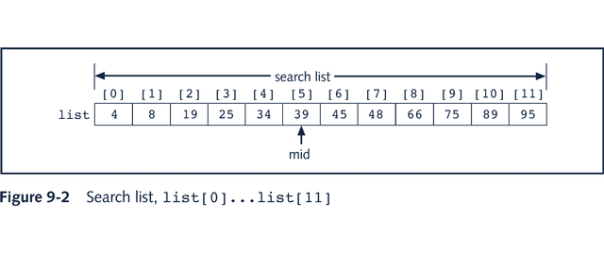
BINARY SEARCH
DATA STRUCTURES USING AS3

Slide 8
BINARY SEARCH: MIDDLE ELEMENT
left + right
mid =
Floor(
)
2
DATA STRUCTURES USING AS3

Slide 9
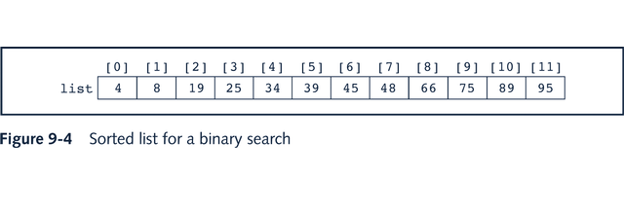
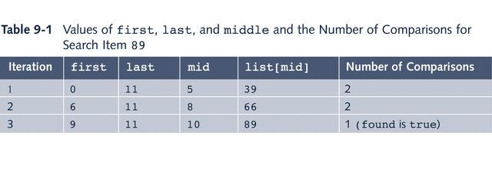
BINARY SEARCH: EXAMPLE
DATA STRUCTURES USING AS3

Slide 10
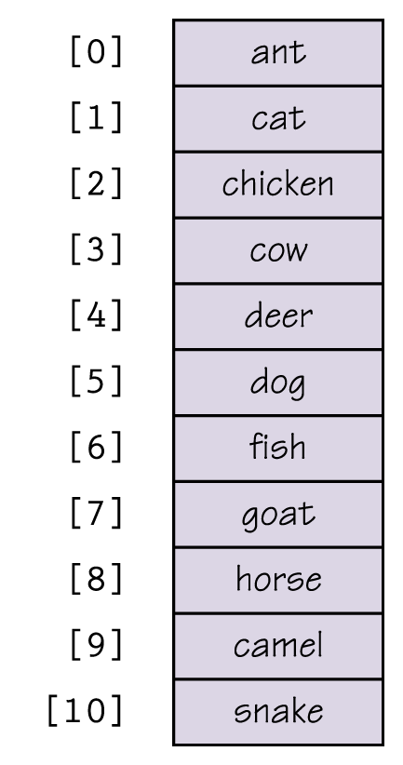
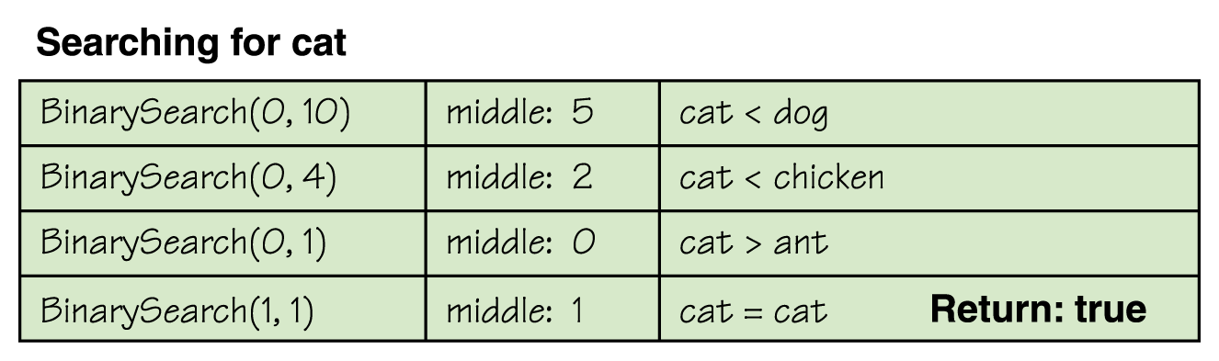
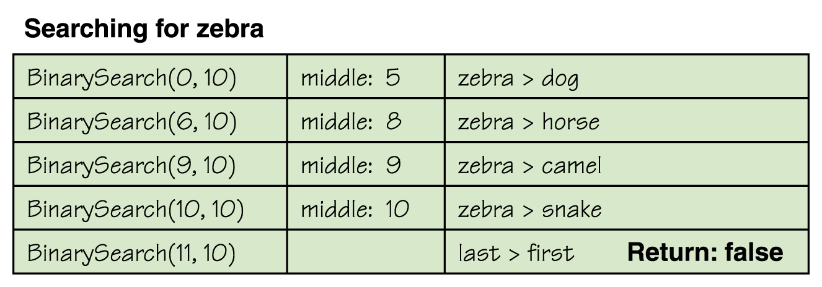
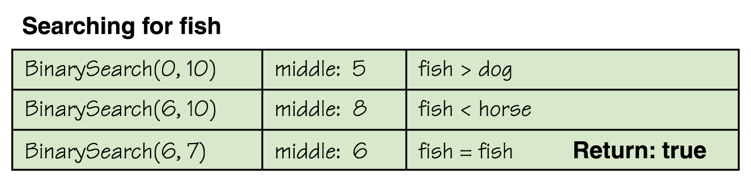
BINARY SEARCH
DATA STRUCTURES USING AS3

Slide 11
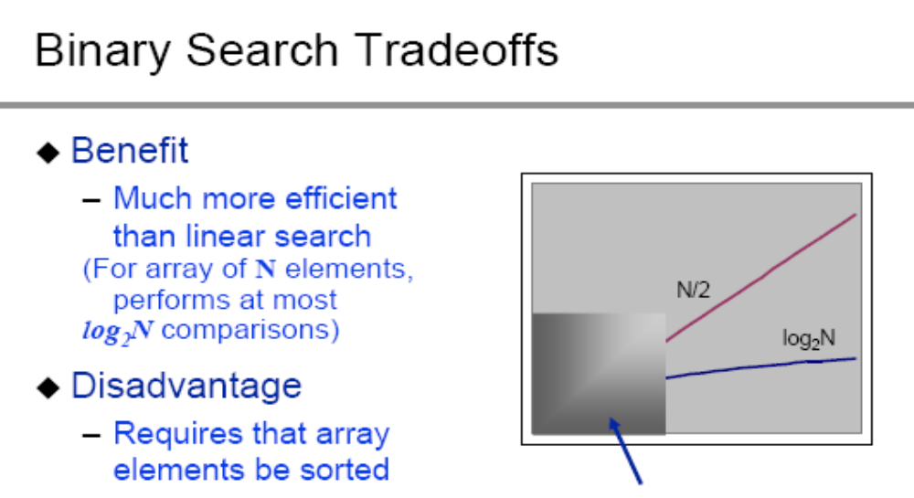
BINARY SEARCH
DATA STRUCTURES USING AS3

Slide 12
EXERCISE-ASSIGNMENT
Design and code a program to illustrate the process of binary search by reading in the file “ispell.words” and then searching for a word (provided by the user) in the file.
Make sure your program indicates whether the item to be found is in the array to be searched and if so where it was found and how many iterations it took.
Post your source and program on your Unit 3 Web Page
DATA STRUCTURES USING AS3

