Slide 1
Objects and Classes

Slide 2
Characteristics of Objects
An object has identity (each object is a distinct individual).
An object has state (it has various properties, which might change).
An object has behavior (it can do things and can have things done to it).

Slide 3
Software Objects
Software objects have identity, state, and behavior just as do real world objects.
Of course, software objects exist entirely within a computer system and don't directly interact with real world objects.

Slide 4
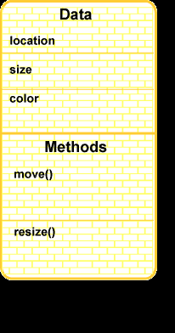
Picture of an Object

Slide 5
Class
A class is a description of a kind of object.
A programmer may define a class using Java, or may use predefined classes that come in class libraries.
A class is merely a plan for a possible object. It does not by itself create any objects.
When a programmer wants to create an object the new operator is used with the name of the class.
Creating an object is called instantiation.

Slide 6
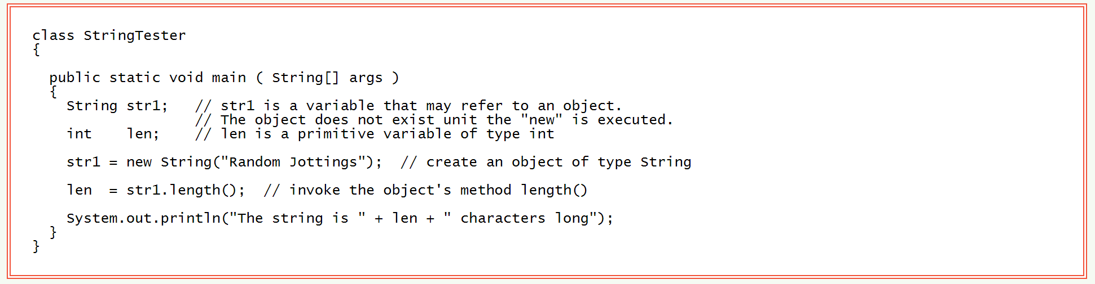
Instantiation

Slide 7
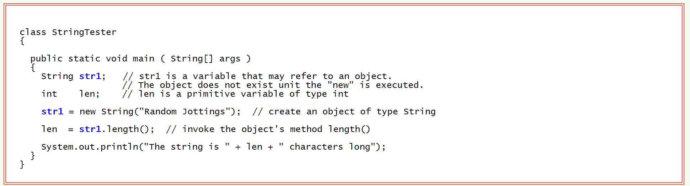
Objects and Names for Objects

Slide 8
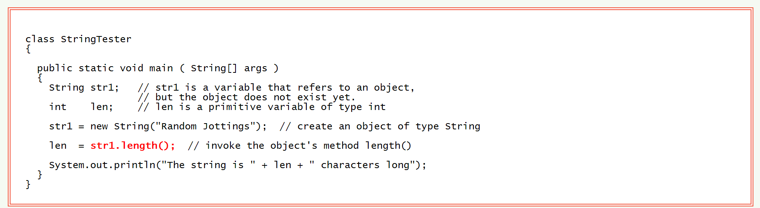
Using a Reference to an Object

Slide 9
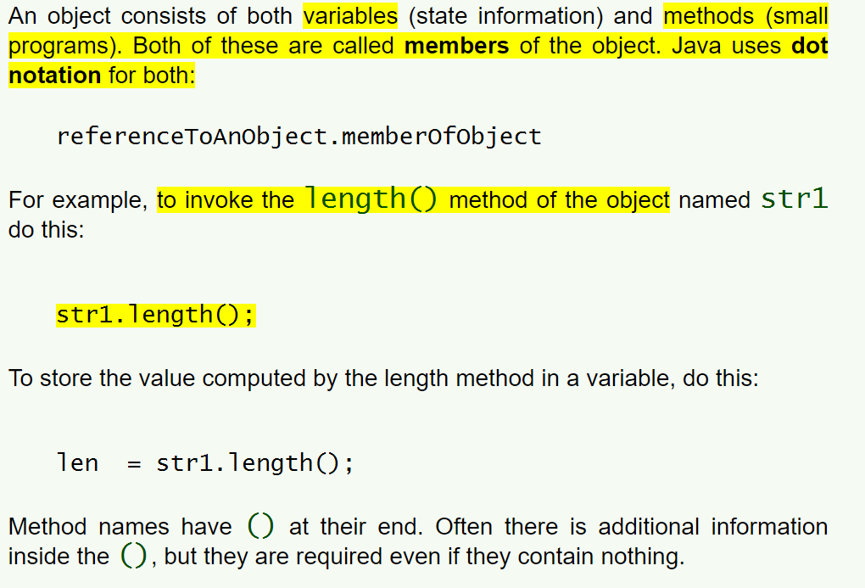
Invoking an Object's Method

Slide 10
Static
In Java, a characteristic of a class definition that is not shared by its objects is called static.
There is only one class definition for a given class, so when a program is running, if something is static then there is only one of it.

Slide 11
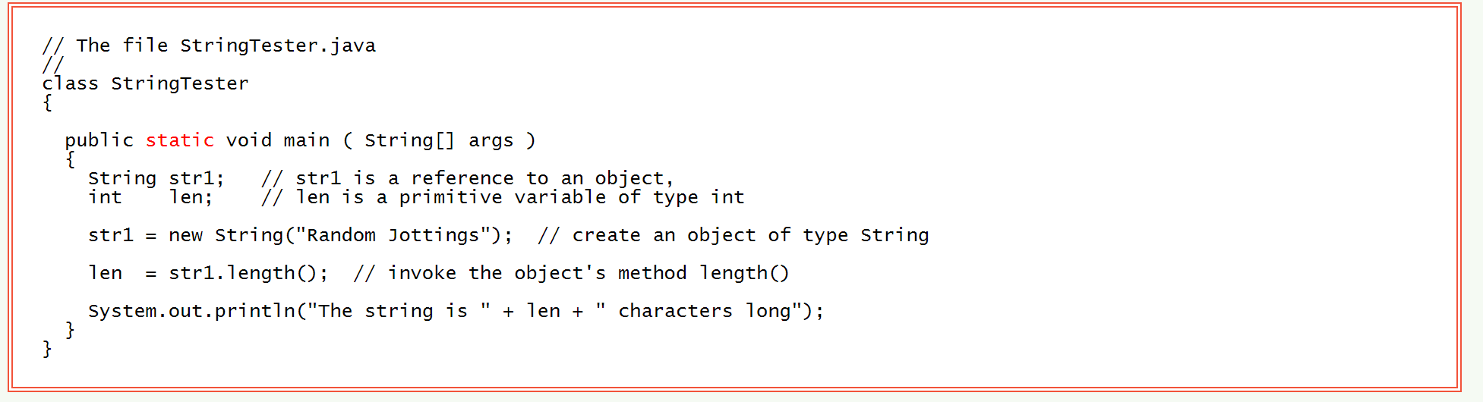
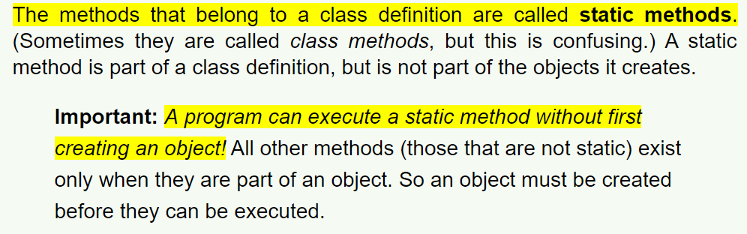
Static Methods

Slide 12
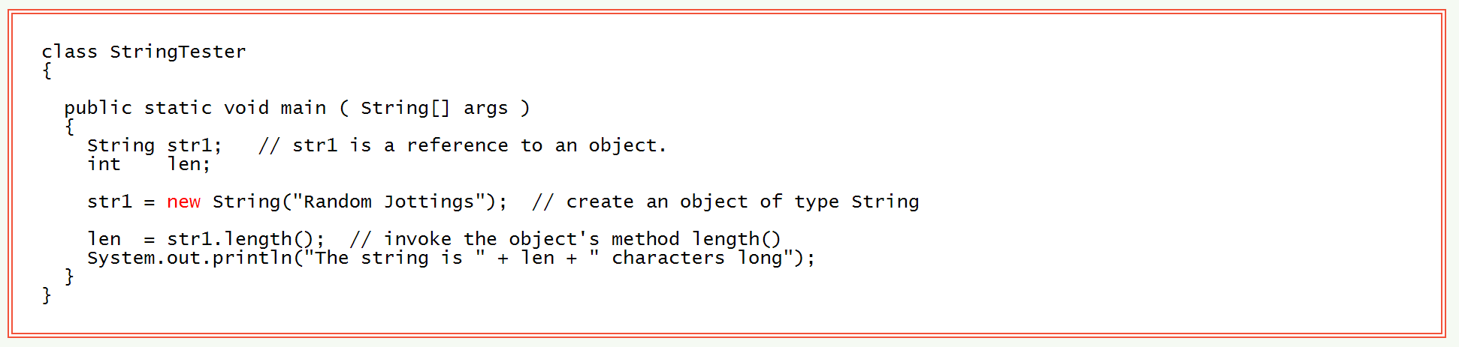
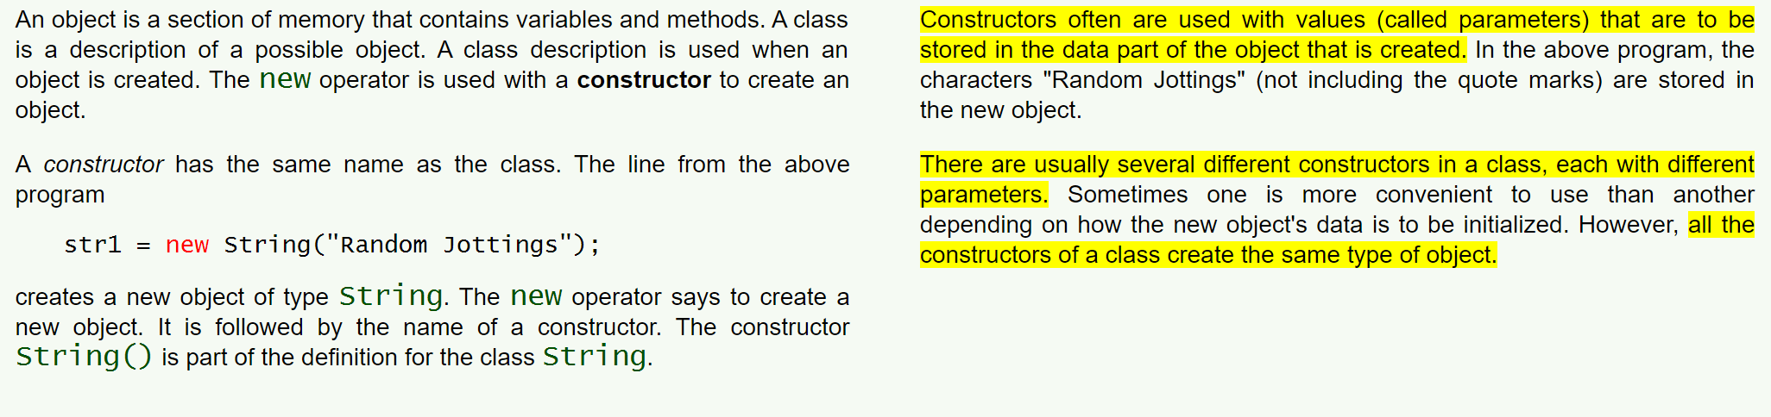
Constructors

Slide 13
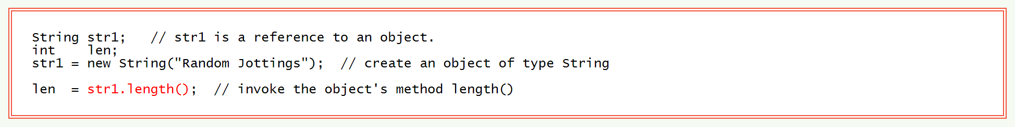
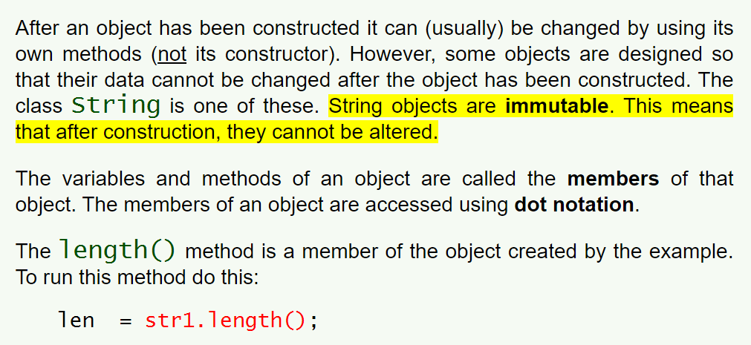
Dot Notation

Slide 14
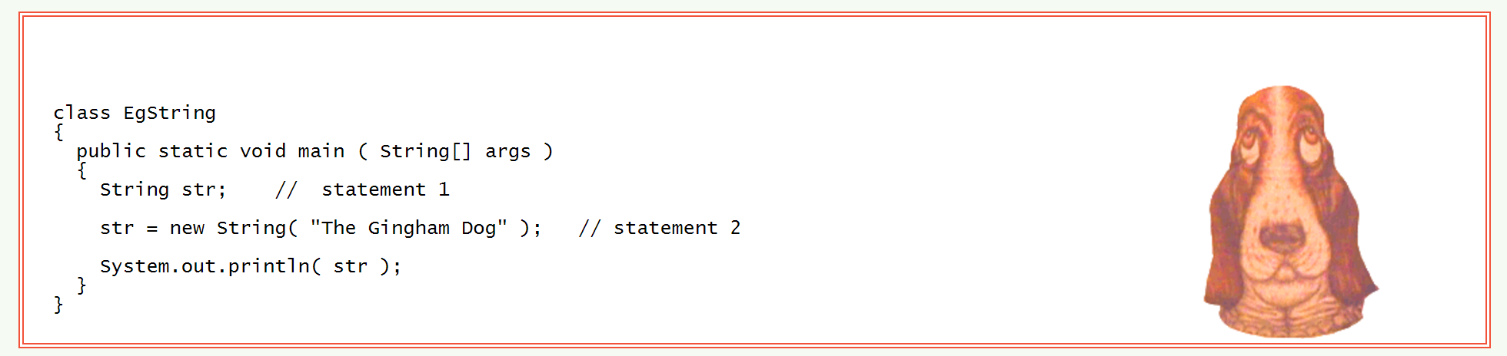
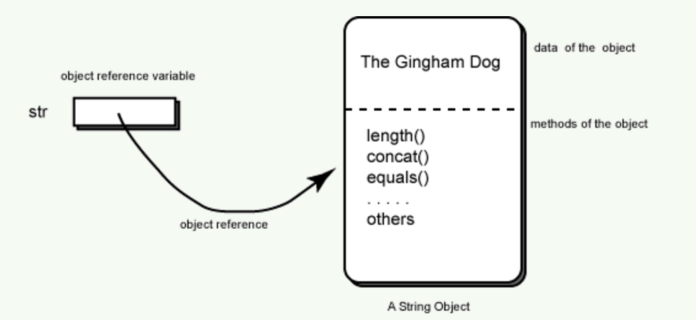
A String Object

Slide 15
Object Reference
An object reference describes the location in memory of a particular object.

Slide 16
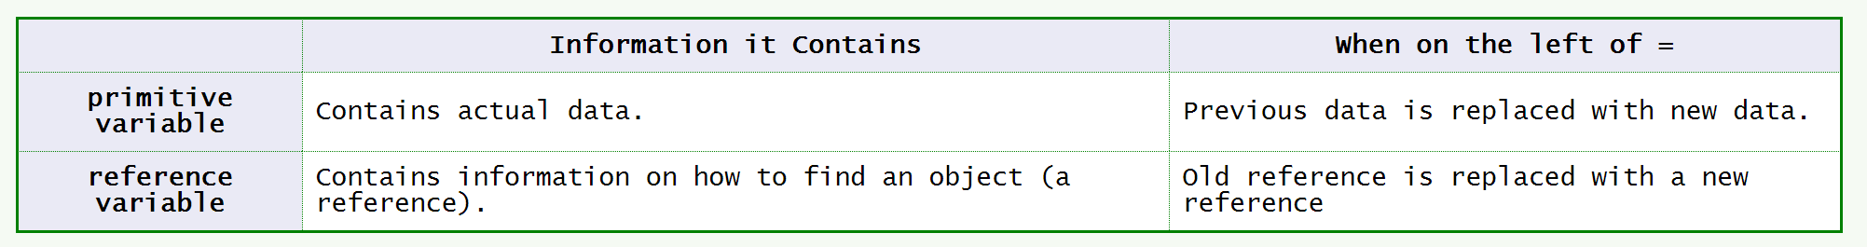
Two Types of Assignment Statements

Slide 17
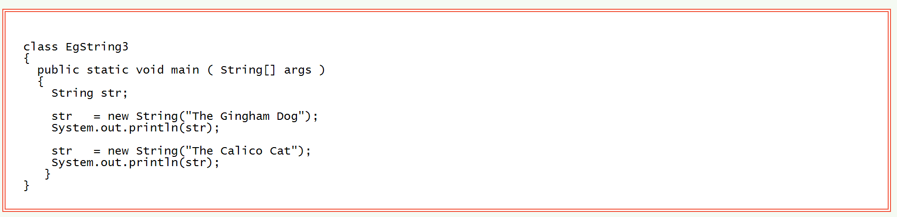
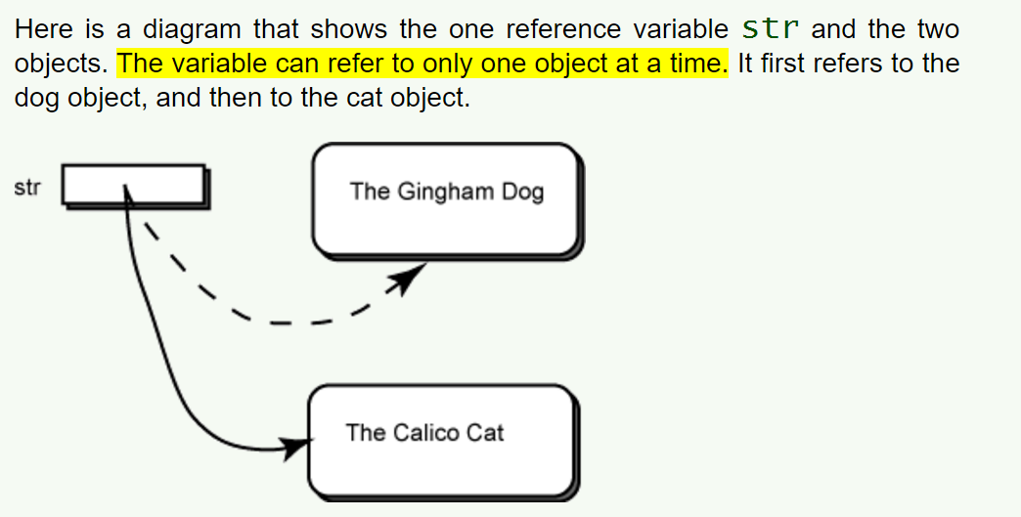
Reference Variable Reused

Slide 18
Garbage
The word garbage is the correct term for objects that are not referred to by any reference variable.
As a program executes, objects are created. Then when they are no longer needed references to them are discarded.
However, a part of the Java system called the garbage collector reclaims the lost objects so that the memory they are made of can be used again.

Slide 19
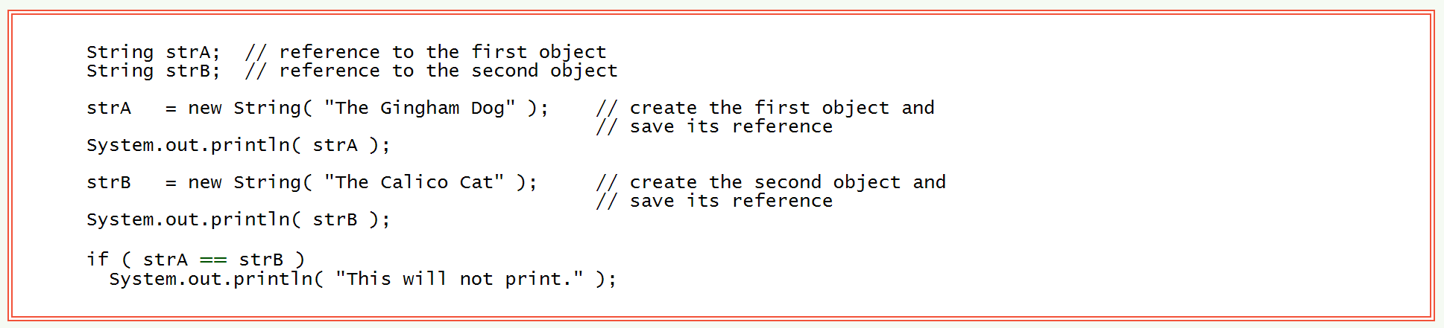
Equality of References
Since the reference in strA is different than the reference in strB, strA == strB is false.

Slide 20
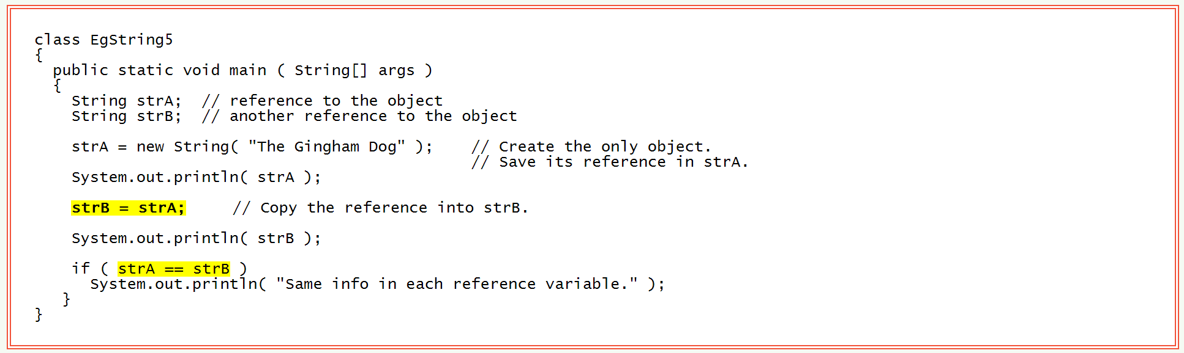
Two Reference Variables Pointing to One Object.
Both strA and strB contain the same reference. So strA == strB evaluates to true.

Slide 21
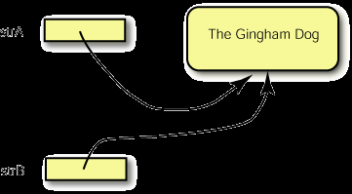
Picture of One Object and Two Reference Variables
strA
strB

Slide 22
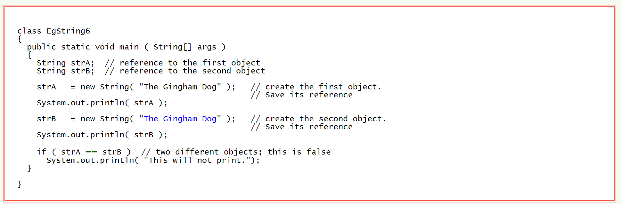
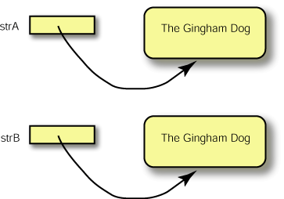
Two Objects with Equivalent Contents

Slide 23
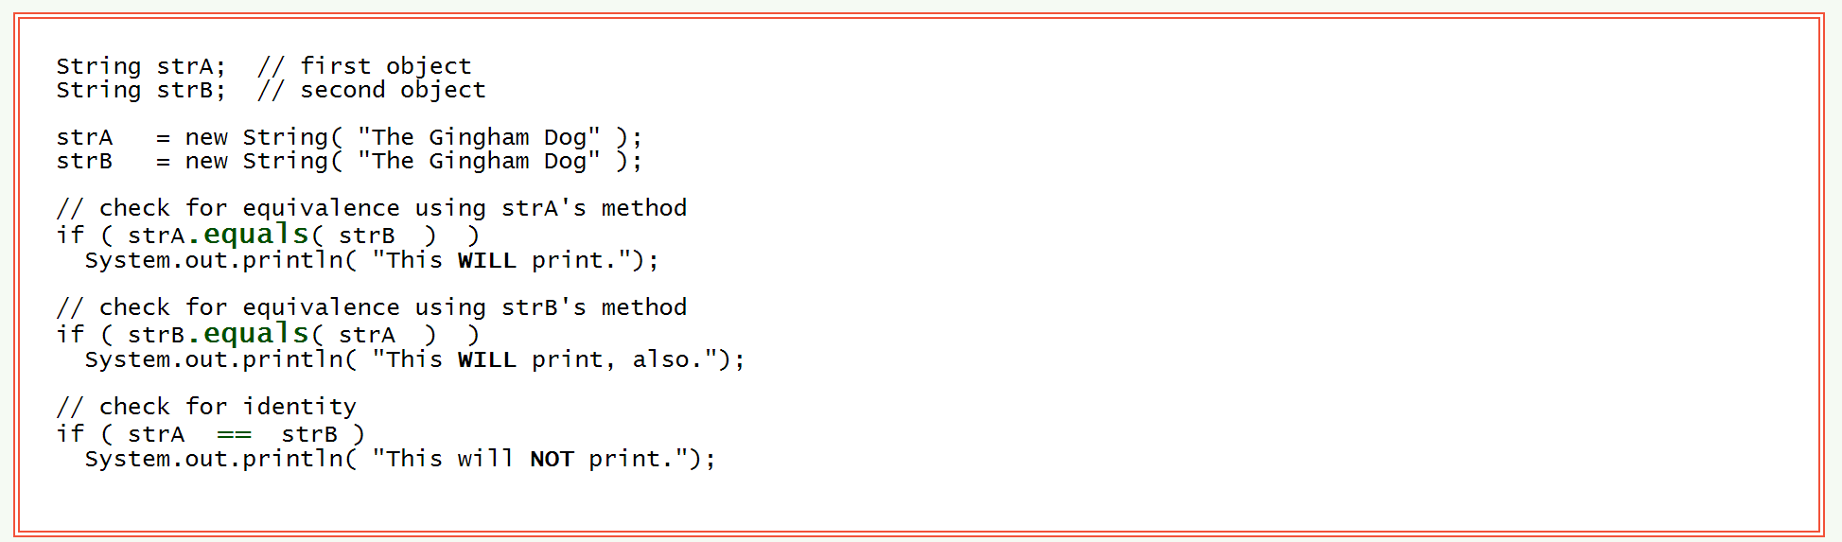
The equals() Method
The equals( String ) method of class String tests if two Strings contain the same characters.
The equals( String ) method looks at objects. It detects equivalence.
The == operator detects identity.

Slide 24
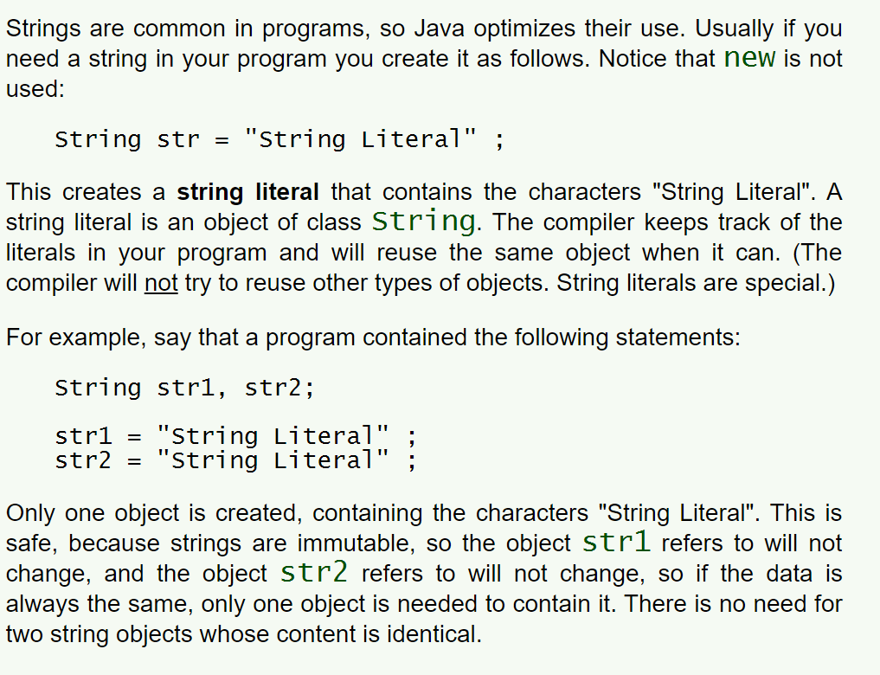
String Literals

Slide 25
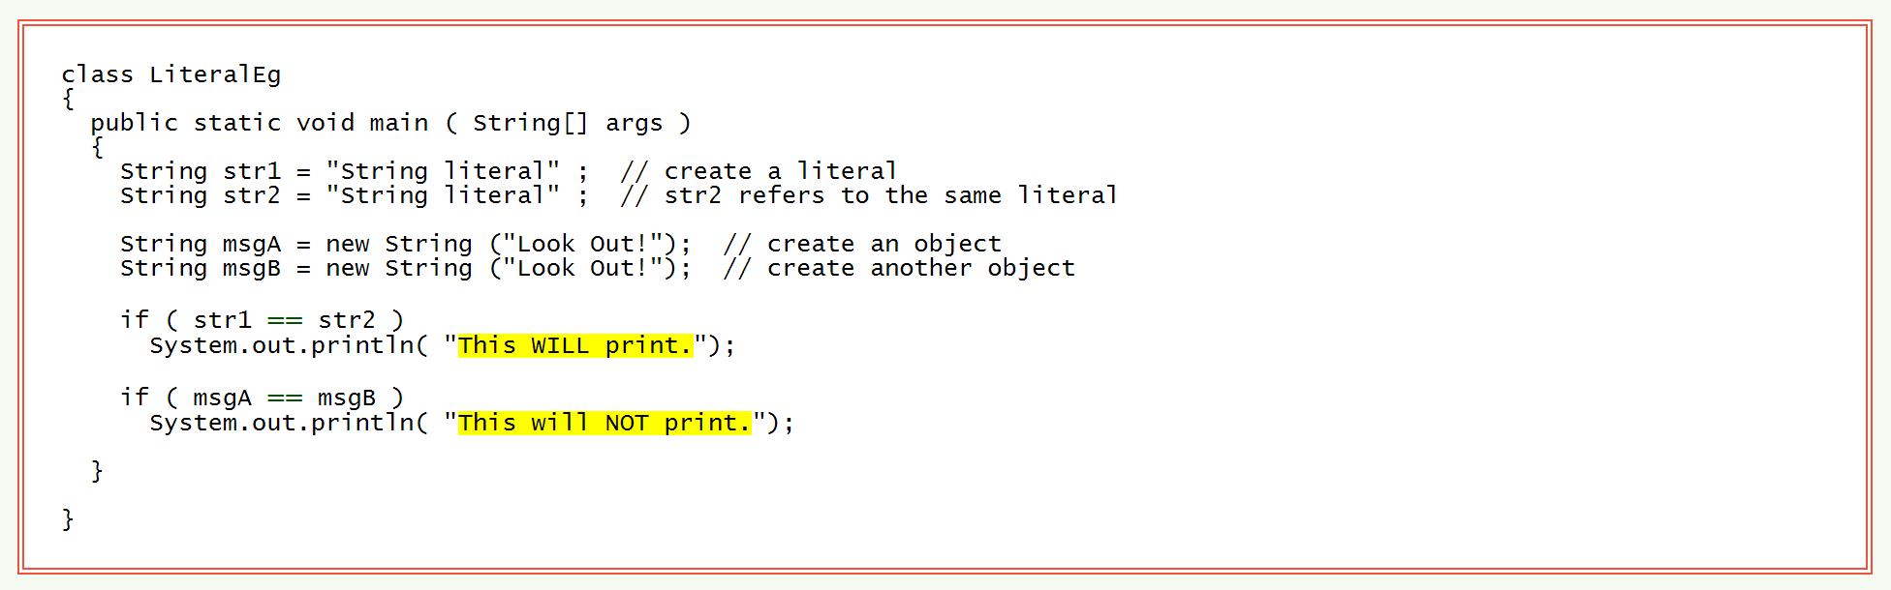
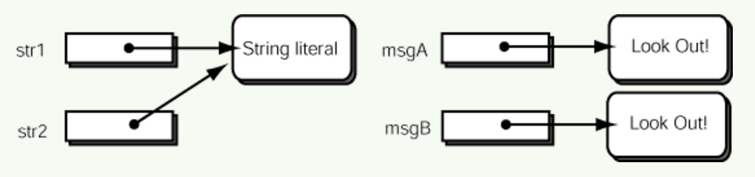
Example Program

Slide 26
Questions
What are the three main characteristics of an all objects?
What are the two main components of a software object?
How is a class different from an object?
What does instantiate mean in programming?

Slide 27
Questions
How are objects instantiated?
What is used to reference objects in programming?
What are the members of an object and how do we access them?
What is a fundamental difference between assigning a variable to a primitive data type or an object?

Slide 28
Questions
What is considered garbage in programming?
Give an example of how you can create garbage.
What does == check for?
How do you check to see that two objects contain the same data?
What is a string literal and how does Java deal with them?

