Slide 1
Using Objects and Classes

Slide 2
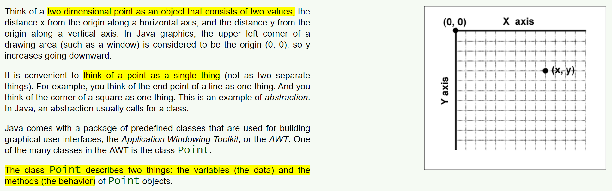
The Class Point

Slide 3
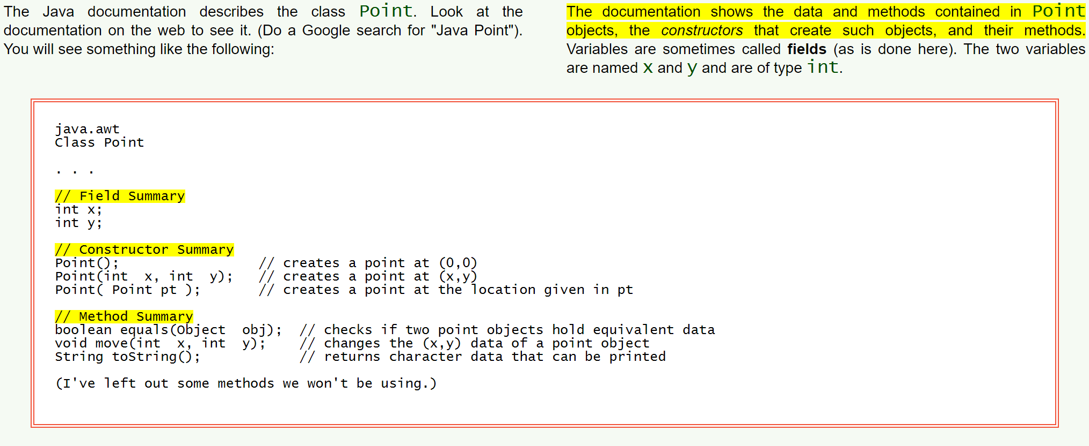
Description of a Class

Slide 4
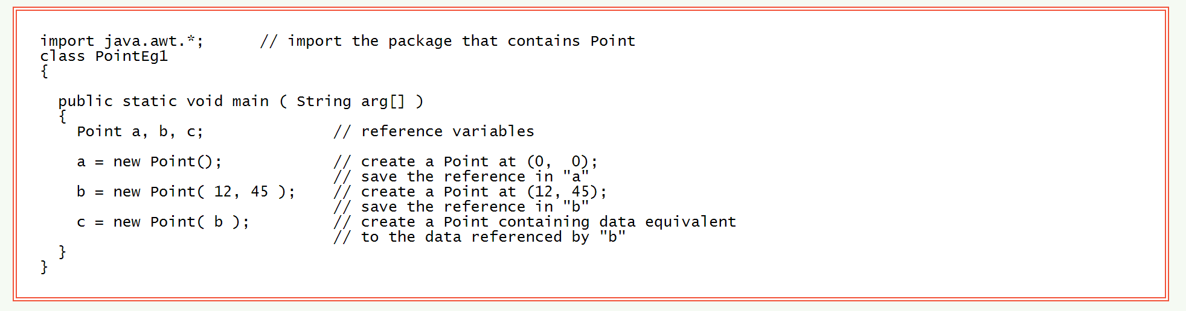
Multiple Constructors
To use the definition of class Point, import the package that contains it. The statement:
import java.awt.* says to use the AWT package that comes with Java. The * says that everything defined in the package can be used (although this program only uses the Point class).

Slide 5
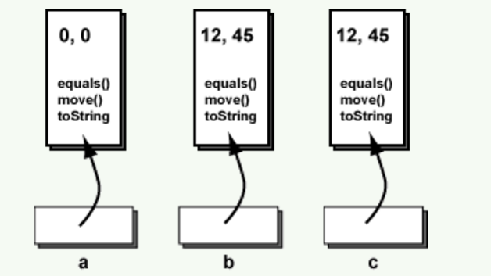
Picture of the Objects

Slide 6
The toString() Method
All objects have their own toString() method, so it is possible to print out something for any object your program has created.

Slide 7
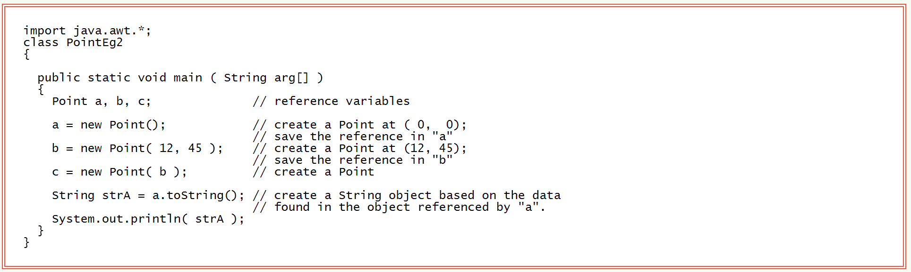
Program that uses the toString() Method
The program prints out:
java.awt.Point[x=0,y=0]

Slide 8
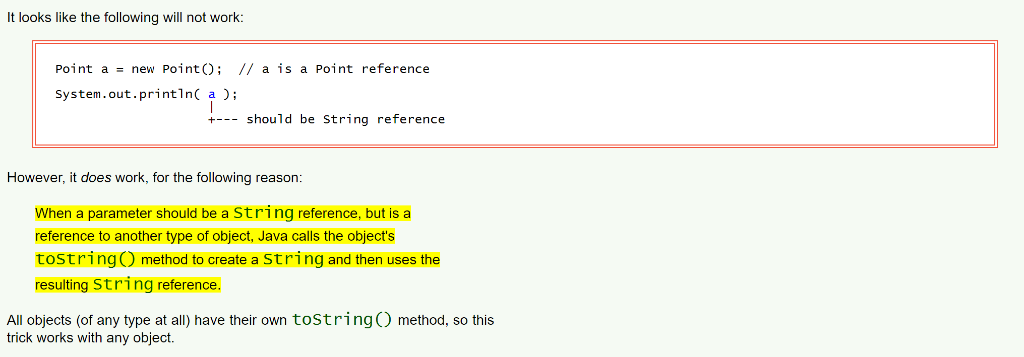
Automatic Call of toString()

Slide 9
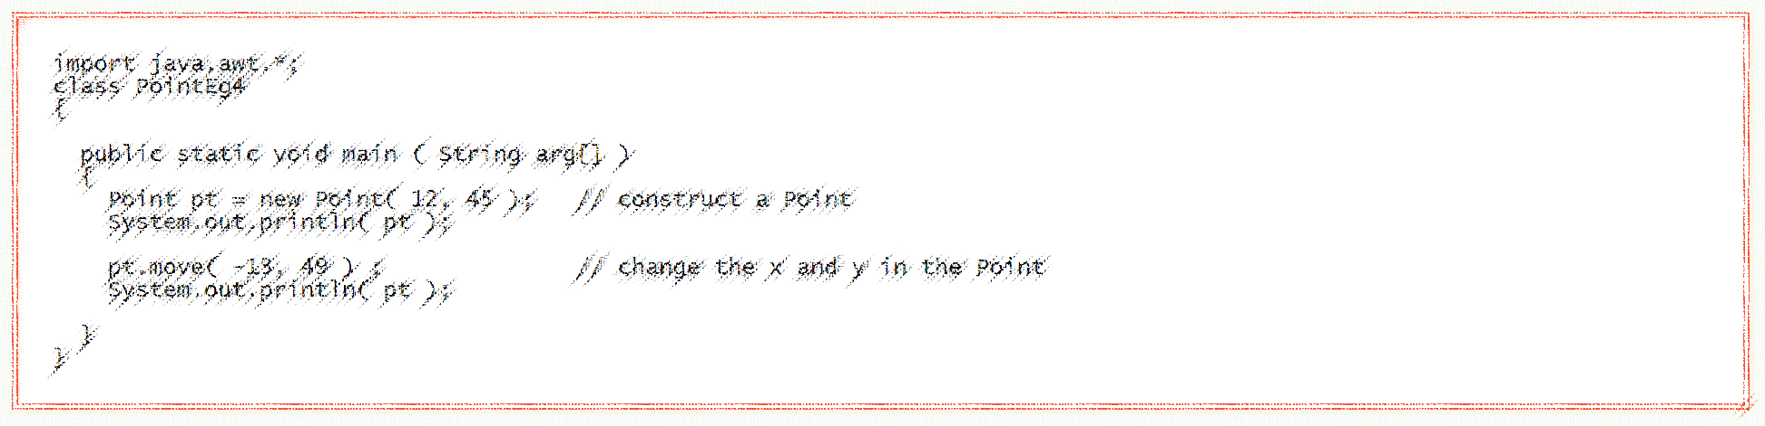
Changing Data inside a Point

Slide 10
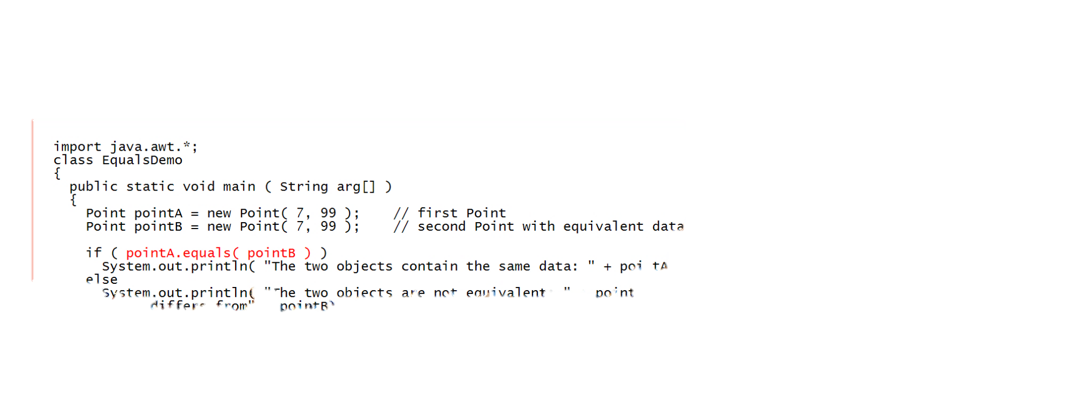
The equals() Method

Slide 11
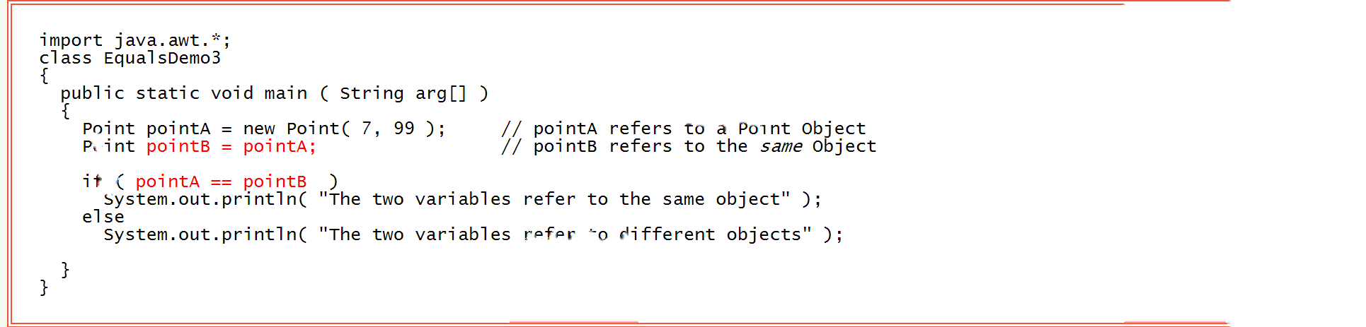
Alias
alias: When two or more reference variables refer to the same object, each variable is said to be an alias.

Slide 12

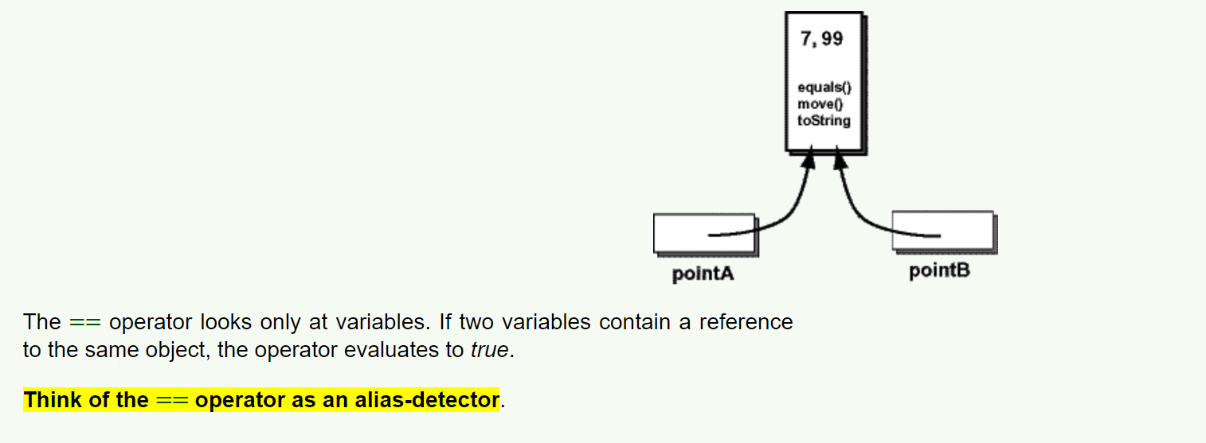
alias-detector

Slide 13

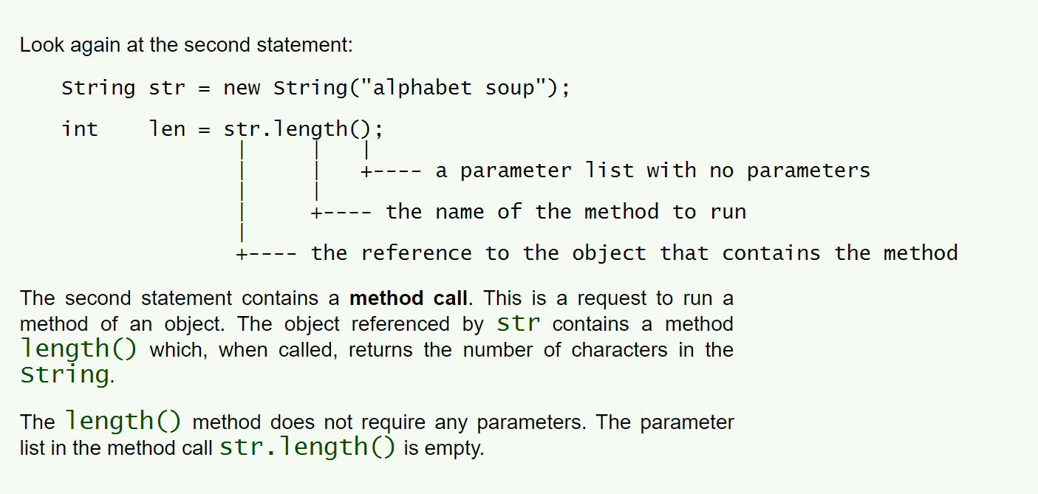
Methods without Parameters

Slide 14

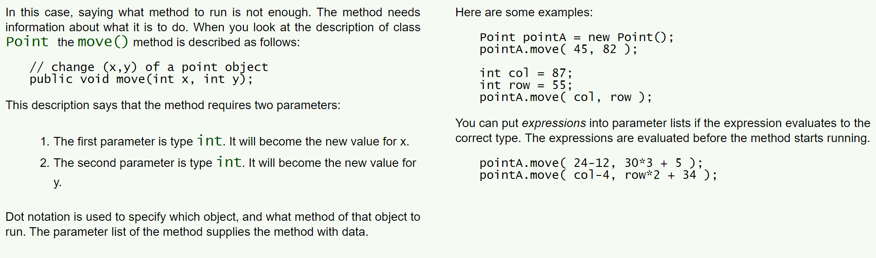
Expressions in Parameter Lists

Slide 15
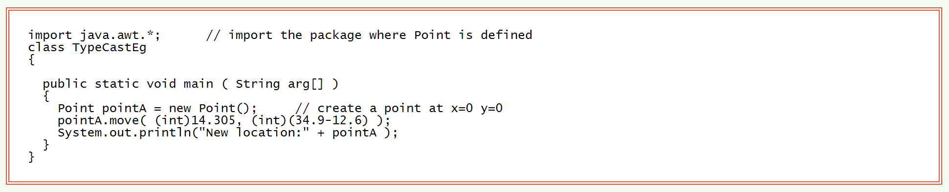


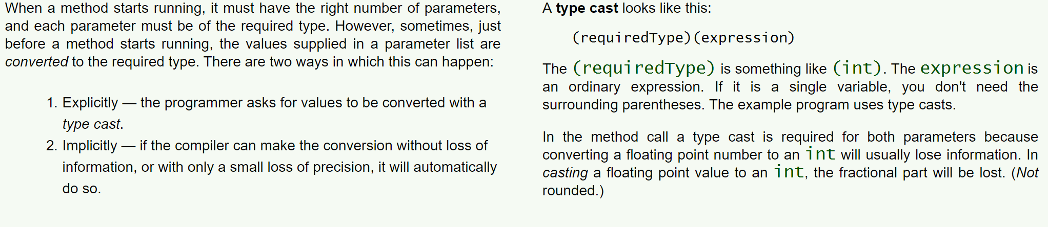
Parameters Must be the Correct Type

Slide 16
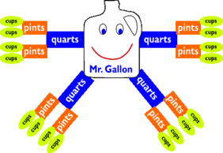
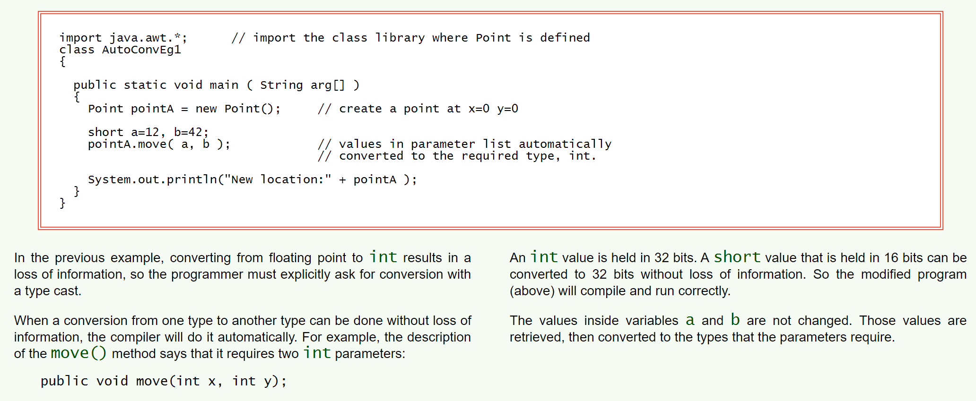
Automatic Conversion of Parameter Type

Slide 17
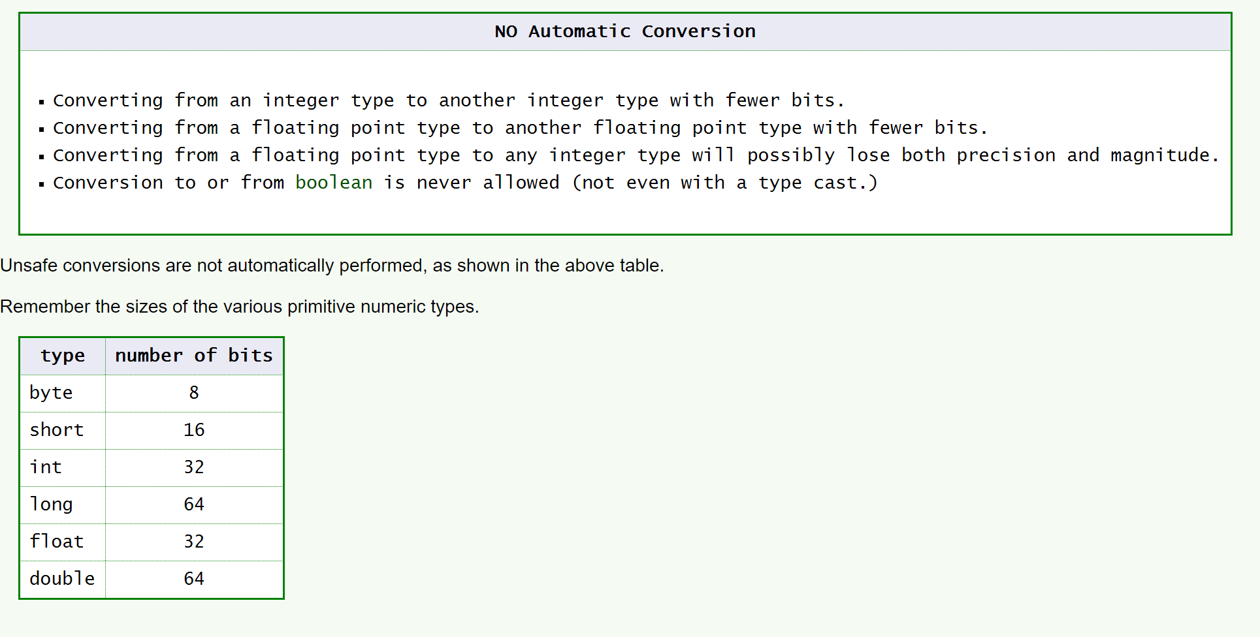


Unsafe Conversions

Slide 18



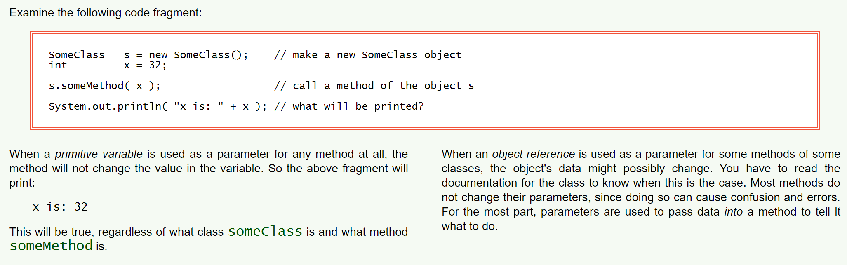



Can a Method Change a Primitive Type?

Slide 19

Questions
Describe the Point class. What is it used for?
Represent xy value
What’s another way to refer to the variables found in a class?
farm fields
What are constructors?
To create an object
Why is it necessary to import java.awt.* when using the Point class in java?
That’s the package where the class is
What does the asterisk mean in the import statement?get all the claddes in the package

Slide 20
Questions
How many constructors does the Point class have? What does this mean to a programmer?
3
What is the purpose pf the toString() method found in most java objects?
How is the state of an object normally changed in programming?
What is an alias of an object? Give an example of creating two aliases.

Slide 21
Questions
What is a method without a parameter? Give an example.
What is an expression? If you pass an expression into a method what must you be aware of?
What is the difference between an explicit and implicit cast? Provide an example.
Why is passing a primitive variable to a method considered safe while passing a reference variable not?

