Slide 1

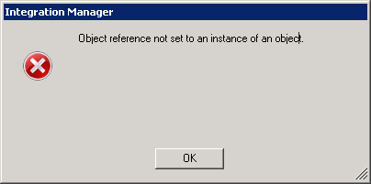
Strings and Object References

Slide 2


Easy way to Construct Strings
String zeta = "The last rose of summer." ;
This creates a String object containing the characters between quote marks.
A String created in this short-cut way is called a String literal
Remember that if several statements in a program ask for literals containing the same characters only one object will actually be constructed

Slide 3
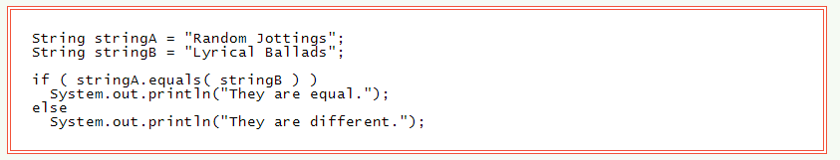

String References as Parameters

Slide 4
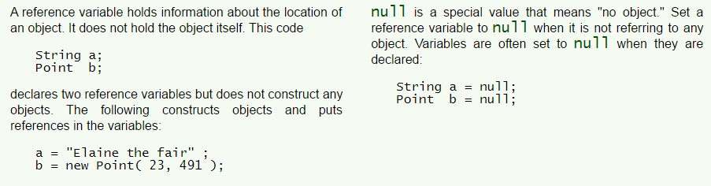

The null Value

Slide 5
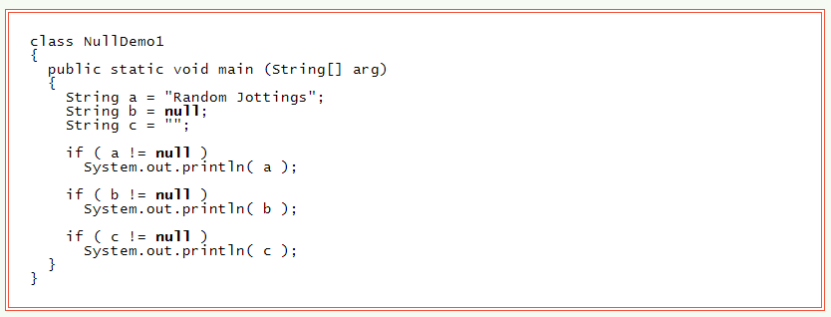

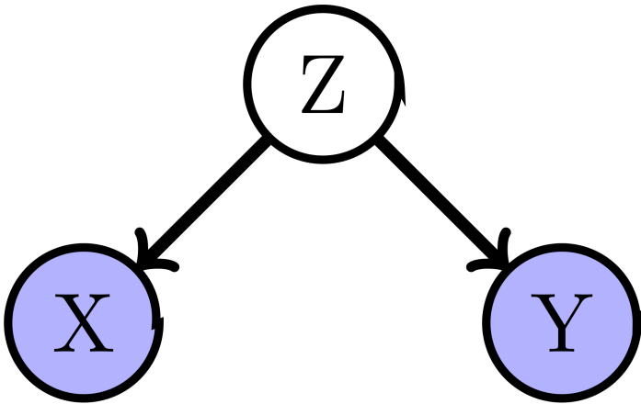
Null Assigned to any Reference Variable

Slide 6
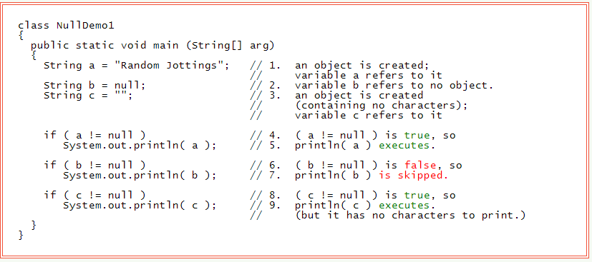


The Empty String
A String object that contains no characters is still an object. Such an object is called an empty string.

Slide 7
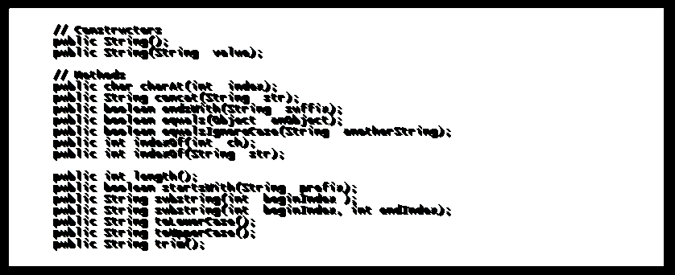
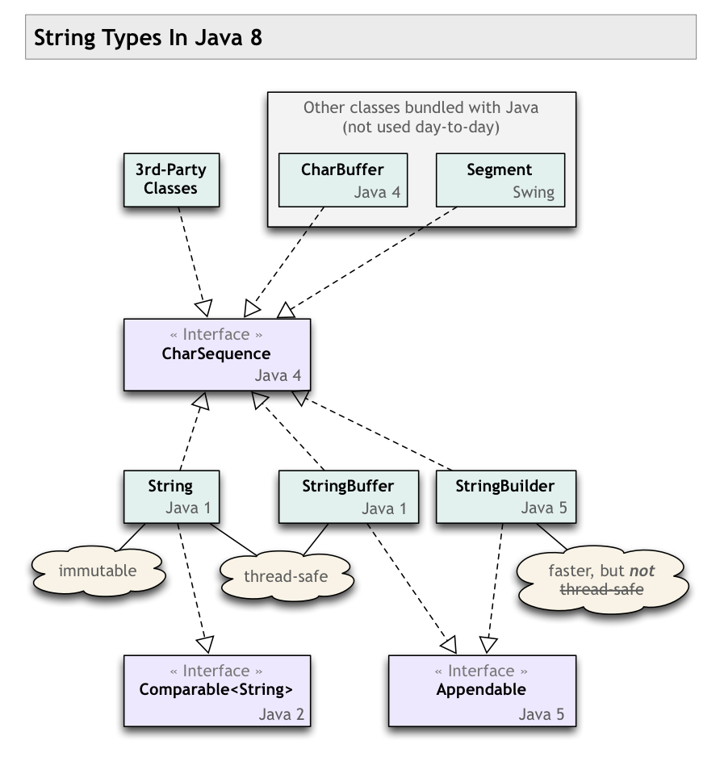

Class String

Slide 8
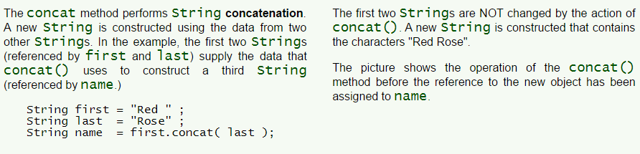


The concat() Method

Slide 9
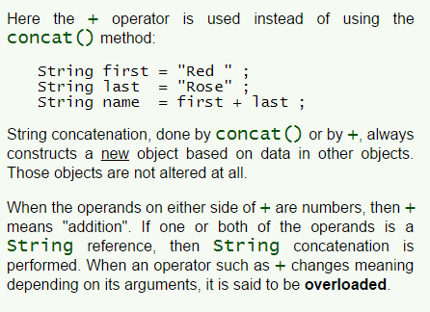

+ Operator

Slide 10


Strings are Forever

Slide 11
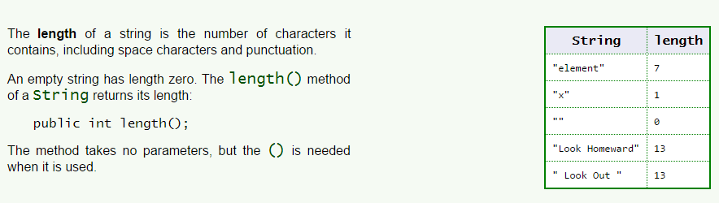

The Length of a String

Slide 12
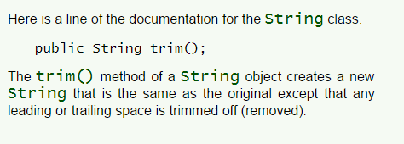
The trim() Method

Slide 13
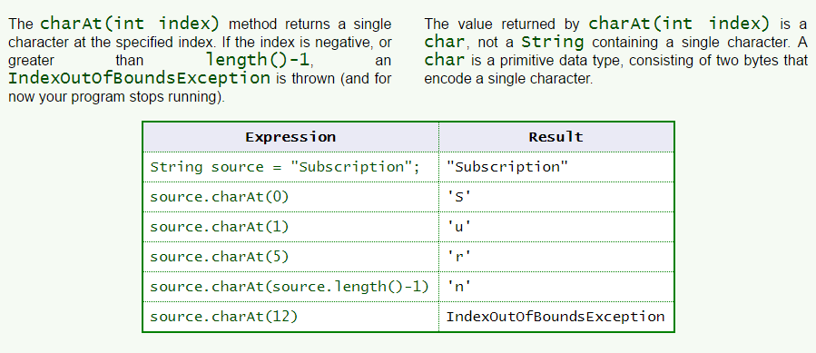

charAt()

Slide 14
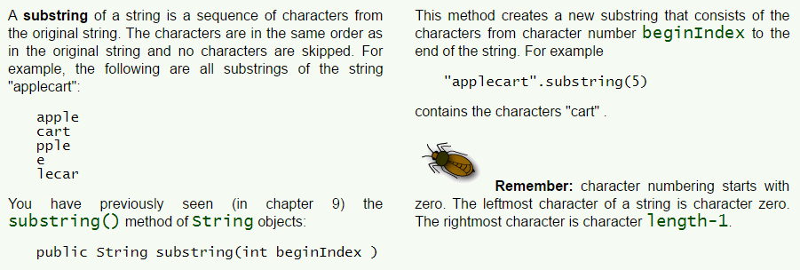
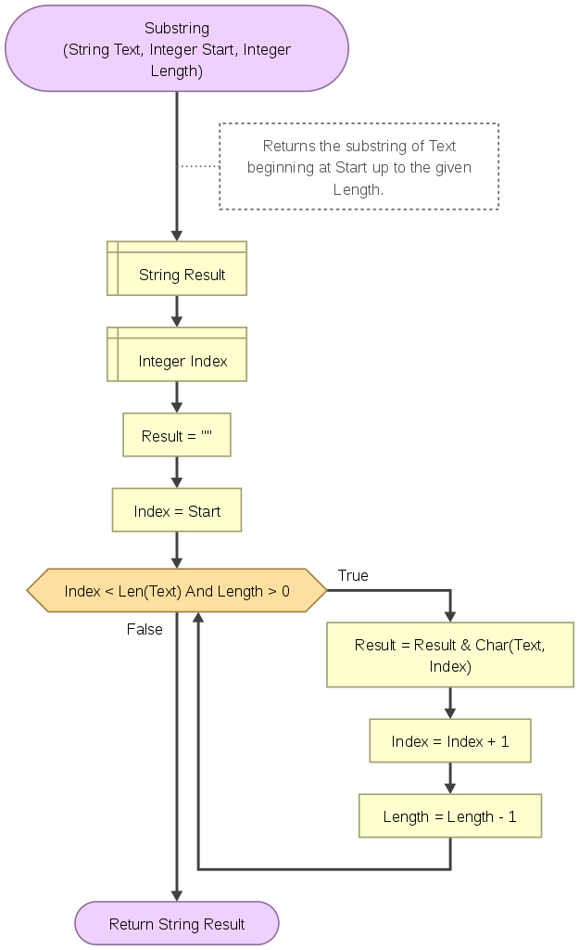
Substrings

Slide 15
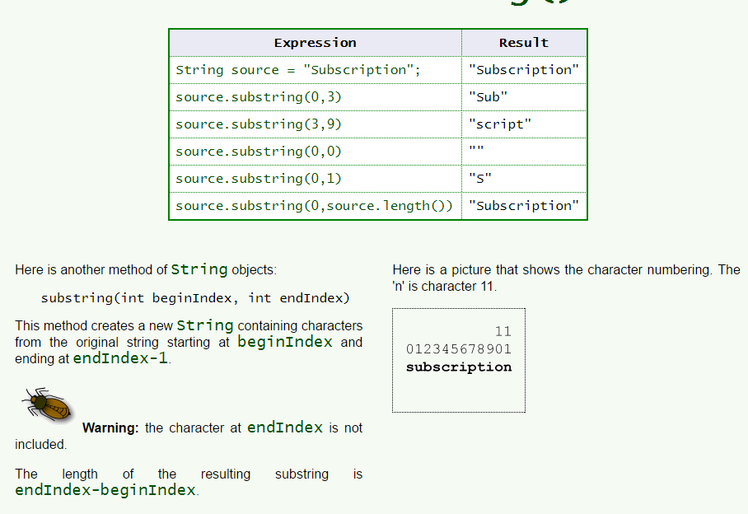

Another substring()

Slide 16
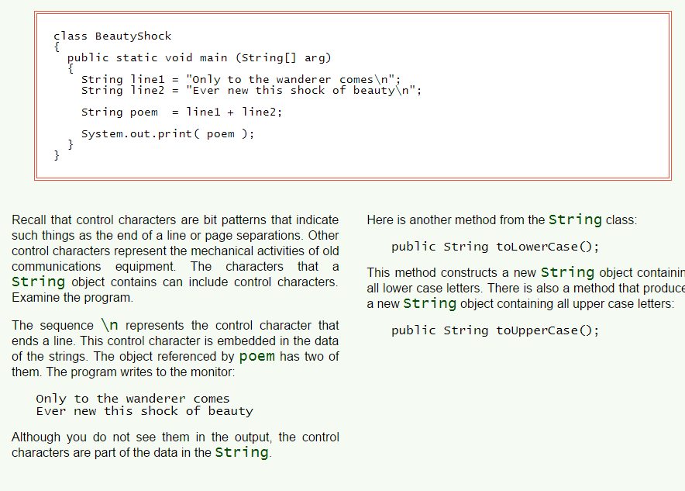

Control Characters inside String Objects

Slide 17
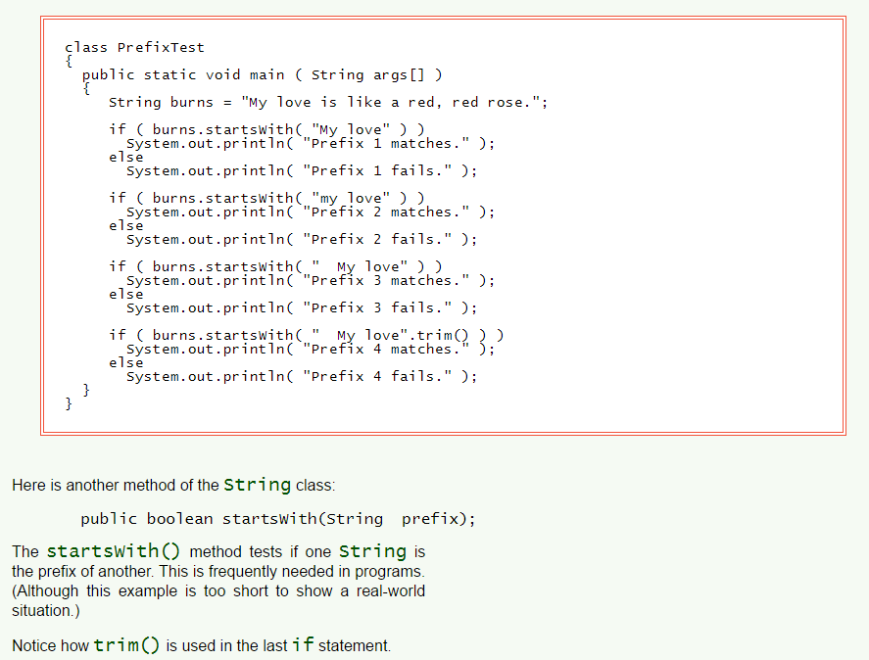

The startsWith() Method
I don’t feel so good

Slide 18
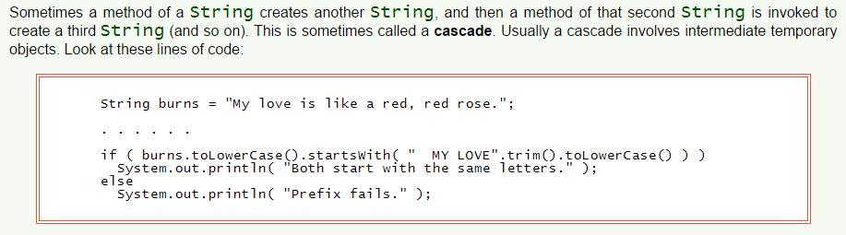

Cascaded String Operations

Slide 19



Questions
How is String a; different from String a=“test”;
string a makes a reference to an empty object
When is null used?
Empty object reference
What is an empty string?
String object that has nothing inside
How many constructors exist for the String class?
2
What does the concat() method do?
Turns it into a cat lol

Slide 20
Questions
When is the IndexOutOfBounds exception thrown while using the charAt() method?
When the parameter is bigger/smaller than the length of the string
What is the return type for this method?
char
What is a control character? Give an example of one.
\n special combos that represent stuff
Provide an example of a cascade. How does this help in programming?
Strings making strings making strings

Slide 21
Questions
What is an overloaded operator? Give an example.
String a=“c”+”d”; creates how many objects?
What are immutable objects?
String b=“hello “; String c=b.trim(); How many object exist after this?
Describe 2 ways you can use the substring() method.

Slide 22
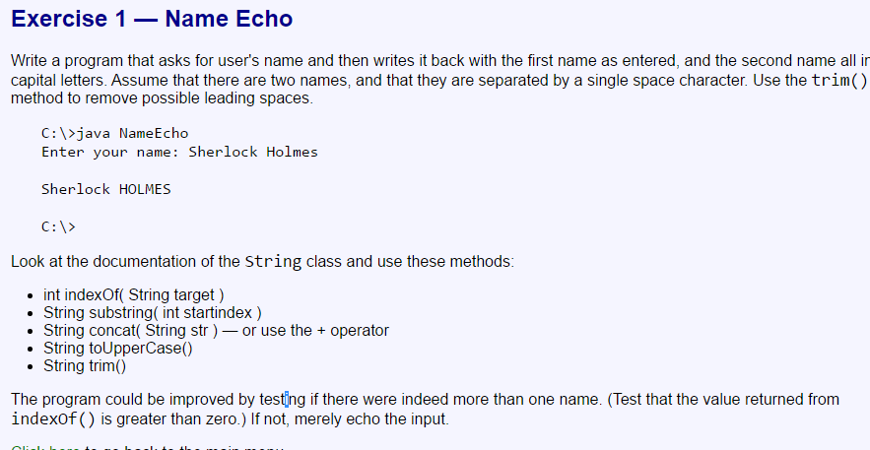
Exercises

Slide 23
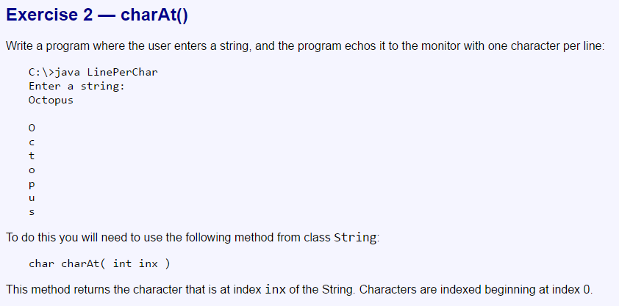

Slide 24
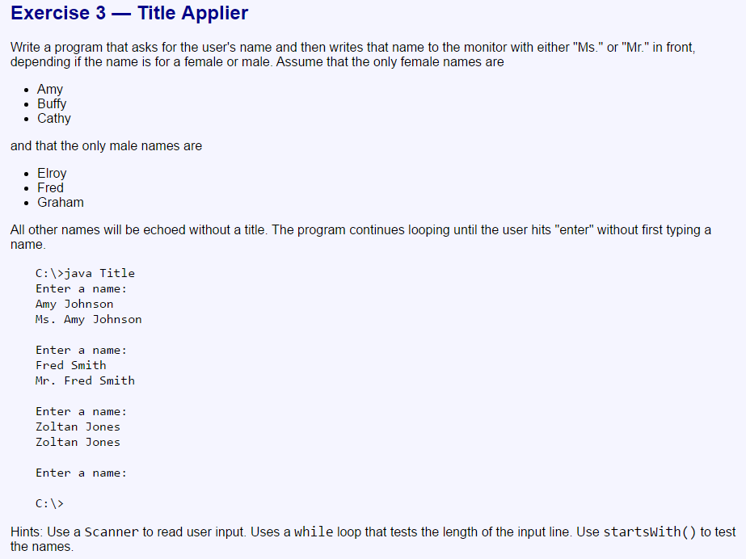

Slide 25
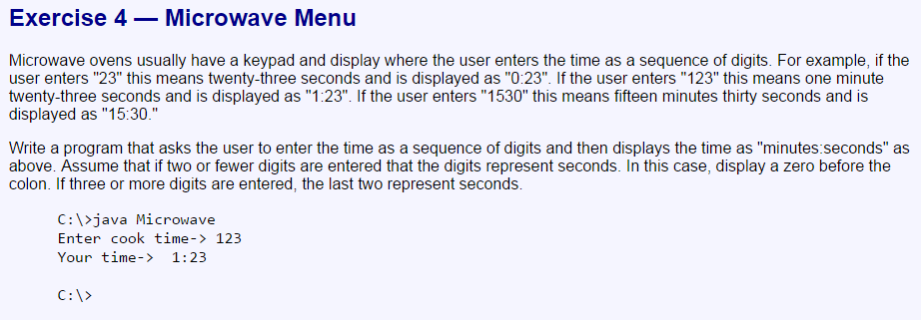

Slide 26
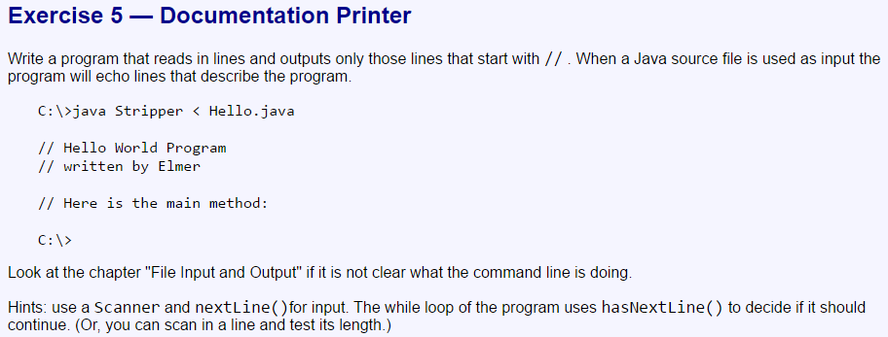

Slide 27
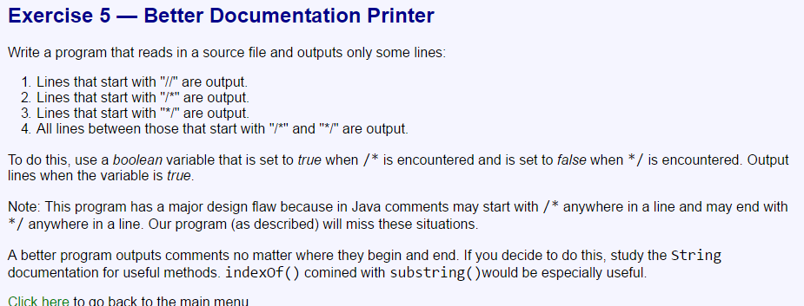

Slide 28
