Slide 1
Defining Your Own Classes

Slide 2
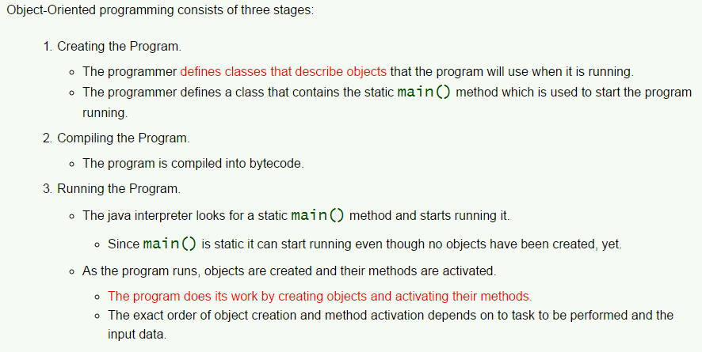
Object Oriented Programming

Slide 3
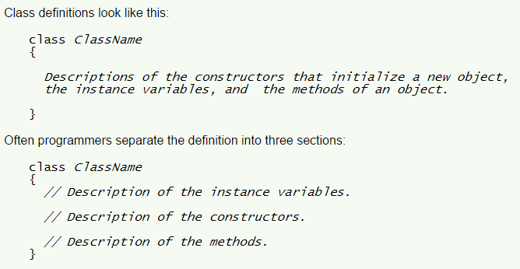
Syntax of a Class Definition

Slide 4
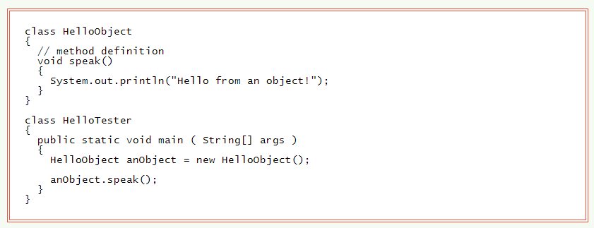
A Tiny Example

Slide 5
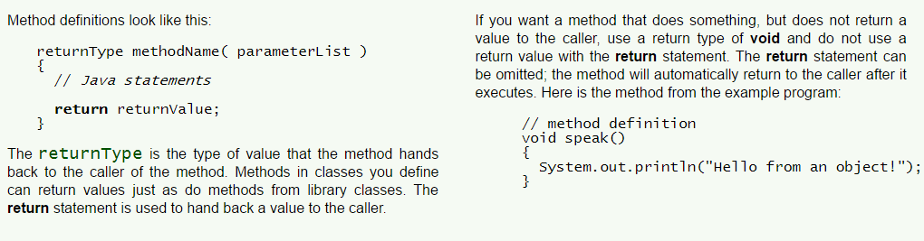
Method Definition

Slide 6
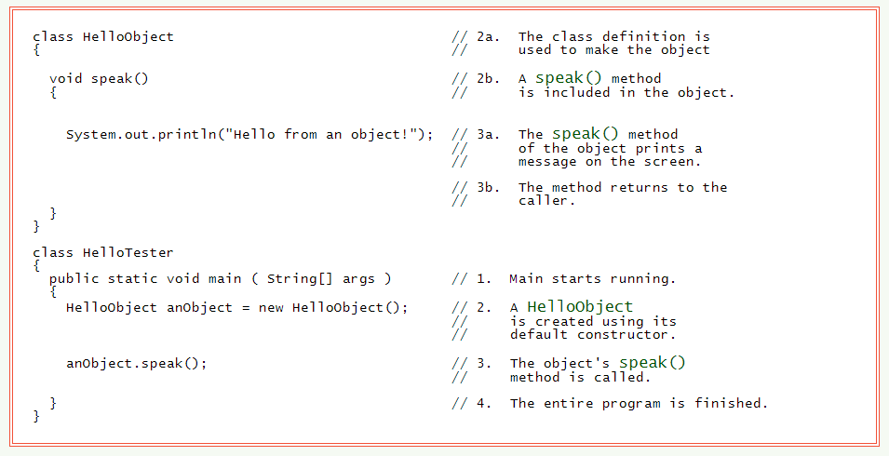
Running the Program

Slide 7
Default Constructor
A class will have a constructor even if one is not explicitly included in the class definition.
If the class definition does not include a constructor a default constructor is automatically supplied by the Java compiler. Syntax Rule: If you define one or more constructors for a class, then those are the only constructors that the class has. The default constructor is supplied automatically only if you define no constructors.

Slide 8

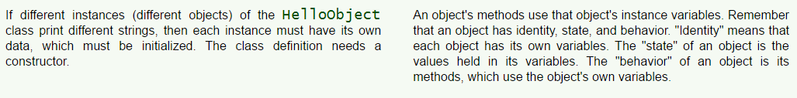
Methods use Instance Variables

Slide 9
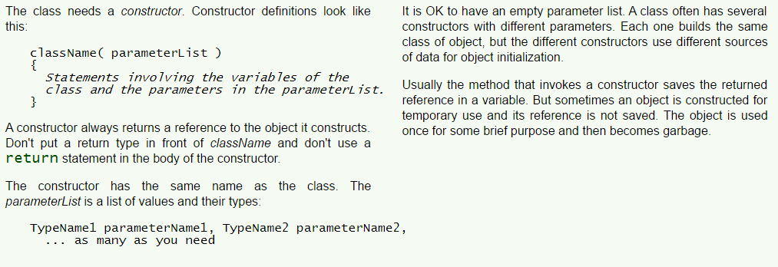
Using a Constructor

Slide 10

Completed Constructor

Slide 11
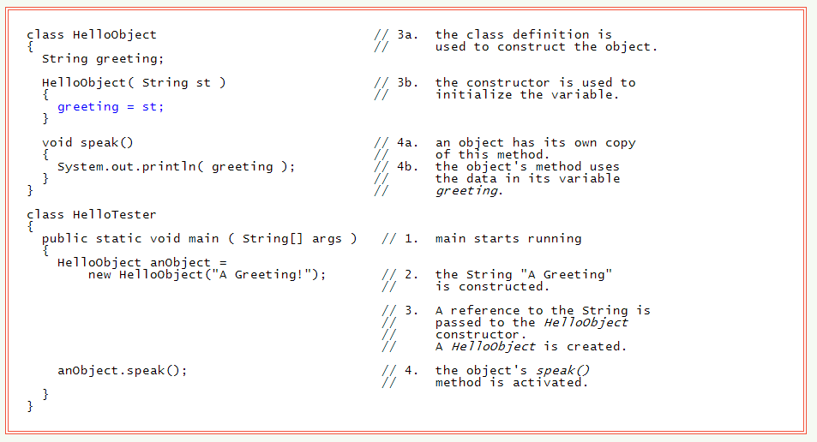
Steps in Program Execution

Slide 12
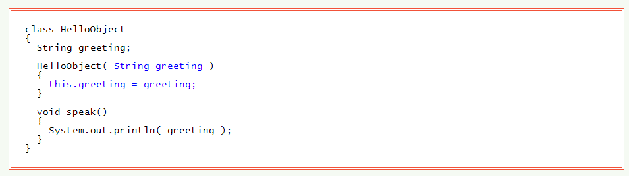
this

Slide 13
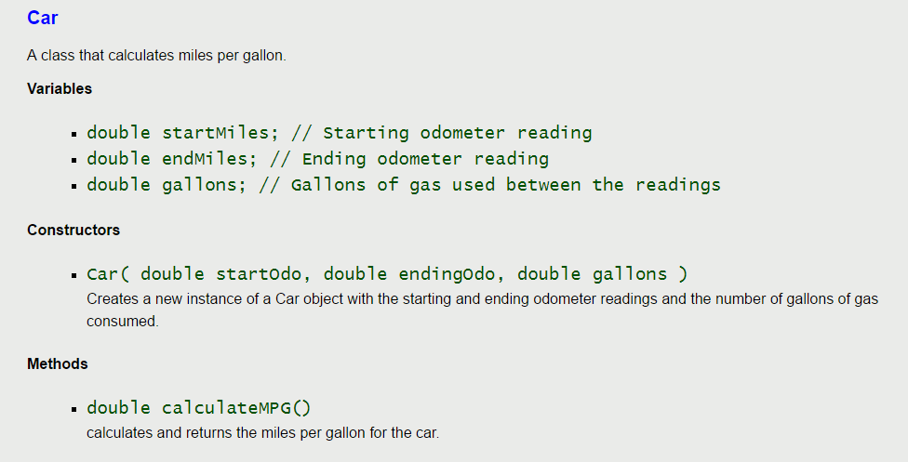
Specifications for the Car class
Object oriented design means deciding what classes you need, what data the objects hold, and how the objects will behave.

Slide 14
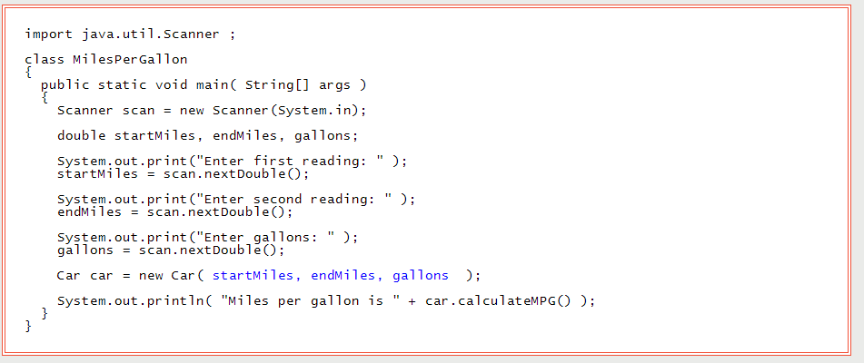
Finished Program

Slide 15
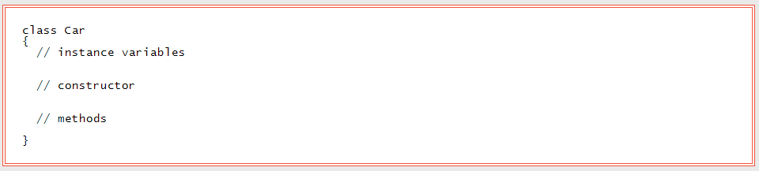
Class Definition

Slide 16
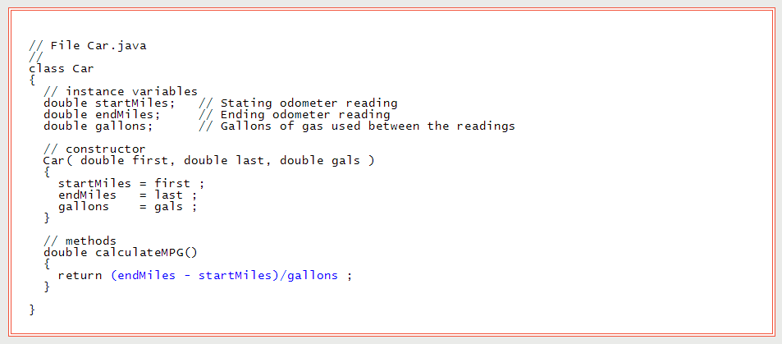
Complete Car

Slide 17
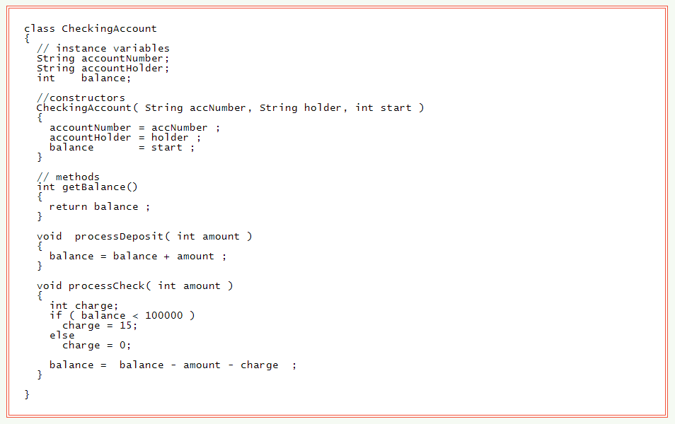
Another Example

Slide 18
Questions
What is the essential first step in OOP?
What is the general framework for designing a class?
Why is it important to have one clas in your program containing a static void main method?
What is the default constructor?
What are instance variables?

Slide 19
Questions
What is the format for creaating a constructor?
What is the role of the constructor?
What is the purpose of this in a class definition?

Slide 20
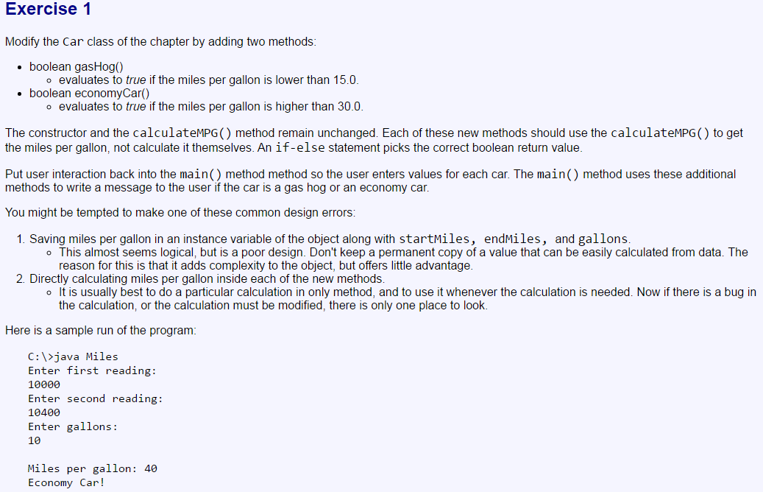
Exercises

Slide 21
