Slide 1
Encapsulation

Slide 2
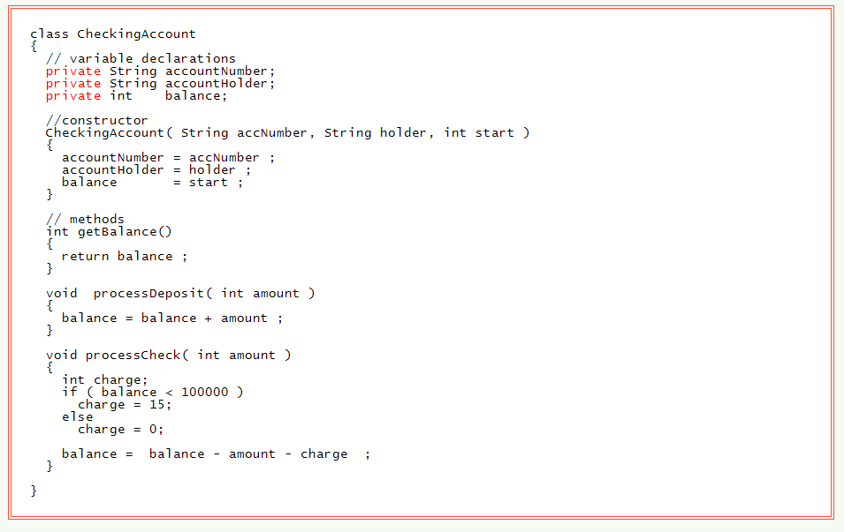
The private Visibility Modifier
When an instance variable is declared private it can be used only by the methods of that class.

Slide 3
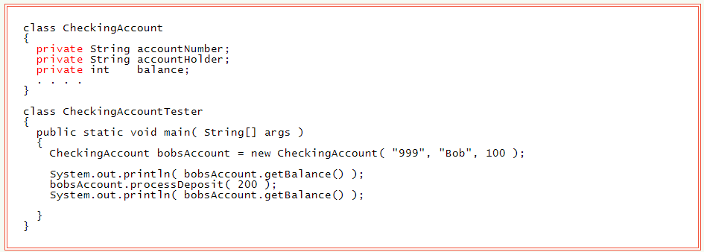
Access Methods A class with private data provides access to that data through access methods. An access method uses the private data of its object and is visible to other classes. Some access methods alter data; others return a value but don't alter data.

Slide 4
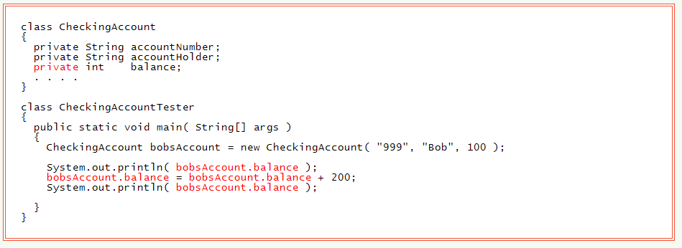
main() Can't See Private Data

Slide 5
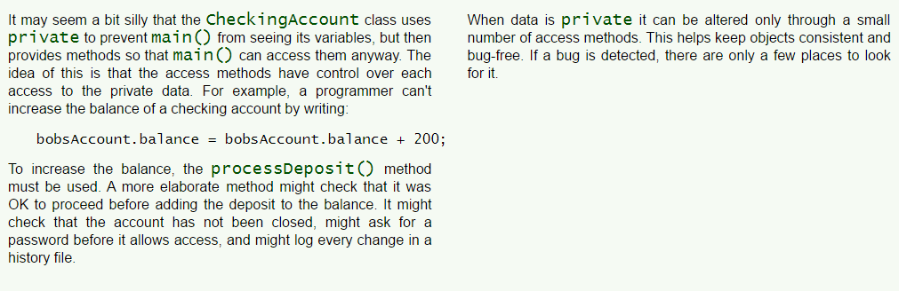
Careful Access Control

Slide 6
Encapsulation
Encapsulation is hiding the details of an object from the other parts of a program.
It is one of the three main features of OOP.
The object can be used only through its access methods, which are carefully written to keep the object consistent and secure.

Slide 7
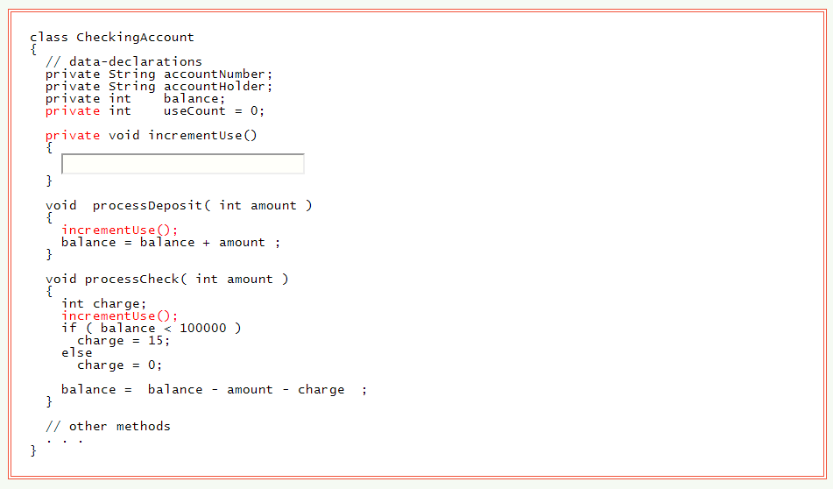
Private Methods
A private method can be used only by the other methods of the object.

Slide 8
The public Visibility Modifier
The public access modifier explicitly says that a method or variable of an object can be accessed by code outside of the object.
The public visibility modifier is usually used for all access methods and constructors in a class definition.
Most variables are made private.

Slide 9
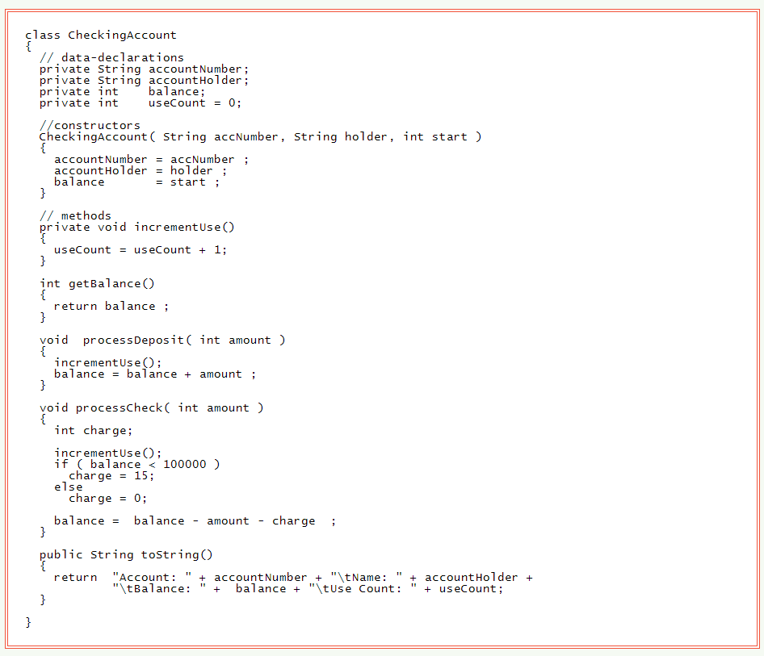
Complete Class

Slide 10
Default Visibility
If you do not specify public or private for a variable or a method, then it will have default visibility.
Default visibility allows a variable or method to be seen by all methods of a class or other classes that are part of the same package.
A package is a group of related classes.
For now, default visibility means about the same thing as public visibility.
But it is best to explicitly declare members public if that is what you actually need.

Slide 11
Summary of Access Modifiers
public Access Modifier
The Java access modifier public means that all code can access the class, field, constructor or method, regardless of where the accessing code is located. The accessing code can be in a different class and different package.
Here is a public access modifier example:
public class Clock {
public long time = 0;
}
public class ClockReader {
Clock clock = new Clock();
public long readClock{ return clock.time; }
}
The time field in the Clock class is marked with the public Java access modifier. Therefore, theClockReader class can access the time field in the Clock no matter what package the ClockReader is located in.

Slide 12
private Access Modifier
If a method or variable is marked as private (has the private access modifier assigned to it), then only code inside the same class can access the variable, or call the method. Code inside subclasses cannot access the variable or method, nor can code from any external class.
Classes cannot be marked with the private access modifier. Marking a class with the private access modifier would mean that no other class could access it, which means that you could not really use the class at all. Therefore the private access modifier is not allowed for classes.
Here is an example of assigning the private access modifier to a field:
public class Clock {
private long time = 0;
}
The member variable time has been marked as private. That means, that the member variable time inside the Clock class cannot be accessed from code outside the Clock class.

Slide 13
public Access Modifier
public Access Modifier
The Java access modifier public means that all code can access the class, field, constructor or method, regardless of where the accessing code is located. The accessing code can be in a different class and different package.
Here is a public access modifier example:
package test;
public class Clock {
public long time = 0;
}
Package test1;
public class ClockReader {
Clock clock = new Clock();
public long readClock{ return clock.time; }
}
The time field in the Clock class is marked with the public Java access modifier. Therefore, theClockReader class can access the time field in the Clock no matter what package the ClockReader is located in.

Slide 14
default (package) Access Modifier
The default Java access modifier is declared by not writing any access modifier at all. The default access modifier means that code inside the class itself as well as code inside classes in the same package as this class, can access the class, field, constructor or method which the default access modifier is assigned to. Therefore, the default access modifier is also sometimes referred to as the package access modifier. If you don't know what a Java package is, I have explained that in my Java packages tutorial.
Subclasses cannot access methods and member variables (fields) in the superclass, if they these methods and fields are marked with the default access modifier, unless the subclass is located in the same package as the superclass.
Here is an default / package access modifier example:
package test;
public class Clock {
long time = 0;
}
package test;
public class ClockReader {
Clock clock = new Clock();
public long readClock{ return clock.time; }
}
The time field in the Clock class has no access modifier, which means that it is implicitly assigned the default / package access modifier. Therefore, the ClockReader class can read the time member variable of the Clock object, provided that ClockReader and Clock are located in the same Java package.

Slide 15
protected Access Modifier
The protected access modifier provides the same access as the default access modifier, with the addition that subclasses can access protected methods and member variables (fields) of the superclass. This is true even if the subclass is not located in the same package as the superclass.
Here is a protected access modifier example:
package test;
public class Clock {
protected long time = 0; // time in milliseconds
}
package test1;
public class SmartClock() extends Clock{
public long getTimeInSeconds() {
return this.time / 1000;
}
}
In the above example the subclass SmartClock has a method called getTimeInSeconds() which accesses the time variable of the superclass Clock. This is possible even if Clock and SmartClock are not located in the same package, because the time field is marked with the protected Java access modifier.

Slide 16
Questions
Define encapsulation in programming.
Describe an example of encapsulation.
How does using private affect the visibility/scope of a member of an object?
How does using public affect the visibility/scope of a member of an object?
How does omitting either of these two access modifiers affect the visibility/scope of a member of an object?

Slide 17
Questions
What is an access method?
Why should we use access methods? Give an example.
Note: If you want to add one project’s package to another then do the following so as to reference it :
add project A to project B's build path.
Right click on project B's folder in eclipse --> properties --> build path --> projects --> add. Now add project A

Slide 18
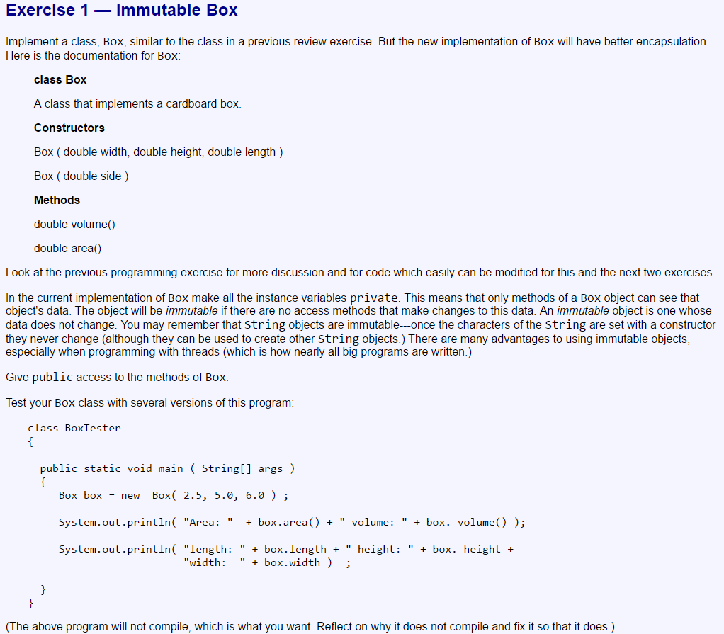
Exercises

Slide 19
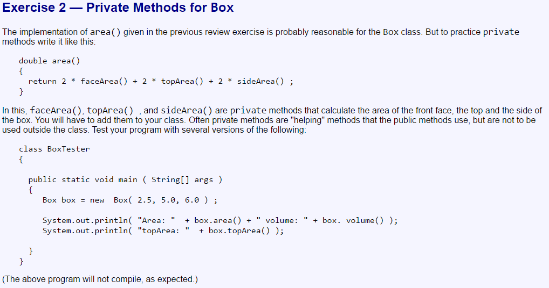

Slide 20
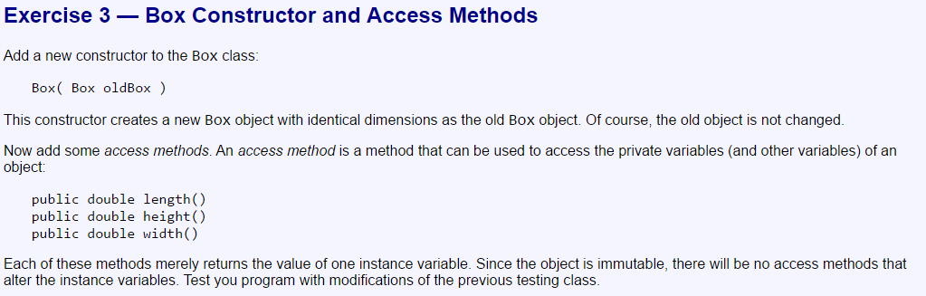

Slide 21
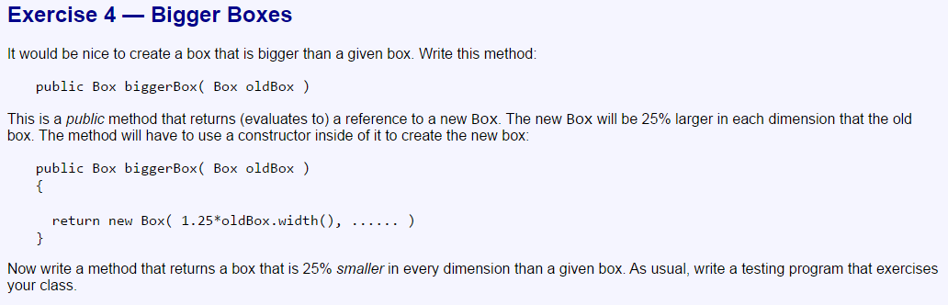

Slide 22
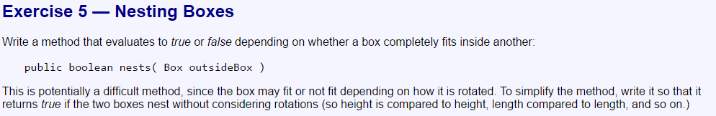

Slide 23
