Slide 1
Parameters, Local Variables, and Overloading

Slide 2
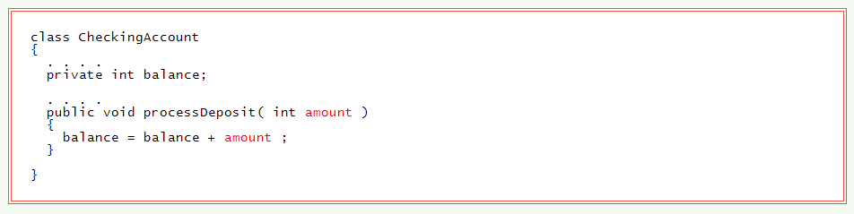
Parameters

Slide 3
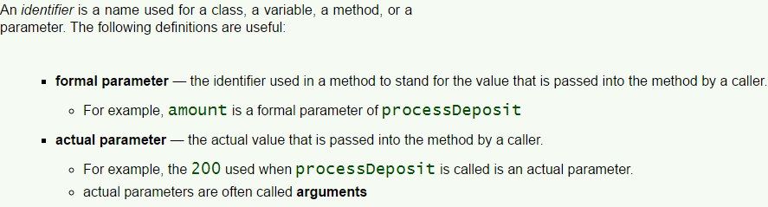
Formal and Actual Parameters

Slide 4
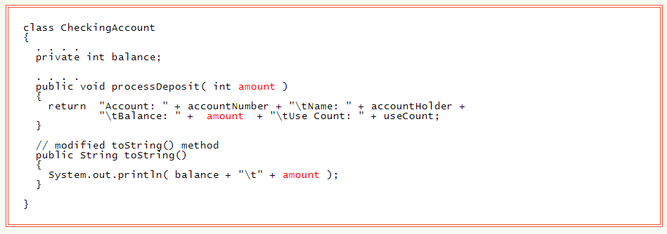
Parameters are Seen by their Own Method, Only

Slide 5
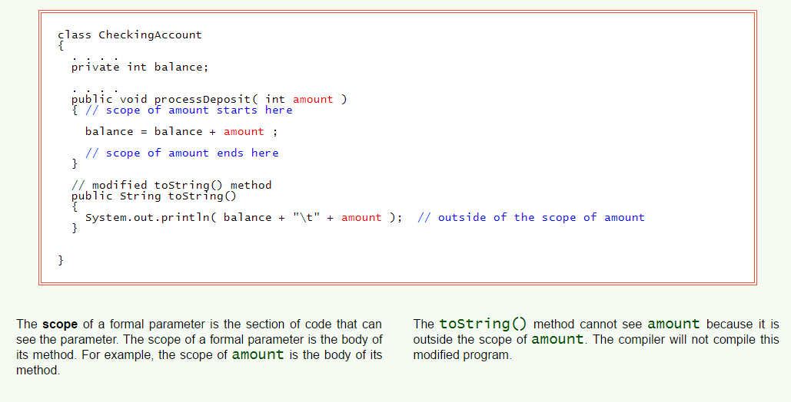
Scope of a Formal Parameter

Slide 6
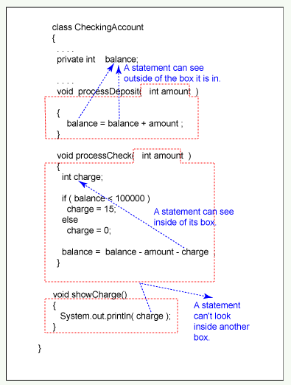
What Statements See

Slide 7
Local Variables
A local variable is a variable that is declared inside of the body of a method.
It can be seen only by the statements that follow its declaration inside of that method.
The scope of a local variable starts where it is declared and ends at the end of the block that it is in.
Recall that a block is a group of statements inside of braces, {}.

Slide 8
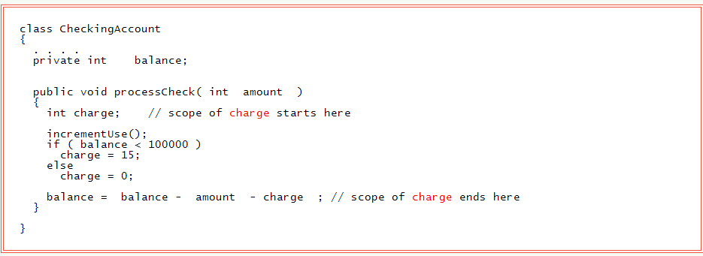
Local Variables

Slide 9
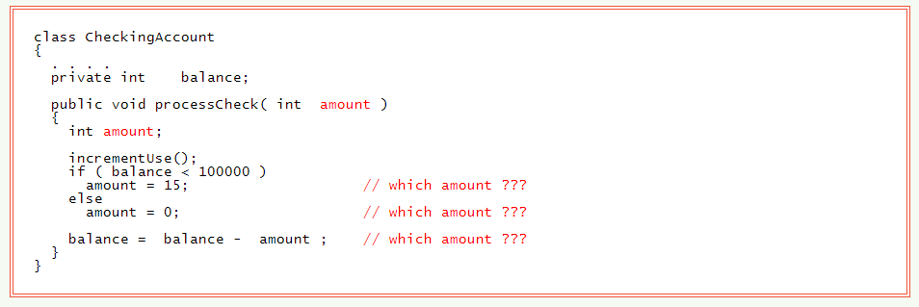
Can't use the Same Name in the Same Scope

Slide 10
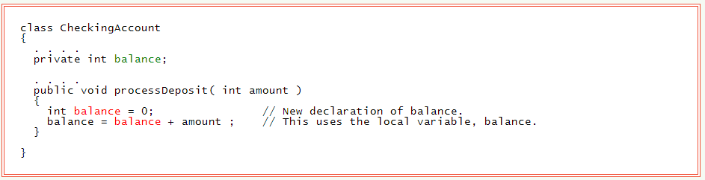
Instance Variable and Local Variable with Same Name

Slide 11
Method Overloading
Overloading is when two or more methods of a class have the same name but have different parameter lists.
When a method is called, the correct method is picked by matching the actual parameters in the call to the formal parameter lists of the methods.

Slide 12
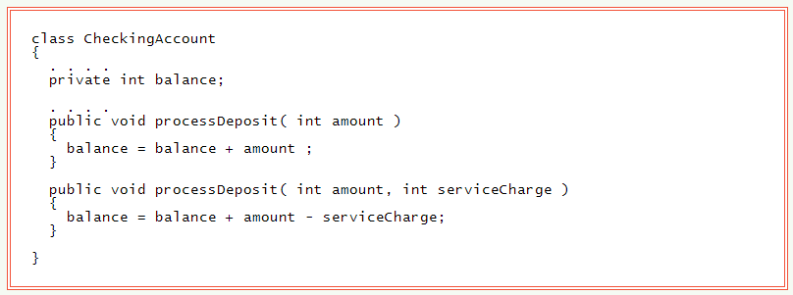
Method Overloading

Slide 13
Method Signature
The signature of a method is:
Its name.
The number and types of its parameters, in order.
For example, the signatures of two processDeposit methods are:
processDeposit( int )
processDeposit( int, int )
Return Type is Not Part of the Signature

Slide 14
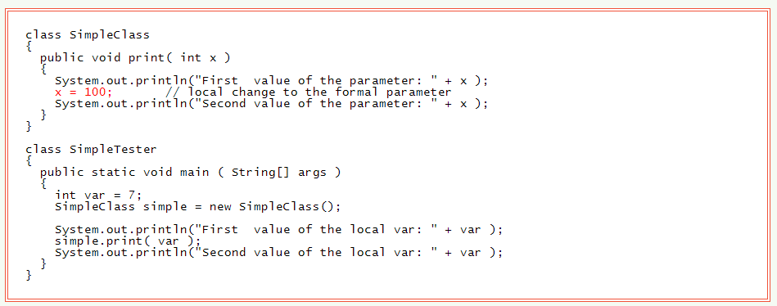
Changes to the Formal Parameter do not affect the Caller

Slide 15
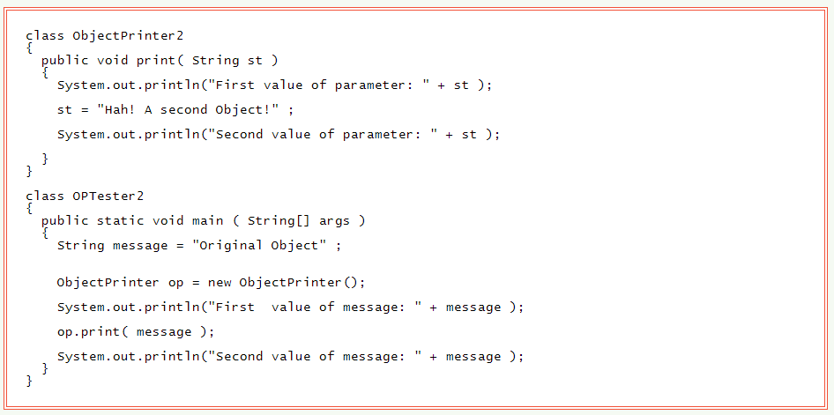
Object References as Parameters
Object references can be parameters.
Call by value is used, but now the value is an object reference.

Slide 16
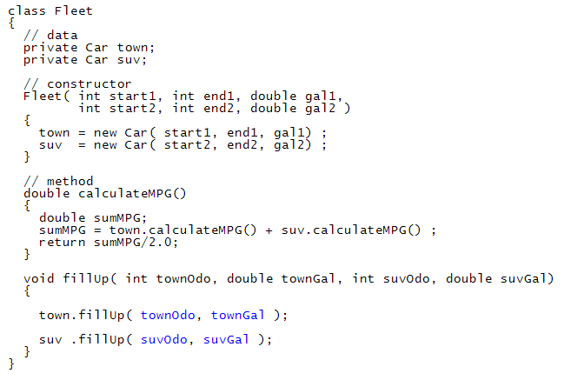
Objects that Contain Objects

Slide 17
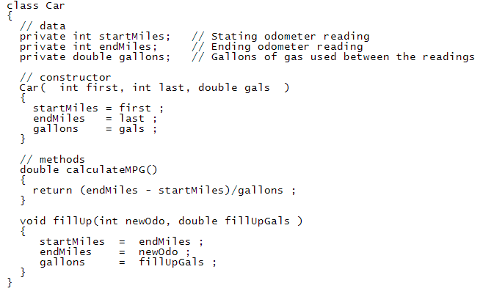
The Car

Slide 18
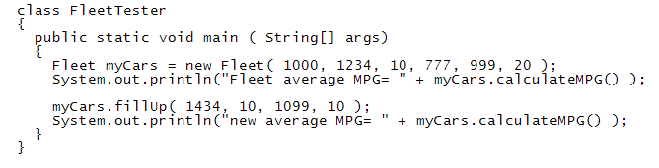
Fleet Tester

Slide 19
Questions
What are parameters related to?
Describe the difference between an actual and formal parameter.
What is another name used to describe an actual parameter?
What is the scope of a formal parameter?
Why is it a bad idea to name a local variable similar to a formal parameter?

Slide 20
Questions
How do we distinguish a local variable with the same name as a instance variable?
How are passing object references to a formal parameter different from passing a primitive variable?
What is method overloading?
What is the signature of a method?
What does it mean when we say an object can contain objects?

