Slide 1
Inheritance

Slide 2
Inheritance
Object oriented languages have a feature called inheritance.
Inheritance enables you to define new classes based upon an existing class.
The new classes are similar to the existing class, but have additional member variables and methods.
This makes programming easier because you can build upon an existing class instead of starting out from scratch.

Slide 3
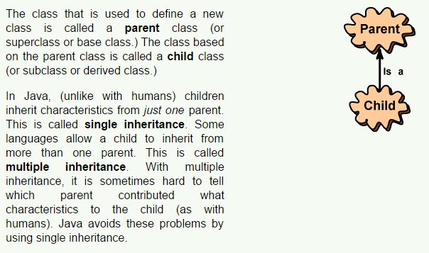
Single Inheritance

Slide 4
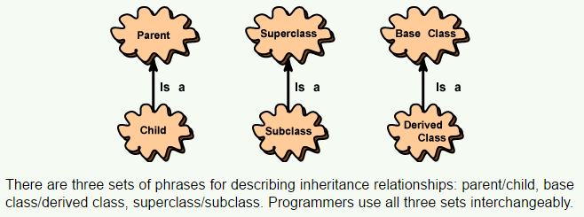
Interchangeable Phrases

Slide 5
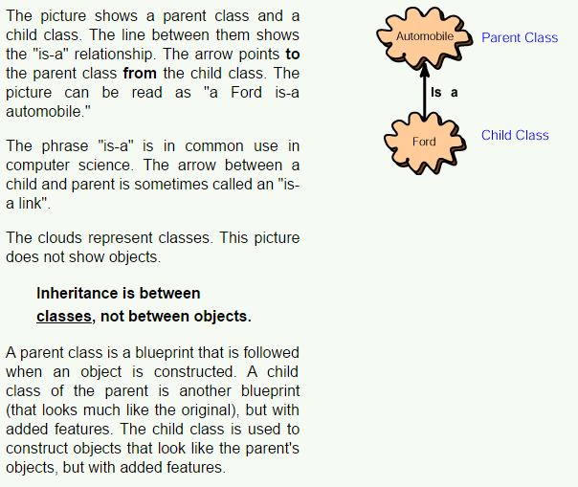
Is-a Relationship

Slide 6
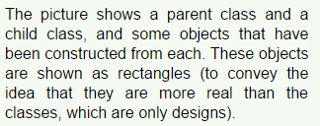
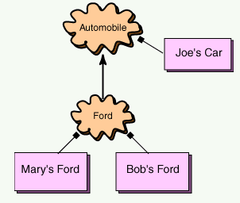
Objects

Slide 7
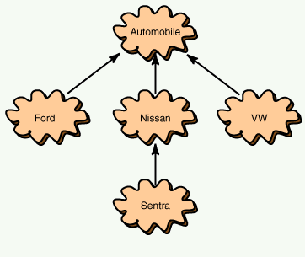
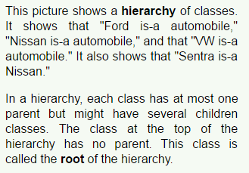
Hierarchies

Slide 8
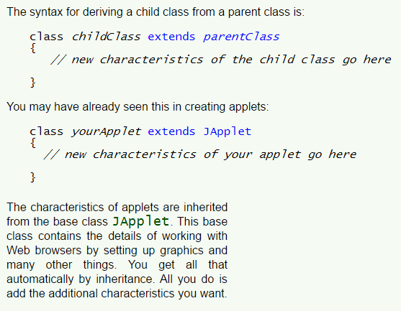
Extends

Slide 9
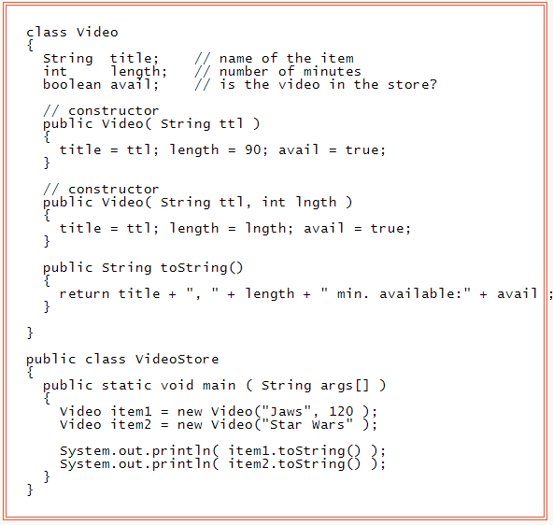
Video Store Example

Slide 10
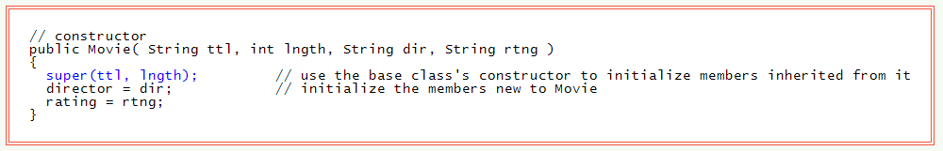
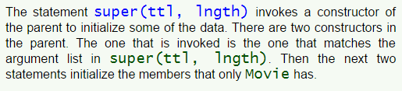
Using a Super Class's Constructor

Slide 11
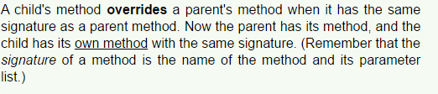
Overriding Methods

Slide 12
Using super in a Child's Method
Sometimes (as in the example) you want a child class to have its own method, but that method includes everything the parent's method does.
You can use the super reference in this situation.

Slide 13
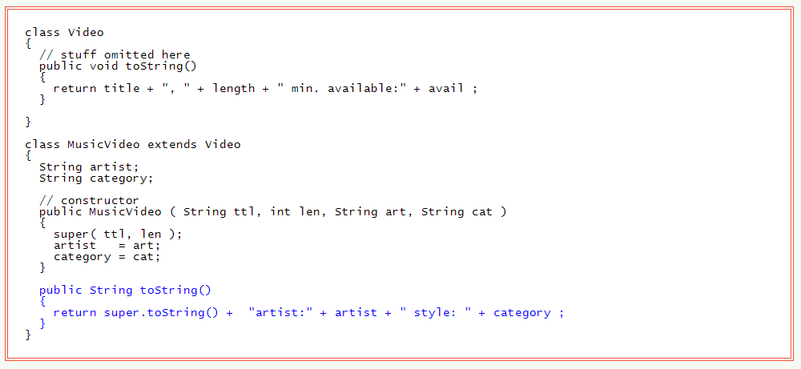
Complete MusicVideo Class

Slide 14
The Object Class
All classes have a parent class (a super class) except one.
The class at the top of the Java class hierarchy is called Object.
If a class definition does not specify a parent class then it automatically has Object as a parent class.

Slide 15
Questions
Dsecribe inheritance as it applies to OOP.
How is inheritance in Java different from some other languages?
How is inherictance implemented in Java?
What does the is-a relationship mean?
How are the inherited members of a class intialized in a child contructor?

Slide 16
Questions
What does it mean to override a method?
By default all Java classes have a parent class. What is its name?

Slide 17
Exercises
Create a class called dog. Give it the following features: mass, lifeSpan, colour. Provide one constructor to allow an object to be made from the class. Give it one behaviour: bark(). When it barks say “Wuff”.
There are many types of dogs ex. Sheep dogs, racing dogs, companion dogs etc. Create three new types of dogs and make sure they inherit from dog. Assign each new dog one new feature not inherited from its parent ex. An attack dog may have a specific level of aggression. In each child class add a new constructor that is used to initialize all inherited traits as well as any new ones. Add one new behaviour to each child class. Finally override bark() in only one child dog so that it barks in its own unique way.
DO NOT FORGET TO FOLLOW ALL OOP PROTOCOLS WHEN DESIGNING AND CREATING YOUR CLASSES.

