Slide 1
Abstract Classes and Polymorphism

Slide 2
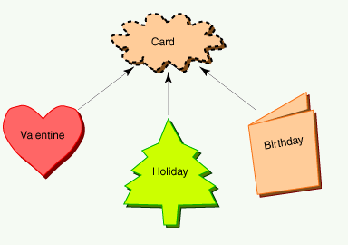
Greeting Card Hierarchy
An object must be an instance of one of the three child types:Valentine, Holiday, andBirthday. There will never be an object that is merely a "Card." The Card class represents the abstract concept of "Card." All actual card objects must be more specific.

Slide 3
Abstract Class
An abstract class in Java is a class that is never instantiated.
Its purpose is to be a parent to several related classes.
The children classes inherit from the abstract parent class.

Slide 4
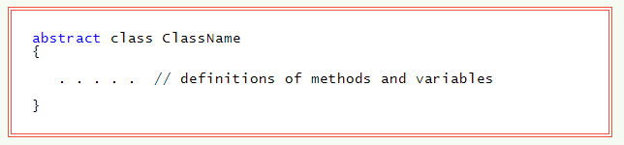
Abstract Class
Access modifiers such as public can be placed before abstract. Even though it can not be instantiated, an abstract class can define methods and variables that children classes inherit.

Slide 5
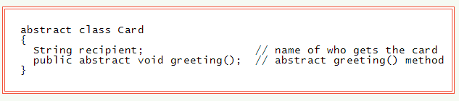
Abstract Methods
Each card class has its own version of the greeting() method. Each class has a greeting(), but each one is implemented differently. It is useful to put an abstract greeting() method in the parent class. This says that each child inherits the "idea" of greeting(), but each implementation is different.
Abstract classes can (but don't have to) contain abstract methods.
An abstract method has no body. (It has no statements.) It declares an access modifier, return type, and method signature followed by a semicolon. A non-abstract child class inherits the abstract method and must define a non-abstract method that matches the abstract method.
An abstract child of an abstract parent does not have to define non-abstract methods for the abstract signatures it inherits. This means that there may be several steps between an abstract base class to a child class that is completely non-abstract.
Since no constructor is defined in Card the default no-argument constructor is automatically supplied by the compiler. However, this constructor cannot be used directly because no Card object can be constructed.

Slide 6
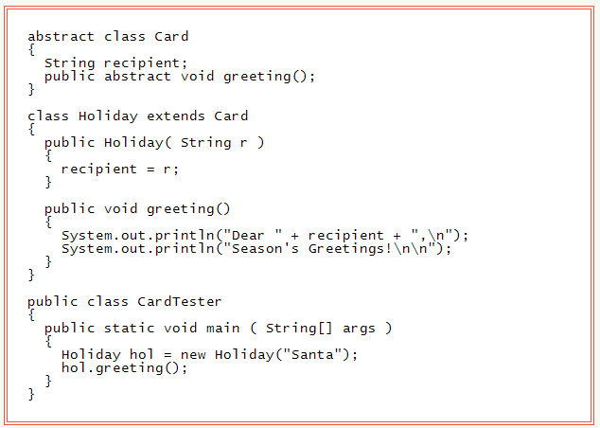
Not Everything in an abstract Class is abstract Not everything defined in an abstract classes needs to be abstract. The variable recipient is defined in Card and inherited in the usual way. However, if a class contains even one abstract method, then the class itself has to be declared to be abstract.

Slide 7
Advantage of Abstract Classes
Abstract classes are used to organize programs.

Slide 8
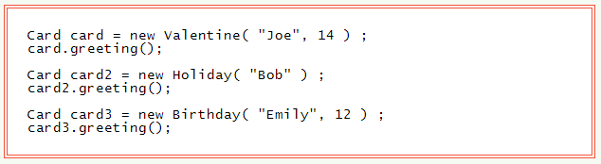
Using Parent Class Reference Variables
This will run the greeting() method for a Valentine, then it will run the greeting() method for a Holiday, then it will run the greeting() method for a Birthday. The type of the object in each case determines which version of the method is run.

Slide 9
Polymorphism
Polymorphism means "having many forms."
In Java, it means that a single variable might be used with several objects of related classes at different times in a program.
When the variable is used with "dot notation" variable.method() to invoke a method, exactly which method is run depends on the object that the variable currently refers to.

Slide 10
Descendants
A variable can hold a reference to an object whose class is a descendant of the class of the variable.

Slide 11
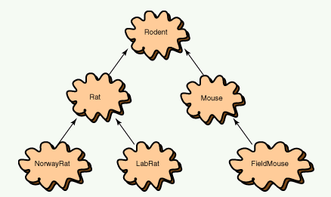
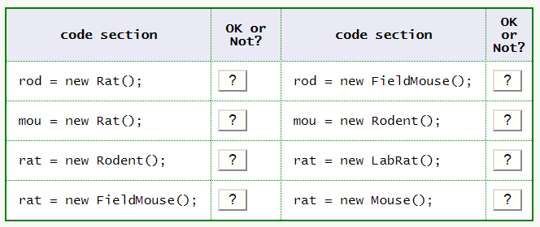
Another Hierarchy

Slide 12
Overriding abstract Methods
A non-abstract child must override each abstract method inherited from its parent by defining a method with the same signature and same return type.
It is an error if a child defines a method with the same signature as a parent method, but with a different return type.

Slide 13
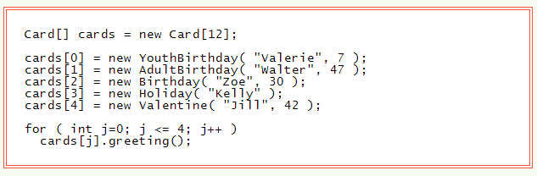
Array of Related Objects

Slide 14
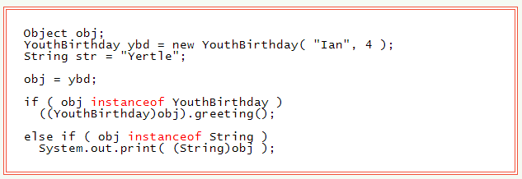
The instanceof Operator
A typecast is used to tell the compiler what is really in a variable that itself is not specific enough.
In a complicated program, a reference variable might end up with any of several different objects, depending on the input data or other unpredictable conditions. To deal with this, the instanceof operator is used.
variable instanceof Class This operator evaluates to true or false depending on whether the variable refers to an object of type Class.
Also, instanceof will return true if variable is a child of Class. It can also be a grandchild or greatgrandchild or ... of the class.

Slide 15
Questions
What are abstract classes and when should they be used?
What is different about an abstract class as opposed to regular Java classes?
How are abstract classes defined?
How are abstract methods defined?
Is everything in an abstract class abstract?

Slide 16
Questions
What is polymorphism?
Provide an example of polymorphism.
A parent reference variable refers to a child object. Both have a method called doSomething(). Which method gets called (the parent’s or the child’s)?
When is casting involved in polymorphism?
What is the instanceOf operator used for?

Slide 17
Questions
Is it mandatory that a child class inheriting from an abstract parent class override all of its methods?

Slide 18
Exercises
Create a project to test the abstract parent classes as well as the children outlined in this powerpoint.

