Slide 1
Interfaces

Slide 2
Interface
An interface describes aspects of a class other than those that it inherits from its parent.
An interface is a set of requirements that the class must implement.
An interface is a list of constants and method signatures.
There is no implementation of the methods (there is no method body).
A class that implements an interface must implement each of the methods listed in the interface.

Slide 3
Interface
As an example, a class Car might extend the Vehicleclass.
Inheritance then gives it all the methods and instance variables of Vehicle.
If Car also implements theTaxable interface, then its definition must contain code for all the methods listed in Taxable.

Slide 4
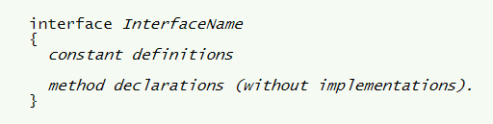

Interface Definition
A class implements an interface by doing this:
A class always extends just one parent but may implement several interfaces.

Slide 5
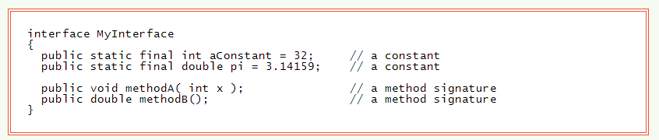
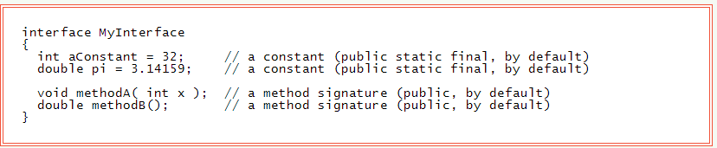
Example Interface
A method in an interface cannot be made private.
A method in an interface is public by default.
The constants in an interface are public static final by default.
Recall that final means that the value will not change.
A class that implements an interface must implement each method in the interface.
Methods from the interface must be declared public in the class.
Constants from the interface can be used as if they had been defined in the class.
Constants should not be redefined in the class.

Slide 6
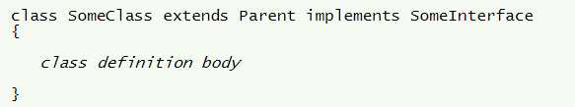
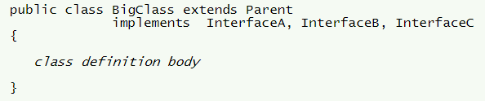
Implementing an Interface

Slide 7
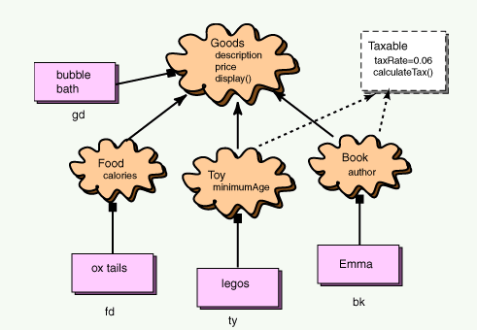
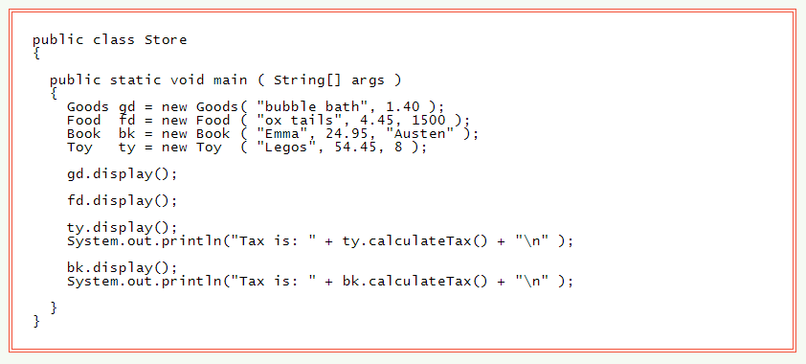
Testing Program

Slide 8
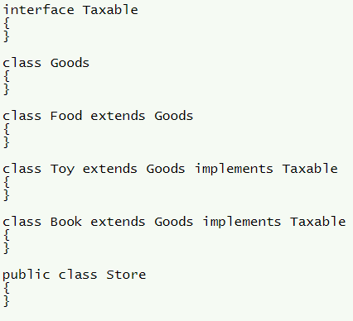
Source File

Slide 9
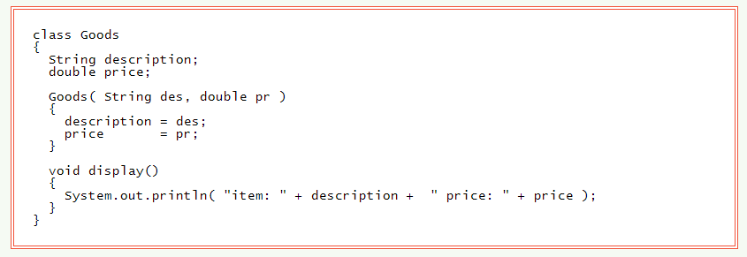
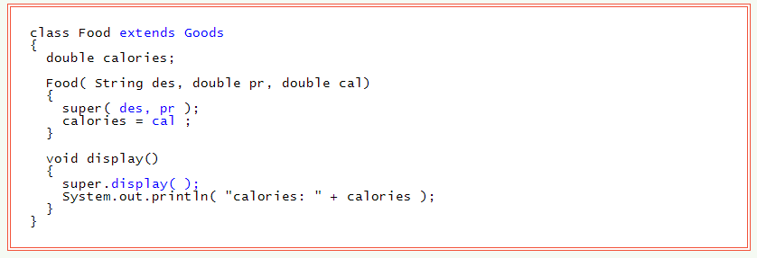
Program

Slide 10
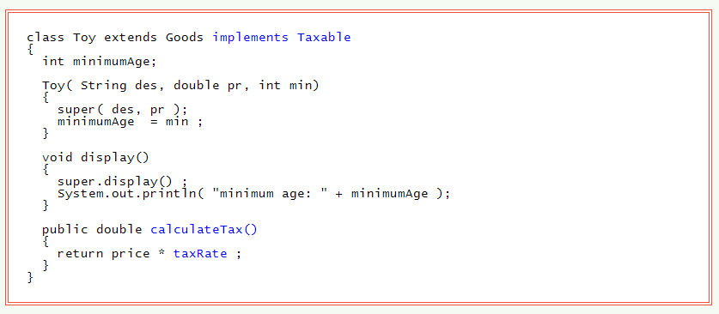
Toy Class

Slide 11
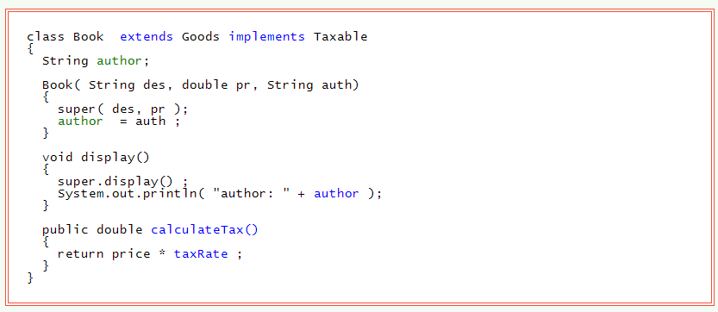
Book Class

Slide 12
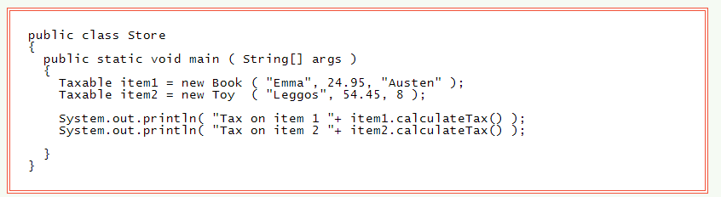
Interface as a Type
An interface can be used as a data type for a reference variable. Since Toy and Book implement Taxable, they can both be used with a reference variable of type Taxable:

Slide 13
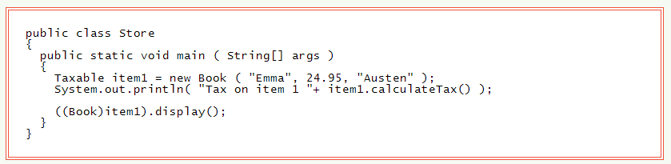
Type Casts
Use a type cast to tell the compiler that in a particular statement in the program the variable will refer to an object of a specific class:

Slide 14
Questions
What is the purpose of an interface?
What is unique about the variables created in an interface?
How are interfaces created?

Slide 15
Questions
What are interfaces composed of?
How do you get a class to inherit from an interface?
How does the use of an interface relate to multiple inheritance?

Slide 16
Questions
Look at slide 13. Why are we able to assign a new Book to Taxable item1?
Look at slide 13. Why was a cast required to call the display() function?
Look at the diagram on slide 7. Why do we use an interface to assign the Taxable members to Toys and Books? Why not just create an abstract class with the same members and have Goods inherit from it?

Slide 17
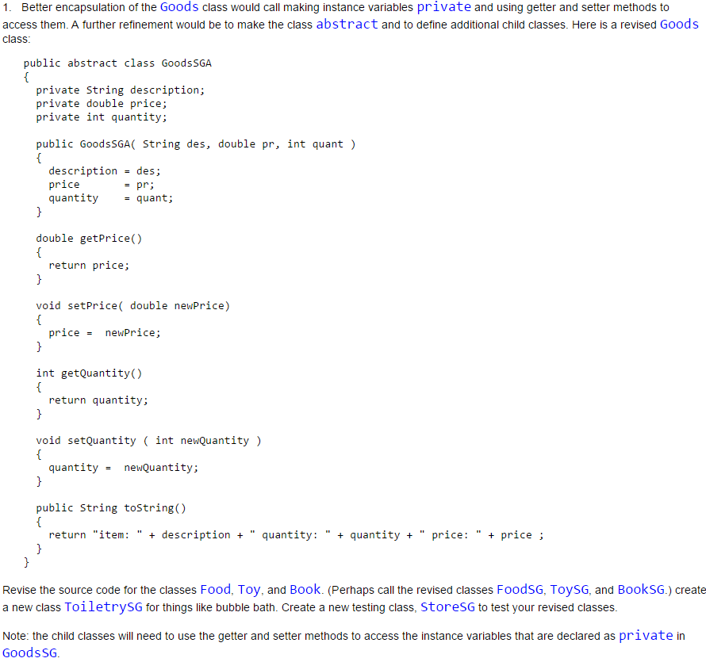
Exercises

