Slide 1

Unit Testing
ACIT 2911
April 29, 2019
Lecture by: Mehdi

Slide 2
Outline
I. Testing
Traditional Testing
Unit Testing
Benefits of Unit Testing
II. Unit testing in JS
III. LAB: Setup your unit testing framework

Slide 3
Traditional Testing
Test the system as a whole
Individual components rarely tested
Errors go undetected
Isolation of errors difficult to track down
Project
Notes:
Software is made up of a number of components. Each component is used by other parts of the system to form some either the application or some major part of the end application. Traditional testing leaves the validation of the system to the end. Due to a number of reasons, the system may not operate correctly:
Poor interface/API design
Procedures/functions/methods not written correctly
Integration not correctly performed
Requirements not clearly defined
When bugs are found, or when the functionality of the system is not operating how it should, the task of tracking down exactly what goes wrong is extremely difficult. This mess can be further compounded when changes are made to the code. Since testing is performed at the highest level, there is no guarantee that the system will operate exactly as it was before because there is no guarantee that other parts of the code are going to break.
Question: How can we ascertain that the system will operate correctly when we can’t guarantee that the smallest parts of the system are going to work independently? Alternatively, when putting together parts that don’t work, aren’t we going to be guaranteed that the system as a whole is not going to work?
We can reduce the number of bugs in the system, but validating that each component on its own operates correctly. The traditional testing can then validate that the pieces of code all operate together.

Slide 4
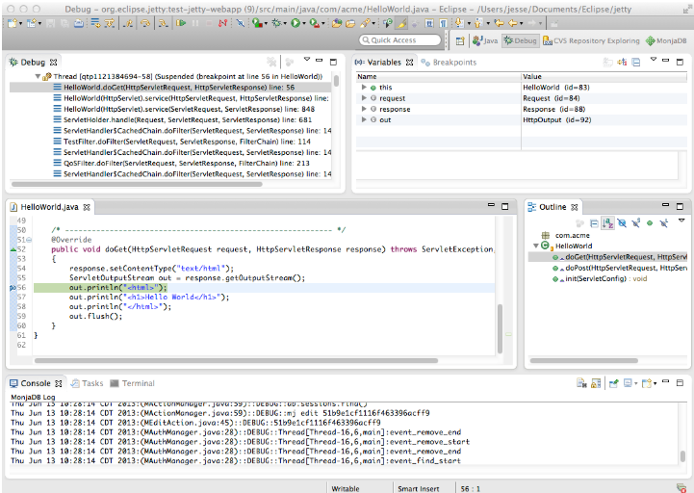
Strategies
Print Statements
Use of Debugger (pdb, gdb)
Debugger Expressions
Test Scripts
Notes:
Print Statements
Intent is usually not described in the output
Other developers need to imply or deduct the purpose of the print statements
Very messy and easy to get lost in what the problem is
Difficult to track
Usually transient as it cannot be included in source – considered a side effect of testing and thus must be removed
Debugger Expressions
Not usually portable outside of that specific debugger
Difficult to add to some form of source control
Test Scripts
Difficult to maintain in sychronisation with the source
Lots of work to establish framework for testing application
Usually system level testing

Slide 5
Unit Testing
Each part tested individually
All components tested at least once
Errors picked up earlier
Scope is smaller, easier to fix errors
Goal
Isolatable
Repeatable
Automatable
Easy to Write
Notes:
Unit testing aims at testing each of the components that a system are built upon. As long as each of them work as they are defined to, then the system as a whole has a better chance of working together.
Where possible, all units that could possibly fail are tested at least one. Judgement is needed to decide what parts need testing. Some things such as accessors/mutators generally don’t need to be tested.
Components that are erroneous can be detected earlier. The scope of unit tests is even smaller that your traditional tests. If errors are detected, they are generally easier to fix.

Slide 6
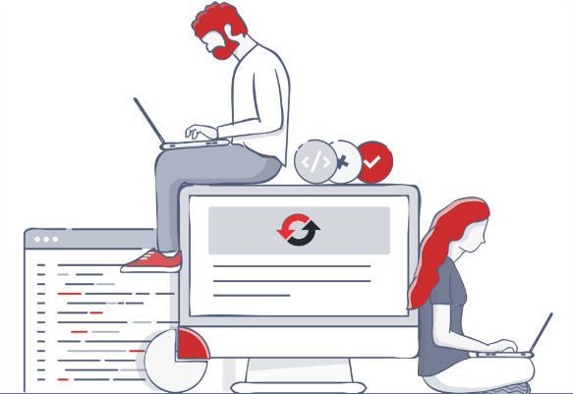
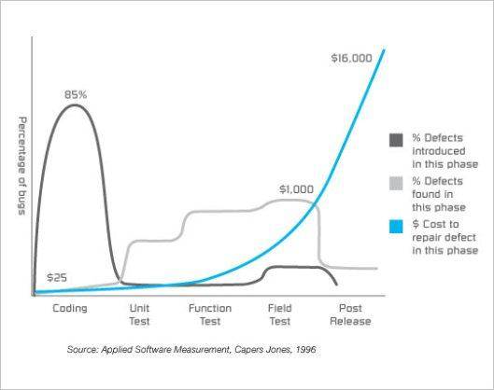
Advantage
Faster Debugging
Faster Development
Better Design
Excellent Regression Tool
Reduce Future Cost
Notes:
Reasons to bother unit testing:
Faster Debugging
Unit tests smaller amounts of code, easily isolating points of error and narrowing the scope for errors.
Faster Development
Less time debugging with unit tests
Encourage aggressive refactoring resulting in better design and easier maintenance.
Adding enhancements can be performed with confidence that existing behaviour of the system continues to operate in the same manner.
Better Design
As mentioned before, unit testing encouraging more refactoring.
Unit tests make developers focus more on the contracts of a class and those classes that might use it
Excellent Regression Tool
Major refactorings and restructuring of the code can be performed.
Reduce Future Cost
Unit testing is an investment in the project. It takes time to ramp up, but in the long-term provides a useful basis for the project.

Slide 7
Take-aways
Define tests correctly
Minimize side-effects of unit tests
Keep tests small and fast
Automate all processes
Write effective exceptions and assertions
Add a test case for every bug exposed
Add a test case for every function (ideal!)
Refactor, refactor, refactor
Notes:
Symbolic model checking

Slide 8
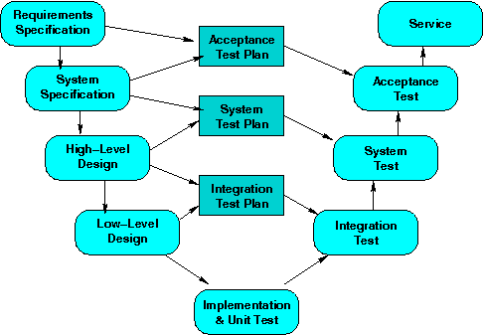
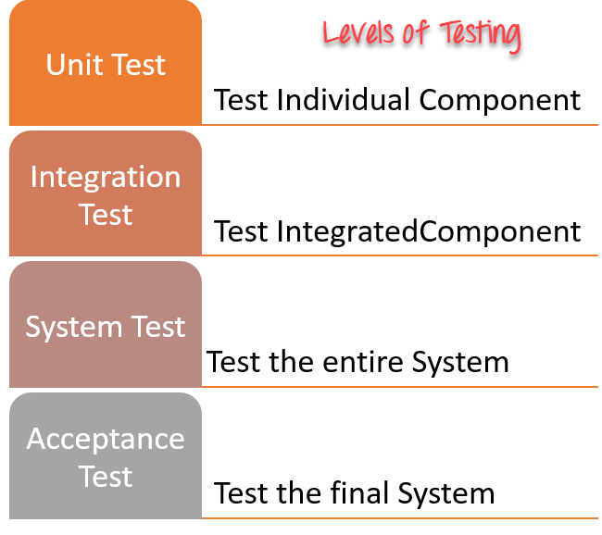
Test hierarchy

Slide 9
Advanced topics
Mock Objects: https://medium.com/@martin.lichstam/unit-testing-and-stubs-mocks-and-spies-68c173331790
What to Test and How Much to Test
Bugs
New Functionality
Optimize Running Time (speed vs. memory overhead)
Code Coverage metrics
Environment Management
Continuous Integration -> we will cover this in the following week
Local and remote development -> build server? Jenkins?
Trigger unit test everytime you have a pull request, if pass then check

Slide 10
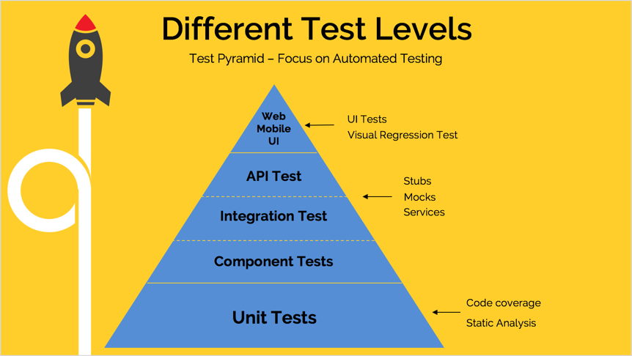
Test Pyramid

Slide 11
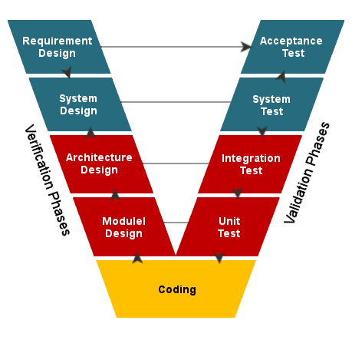
V-Model

Slide 12
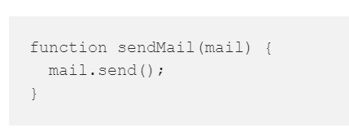
Mocking
Test the following function:
Say you would like to verify whether the mail will be sent or not — in this case the invocation of send()
Options?
…without actually sending it.

Slide 13
II. Unit Testing in JavaScript

Slide 14
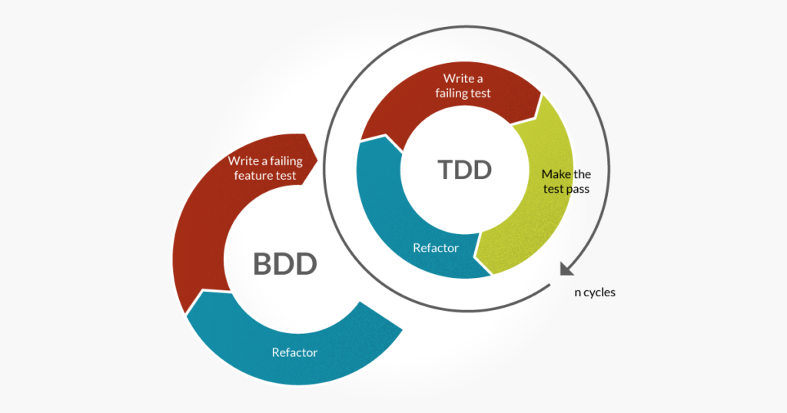
Unit Testing in JavaScript
There are too many frameworks for unit testing for JavaScript
Some use Test-Driven-Development method: TDD → will cover next week
Others use Behavior-Driven-Development method: BDD
Intuitively, in BDD, a test is written that can satisfy both the developer and customer, but in TDD you write a test that will only satisfy a developer and the code they write.
Read more: https://blog.testlodge.com/tdd-vs-bdd/
Some of the frameworks:
TDD
QUnit, JsUnit & Mocha
BDD
Jasmine & Mocha
Notes:
Ref: https://codeutopia.net/blog/2015/03/01/unit-testing-tdd-and-bdd/

Slide 15

QUnit
QUnit was developed to test jQuery
jQuery:
jQuery is a JavaScript library designed to simplify HTML DOM tree traversal and manipulation, as well as event handling, CSS animation, and Ajax.
It is free, open-source software using the permissive MIT License.
QUnit has the following features:
Uses test-driven development (TDD)
Has a lot of asserts to match every need
Can test async code

Slide 16

Jasmine
Jasmine is an open-source testing framework
Can run in both the browser and on Node.js
Uses behavior-driven development
Widely used
Jasmine has the following features:
Easy-to-read (expressional) syntax
Testing async code
Spies (mocking objects and methods)
DOM testing
Notes:
The Document Object Model (DOM) is a cross-platform and language-independent application programming interface that treats an HTML, XHTML, or XML document as a tree structure wherein each node is an object representing a part of the document.

Slide 17

Mocha
Mocha is the new kid on the block
Open source framework, introduced in 2012
Can run in both the browser and on Node.js
Plugins for test syntax, spies, etc…
Mocha has the following features:
Easy-to-read (expressional) syntax
Testing async code
Supports both BDD and TDD
The most used plugin for syntax is Chai.js
The most used plugin for spies is Sinon.js

Slide 18
III. LAB Setup your unit test environment Testing with Mocha
Overview and Installation

Slide 19
Mocha Overview
Mocha is a feature-rich framework for testing JavaScript
Run in both the browser and on Node.js
Can test async code
Compatible with Karma & other test runners
Pluggable
Different plugins to add even more features

Slide 20
Installing Mocha
To start working with Mocha follow the steps:
Get Mocha
Download mocha from GitHub
With bower
With NuGet
Setup a reporter
HTML reporter
Karma reporter
$ bower intall mocha
PM> Install-Package MochaChaiBdd

Slide 21
Installing Mocha
Select a plugin for the test syntax
Mostly used is chai.js
Start writing tests
$ bower intall chai
describe('#sum', function () {
it('when empty array, expect to return 0', function () {
var actual = sum([]);
expect(actual).to.equal(0);
});
it('when with single number, expect the number', function () {
var number = 6;
var actual = sum([number]);
var expected = number;
expect(actual).to.equal(expected);
});
});

Slide 22
Mocha Reporters
Where Mocha can report the result of the tests?

Slide 23
Mocha Reporters
What is a reporter?
Reporter is the place where Mocha outputs the result from the unit tests
If the tests passed
Or if they failed
Mocha has a lot of reporters:
https://blog.logrocket.com/a-quick-and-complete-guide-to-mocha-testing-d0e0ea09f09d
https://mochajs.org/
Good reporters are the HTML reporter, the Spec reporter and the Karma reporter

Slide 24
Mocha HTML Reporter
The HTML reporter outputs in the browser
Needs an HTML template:
<!-- document start -->
<head>
<link rel="stylesheet" href="mocha/mocha.css">
</head>
<body>
<div id="mocha"></div>
<!-- include mocha.js and chai.js -->
<script type="text/javascript">
mocha.setup('bdd');
expect = chai.expect;
</script>
<!-- import javascript files and test files -->
<script type="text/javascript">
mocha.run();
</script>
<!-- document end -->

Slide 25
Mocha HTML Reporter
The HTML reporter outputs in the browser
Needs an HTML template:
Include the Mocha styles
<!-- document start -->
<head>
<link rel="stylesheet" href="mocha/mocha.css">
</head>
<body>
<div id="mocha"></div>
<!-- include mocha.js and chai.js -->
<script type="text/javascript">
mocha.setup('bdd');
expect = chai.expect;
</script>
<!-- import javascript files and test files -->
<script type="text/javascript">
mocha.run();
</script>
<!-- document end -->

Slide 26
Mocha HTML Reporter
The HTML reporter outputs in the browser
Needs an HTML template:
<!-- document start -->
<head>
<link rel="stylesheet" href="mocha/mocha.css">
</head>
<body>
<div id="mocha"></div>
<!-- include mocha.js and chai.js -->
<script type="text/javascript">
mocha.setup('bdd');
expect = chai.expect;
</script>
<!-- import javascript files and test files -->
<script type="text/javascript">
mocha.run();
</script>
<!-- document end -->
Mocha will report here

Slide 27
Mocha HTML Reporter
The HTML reporter outputs in the browser
Needs an HTML template:
<!-- document start -->
<head>
<link rel="stylesheet" href="mocha/mocha.css">
</head>
<body>
<div id="mocha"></div>
<!-- include mocha.js and chai.js -->
<script type="text/javascript">
mocha.setup('bdd');
expect = chai.expect;
</script>
<!-- import javascript files and test files -->
<script type="text/javascript">
mocha.run();
</script>
<!-- document end -->
Setup Mocha

Slide 28
Mocha HTML Reporter
The HTML reporter outputs in the browser
Needs an HTML template:
<!-- document start -->
<head>
<link rel="stylesheet" href="mocha/mocha.css">
</head>
<body>
<div id="mocha"></div>
<!-- include mocha.js and chai.js -->
<script type="text/javascript">
mocha.setup('bdd');
expect = chai.expect;
</script>
<!-- import javascript files and test files -->
<script type="text/javascript">
mocha.run();
</script>
<!-- document end -->
Run the tests with Mocha

Slide 29
Karma: JavaScript Test Runner
Overview

Slide 30
Karma Overview
Karma is a testing environment
Getting instant feedback
Can run in any browser environment
Even in phantom.js environment
Karma can work with most of the testing frameworks
Mocha
Jasmine
QUnit

Slide 31
Installing Karma
Karma is a Node.js package
Must have Node.js installed, to run Karma
Install Node.js from http://nodejs.org/
There is an installer for every platform:
Windows
Linux
Macintosh
Install Karma with
$ npm install karma -g

Slide 32
Setting up Karma Environment
To setup karma environment for a project follow the steps:
Install karma, if you have not done so already
Install the necessary packages for the wanted test framework:
$ npm install karma-mocha karma-chai --save-dev
Install one or many browser environments
$ npm install karma-chrome-launcher --save-dev
$ npm install karma-phantomjs-launcher --save-dev
Run and fill in the needed data
Start the Karma environment with
$ karma init
$ karma start

Slide 33
Mocha with Chai
Adding assertion framework

Slide 34
Mocha with Chai
Mocha is made pluggable
Can use almost any assertion framework
The most used is Chai.js
Chai.js uses behavior-driven development
To use Chai in Mocha, do the following:
Install Chai:
Add chai.js to your reporter
Set the global expect object to chai.expect
$ bower install chai
<script src="…/chai.js">
expect = chai.expect;

Slide 35
Mocha Test Suites and Specs

Slide 36
Mocha Test Suites
Mocha uses test suites to order the tests
Tests suites are created with the describe(name, callback) function
Provide a name of the test suite and a callback function
describe('#sum', function() {
//here are the tests
});
Test suites can be nested in one another
describe('Person', function() {
describe('when initializing', …
describe('when changing name', …
});

Slide 37
Mocha Specs
Spects (tests) are contained in a test suites
Call the function it(name, callback)
Has a name and a callback:
describe('Person', function() {
describe('when initializing', function(){
it('with valid names, expect ok', function(){
var person = new Person('Peter', 'Petrov');
expect(person.firstname()).to.equal('Peter');
expect(person.lastname()).to.equal('Petrov');
});
});
});

Slide 38
Chai Assertions
How to use Chai.js?

Slide 39
Chai Assertions
Chai.js is a assertion framework
Allows to assert expected/actual in tests
Chai.js has three assertion styles
Assert style
assert.equal(person.firstname(), 'Peter');
Expect style
expect(person.firstname()).to.equal('Peter');
Should style
person.firstname().should.equal('Peter');

Slide 40
Chai Expect Assertion Style
Using the BDD Styles

Slide 41
Chai Expect Assertion Style
Chai.js expect assertion style has a fluent and expressive syntax:
expect(person.firstname()).to.equal('Peter');
expect(person).to.be.a('Person');
expect(person).to.not.be.undefined;
expect(person).not.to.be.null;
expect(person).to.be.ok;
expect(person).not.to.be.ok;
expect(function(){
//without name
new Person();
}).to.throw(ReferenceError);

