Slide 1
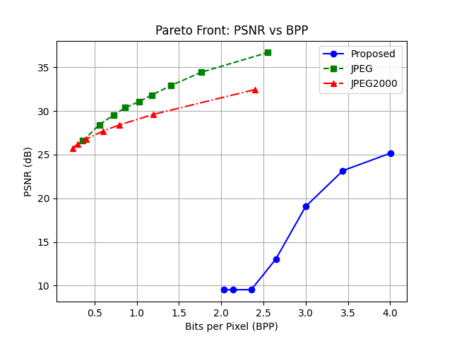
Image Compression Using Neural Networks
Jozko Mrkvicka
Jozko Mrkvicka
Jozko Mrkvicka
Image is compressed when

