Slide 1
Energy Efficient Operation of 3GPP LTE-A and IEEE 802.16m Downlink Channel

Slide 2
Introduction
Improving client operation period without recharging its battery, GPP LTE Advanced defines a so called Discontinuous Reception DRX mode, whereas IEEE. The approach is based on an M GI K queueing model with vacations, where authors propose an optimization with respect to the packet loss probability.
In particular, and concentrate on DBMAP arrival flow and conduct performance analysis of packet delay and energy consumption for the sleep mode. In what follows, we bridge in this gap by first introducing the power saving modes and then by conducting their comparative analysis.

Slide 3
Outline
Introduction (2)
Methods (5-7)
Experiments (9-12)
Discussion (14)
Conclusion (15)

Slide 4
Methods

Slide 5
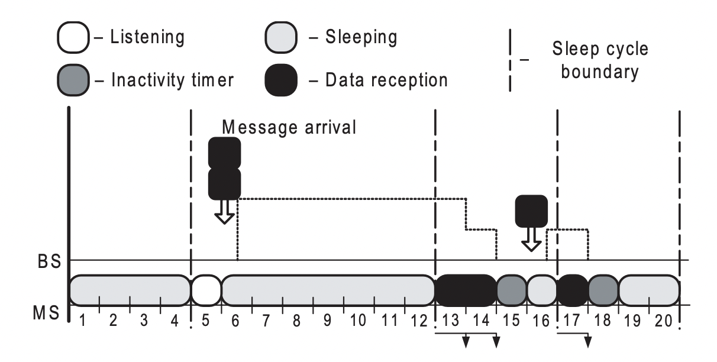
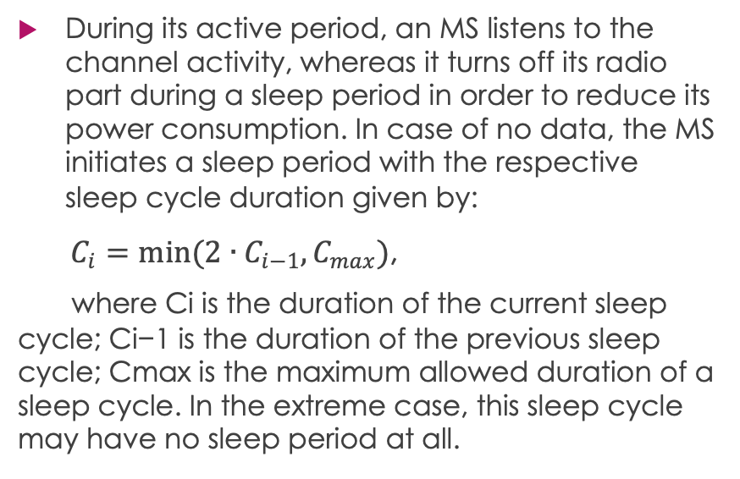
IEEE 802.16m Sleep Mode Operation
During its active period, an MS listens to the channel activity, whereas it turns off its radio part during a sleep period in order to reduce its power consumption. In case of no data, the MS initiates a sleep period with the respective sleep cycle duration given by:
$C_{i}=min(2∙C_{i−1}, C_{max})$,
where Ci is the duration of the current sleep cycle; Ci−1 is the duration of the previous sleep cycle; Cmax is the maximum allowed duration of a sleep cycle. In the extreme case, this sleep cycle may have no sleep period at all.
Figure 1 – The sleep mode operation

Slide 6
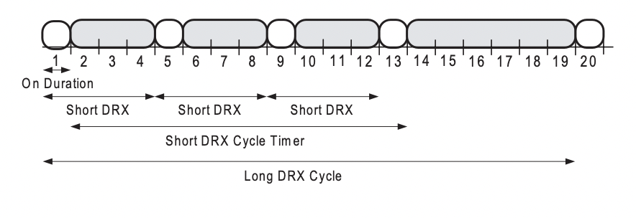
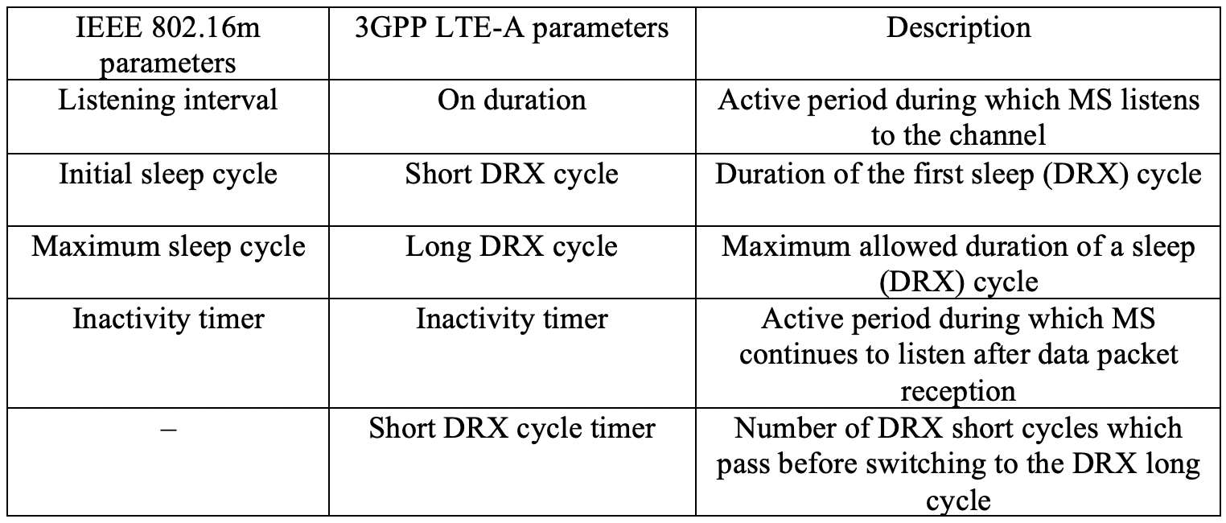
3GPP LTE-Advanced DRX Mode Operation
In Table 1, the DRX mode differentiates between two types of cycles: a short DRX cycle and a long DRX cycle.
Figure 2 – The DRX mode operation
In particular, an MS listens to the channel activity periodically to save some of its power. However, 3GPP LTE-Advanced defines an alternative mechanism to control the listening intervals. Figure 2 demonstrates an example of the DRX mode operation, as well as introduces several important parameters.
Table 1 – Parameters of the power saving modes:

Slide 7
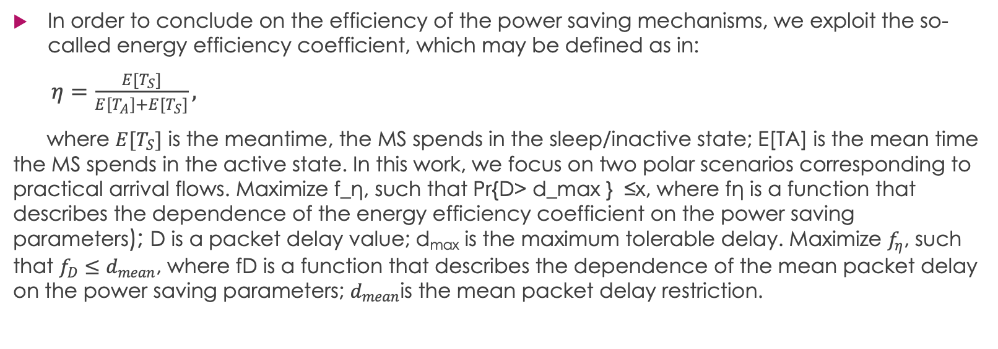
Power Saving Analysis
In order to conclude on the efficiency of the power saving mechanisms, we exploit the so-called energy efficiency coefficient, which may be defined as in:
$η=\frac{E[T_{S}]}{E\left[T_{A}\right]+E[T_{S}]},$
where $E[T_{S}]$ is the meantime, the MS spends in the sleep/inactive state; E[TA] is the mean time the MS spends in the active state. In this work, we focus on two polar scenarios corresponding to practical arrival flows. Maximize f_η, such that Pr{D> d_max } ≤x, where fη is a function that describes the dependence of the energy efficiency coefficient on the power saving parameters); D is a packet delay value; d_{max} is the maximum tolerable delay. Maximize $f_{η}$, such that $f_{D}≤d_{mean}$, where fD is a function that describes the dependence of the mean packet delay on the power saving parameters; $d_{mean}$is the mean packet delay restriction.

Slide 8
Experiments

Slide 9
Model Assumptions
Below we introduce a wireless system model in order to assess the performance of the power saving mechanisms. The assumptions of the model may be summarized as follows:
System topology comprises
Only downlink channel is considered.
During a frame, the MS may receive at most one data packet.
Data packets are served by the BS in the order of their arrival
If a packet arrives at the BS during the frame k, it may be sent to the MS not earlier than in the following frame k+1.
Data packet errors are not considered.

Slide 10
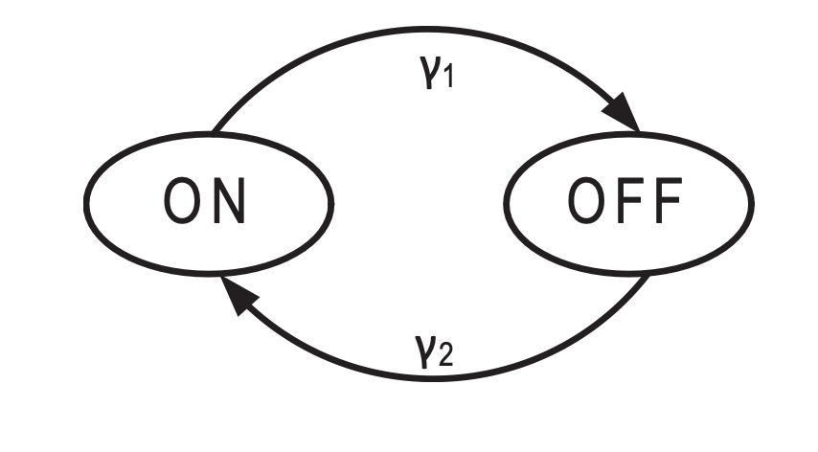
Traffic Arrival Patterns
As we discussed above, this work compares HTTP and VoIP traffic. Both packet arrival flows belong to ON-OFF models, where each model has two states: an active (ON) state and a passive (OFF) state Figure 3. If a model is currently in the ON state, it generates new data packets. Otherwise, in the OFF state there are no new arrivals. Whereas ON and OFF dwell times have exponential distribution with parameters γ1 and γ2 for both models, the values of these parameters are different.
Figure 3 – Example of an ON-OFF model

Slide 11
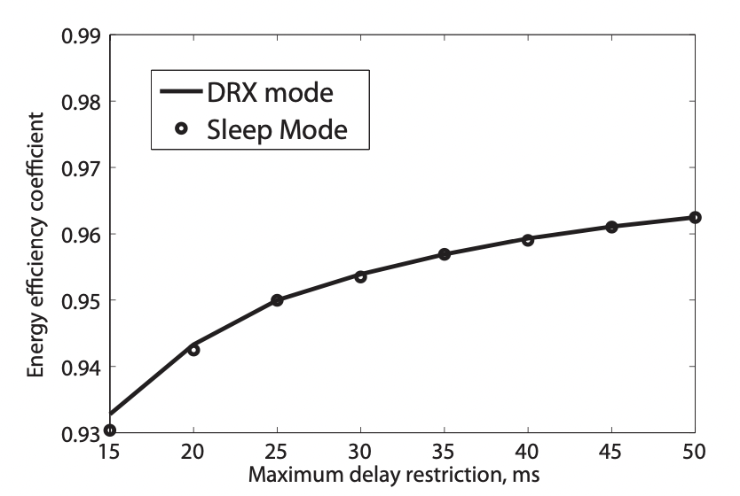
Comparison of Power Saving Modes for VOIP
In order to reduce the complexity of the considered optimization problem, we set the listening period, as well as the inactivity timer equal to one frame (1ms). In Figure 4, we plot the energy efficiency coefficient against the maximum packet delay restriction. Importantly, we limit the number of packets, which may exceed the restriction, by at most 2%.
Figure 4 – Energy coefficient for VoIP

Slide 12
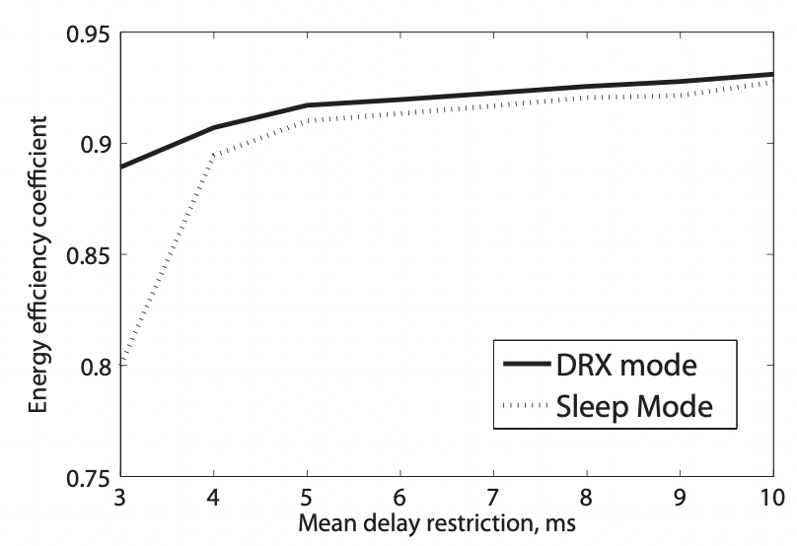
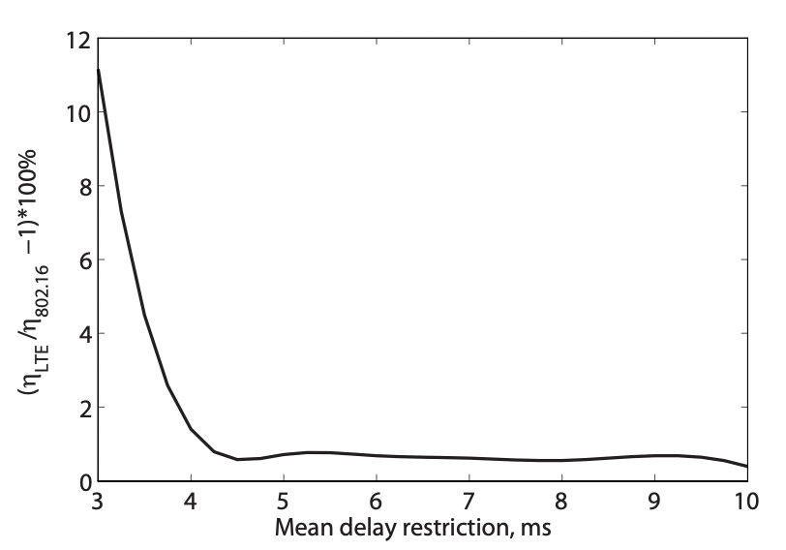
Comparison of Power Saving Modes for HTTP
Figure 5 – Energy coefficient for HTTP traffic
In Figure 5, we plot the energy efficiency coefficient against the mean packet delay restriction for HTTP traffic. We notice that as the mean delay restriction increases, the energy efficiency coefficient grows for both powers saving modes. In Figure 6, we demonstrate the gain of the DRX mode over the sleep mode.
Figure 6 – Energy coefficient gain for HTTP

Slide 13
Discussion

Slide 14
Summary of the results
In this paper, we conducted performance analysis of two power saving modes defined by next-generation wireless communication standards, IEEE 802.16m and 3GPP LTE- Advanced. In order to conclude on the efficiency of the con- sidered mechanisms, we developed a comprehensive system model, which allows comparison of energy efficient perfor- mance in case of different practical traffic patterns (VoIP and HTTP).

Slide 15
Conclusion
Our analysis indicates that the DRX mode and the sleep mode demonstrate similar behavior of the energy efficiency coefficient (in case of VoIP traffic) subject to a particular maximum packet delay restriction. However, the DRX mode outperforms the sleep mode in terms of the energy efficiency coefficient (in case of HTTP traffic) for tight mean packet delay restriction. Nevertheless, the performance gain of the DRX mode over the sleep mode drops dramatically for higher values of the mean packet delay restriction. We thus conclude that both advanced powers saving modes generally show ex- cellent energy efficient performance and are important for the development of the future wireless cellular networks.

Slide 16
Thanks for attention!

