Slide 1
INVESTMENT ASSIGNMENT SUBMISSION
Name: Ankit Mishra
(ankitmishra723@gmail.com)

Slide 2
<Abstract>
The problem statement is to help an asset management company “Spark funds” with a rigorous analytics to identify global trends of investment by different countries in identified different companies based on the required business use cases.
Constraints for investment :
The amount of investment that needs to be made is in the range of 5 to 15 million USD per round.
Investment should be made in English –Speaking countries only i.e. countries where English is identified as an official language

Slide 3
<Problem solving methodology>
Use flow chart
Reading Data into dataframes
Cleaning of data 1.filling NaN values, 2. removing duplicates, 3. uniformity in text case for uniqueIDs in all dataframes
Analysis based on business requirements: 1. scenario understanding 2. data susetting for analysis 3. Analytics
Plotting of Results for better visualization of results

Slide 4
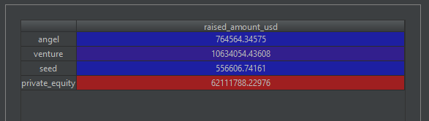
<Analysis>
In the checkpoint 1 section of the Assignment, the following observations were made using the ‘Companies dataframe’ and ‘rounds2 dataframe’
Mean values for all the different funding types namely [‘venture’, ‘seed’,’angel’,’private_equity’ is as follows:
From the result we understand that ‘private_equity’ receives the highest amount of investment as compared to any other funding type. BUT, recalling the constraints of investing limit (5-15) million USD. We can conclude that VENTURE funding type will be most suited.

Slide 5
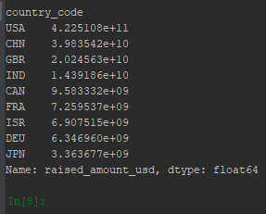
<Analysis>
Having identified the Right Investment type, the goal is now to analysis the countries where investment is done. So for this 9 countries were identified where investments have been made in great capacity.
From this observation, narrowing down further to countries where English is an Official language, we concluded that USA, GBR, CAN are the three countries where VENTURE investment was heavy.
Note: though CHN (china) has a far greater investment than GBR, English is not an official language their, hence have to be dropped, a similar reason is for dropping IND (India)

Slide 6

<Analysis>
A further analysis on the sectors where investment was done needs to be analysed.
For the Identified three countries, the observation was as follows:
USA, the top 3 investment sectors were :
Others
Cleantech / Semiconductors
Social, Finance, Analytics, Advertising
GBR , the top 3 investment sectors were :
Others
Cleantech / Semiconductors
Social, Finance, Analytics, Advertising
CAN, the top 3 investment sectors were :
Cleantech / Semiconductors
Others
Social, Finance, Analytics, Advertising

Slide 7
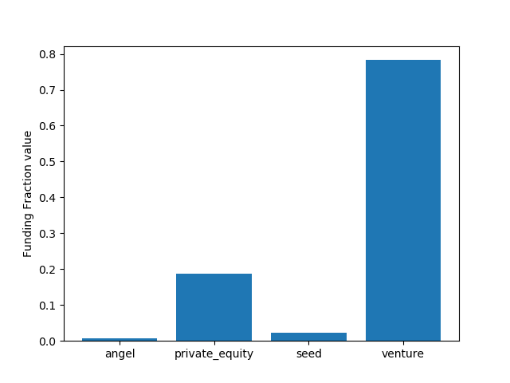
<Results>
Plot 1
From this plot we can infer that globally Venture type of investment is the most preferred type of funding with approximately 80% of total investment.
Therefore Venture type of funding is the most suitable type of funding that Spark funds can do.

Slide 8
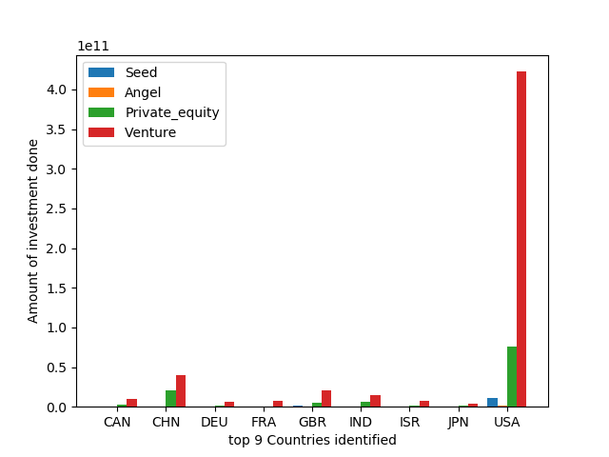
<Results>
Plot 2
From this plot we can visualize the top 9 countries and their investment trends in the 4 identified type of investments.
Evidently USA takes a major lead of investments for a venture type of funding, followed by CHN , GBR, IND & CAN.
But as per our constrain of ‘English speaking countries’ we identify USA, GBR, CAN as our potential countries for investment.

Slide 9
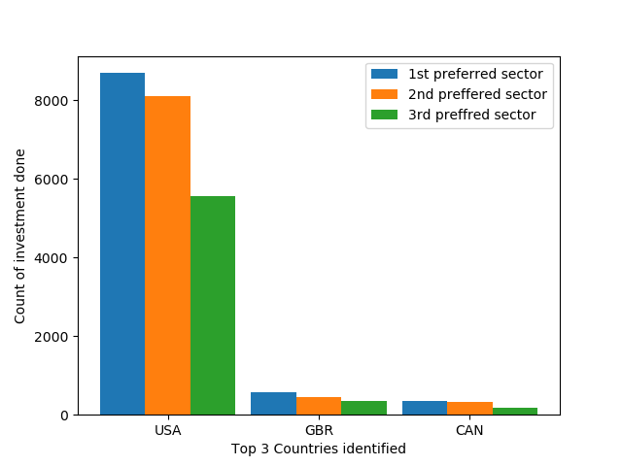
<Results>
Plot 3
This plot shows the count of investment done in the top 3 sectors for respective top3 identified countries (‘USA’, ‘GBR’, ‘CAN’), for the funding type ‘VENTURE’
Top 3 identified sectors for the 3 countries differ and is tabled below.
USA, the top 3 investment sectors were :
Others
Cleantech / Semiconductors
Social, Finance, Analytics, Advertising
GBR , the top 3 investment sectors were :
Others
Cleantech / Semiconductors
Social, Finance, Analytics, Advertising
CAN, the top 3 investment sectors were :
Cleantech / Semiconductors
Others
Social, Finance, Analytics, Advertising

Slide 10
<Conclusions>
The final conclusion that can be thus made for Spark Funds to invest are :
The Funding type should be ‘VENTURE’
The investment should be done in ‘USA’ for a risk free approach in the market

