Slide 1
LENDING CLUB CASE STUDY SUBMISSION
Group_faclicitator: Ankit Mishra
(ankitmishra723@gmail.com)
Vijayashree Reddipalli VIJAYASHREEREDDIPALLI@gmail.com
Team Members: Ankit Mishra Vijayashree Reddipalli

Slide 2
<Abstract>
The problem statement is to help an consumer finance company which specialises in lending various types of loans to urban customers with a rigorous analytics to identify the driving factors (or driver variables) behind loan default, i.e. the variables which are strong indicators of default.

Slide 3
<Problem solving methodology>
Use flow chart
Reading Data into dataframes
Cleaning of data 1.filling NaN values, 2. removing duplicates, 3. uniformity in text case for uniqueIDs in all dataframes
Analysis based on business requirements: 1. Each Variable Analysis 2. Correlation between different variables 3. Analytics
Plotting of Results for better visualization of results

Slide 4
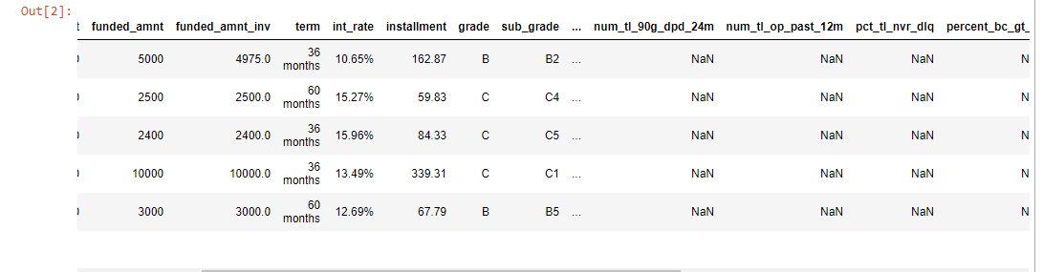
<Analysis>
We start with the basic step of DATA CLEANING,
Loading the “loan.csv” into the dataframe gives us a broad observation that we make many columns as NaN.
We therefore start with dropping of such redundant columns which won’t affect our Analytics.

Slide 5
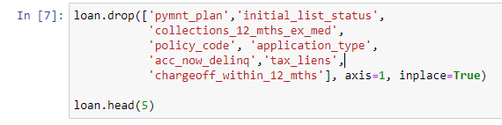
<Analysis>
We identify 54 columns which have all entries as NaN and therefore drop these columns.
We further identify columns where more than 80% of entries are NaN, these columns too are redundant as we can’t impute data using any Statistical method. ['next_pymnt_d','mths_since_last_record’]
Next we identify columns which have only 1 type of unique entries and even these features will have no Analytical impact.
We next clean our data based on datatypes needed for Analysis; like stripping symbols like [“%”,”<“,”+”] etc from data as part of data cleaning.
Separating month and year from data for better analysis.

Slide 6
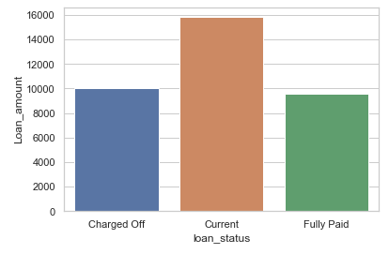
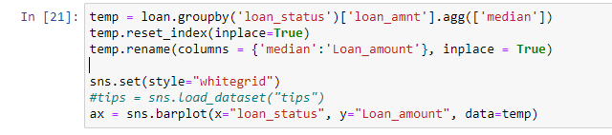
<Results>
Plot 1
Doing an Analysis on Loan Amount and Loan Status we observe that, Defaulters requested for a higher loan amount. And higher funded amount.

Slide 7
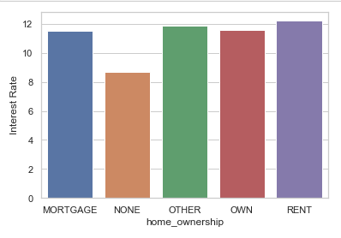
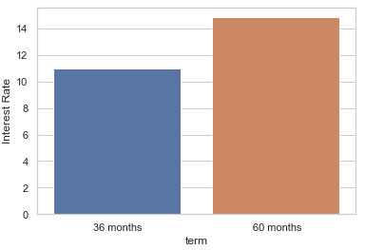
<Results>
Since higher interest brings higher income for financial institution. Also,the high intreset rates are levied to risky customer So, lets see what are the factors that impact the Rate of interest(ROI)
Plot 2
From this plot we can visualize that Customers with "RENT" accommodation attracts more interest rate.
More tenure attracts more Interest rate.

Slide 8
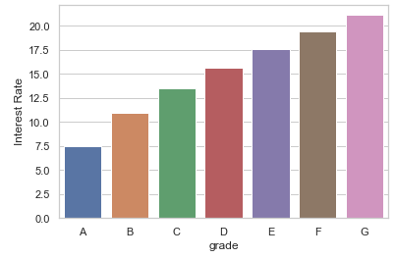
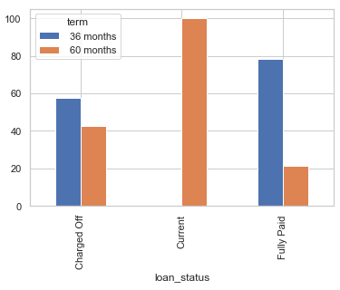
<Results>
Plot 4
Grade A loans have least interest rate.
Plot 5:
Customers who have taken lower tenure(36 months) are likely to repay the loan

Slide 9
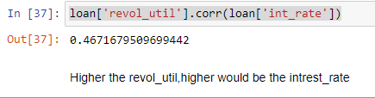
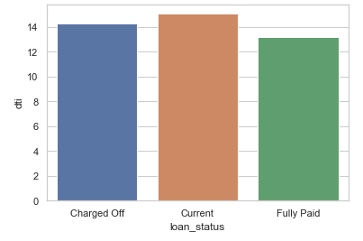
<Results>
Observation 5:
Correlation between “Revol_util” vs “interest_rate”
Plot 6
Fully-Paid customers have low dti as compared to deliquent customer.Therefore,customers with low dti are good for business

Slide 10
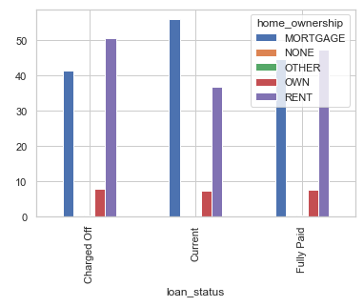
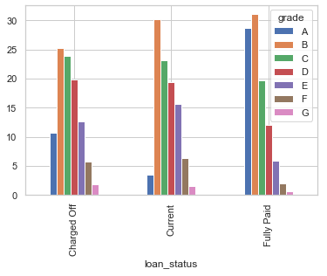
<Results>
Plot 7
Customers with Rented accomodation are likely to default more followed by customer who have mortagegd the property.
Customers with owned house are least likely to default
Plot 8
Grade B,C and D have high chances to default

Slide 11
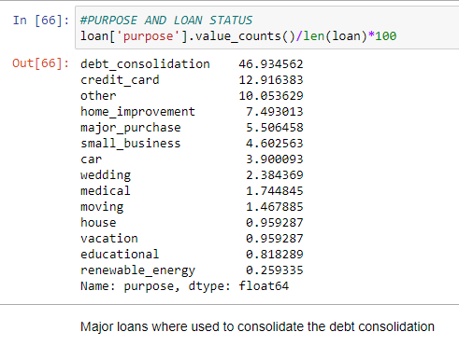
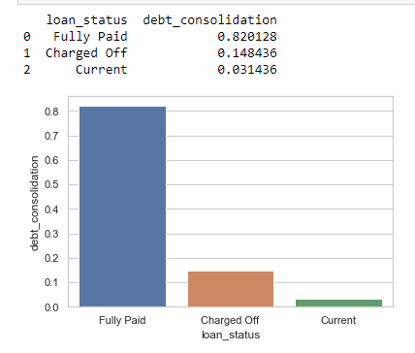
<Results>

Slide 12
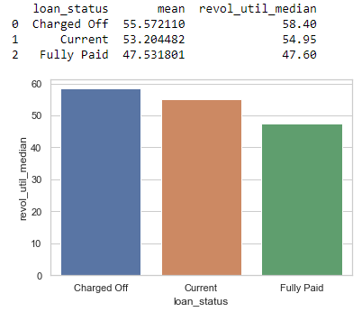
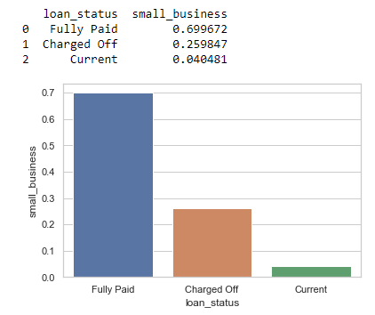
<Results>
Plot 11
Customers who have high utilization of the revolving credit are more likely to default.
Plot 10
small_business loans have highest probablity to turn in NPAs.In this category, ~26% customers have defaulted.

