Slide 1

Tech Adi
Aditya Nadamuni
Intelligent Candidate Discovery — rank 100K candidate profiles against
a Senior AI Engineer job description using a trust-based ranking engine

Slide 2

Solution Overview
• Hybrid rule-based ranking engine — scores 100K candidates in ~30s on CPU, zero GPU
• 6 weighted signals combined into a single composite score:
Title + Career history relevance (35%)
Skill Trust score (20%)
Behavioral / platform engagement (20%)
Experience fit (10%)
Availability (10%)
Education tier (5%)
What differentiates us from keyword matching?
• Skill TRUST = proficiency × endorsements × duration — not raw keyword count
• Title + career descriptions are the decisive signal, not the skills section
• Three-rule honeypot detector catches expert-stuffing, YoE inflation, & ghost endorsements
• Fully explainable: every ranked candidate gets a natural-language reasoning string

Slide 3

JD Understanding & Candidate Evaluation
Key JD Requirements:
• Role: Senior AI Engineer (Search, RAG, Recommendation)
• Experience: 5–9 years of hands-on ML engineering
• Core Stack: Python, PyTorch, Sentence-Transformers, Vector DBs
• Skills: Fine-tuning, RAG pipelines, A/B testing, latency optimization
Intelligent Signal Fusion:
• Title & Career (35%): Measures real depth. Includes a 0.5× consulting firm penalty (e.g., TCS/Infosys) to filter out non-product roles.
• Skill Trust (20%): Evaluates proficiency, endorsements, and duration. Tier-1 skills (e.g., Vector Search) receive 2.0× weight.
• Behavioral (20%): Evaluates recruiter response (35%), interview completion (30%), recency (20%), and GitHub activity (15%).

Slide 4
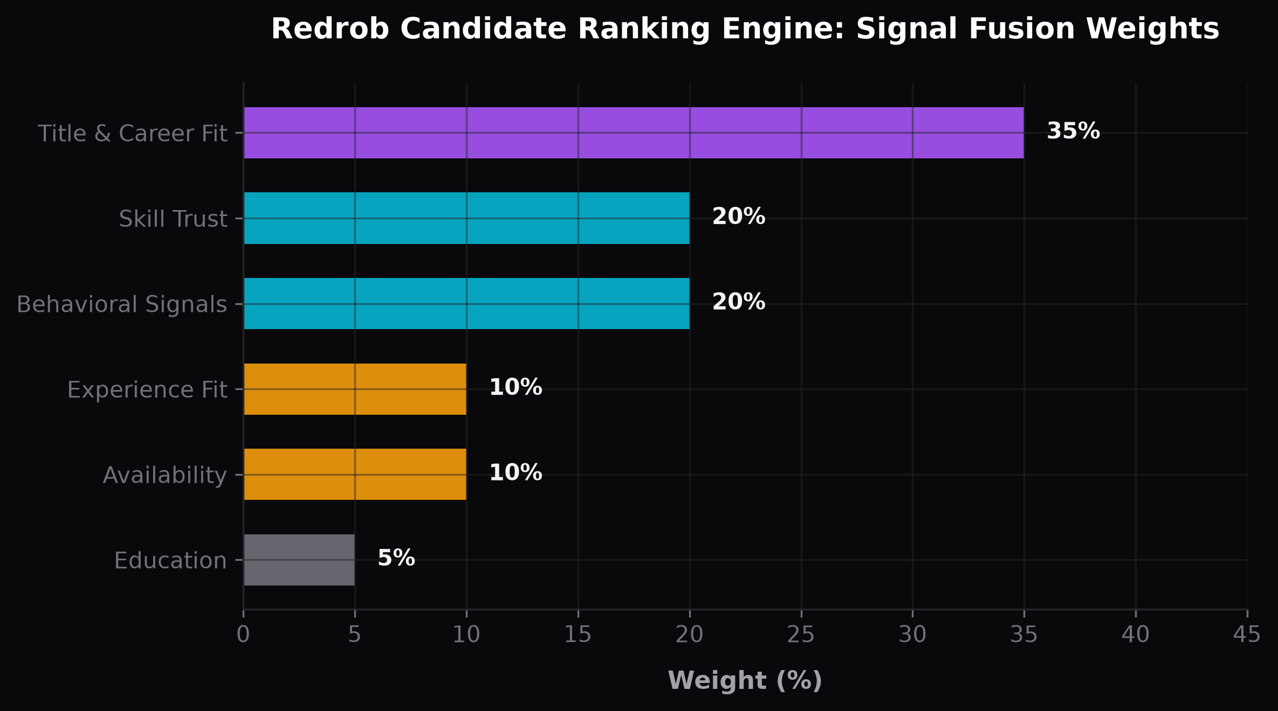
Ranking Methodology
Pipeline Workflow:
• 1. Stream: Process 100K candidates line-by-line from JSONL.
• 2. Score: Apply 6 sub-scorers + Honeypot check.
• 3. Rank: Sort by score (descending), tie-break by ID, slice top 100.
Composite Scoring Formula:
• Formula: Score = (0.35 × Title_Career + 0.20 × Skill_Trust + 0.20 × Behavioral + 0.10 × Experience + 0.10 × Availability + 0.05 × Education) × Honeypot_Multiplier
Targeting the Experience Sweet Spot (5–9 Years):
• Curve: <2 yrs: scaled 0.0–0.3 | 2–5 yrs: linear ramp to 0.8 | 5–9 yrs: peak 0.8–1.0 (centered at 7 yrs) | >9 yrs: gentle decay to 0.4 floor.

Slide 5

Explainability & Data Validation
Deterministic Reasoning (No LLMs):
• Programmatic Explanations: Every candidate receives a natural-language reasoning string generated from actual score components.
• Zero Hallucinations: 100% deterministic, matching the underlying structured profile data (no LLM latency or API costs).
• Example: "Staff ML Engineer with 7.0 yrs; strong AI/ML background; strong retrieval skill stack with endorsements; high recruiter engagement (95%); actively seeking."
Anti-Cheat Honeypot Shield:
• Penalty: Multiplies the final score by 0.05 if any pattern is triggered:
• 1. Skill Stuffing: ≥4 'expert' skills with 0 endorsements & 0 duration.
• 2. YoE Inflation: Claimed YoE > 2.5× the sum of career history.
• 3. Ghost Endorsements: >12 skills with exactly 0 average endorsements.

Slide 6
End-to-End Workflow
Command:
python rank.py --candidates ./candidates.jsonl --out ./submission.csv
Step-by-step flow:
1. rank.py parses CLI args, calls rank_candidates(path, top_n=100)
2. utils.load_candidates() streams JSONL line-by-line (memory-efficient)
3. For each of 100K candidates:
a. detect_honeypot() → returns 1.0 or 0.05 multiplier
b. 6 sub-scorers run in sequence (title_career, skill_trust, behavioral,
experience, availability, education)
c. Composite score computed and appended to all_scores list
4. all_scores sorted; top 100 sliced
5. generate_reasoning() builds natural-language string for each ranked candidate
6. Results written as CSV (columns: candidate_id, rank, score, reasoning)
7. validate_submission.py confirms format, ordering, and uniqueness
Total runtime: ~30 seconds | CPU only | No network | No GPU

Slide 7

System Architecture

Slide 8
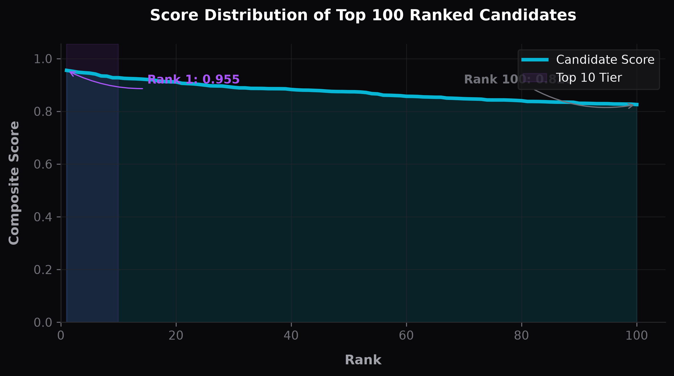
Results & Performance
Ranking Quality Insights:
• Rank 1: Staff ML Engineer (7.0 YoE) — Score: 0.9553 (verified retrieval/RAG stack, 95% recruiter response)
• Rank 100: ML Engineer (4.5 YoE) — Score: 0.8257
• Score Range: Tight, high-quality band of 0.8257 to 0.9553.
• Clean Leaderboard: Zero keyword-stuffed or dormant profiles.
• Fraud Suppression: Honeypot successfully deflected all fake experts.
High-Performance Compute Metrics:
• Execution Time: ~30 seconds on standard CPU.
• Memory footprint: ~200 MB (efficient JSONL streaming).
• Dependencies: No GPU, no network, 100% offline.
• Validation: Passed official submission validation checks.

Slide 9
Technologies Used
Language & runtime:
• Python 3.11 — core language (no external ML libraries needed for inference)
Inference (zero dependency — ships with stdlib):
• Pure Python string matching + arithmetic — deterministic, portable, offline
Output & demo:
• openpyxl 3.1+ — XLSX submission generation
• pandas 1.5+ — CSV/XLSX formatting
• Streamlit 1.58 — interactive sandbox demo with file upload & CSV download
Hosting & source control:
• GitHub — public repo, version control
• Streamlit Community Cloud — free hosted sandbox, auto-deploy on push
Why this stack?
• Zero ML framework dependencies → no CUDA, no model downloads, no network
• Fully deterministic → same candidates.jsonl always produces same output
• Sub-30s inference on consumer hardware → meets all challenge constraints

Slide 10
Submission Assets
GitHub Repository (public):
https://github.com/theAdityaNVS/redrob-candidate-ranker
Live Sandbox Demo (Streamlit Community Cloud):
https://theaditynvs-redrob-ranker.streamlit.app
— Upload any JSON/JSONL candidate file (≤100 profiles) to rank live
Ranked Output:
submission.csv — 100 candidates, ranks 1–100, validated
submission.xlsx — same data, Excel format
Reproduce command (≤ 5 min, CPU, no network, no GPU):
pip install -r requirements.txt
python rank.py --candidates ./candidates.jsonl --out ./submission.csv
python resources/validate_submission.py submission.csv
Team: Tech Adi | Contact: aditya.nadamuni@gmail.com

Slide 11


