Slide 1
MongoDB
Adrian M. Perez
LBYCLDS

Slide 2

What is MongoDB
NoSQL database
Schema less
Document Oriented Storage : JSON style documents
Supports dynamic queries on documents using a document-based query language
Easy replication and Scaling

Slide 3
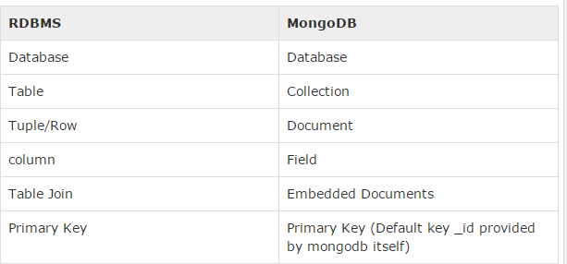

Slide 4
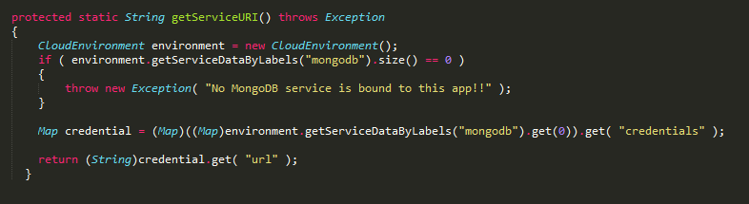
Connecting to MongoDB
Cloud Foundry API (org.cloudfoundry:cloudfoundry-runtime:0.8.4)

Slide 5
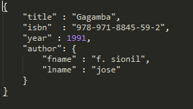
Sample Entry

Slide 6
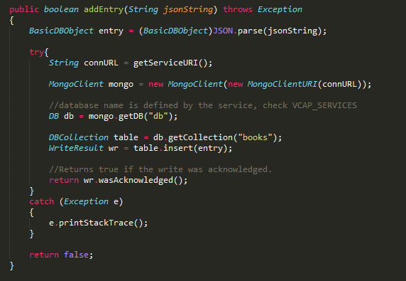
Adding entry

Slide 7
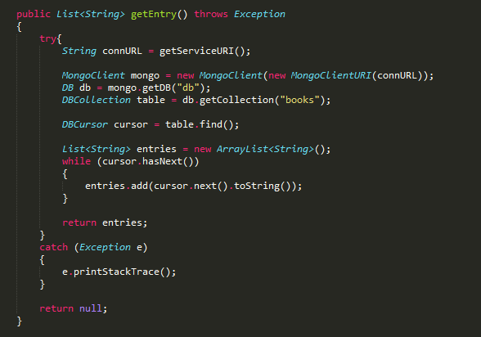
Get entry

Slide 8

Specific Entry

Slide 9
MongoDB Java Driver
https://docs.mongodb.org/ecosystem/drivers/java/

