Slide 1
SLIDE 1
Problem & why it matters
TEAM DengueSUX PROBLEM STATEMENT A2 — DengueRadar: Real-time outbreak forecasting
THE PROBLEM IN ONE SENTENCE
Singapore's public view is strongest after cases are reported. DengueSUX makes earlier weather and cluster context visible while stating exactly when a current national forecast is unavailable.
Annual dengue cases, Singapore
Outbreak years highlighted
WHO IS AFFECTED, AND HOW BADLY
164,447 dengue cases in Singapore from 2012–2022, including a record 35,315 in 2020; 1,792 in a single week at the peak. Repeat infections carry a higher risk of severe dengue.
WHY IT MATTERS NOW
Outbreaks swing more than 10× between years (2,776 cases in 2017 vs 35,315 in 2020). Weather can provide leading context, but strain changes and reporting delays matter too. We therefore show a two-week backtest, a freshness-gated live mode, and dated local signals.
Source: MOH Weekly Infectious Disease Bulletin, data.gov.sg (Dengue Fever + DHF)
“I've had dengue three times. The third time, I almost died.” — why we're building this
Solo Project Apollo Joshua · Nanyang Technological University · Computer Engineering · Year 2 · POLO0002@e.ntu.edu.sg
DAISI Challenge Singapore 2026 · Round 1 · A2 — DengueRadar: Real-time outbreak forecasting

Slide 2
SLIDE 2
Solution & data
OUR SOLUTION IN ONE SENTENCE
DengueSUX turns open data into a weekly plan: which areas to check first, which blocks to walk, and what to tell residents, backed by a 2-week national forecast tested on the 2022 outbreak.
DATASETS (ALL OPEN AND PUBLIC)
1
Weekly Infectious Disease Bulletin
MOH · 574 weeks of dengue cases, 2012–2022
WHO USES IT, AND WHAT DECISION IT CHANGES
Town council officers and grassroots volunteers decide where to inspect this week and in what order, starting from 8 ranked stops instead of a whole estate. Residents get a notice in their own language.
2
Rainfall, temperature & humidity archives
NEA · 125M station readings, 2017–2022
3
Real-time weather APIs (V2)
NEA · live station readings
4
Dengue Clusters (GeoJSON)
NEA · live; archived daily since 24 Sep 2026
WHAT MAKES IT DIFFERENT FROM A GENERIC DASHBOARD
5
Master Plan 2025 Planning Areas
URA · 55 areas
Street-level inspection plan
Real cluster blocks → 8 places to check on a 1.2 km OneMap walking route.
Tested on a real outbreak
About 2× more accurate than a simple average on 2022; turned High 11 weeks before the peak.
6
HDB Property Information
HDB · matches cluster block addresses
7
Parks · Hawker Centres
NParks, NEA · candidate places to check
8
OneMap Search & Routing
SLA · block locations and walking routes
AI Analysis
Top drivers and a dated source on every figure. Places to check for fumigation and maintenance suggestions.
Speaks residents' languages
Notices in English, 中文, Melayu and தமிழ், each passing 5 automatic fact checks.
Honest limits: public case data ends in 2022, so the forecast replays 2022 until recent weekly counts are approved. Area ranks are priorities, not local case predictions.
DAISI Challenge Singapore 2026 · Round 1 · A2 — DengueRadar: Real-time outbreak forecasting

Slide 3
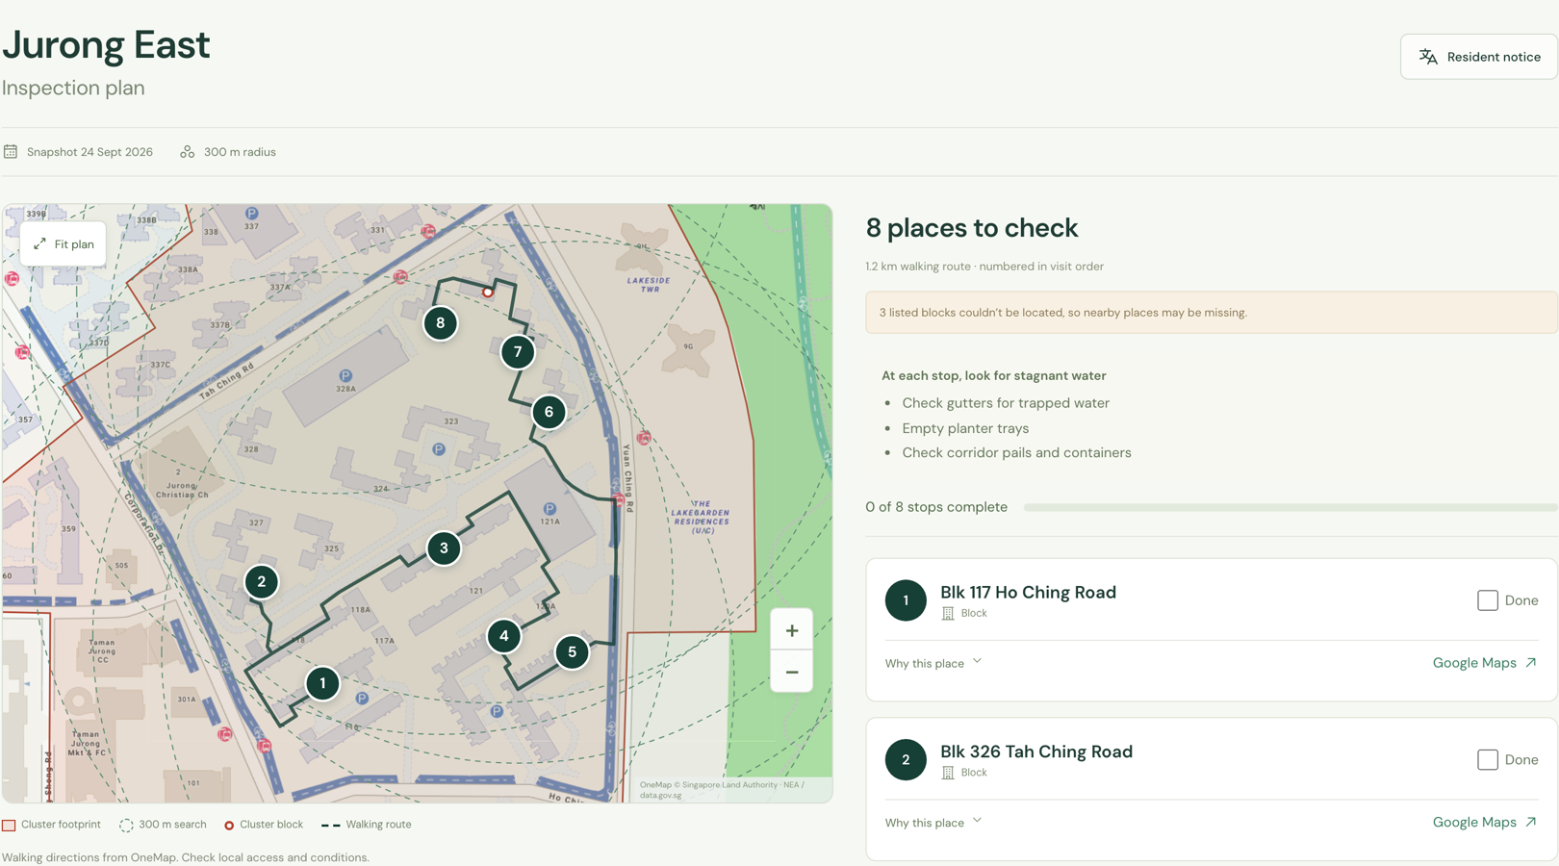
SLIDE 3
Databricks architecture & impact
SOURCE
data.gov.sg + OneMap
Bulletin, weather, clusters, URA, HDB, parks, hawkers
INGEST
Bronze Delta
Checksummed raw files; daily cluster snapshot job
TRANSFORM
PySpark → Delta
Sun–Sat epi-weeks, 55-area panel, cluster → block → place joins
MODEL
MLflow
3 models, 39 folds (2019–21); gradient boosting won; SHAP drivers
OUTPUT
App + Genie
Map, inspection routes, 4-language notices via Foundation Model API
→
→
→
→
UNITY CATALOG governs every table: source receipts and checksums, lineage from raw file to forecast and route, access controls
WHAT WE WILL DEMO
MEASURABLE IMPACT
WHAT WE CAN FINISH IN TWO WEEKS
Forecast off by ~83 people a week vs ~172 for a simple average: 52% lower error on the 2022 outbreak
Turned High 11 weeks before the 2022 peak, 1 week earlier than the simple average
Teams start with 8 ranked stops instead of a whole estate
220 ready-to-review resident notices: 55 areas × 4 languages
Deploy the 6 notebooks and daily job on Databricks Free Edition (serverless), with Unity Catalog tables and MLflow
Replace the scripted prototype assistant with a Genie space
Run the forecast live once recent weekly case counts are approved
Switch on cluster-growth ranking after 7+ days of snapshots
Already working: 8 places to check on a 1.2 km walking route around the largest cluster (real NEA, HDB, OneMap data).
DAISI Challenge Singapore 2026 · Round 1 · A2 — DengueRadar: Real-time outbreak forecasting

