Slide 1
Indexs
MongoIndex_Bipin

Slide 2
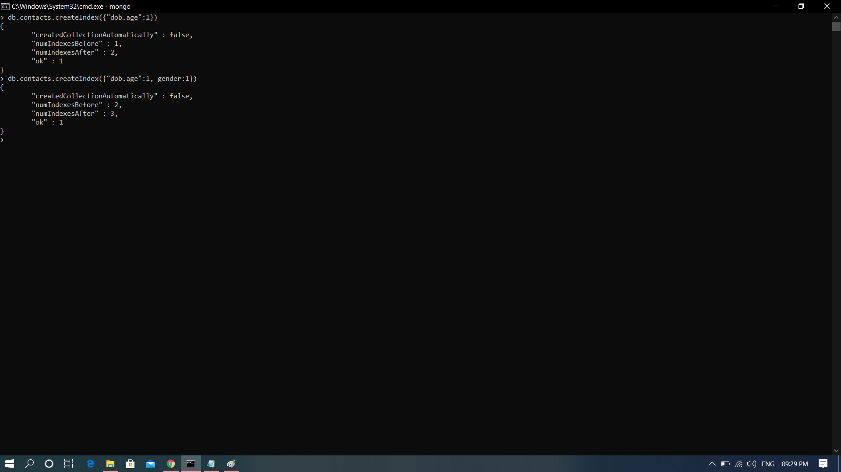
createIndex()

Slide 3
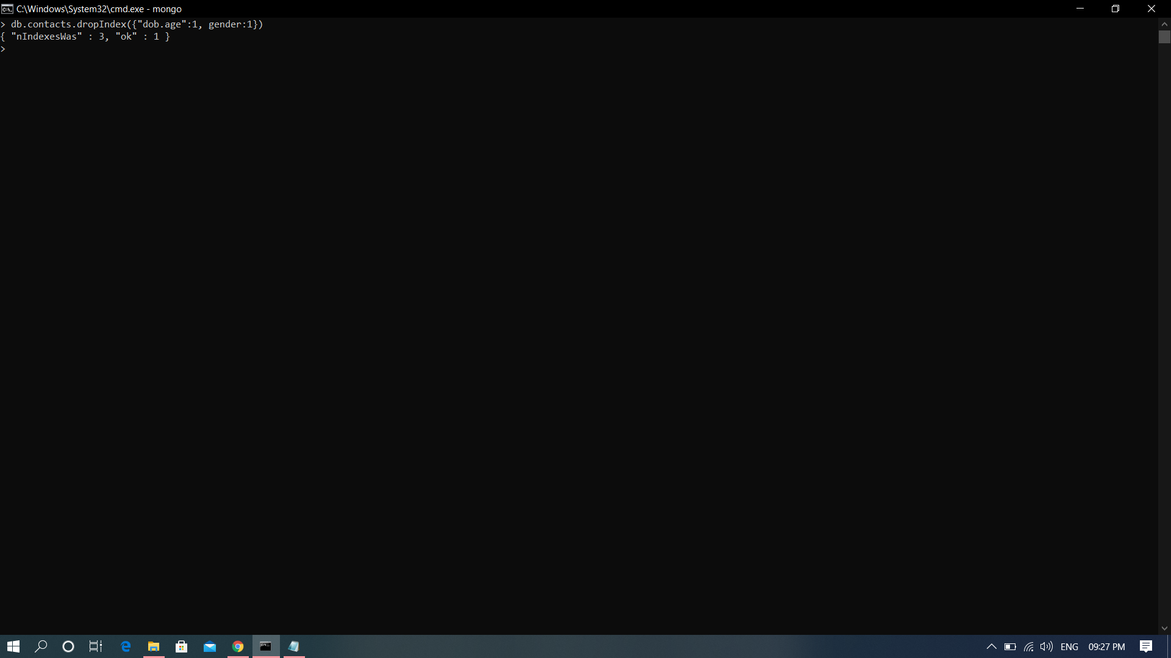
dropIndex()

Slide 4
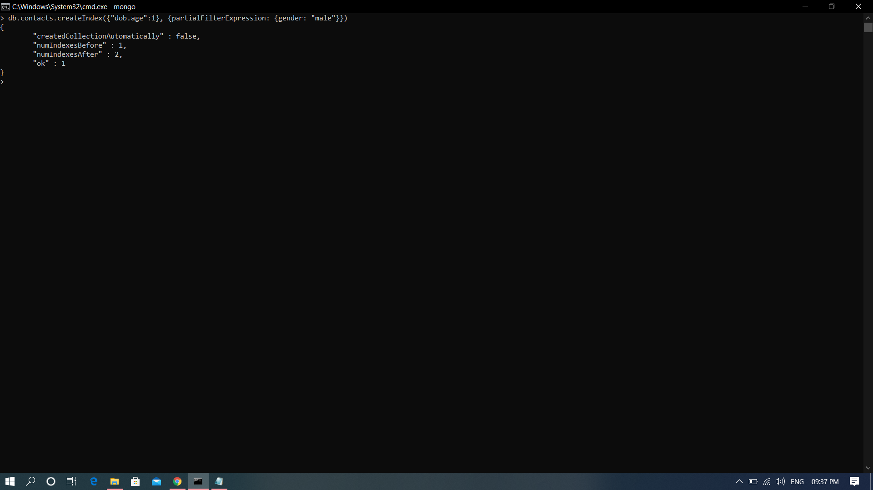
Partial Index

