Slide 1
Scans
Scan_Bipin

Slide 2
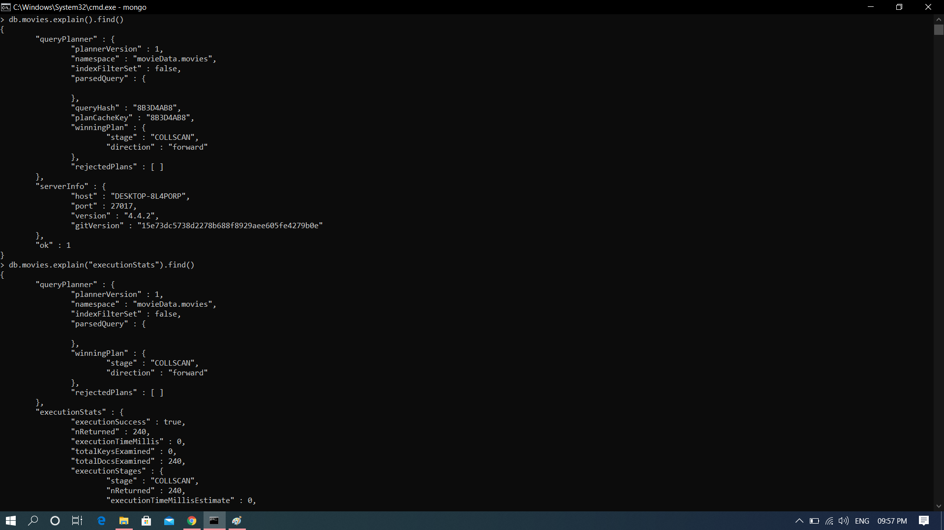
Collection Scan

Slide 3
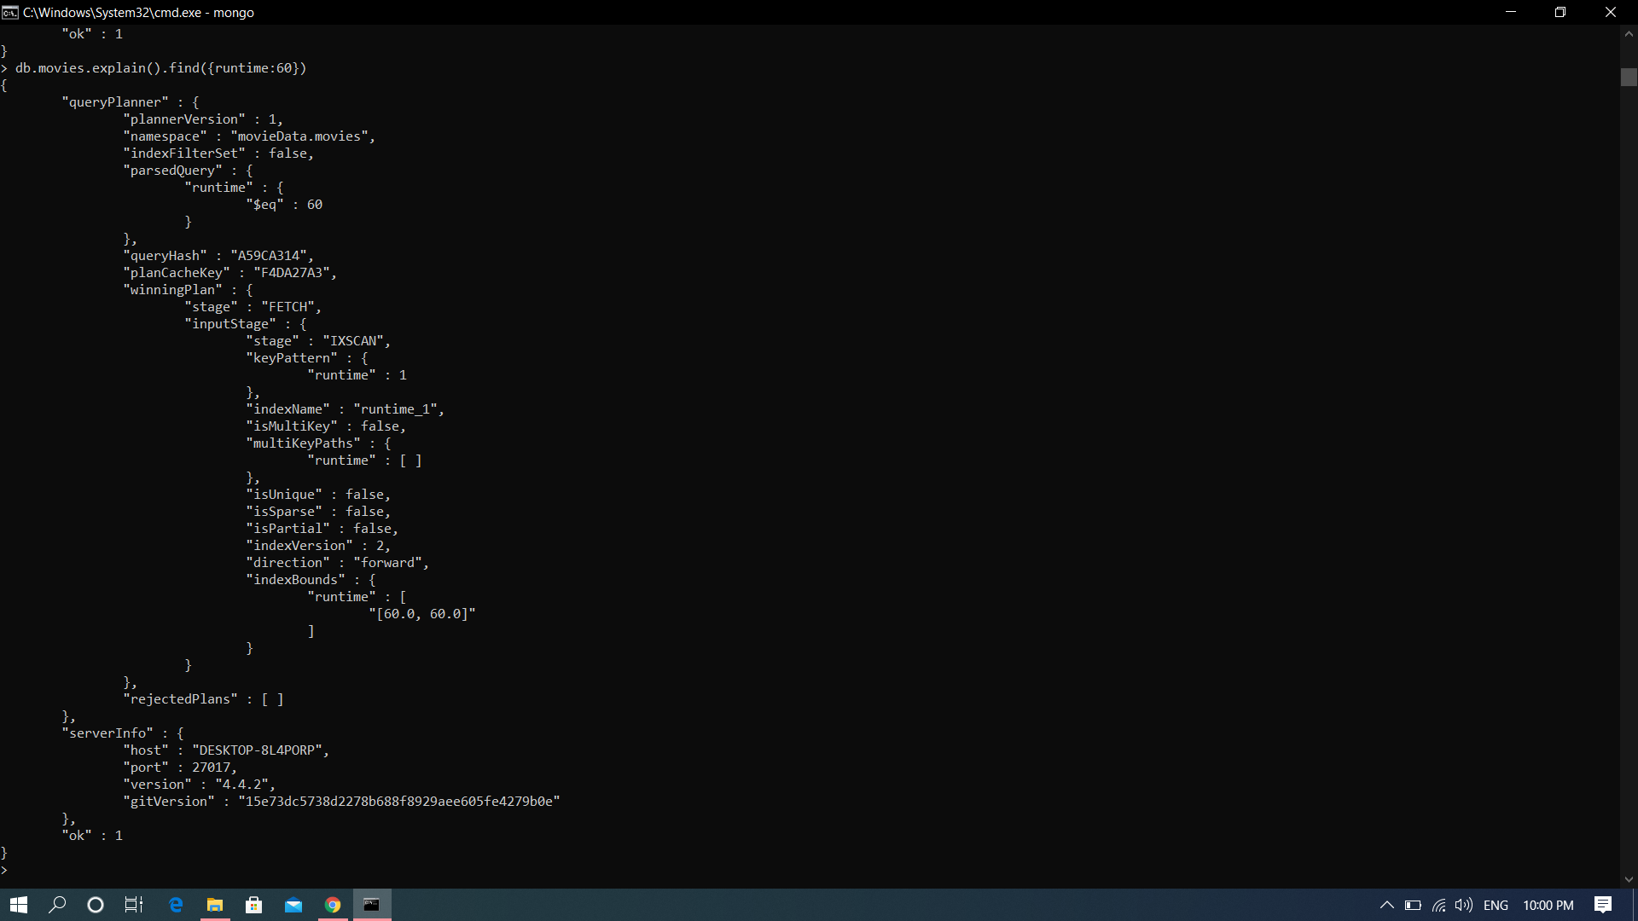
Index Scan

