Slide 1
MongoDB
Schema and Relations

Slide 2
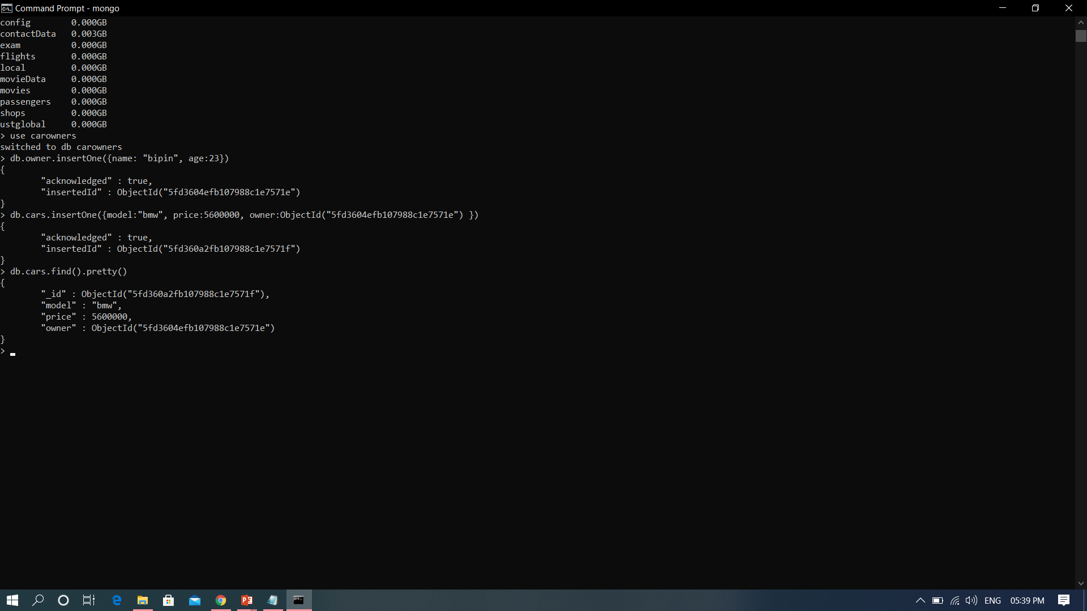
Relations – one to one

Slide 3
One to Many
{
title: "MongoDB: The Definitive Guide",
author: [ "Kristina Chodorow", "Mike Dirolf" ],
published_date: ISODate("2010-09-24"),
pages: 216,
language: "English",
publisher: {
name: "O'Reilly Media",
founded: 1980,
location: "CA"
}
}
{
title: "50 Tips and Tricks for MongoDB Developer",
author: "Kristina Chodorow",
published_date: ISODate("2011-05-06"),
pages: 68,
language: "English",
publisher: {
name: "O'Reilly Media",
founded: 1980,
location: "CA"
}
}

Slide 4
One to many with reference
{
_id: "oreilly",
name: "O'Reilly Media",
founded: 1980,
location: "CA"
}
{
_id: 123456789,
title: "MongoDB: The Definitive Guide",
author: [ "Kristina Chodorow", "Mike Dirolf" ],
published_date: ISODate("2010-09-24"),
pages: 216,
language: "English",
publisher_id: "oreilly"
}
{
_id: 234567890,
title: "50 Tips and Tricks for MongoDB Developer",
author: "Kristina Chodorow",
published_date: ISODate("2011-05-06"),
pages: 68,
language: "English",
publisher_id: "oreilly"
}

Slide 5
Many to many
{
_id: "5db579f5faf1f8434098f123"
title: "Tut #1",
author: "bezkoder"
tags: [
{
name: "tagA",
slug: "tag-a"
},
{
name: "tagB",
slug: "tag-b"
}
]
}
{
_id: "5db579f5faf1f84340abf456"
name: "tagA",
slug: "tag-a"
tutorials: [
{
title: "Tut #1",
author: "bezkoder"
},
{
title: "Tut #2",
author: "zkoder"
}
]
}

Slide 6
Many to many with reference
{
_id: "5db57a03faf1f8434098ab01",
name: "tagA",
slug: "tag-a",
tutorials: [ "5db579f5faf1f8434098f123", "5db579f5faf1f8434098f456" ]
}
{
_id: "5db57a04faf1f8434098ab02",
name: "tagB",
slug: "tag-b",
tutorials: [ "5db579f5faf1f8434098f123" ]
}
{
_id: "5db579f5faf1f8434098f123"
title: "Tut #1",
author: "bezkoder"
tags: [ "5db57a03faf1f8434098ab01", "5db57a04faf1f8434098ab02" ],
}
{
_id: "5db579f5faf1f8434098f456"
title: "Tut #2",
author: "zkoder"
tags: [ "5db57a03faf1f8434098ab01" ],
}

Slide 7

MongoDB Validator

Slide 8
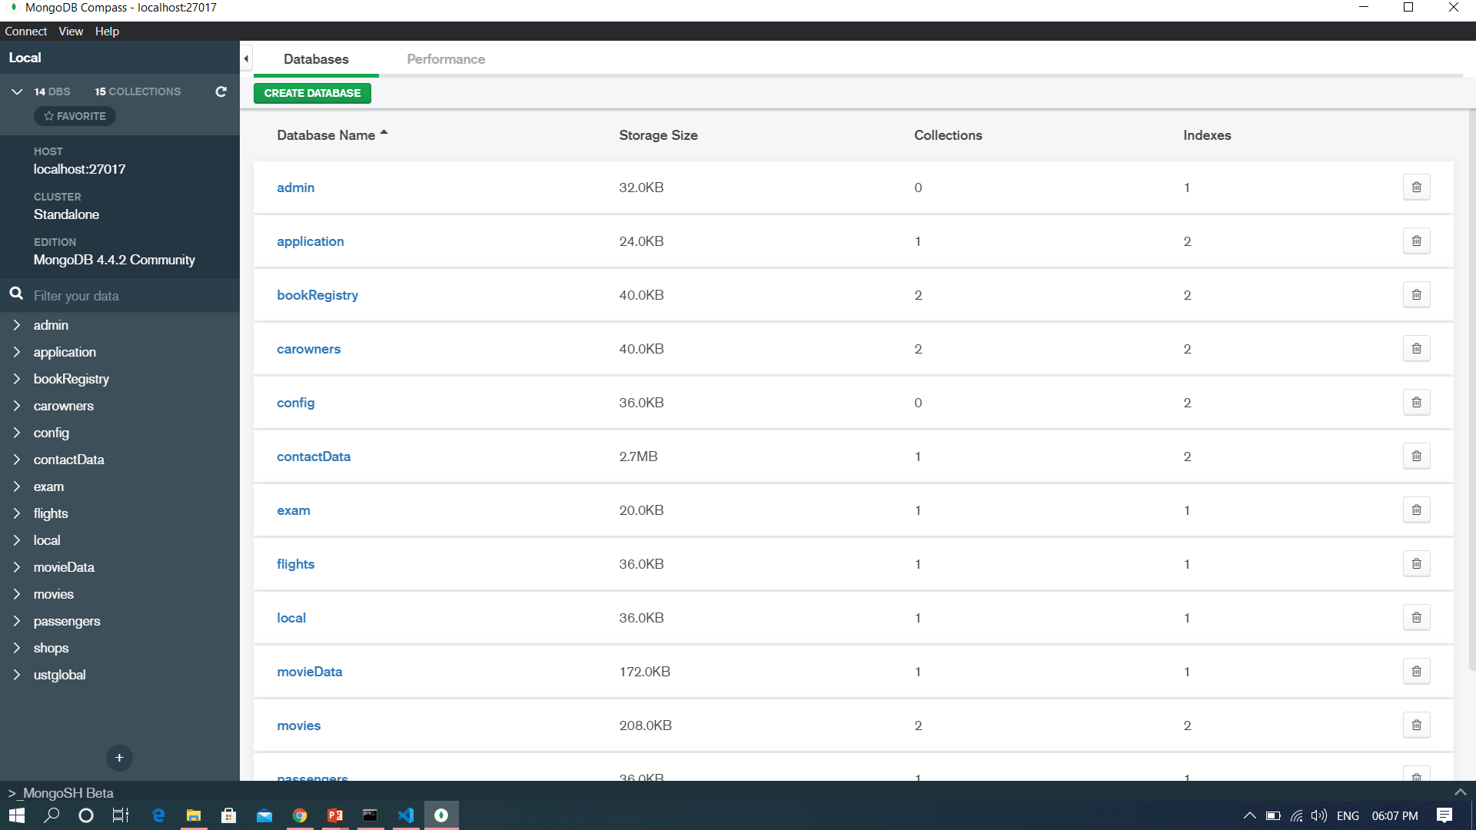
MongoDBCompass

Slide 9
