Slide 1
WHOLESALE-MART
By
BISHAL SHRESTHA
SAUGAT POUDEL
SUCCESS CHHANTYAL

Slide 2
INTRODUCTION
WHOLESALE-MART is a digital platform that transforms the way dealers and retailers engage and conduct business.
The platform utilizes advanced technology to create a environment for product exchange and payments.
WHOLESALE-MART serves as a centralized hub where dealers and retailers can register and effortlessly connect with each other.
Retailers can browse and select products from multiple dealers in one place, eliminating the need to visit multiple websites or physical stores.
WHOLESALE-MART provides valuable insights into sales data, empowering dealers to optimize their offerings and maximize profits.

Slide 3
OBJECTIVES
The aim and objectives of this project are:
To simplify the business between dealers and retailers.
To calculate the annual selling estimation to pay government tax.

Slide 4
LITERATURE REVIEW
Daraz
The comparison between the “Daraz” and our proposed “WHOLESALE-MART ” is tabulated as below:
Features | Daraz | WHOLESALE-MART
Login/Register | ✔ | ✔
Wholesale price | ✖ | ✔
Online payment | ✔ | ✖
Deals Customer | ✔ | ✖
Voucher | ✔ | ✖

Slide 5
LITERATURE REVIEW
OkDam
The comparison between the “OkDam” and our proposed “WHOLESALE-MART ” is tabulated as below:
Features | OkDam | WHOLESALE-MART
Login/Register | ✔ | ✔
Wholesale price | ✔ | ✔
Online payment | ✔ | ✖
Wishlist | ✔ | ✖
Review | ✔ | ✖

Slide 6
LITERATURE REVIEW
Thokvikreta
The comparison between the “Thokvikreta” and our proposed “WHOLESALE-MART ” is tabulated as below:
Features | Thokvikreta | WHOLESALE-MART
Login/Register | ✔ | ✔
Wholesale price | ✔ | ✔
Online payment | ✔ | ✖
Deal B2C | ✔ | ✖
Wishlist | ✔ | ✖

Slide 7
TOOLS AND METHODOLOGIES
Tools | Description/Purpose
Xampp Application | Mainly of the Apache HTTP Server, Mysql database, and interpreters for scripts written in the PHP programming languages.
Php | It is used to manage dynamic content, databases, session etc…(backend)
Javascript | JavaScript library that simplifies creation and navigation of web applications
Html, CSS | System for displaying material retrieved how HTML elements are to be displayed on screen, or in other media
Mysql | To add, access, and process data stored in a database
Github | Code hosting platform for version control and collaboration

Slide 8
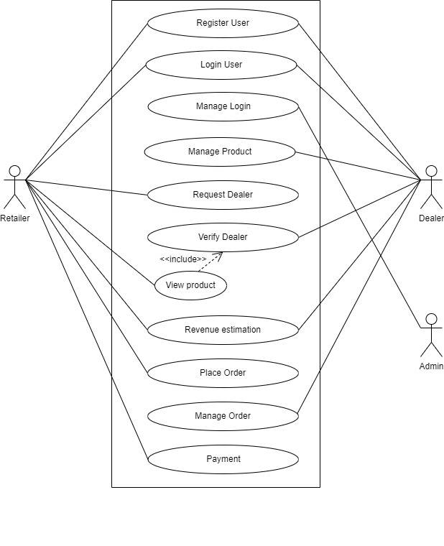
USE CASE DIAGRAM

Slide 9
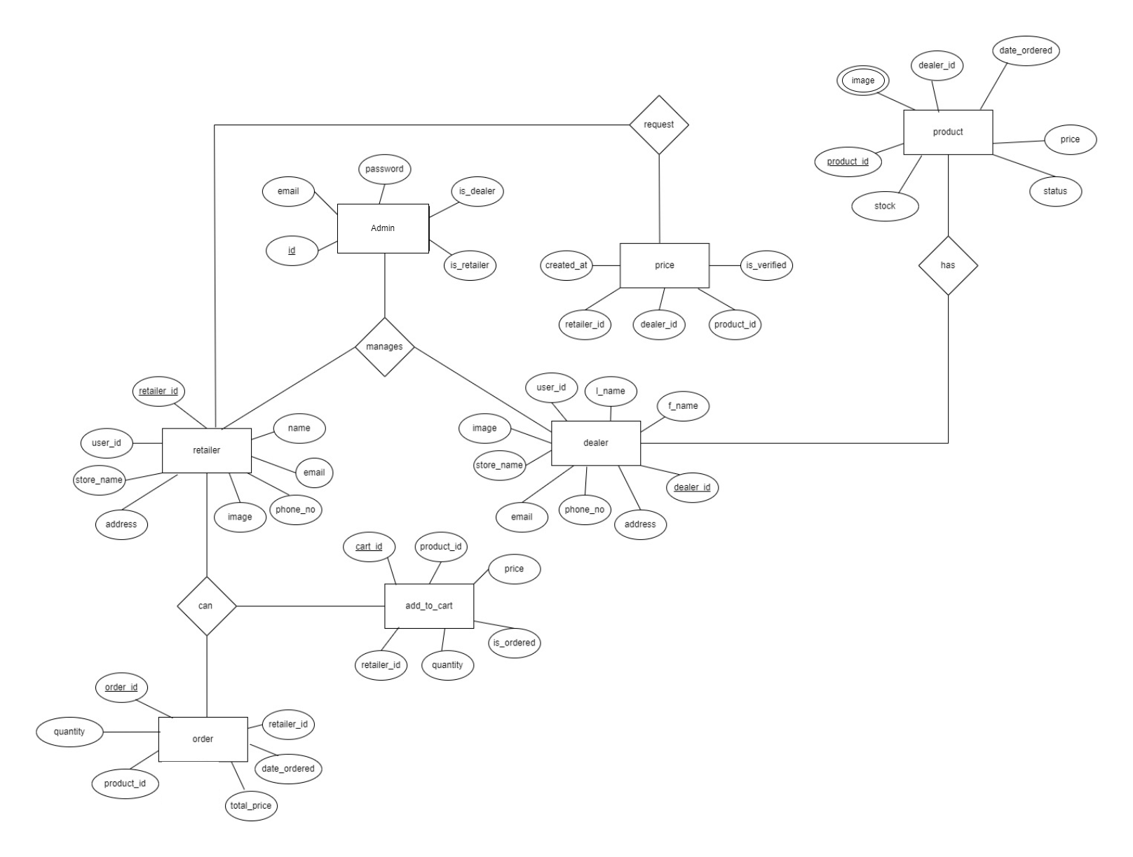
ENTITY RELATIONSHIP DIAGRAM

Slide 10
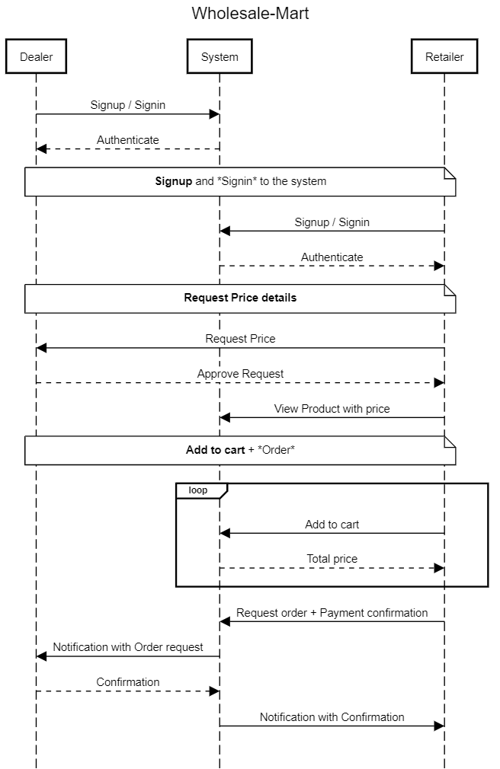
SYSTEM SEQUENCE DIAGRAM

Slide 11
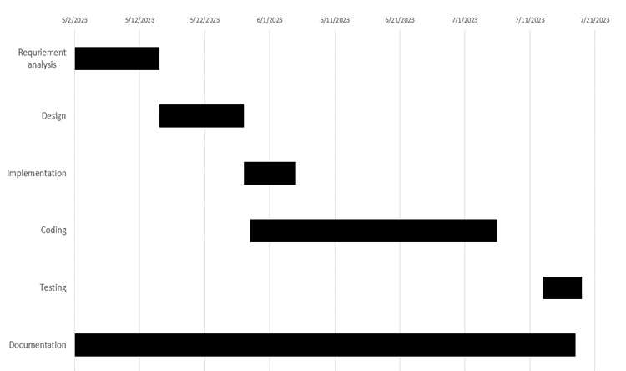
TIMELINE CHART

Slide 12
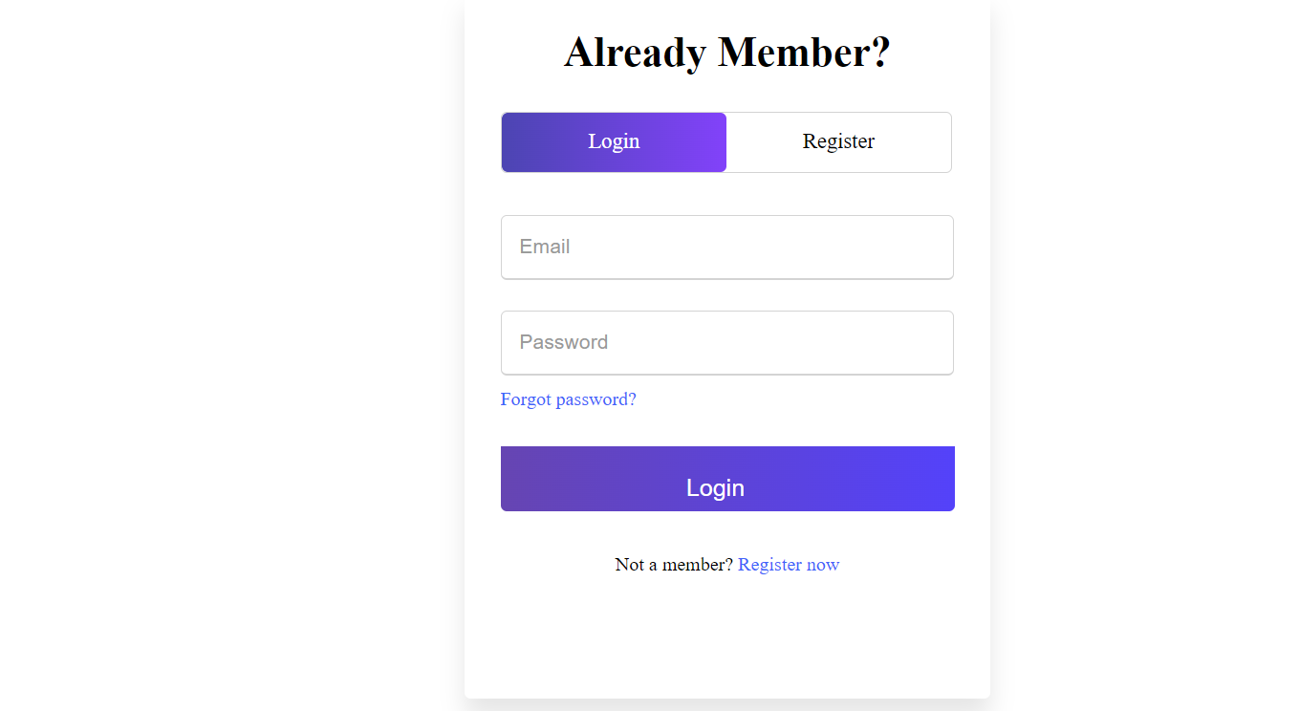
WireFrame for Login Page

Slide 13
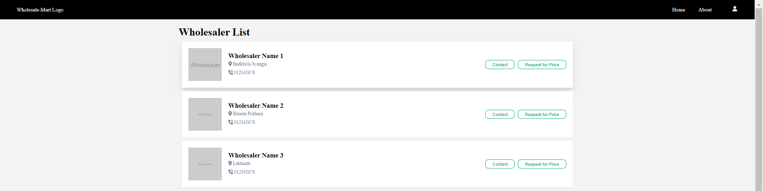
WireFrame for Wholesaler List

Slide 14
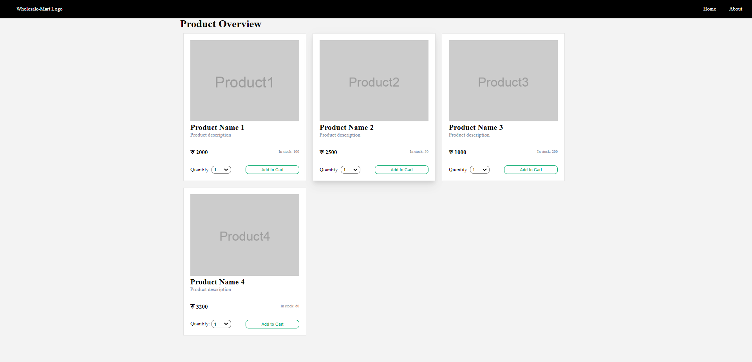
WireFrame for Product list

Slide 15
Thank you!
Any Queries???

