Slide 1
Bakery Sales Prediction
Group presentation Introduction to Datascience and Machine Learning
Lukas Kling, Lina Sandberg, Edil, Melissa Muszelewski

Slide 2
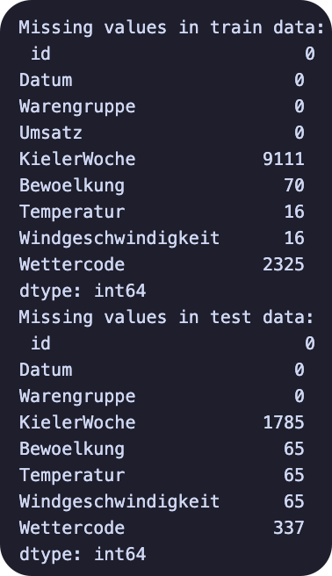
Data imputation
Missing Values
KiWo
Weather Data
Temperatur
Windgeschwindigkeit
Bewölkung
Wettercode
Methods
Binary categor
Average
Copy from Day/Week/Month before

Slide 3
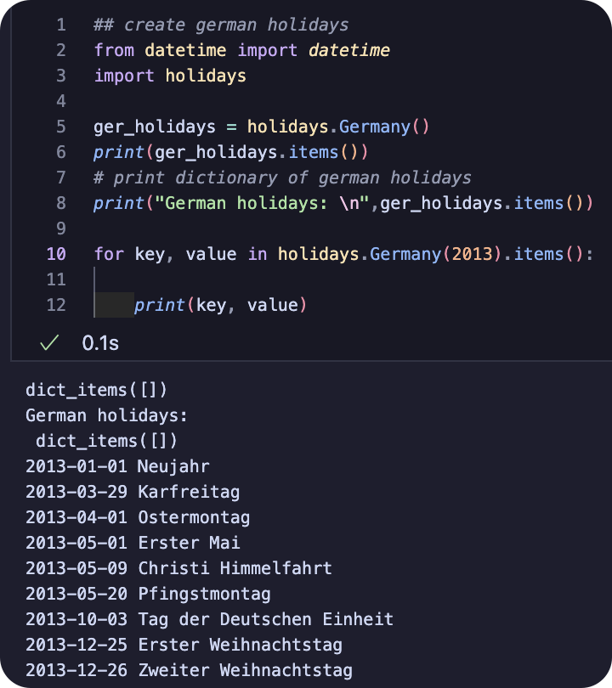
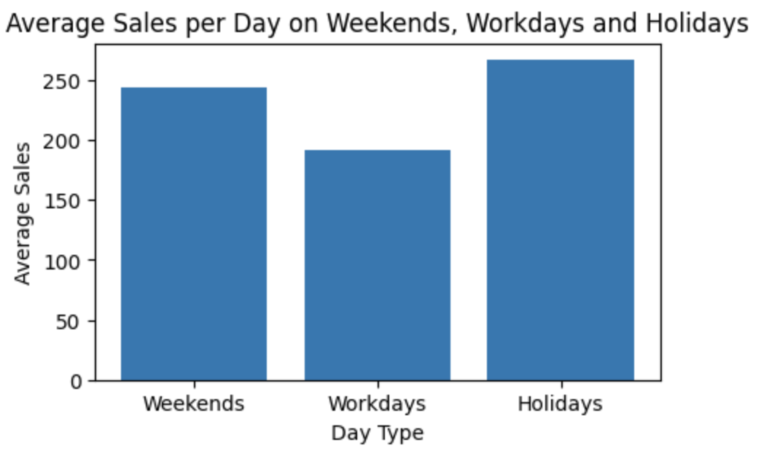
Data exploration
Impact of
Weekdays
Weekends
Public Holidays

Slide 4
Self created variables
Weekday
Is_holiday
added all the holidays
Temp_vs_Avg
weekly temperature compared to daily temperature
Weather_Impression
used weathercode to classify weather into categories

Slide 5
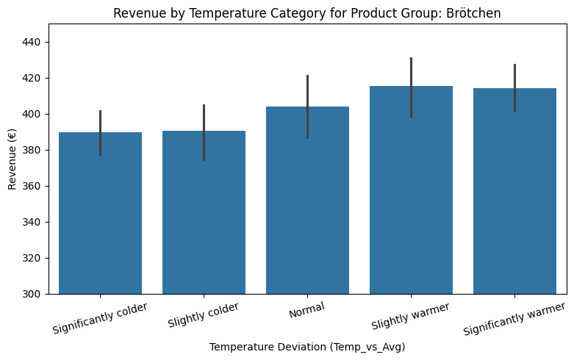
Categorized temperature

Slide 6
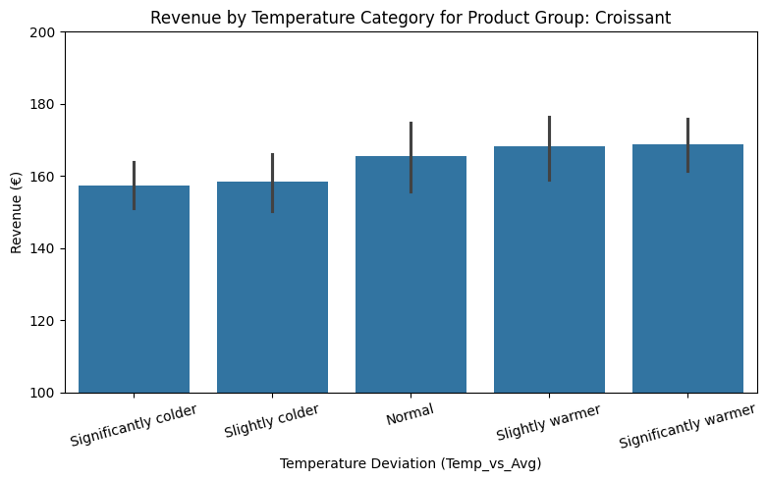
Categorized temperature

Slide 7
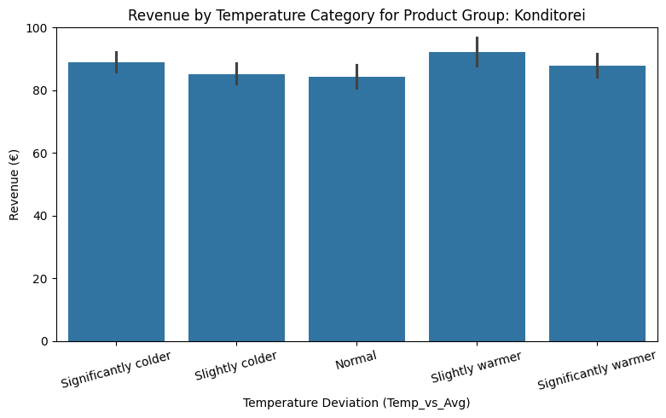
Categorized temperature

Slide 8
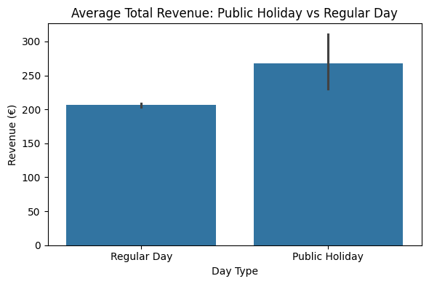
Public Holiday vs Regular Day

Slide 9
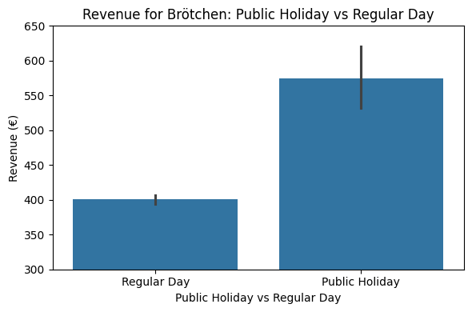

Public Holiday vs Regular Day

Slide 10
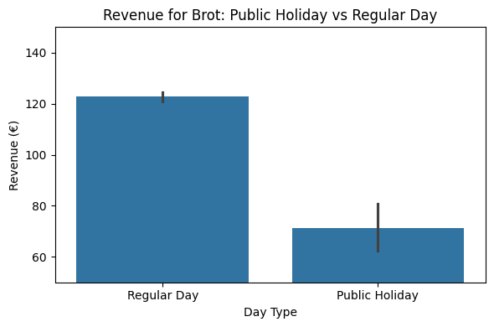
Public Holiday vs Regular Day

Slide 11
Linear Modell - Preparation
Missing values replaced with the average of the previous and following value
IQR method: statistical technique for detecting outliers
IQR = Q3 - Q1
Q1 (first quartile): 25% of the data is below this value
Q3 (third quartile): 75% of the data is below this value
IQR: The range between Q1 and Q3, containing the middle 50% of the data

Slide 12
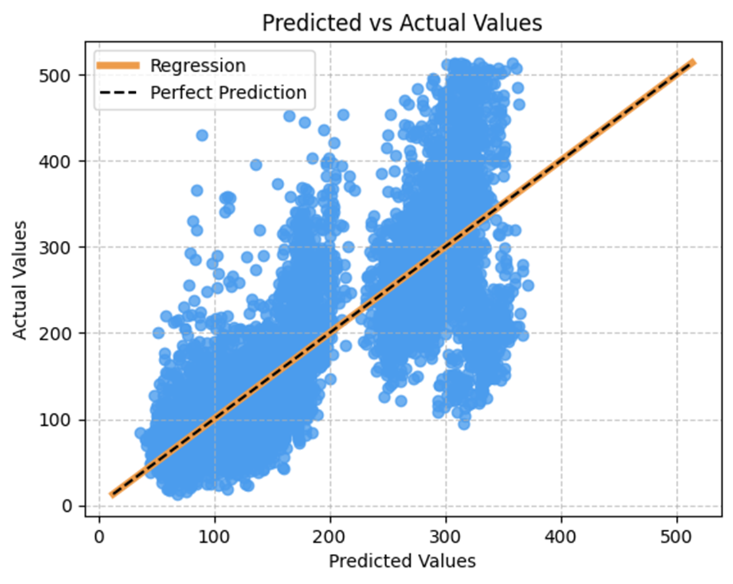
Linear Modell
R² = 0.672
Kaggle Submission Score: 0.26734

Slide 13
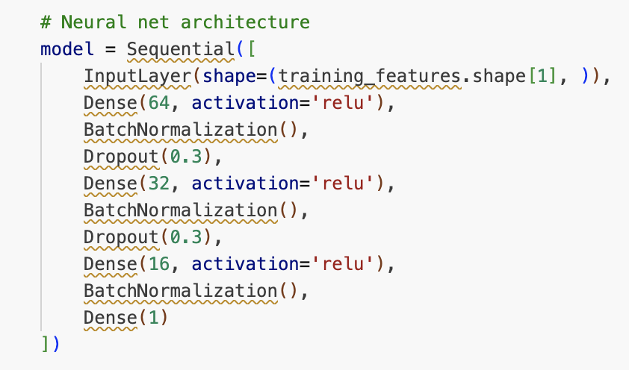
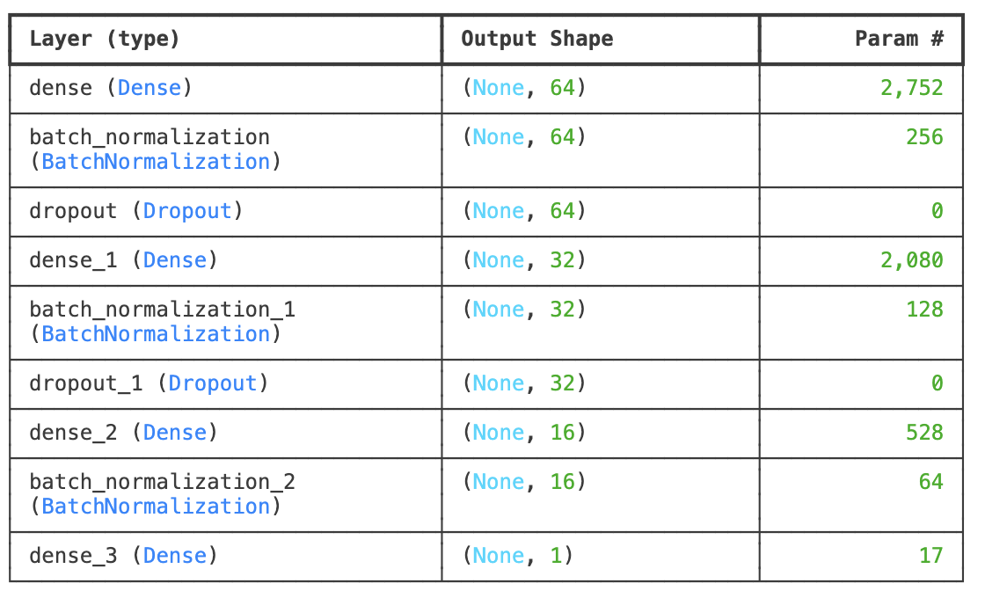
Neural network optimization
Source code

Slide 14
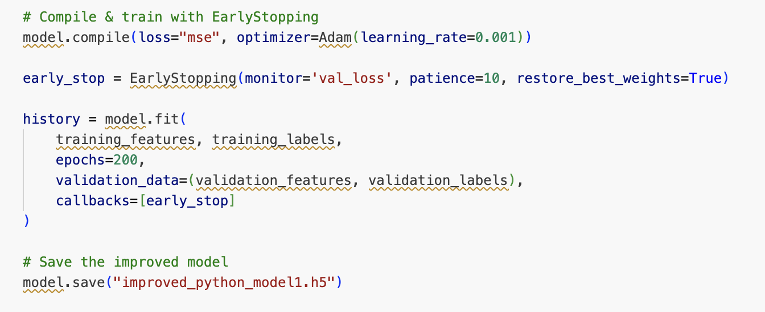
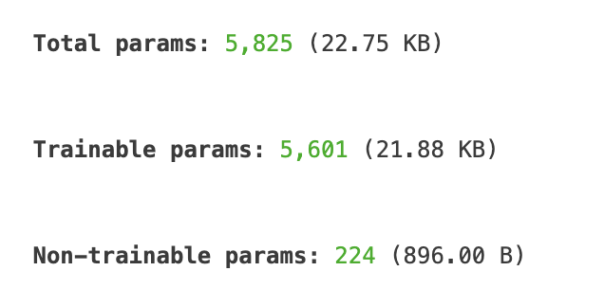
Neural network optimization
Source code

Slide 15
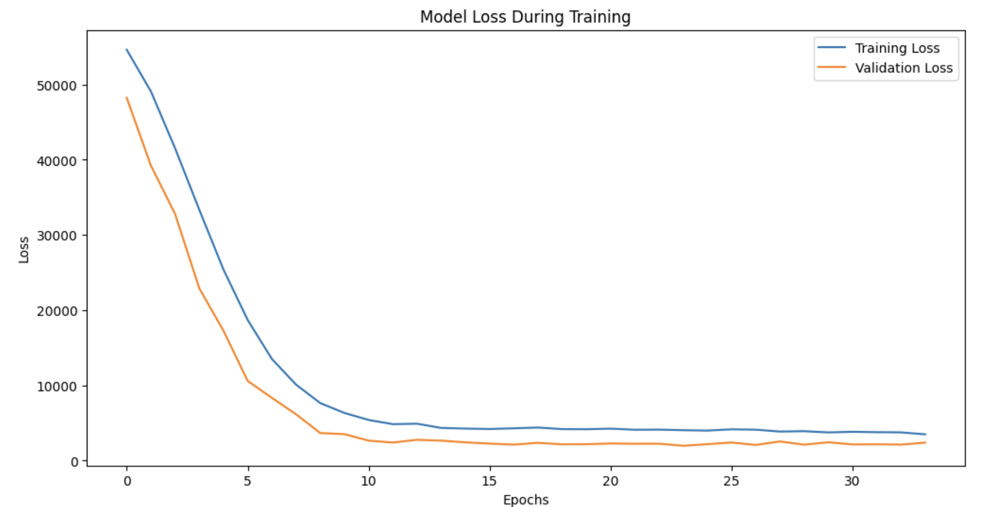
Neural network optimization
Loss function plot

Slide 16
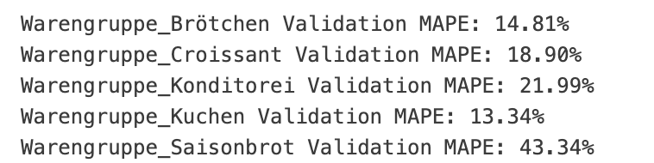
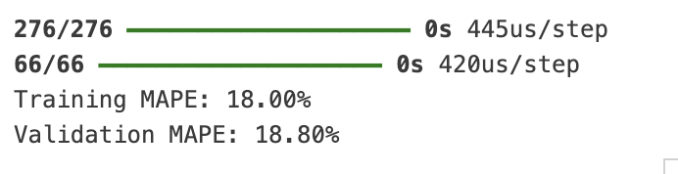
Neural network optimization
MAPE

Slide 17
Highlights & Lowlights
Worst Fail
Best Improvement
Weather data imputation
Getting weather data from weather station
Keeping it simple
Resulted in best MAPE and R^2
Adding time-series features
Took a lot of times, didn't improve the model

