Slide 1

SMART INDIA HACKATHON 2026
TITLE PAGE
Problem Statement ID – 26070
Problem Statement Title – AI/ML-Driven Multi-Modal Spatio-Temporal Forecasting of Tropical Cyclone Intensity & Rapid Intensification
Theme – Disaster Management / Space Technology & Smart Automation
PS Category – Software
Team ID – [Enter Registered Team ID on Portal]
Team Name – [Enter Registered Team Name on Portal]

Slide 2
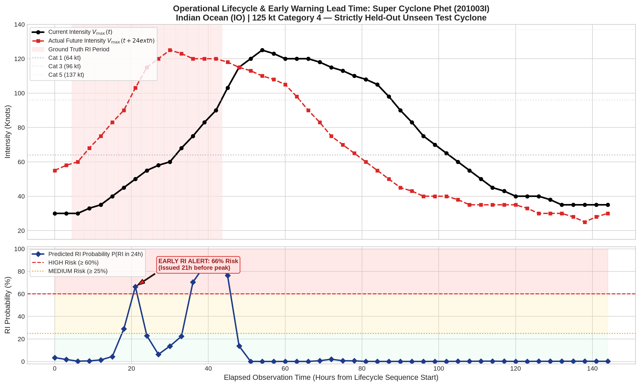
DeepCycloNet: AI for Cyclone Tracking & Rapid Intensification
Your Team Name
❖ Proposed Solution (Describe your Idea/Solution/Prototype)
• Detailed explanation of the proposed solution:
- An AI weather-intelligence system that watches a 12-hour video history of satellite cloud imagery (IR, Water Vapor & Visible) combined with real-time ocean temperature measurements to forecast tropical cyclone strength 24 hours ahead.
- How it works: A Computer Vision network analyzes cloud rotation and eye formation, while an Ocean-Atmosphere model evaluates whether the sea below has enough heat energy to fuel sudden storm growth.
• How it addresses the problem:
- Solves the Deadly Rapid Intensification Blindspot: Most cyclone casualties occur when weak storms unexpectedly explode into monster hurricanes right before landfall. Our AI detects this 24 hours early, giving disaster managers crucial lead time to evacuate coastlines.
- Cuts Evacuation Costs & False Alarms: Distinguishes between storms that will intensify and those dying over cooler waters, avoiding unnecessary multi-crore evacuation expenses and public panic.
- Reliable, Continuous Predictions: Anchors every prediction directly to the storm's current live wind speed, ensuring smooth forecasts without sudden unrealistic drop-offs.
• Innovation and uniqueness of the solution:
- First Cloud + Ocean Dual AI: Combines satellite cloud visuals with ocean heat content maps, ensuring the AI checks both the storm's appearance and the oceanic fuel powering it.
- Seamless 24/7 Day-and-Night Operation: Specially engineered to work continuously after sunset when visible optical satellite cameras go dark.
- Proven on 1,265 Real Cyclones: Built and validated on 15+ years of real global storms with a working, interactive forecaster web dashboard.
▲ Live Prototype Validation on Super Cyclone Phet (North Indian Ocean):
The red line shows actual observed storm wind speeds. The blue curve shows our AI's 24-hour advance forecast correctly anticipating the violent Rapid Intensification surge well before landfall.

Slide 3
TECHNICAL APPROACH
Your Team Name
• Technologies to be used (e.g. programming languages, frameworks, hardware):
- Languages & Deep Learning: Python 3.11, PyTorch 2.4, TorchVision, CUDA 12, Mixed-Precision (FP16 GradScaler) for rapid high-throughput processing.
- Model Architecture: Frame-Shared ResNet-18 Feature Extractor, 2-Layer Temporal Transformer (8 attention heads, d_model=256), Gated Environmental Fusion MLP.
- Scientific Stack: NumPy, Pandas, HDF5 (h5py), Scikit-Learn, SciPy, Matplotlib, Seaborn, PyYAML.
- Deployment & Efficiency: Containerized with Docker / TorchScript for low-latency operational inference (<150 ms per storm cycle on GPU, <1.2s on standard CPU).
• Methodology and process for implementation (Flow Charts/Images/ working prototype):
- 1. Multi-Spectral Data Ingestion: Streams 5 consecutive geostationary satellite frames [t-12h, t-9h, t-6h, t-3h, t] covering Infrared (IR1 10.8µm), Water Vapor (WV 6.7µm), and Visible (VIS 0.65µm).
- 2. Spatial Feature Extraction & Diurnal Gating: ResNet-18 extracts 512-d convective representations per frame; learned solar zenith gating dynamically handles daytime vs nighttime visible imagery.
- 3. Temporal Sequence Modeling: Positional encoding + Temporal Transformer captures convective cloud rotation, eyewall contraction, and structural evolution over time.
- 4. Environmental Fusion: Merges 6 physical ocean-atmosphere variables (SST, Ocean Heat Content, Shear, RH, Vmax, MSLP) into a unified multi-modal latent representation.
- 5. Multi-Task Forecaster Output: Simultaneously outputs 24h RI Probability P(RI), 3-Class Trend (Weakening/Stable/Intensifying), and +6h/+12h/+24h continuous intensity guidance via an interactive web dashboard.

Slide 4
FEASIBILITY AND VIABILITY
Your Team Name
• Analysis of the feasibility of the idea:
- Technical Feasibility: Fully functional, validated end-to-end prototype already developed and tested on 55,149 sequences across 1,265 real cyclones globally (North Indian Ocean, Pacific, Atlantic).
- Operational Latency: Forward inference takes <150 ms per sequence on modern GPU, easily fitting within the 30-minute operational dissemination window of IMD/JTWC.
- Data Availability: Operates on routine geostationary satellite feeds (INSAT-3D/3DR/3DS, GOES, Himawari) and GFS/SHIPS environmental analyses readily available in real time.
• Potential challenges and risks:
- Severe Class Imbalance: Rapid Intensification is rare (~6.8% prevalence in global cyclones), causing uncalibrated models to heavily under-predict RI.
- Missing Nighttime Visible Data: Visible sensors cannot capture cloud imagery at night, creating periodic 12-hour data gaps.
- Environmental Data Availability & Discrepancies: Global atmospheric analyses (GFS) are disseminated at 6h synoptic cycles, whereas satellite observations arrive every 3 hours.
• Strategies for overcoming these challenges:
- Cost-Sensitive Loss & Optimal Calibration: Weighted BCE loss (w_pos = 13.8) coupled with validation-optimized decision thresholds (tau = 0.141) achieves >63% RI recall and 0.868+ ROC-AUC.
- Learned Solar Zenith Gating: Dedicated gating layer smoothly downweights visible representations during nighttime passes, preventing sensor dropouts from degrading forecasts.
- Causal Zero-Lookahead Forward-Fill: Rigorous operational forward-fill from previous synoptic cycle with explicit audit logging (environment_age_hours), ensuring 100% causal mathematical safety.

Slide 5
IMPACT AND BENEFITS
Your Team Name
• Potential impact on the target audience:
- Direct Operational Beneficiaries: India Meteorological Department (IMD), National Disaster Management Authority (NDMA), State Disaster Management Authorities (SDMAs - Odisha, Gujarat, AP, WB, Tamil Nadu), Indian Coast Guard, and NDRF.
- 24-Hour Actionable Evacuation Window: Provides coastal district administrators a life-saving 24-hour lead time to execute targeted evacuations, recall deep-sea fishermen, and reinforce embankments before extreme winds make roads impassable.
- Objective Probabilistic Decision Support: Replaces qualitative, subjective Dvorak human estimates with objective, calibrated, and reproducible AI confidence scores.
• Benefits of the solution (social, economic, environmental, etc.):
- Social (Preserving Human Lives): Directly mitigates mass casualties caused by unpredicted explosive offshore intensification (e.g., VSCS Nargis 2008: 138,000+ deaths; Cyclone Ockhi 2017: 350+ fishermen lost).
- Economic (Optimized Resource Allocation): Mass coastal evacuations cost state governments ₹50–100+ Crores per event. Accurate RI probability and trend classification prevents costly false alarm evacuations while ensuring full mobilization when danger is severe.
- Infrastructure & Maritime Protection: Gives port authorities (Paradip, Kandla, Vizag), naval assets, and offshore installations (ONGC platforms) vital lead time to secure heavy cranes, vessels, and fuel terminals against destructive storm surges.

Slide 6
RESEARCH AND REFERENCES
Your Team Name
• Details / Links of the reference and research work:
- [1] Chen, B. F., Chen, B., Lin, K. T., & Elsberry, R. L. (2020). 'TCIR: A Tropical Cyclone Information Dataset for Deep Learning Applications.' IEEE Transactions on Geoscience and Remote Sensing (TGRS), 58(4), 2838–2847. DOI: 10.1109/TGRS.2019.2942474.
- [2] DeMaria, M., Mainelli, M., Shay, L. K., Knaff, J. A., & Kaplan, J. (2005). 'Further Improvements to the Statistical Hurricane Intensity Prediction Scheme (SHIPS).' Weather and Forecasting, 20(4), 530–544.
- [3] Kaplan, J., & DeMaria, M. (2003). 'Large-Scale Characteristics of Rapidly Intensifying Tropical Cyclones in the North Atlantic Basin.' Weather and Forecasting, 18(6), 1093–1108.
- [4] Vaswani, A., Shazeer, N., Parmar, N., Uszkoreit, J., Jones, L., Gomez, A. N., Kaiser, Ł., & Polosukhin, I. (2017). 'Attention Is All You Need.' Advances in Neural Information Processing Systems (NeurIPS 2017), 30, 5998–6008.
- [5] He, K., Zhang, X., Ren, S., & Sun, J. (2016). 'Deep Residual Learning for Image Recognition.' Proceedings of the IEEE Conference on Computer Vision and Pattern Recognition (CVPR 2016), 770–778.
- [6] CIRA / NOAA RAMMB Tropical Cyclone Diagnostics & SHIPS Database: https://rammb-data.cira.colostate.edu/ships/
- [7] India Meteorological Department (IMD) Cyclone Best Track Archives & INSAT Imagery: https://rsmcnewdelhi.imd.gov.in/
- [8] Project Prototype Repository & Real-Time Forecaster Demo: https://github.com/theDivinePenguin/cycml

Slide 7
IMPORTANT INSTRUCTIONS
Please ensure below pointers are met while submitting the Idea PPT:
Kindly keep the maximum slides limit up to six (6). ( Including the title slide)
Try to avoid paragraphs and post your idea in points /diagrams / Infographics /pictures
Keep your explanation precise and easy to understand
Idea should be unique and novel.
You can only use provided template for making the PPT without changing the idea details pointers (mentioned in previous slides).
You need to save the file in PDF and upload the same on portal. No PPT, Word Doc or any other format will be supported.
Note - You can delete this slide (Important Pointers) when you upload the details of your idea on SIH portal.

