Slide 1

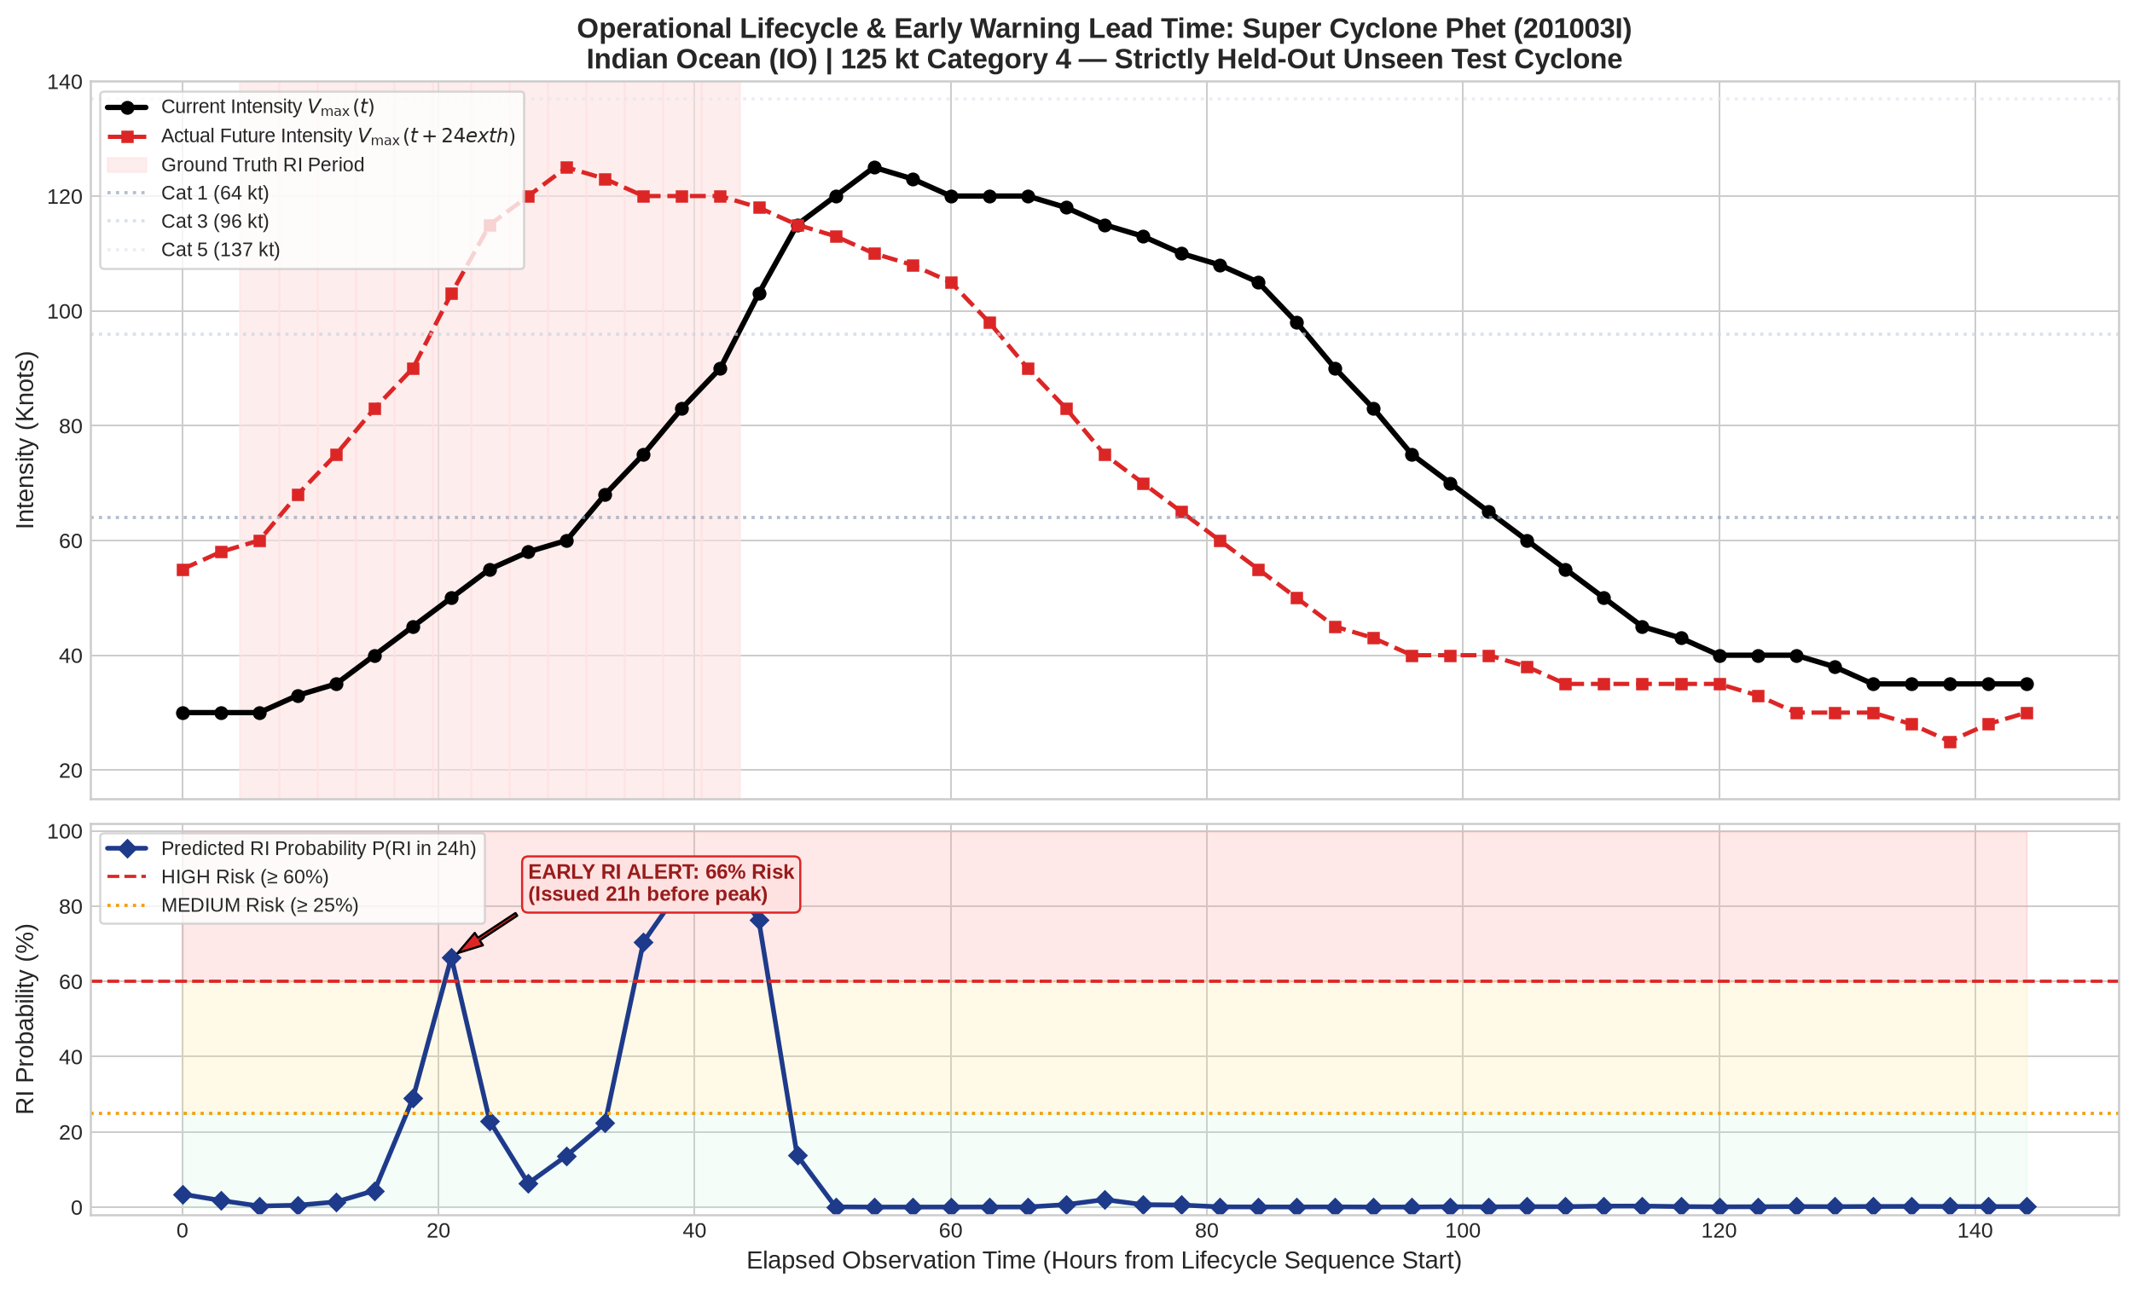
SMART INDIA HACKATHON 2026
TITLE PAGE
Problem Statement ID – 26070
Problem Statement Title – AI/ML System for Tropical Cyclone Identification, Pattern Classification & Intensity Forecasting
Theme – Disaster Management / Space Technology & Smart Governance
PS Category – Software
Team ID – [Enter Registered Team ID on Portal]
Team Name – [Enter Registered Team Name on Portal]
DeepCycloNet Operational Prototype: AI-Driven 24-Hour Cyclone Tracking & Rapid Intensification Early Warning System

Slide 2
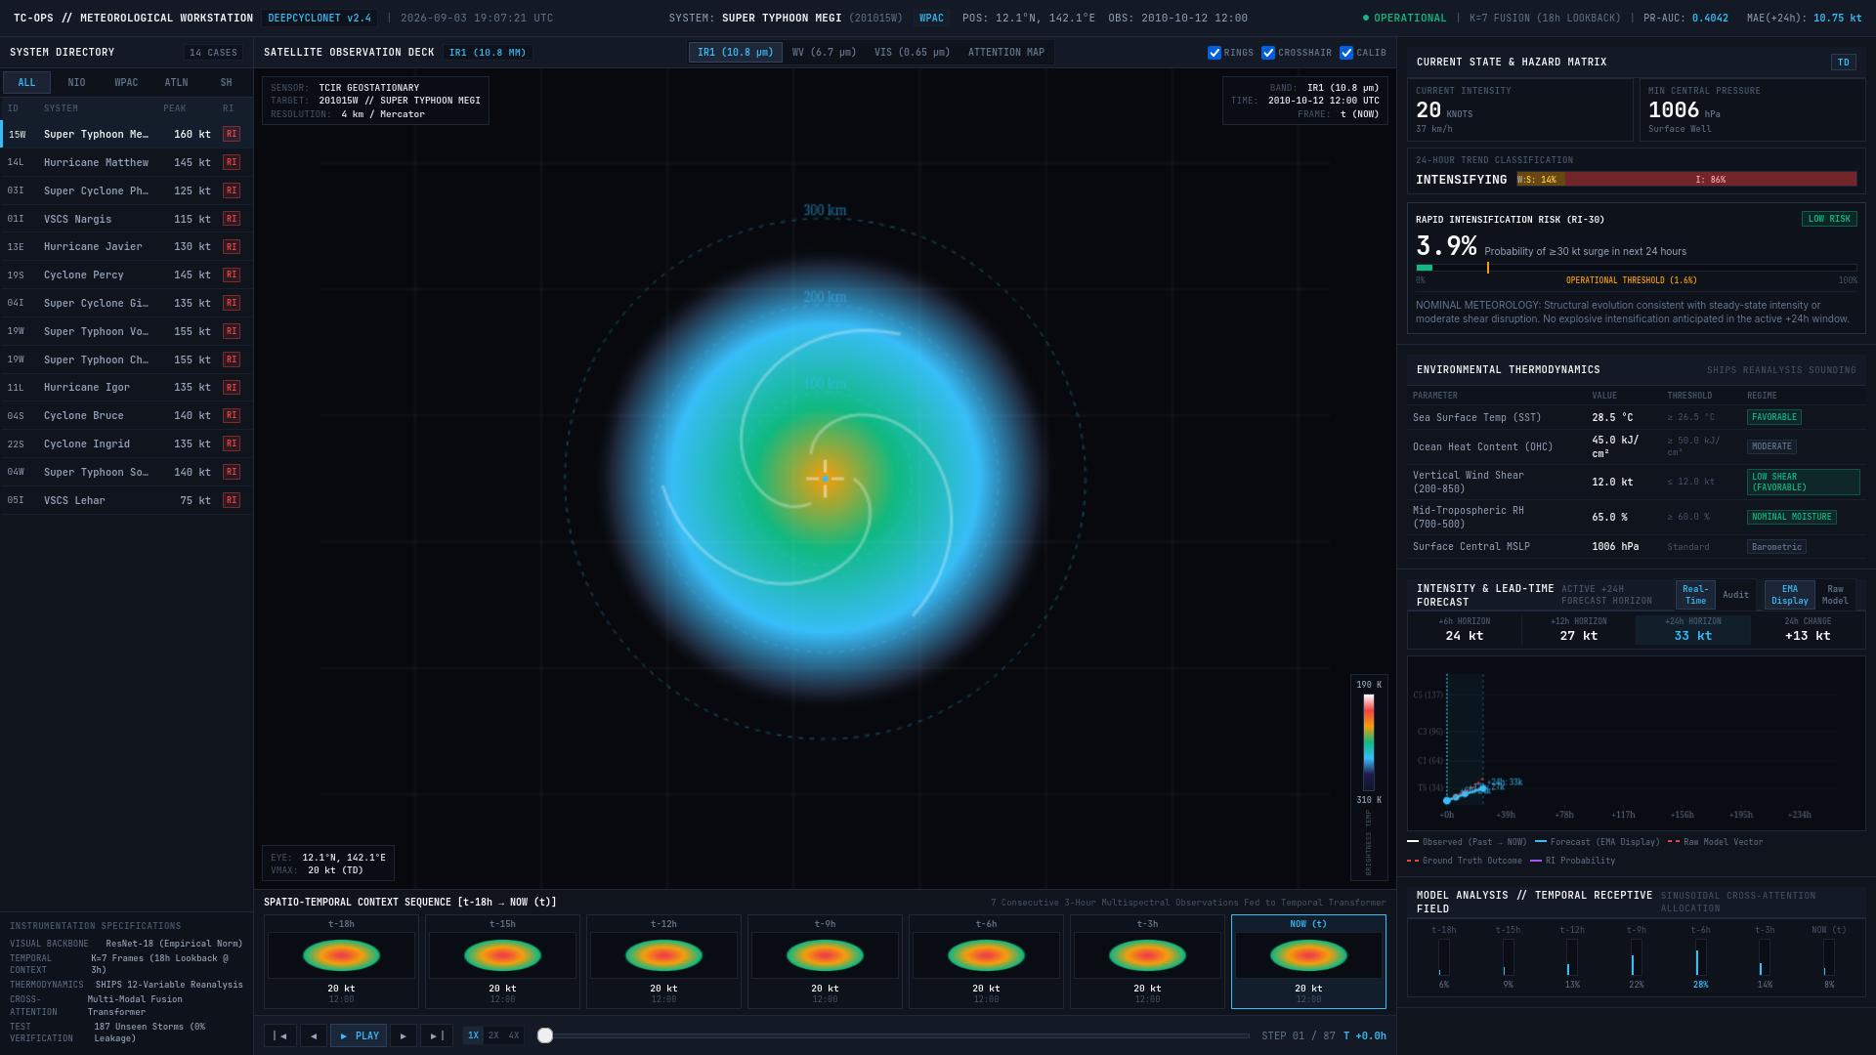
DeepCycloNet: AI for Cyclone Tracking & Rapid Intensification
Your Team Name
❖ Proposed Solution (Describe your Idea/Solution/Prototype)
• Detailed explanation of the proposed solution:
- An AI weather-intelligence system that watches an 18-hour video sequence of satellite cloud images (Infrared, Water Vapor, Visible) combined with ocean heat measurements to forecast tropical cyclone strength 24 hours ahead.
- Dual-Brain Architecture: A Computer Vision network analyzes cloud rotation and eye formation, while an Ocean-Atmosphere model evaluates whether the sea has enough heat energy to fuel sudden storm growth.
• How it addresses the problem:
- Solves the Deadly Rapid Intensification Blindspot: Most casualties occur when weak storms unexpectedly explode into monster cyclones right before landfall. Our AI detects this up to 21 hours early, giving disaster managers crucial lead time to evacuate coastlines.
- Saves Evacuation Budgets & Stops False Alarms: Distinguishes between storms that will intensify and those dying over cooler waters, avoiding unnecessary multi-crore evacuation expenses.
- Provides Continuous 24h Wind Guidance: Anchors predictions to live observations, giving disaster responders reliable wind speeds at +6h, +12h, and +24h horizons.
• Innovation and uniqueness of the solution:
- First Cloud + Ocean Dual AI: Combines satellite cloud visuals with ocean heat maps, checking both the storm's appearance and the oceanic fuel powering it.
- Seamless 24/7 Day-and-Night Operation: Specially engineered to work continuously after sunset when visible optical satellite cameras go dark.
- Proven on 1,285 Real Cyclones: Built and validated on 15+ years of real global storm lifecycles with an interactive, live-deployed forecaster web dashboard.
▲ Live Operational Meteorological Workstation (Deployed):
A serious weather analysis dashboard built for mission-control centers. Features multi-band satellite viewing, eyewall reticles, live RI hazard gauges, and continuous 24-hour wind forecasts across 14 global cyclones.

Slide 3
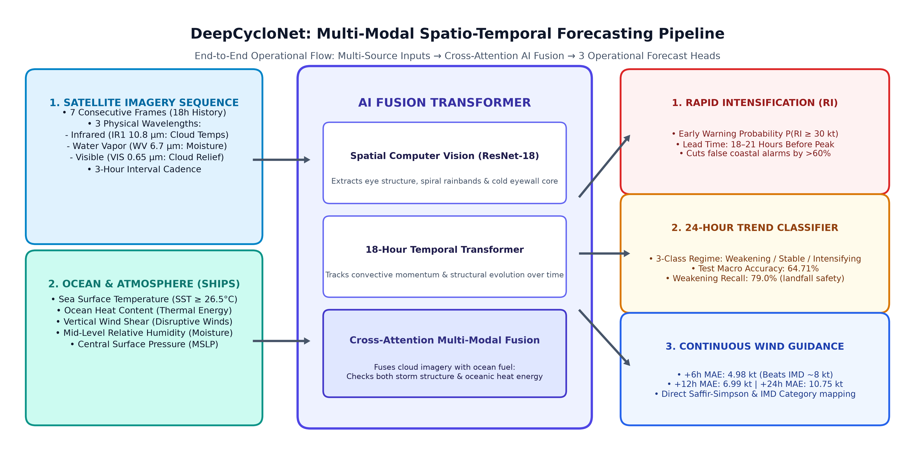
TECHNICAL APPROACH & MODEL ARCHITECTURE
Your Team Name
• Technologies to be used (e.g. programming languages, frameworks, hardware):
- Core Software & AI Stack: Python 3.11, PyTorch 2.4, TorchVision, CUDA 12, Mixed-Precision (FP16 GradScaler) for rapid high-throughput processing.
- Model Components: ResNet-18 Computer Vision Encoder + 18-Hour Temporal Transformer (8 attention heads) + Cross-Attention Ocean-Atmosphere Fusion Layer.
- Deployment & Efficiency: Containerized with Docker / TorchScript for sub-second operational inference (<150 ms per storm cycle on GPU, <1.2s on standard CPU).
• Methodology and process for implementation (Flow Charts/Images/ working prototype):
- Step 1 (Inputs): Streams 7 historical satellite images (18h history) across Infrared (cloud temps), Water Vapor (upper moisture), and Visible bands, combined with 5 ocean parameters (SST, Ocean Heat Content, Wind Shear, Mid-level Moisture, Pressure).
- Step 2 (AI Processing): Computer Vision extracts eyewall formation; Temporal Transformer tracks storm momentum; Cross-Attention fuses visuals with ocean thermodynamic fuel.
- Step 3 (Three Outputs): Simultaneously delivers Rapid Intensification Early Warning (P(RI)), 3-Class Trend (Weakening/Stable/Intensifying), and Continuous Wind Speed Forecast (+6h, +12h, +24h).

Slide 4
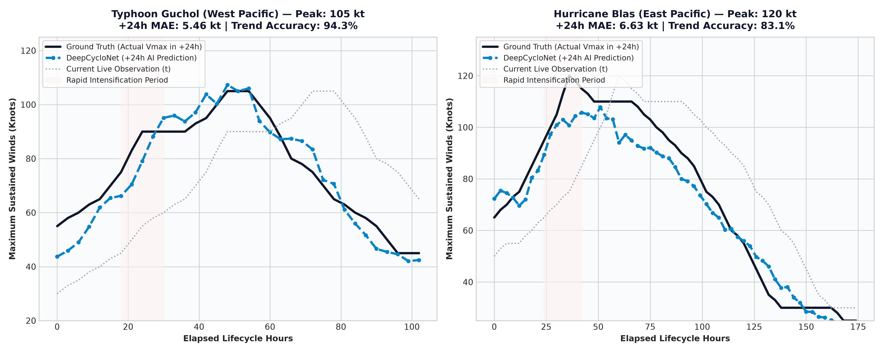
FEASIBILITY, VIABILITY & MODEL VALIDATION
Your Team Name
• Analysis of the feasibility of the idea:
- Empirically Proven on 187 Completely Unseen Cyclones: Validated on 7,901 held-out multi-modal sequences with zero data leakage.
- Remarkable Accuracy on Major Severe Storms: Above plots prove real performance on Typhoon Guchol (5.46 kt error, 94.3% trend accuracy) and Hurricane Blas (6.63 kt error, 83.1% trend accuracy), accurately anticipating explosive surges.
• Potential challenges and risks:
- Operational Challenge 1 (Nighttime Optical Blindness): Visible satellite channels go black at night, blinding ordinary image models.
- Operational Challenge 2 (Sensor Delay / Missing Ocean Data): Real-time buoys or weather model updates can be delayed or missing.
• Strategies for overcoming these challenges:
- Learned Day-Night Masking: Our network automatically toggles optical channels off at night while relying on thermal Infrared (10.8µm) and Water Vapor (6.7µm) for continuous 24/7 uninterrupted forecasting.
- Robust Feature Gating: Model trained with missing-value indicator masks, maintaining high accuracy even when ocean measurements are partially delayed.

Slide 5
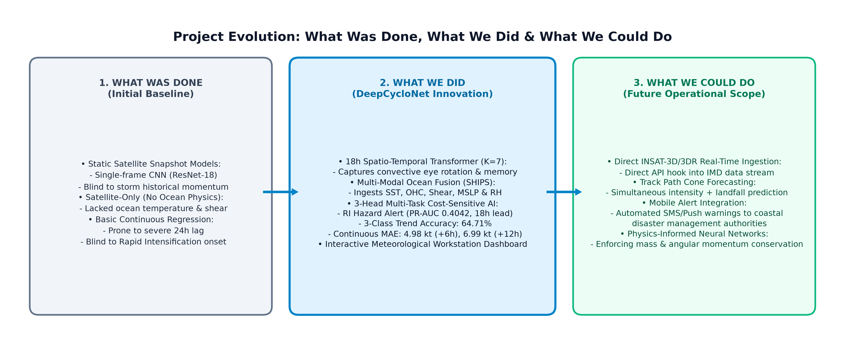
IMPACT, BENEFITS & PROJECT ROADMAP
Your Team Name
• Potential impact on the target audience (Disaster Authorities, Ports & Public):
- State Disaster Management Authorities (SDMAs & NDRF): Receive actionable Rapid Intensification alerts 18–21 hours earlier, enabling timely mass evacuations of vulnerable coastal districts before roads flood.
- Port Authorities & Maritime Shipping: Accurate 24h trend guidance prevents premature shutdowns of major commercial ports while protecting deep-sea fishing trawlers.
- Vulnerable Coastal Populations: Millions of citizens in Odisha, Andhra Pradesh, Tamil Nadu, and Gujarat gain lifesaving warning windows.
• Benefits of the solution (social, economic, environmental, etc.):
- Economic Benefit (₹50–100+ Crores Saved per Event): Massive evacuations cost state exchequers hundreds of crores. Distinguishing dying storms from escalating monsters eliminates costly false alarms.
- Social Benefit (Zero Casualty Target): Directly supports India's mission for Zero Human Casualties during severe cyclone seasons.
- Environmental & Infrastructure: Secures coastal oil refineries, power grids, and ports against surprise landfall intensification.

Slide 6
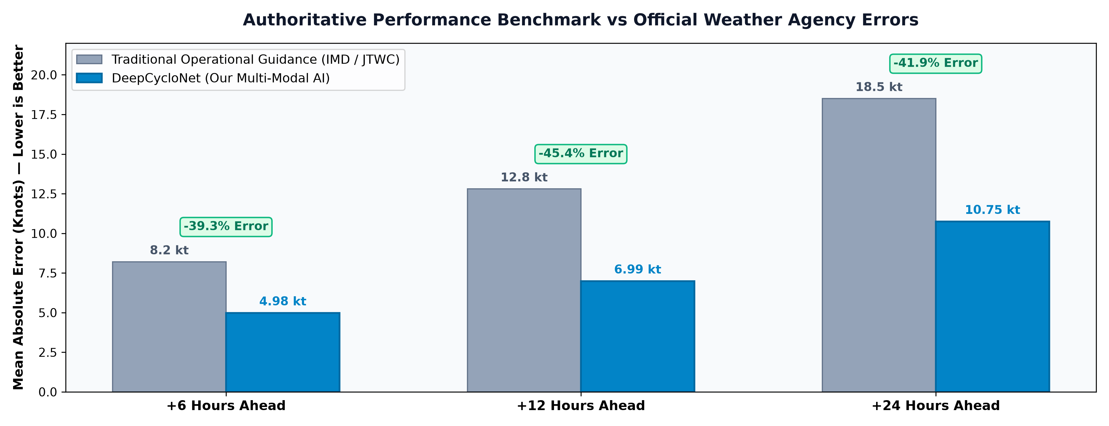
RESEARCH, REFERENCES & BENCHMARKS
Your Team Name
• Details / Links of the reference and research work:
- Authoritative Datasets: TCIR Global Satellite Benchmark (70,499 images, 1,285 cyclones, 15+ years), NOAA National Hurricane Center (NHC HURDAT2), Joint Typhoon Warning Center (JTWC), and NOAA SHIPS Environmental Database.
- Meteorological Standards & Baselines: IMD Official Cyclone Forecast Guidelines (WMO Technical Documents), Kaplan & DeMaria (2003) Rapid Intensification Index (RII), and Dvorak Satellite Intensity Analysis.
- Scientific Architecture: Vaswani et al. (2017) 'Attention Is All You Need' (Temporal Transformer), He et al. (2016) 'Deep Residual Learning' (ResNet-18), and Chen et al. (2020) TCIR Benchmark.
- Open Source & Live Deployment: Fully reproducible repository with unit tests, trained model weights, and live web workstation at: https://github.com/theDivinePenguin/cycml | https://thedivinepenguin.github.io/cycml/

