Slide 1
Using Graphics in R with Microsoft Office
Graphics in R for Research and Publication
SEPA 2019
Matthew D. Turner
Georgia State University
mturner46@gsu.edu

Slide 2
Technical Note
These slides are made in Microsoft Powerpoint
Looking at them with the actual Powerpoint software is required for fully seeing the issues described in the text
Note that these were made with Microsoft Office running on a Windows operating system
If you work with these files in Microsoft Office on the Mac, your results may vary
Note also that the PDF version of this file, exported by Powerpoint, may look different from the descriptions given in the slides (which are based on how the file looks when displayed with Powerpoint)
Furthermore, PDFs will display differently when viewed with different software
Generally, PDFs will have a slight blur in their appearance

Slide 3
Working with Microsoft Office Products
These slides discuss some of the issues for making figures for use with Microsoft Office products
I review several different file formats that can be imported into Powerpoint or Word
See the end for some recommendations

Slide 4
Windows Metafiles
Windows metafiles (WMF) files are sometimes recommended to be used for Microsoft Office
However, I do not agree with this
You can decide for yourself, I have imported the WMF from the workshop on the slide that follows
I think the quality is questionable…

Slide 5
This image looks a little better when displayed in presentation mode.
This is a WMF figure. While the text is better quality than what you get from a GIF or JPEG, the figure’s PCH (filled points) look bad.
I have highlighted the picture’s border in orange so you can see the empty space included with it. WMF files always seem to have this excess space when made in R.

Slide 6
Windows Metafiles
Windows metafiles treat titles/text differently from the graphical parts
So in the previous slide the text of the figure looks fairly good
But the dots in the graphic are not shaped correctly
There are many oddities that can occur in WMF figures
There is often extra blank space inside the figure region (called the bounding box)
This is apparently a problem with R and how it makes WMF files, not Office
I think the R developers do not spend a lot of time investing in making stuff that works just for Microsoft products so I recommend focusing on general formats

Slide 7
High Resolution (600 dpi) Figures
On the following slide is a 600 dpi PNG (bitmap) figure
Because 600 dpi is a good resolution for printing it usually looks good on screen as well
This PNG also does not have the empty space inside the bounding box that is present in the WMF file
If you are working with things that require precise figures, you can take the dpi up even further
I think this is better than the WMF…

Slide 8
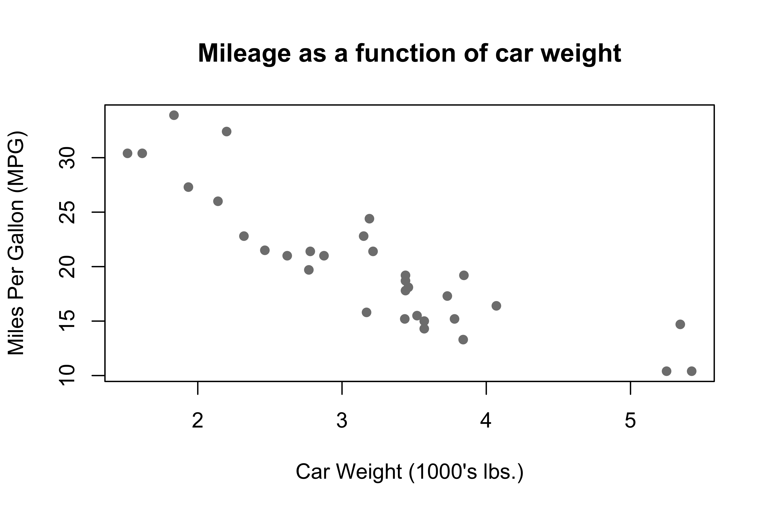
600 dpi PNG

Slide 9
Low Resolution Figures
The main thing to remember about bitmap graphics is that you have to set larger dpi’s than will come by default
Default dpi’s for figures will look much worse in Microsoft Office products
The following two slides show an image at the default resolution/dpi
In the first it is at import size (too small!)
In the second it has been resized (too blurry!)
Look at the quality issues on the following two slides

Slide 10
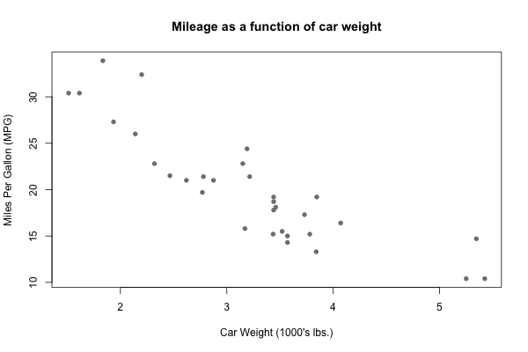
Original PNG at default size/resolution – too small for a slide!

Slide 11
Now the size is right but it is too blurry!
Also the characters are jagged

Slide 12
SVG Files
One common format that Microsoft does appear to support is SVG
The SVG format is a vector graphics format: this means that it is not resolution dependent and can be resized
It also works a lot better than WMF when exported from R as it is a “universal” format
The following slide shows an SVG that has been resized to fill the slide
I believe that this is the best format for most graphics exported from R when including them in Microsoft Office documents
Especially if you want to manually resize them in the Office product

Slide 13

SVG file imported to Powerpoint and resized for slide

Slide 14
Other File Types
Unfortunately, Microsoft Office does not support importing industry standard file formats like EPS or PDF.
Microsoft imports SVG files, but SVG files made on other operating systems will not always load so make sure to make them on a Windows computer if you are on Microsoft Windows
If you look really closely at the SVG and compare it with the 600 dpi figure, you will see slightly more jaggedness in the SVG’s text
This is due to Microsoft’s implementation of the SVG rendering engine
Other SVG software make the files look much better
For really precise control, bitmap figures at extremely high resolutions are always going to be best in Microsoft Office
But for presentations, SVGs are a good compromise and work well

Slide 15
Recommendations for Microsoft Office
Use SVG for figures you want to manipulate or resize inside of Word or Powerpoint
Use high-resolution (600+ dpi) settings for more complex figures, and make sure to set them to their final size in R (before export)
For extremely complicated graphics, you may need even higher resolutions (1200 dpi)
But avoid this as much as you can as the file sizes will get huge!
For publications, make sure to follow the publisher’s requirements which may force you to use one or the other of these options

