Slide 1
R: From Startup to Statistics
Matthew Turner
Department of Psychology
Georgia State University

Slide 2
Today’s Workshop
Presenters:
Matthew Turner, PhD, Research Scientist
Jessica Turner, PhD, Professor of Psychology
Maria Misiura, MA, Graduate Student (Psychology)
All of the slides, R code, handouts, etc., are in the files you copied from the USB sticks and include web links for more information.
The original sources are available at Github and we welcome feedback!
For more information contact: mturner46@gsu.edu

Slide 3
My Background
I started out years ago in physics, but quickly washed out of that and ended up doing things like Religious History, Art History, and Chemistry for a long while
I eventually got my degrees in Social Science (MA), Mathematics (MA), Statistics (MS), and finally Psychology (PhD)
All of this was shot through with a lot of work in computing and data analysis
This has given me an unusual perspective on statistics
Each of the fields I was exposed to had a very different approach!

Slide 4
Assumptions:
You – for some reason entirely of your own – want to start using R
You know basic statistics at about the graduate or advanced undergraduate level (for Psychology)
You, very likely, know another system for doing statistics (at least a little)
This other system is, most likely, SPSS (and if not that, then it is SAS)
If you tried it before, you may have had problems getting started

Slide 5
Oddities of R

Slide 6
Biggest Change/Challenge
If you are coming from SPSS, there is one huge change: R is a programming language
Almost everything you want to do requires what SPSS people call “syntax” ( = code)
Good news! If you write SPSS syntax, you are already programming
Also no one outside of the SPSS community calls it “syntax”!
Every analysis requires writing a program, although for simple analyses these may be a single command
Today’s workshop will be very simple analyses

Slide 7
Biggest Change/Challenge
The main benefit is that these programs are transferrable and make a permanent record of the analysis
This transferability is critically important!
Journals want people to share analyses which means sharing code
Funders expect a certain level of sharing of code with data
If you are young:
Get used to this, it is the future!
“Reproducible research” requires code

Slide 8
Big stuff to get used to…
Updates require fully reinstalling R roughly every 12 months
Very little changes, I reinstall for every major new project
I have never had an old program not work due to an upgrade but YMMV
Most functionality has to be installed on demand with R packages (discussed later)
All of this indicates the need for the user to have “admin privileges” to their computer
There are ways around this if your IT department denies you this

Slide 9
Objects an Variables
In R, we put many things into variables:
Data (numbers, factors, names, etc.)
The results (outputs) of computations (a linear model, a t-test, etc.)
Note that this is the actual test construction, not just the final results of the test!
We can often manipulate or continue the analysis with the stuff we stored in a name
Figures and graphics
All of these things are “objects” which are essentially lists of things
This probably seems weird to many of you who view variables as only data and all this other stuff as “output”

Slide 10
R is Taciturn
SPSS returns reams of output for even the simplest commands
R often responds with no output or just an acknowledgement that something happened
R usually has the information you want, but it waits until you ASK for the information rather than forcing it on you

Slide 11
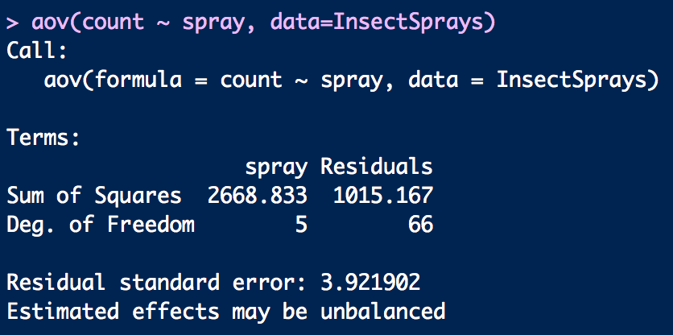
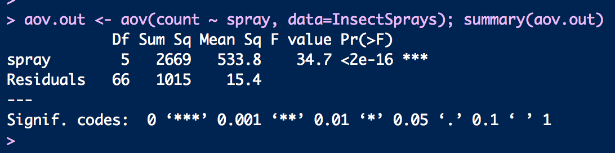
Do an ANOVA
Do an ANOVA and print the table

Slide 12
R is Taciturn
This is a good thing:
It forces you to know what you want and ask for it
It encourages you to build up computations step-by-step
It does not overwhelm you with details that you may not want

Slide 13
SPSS vs R: Packages
Both R and SPSS come with some functions built in
Basic R is a little sparser than SPSS
But R with a few added packages added is vastly more powerful
Both R and SPSS have “packages”
SPSS calls these modules
IBM wants $$$ for these modules
R packages are free and open, at least in the main R ecosystem
There are companies that sell R packages, too!
Revolution Analytics (now Mircosoft) makes a commercial R for high performance computing

Slide 14
Packages
The best and worst thing about R is the package manager:
Pros:
Allows anyone to release new statistical procedures to the world
Almost every possible statistical procedure is out there somewhere you just have to find it (Google!)
All the main R packages are kept in one place (CRAN)
R is automatically connected to CRAN
Cons:
Allows anyone to release new statistical procedures to the world
Packages are managed independently
Very uneven in how well-developed they are
Inconsistent in terms of syntax
Packages are not well-organized by topic (ex: car)

Slide 15
Packages
How do you know if a package is good enough to use?
Generally the answer is yes, use it!
Most packages are written by statisticians and professional data analysts and are heavily tested
The more important they are, the better tested they are, the larger the user community is…
Biggest problems are odd syntax or inefficient computing (slow or need a lot of memory)
For psychological research this likely does not matter
All packages have a manual that lists authors and contributors
Treat it like research papers and look up the authors/citations

Slide 16
The Safety is Off
R will let you do any analysis that is not strictly impossible for the data
SPSS, for instance, blocks some operations when you carefully set your variable types
However, SPSS, often guesses wrong and people don’t set the types
R has all the usual data types and they can be set
This will lead to some safety, but it is not strict like SPSS
The better developed packages will try to guide you to sensible results

Slide 17
Using R

Slide 18
Interface
R has a very bad native interface
No one uses R directly
The R Project has basically ceded this to other teams
You really need to use a different program to interface with R
The most common is RStudio (by RStudio, Inc.)
This is a free system, most of it is open source (but not all!)
There are GUI interfaces (that look like SPSS or other software) but they are not very good!
I actively discourage students from using them

Slide 19
Finding Stuff Out
Because R is command driven, you have to develop a sense of how to find things out:
The “?” operator – put ? in front of a command name to get some help printed out
The help() and help.search() functions open help text
The apropos() function looks for partial matches for command names
For all but ? you must put the search term in quotes
However: the R native documentation can be hard to read!

Slide 20
Finding Stuff Out
Google:
How do I _____ in R?
After about a week of this, your Google will start filling things in for you
Rstudio’s interface also has help functions:
Rstudio does a good job with help
It has a help browser off to the side that uses R’s help.search() but looks nicer
It will automatically show hints as you type to remind you what is expected from a command

Slide 21
General Process for Data Analysis
Read in the data
The linga franca of the data world is the CSV file
R can also read in SPSS, SAS, and XLS formatted data, among others
Name, Edit, Subset, and Transform the variables
In the data science world this is called “munging”
Apply a function to data (aov, lm, etc.)
Ask for the results you want/need
Repeat
R encourages a very interactive style of data analysis! Some psychologists seem distrustful of this!

Slide 22
Interactive Style
R encourages an interactive style of data analysis
Load the data
Do analyses/make graphs quickly
Re-analyze the data once you understand it
Export results and publication quality results
Reproducibility note:
There are tools in R that allow it to export data, graphs, tables, and numbers directly into your research paper text
Not easy to use (steep learning curve)
But, once you do, you can write the paper and the analysis in a single document, with tables/numbers/figures updating automatically

Slide 23
Resources
At the graduate level, a good high-level book on statistics with R is Maindonald and Braun’s Data Analysis and Graphics Using R
The Quick R website is full of short articles on R organized by method
The Personality Project website has a good guide to R for psychological researchers
Lynda.com is a courseware site that has basic R lessons and many universities have contracts for staff and students to use it
Finally, the R-Bloggers site is an aggragrator of blog posts by 750 international R bloggers and has articles on lots of topics

Slide 24
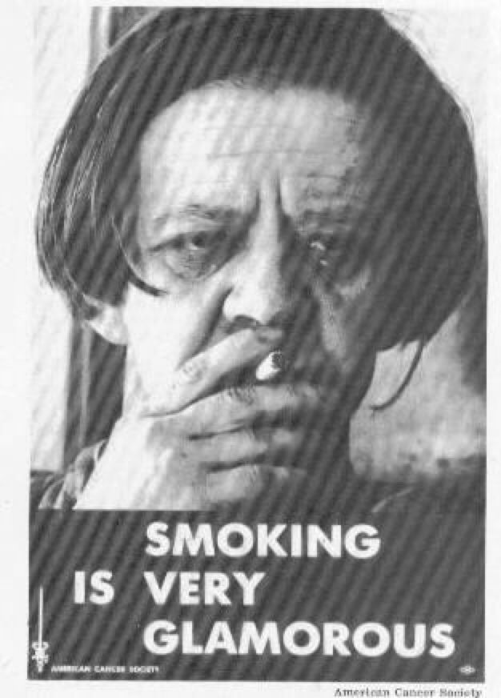
Warning!
“Using R is a bit akin to smoking. The beginning is difficult, one may get headaches and even gag the first few times. But in the long run, it becomes pleasurable and even addictive. Yet, deep down, for those willing to be honest, there is something not fully healthy in it.”
⎯ Francois Pinard
R
https://statsinthewild.com/2012/02/29/harry-potter/

