Slide 1

Twitter Opinion Retrieval
Matteo Lugli, Davide Rivi, Carlo Uguzzoni

Slide 2
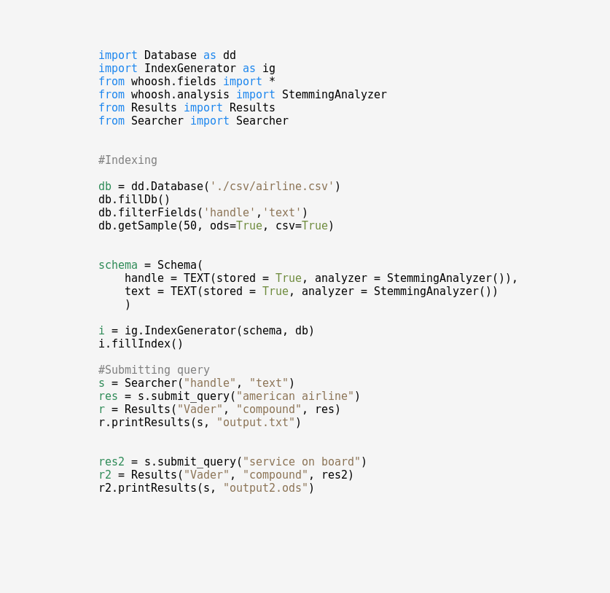
Software and interface
Python and whoosh;
Object oriented;
Adaptable to different SA tools;
Based on 4 main Classes:
Database;
IndexGenerator;
Searcher;
Results;

Slide 3
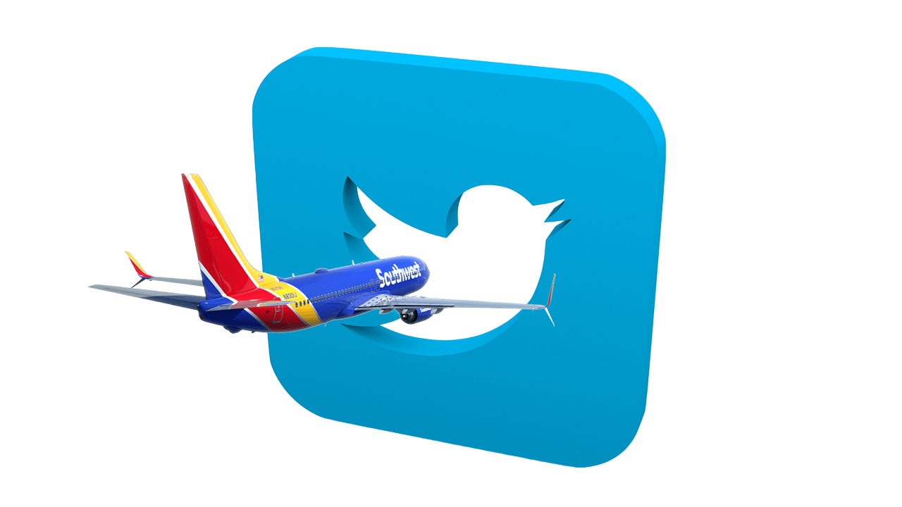
Dataset Used
Twitter Airlines
14647 tweets on each major U.S Airline;
Manually annotated;
Tweets are at most 280 characters long;
Short and concise documents;
https://www.kaggle.com/datasets/crowdflower/twitter-airline-sentiment

Slide 4

Query Language
Supports OR queries by default (though different terms are rewarded above repetitions)
User can also explicitly use OR/AND special tokens for custom queries
Double quotes (“ ”) are used for proximity search
More sophisticated constructs:
Wildcard queries
Range queries
Results boosting
And finally… it’s possible to mix all the above to obtain the most flexibility!

Slide 5
Example queries
reviews on customer service,
“sauvignon wine”,
technical problems with flight,
quality of personal,
rerouting OR rescheduling,
late arrival,
tickets and bookings,
luggage OR bags,
departures AND arrivals,
internet connection,
[fight TO flight]

Slide 6
Preprocessing
Whoosh default preprocessing is used;
Stemming;
Stopwords removal;
Tweets are short, so query expansion is also needed → using a Thesaurus might be useful, see next slide;

Slide 7

Query Expansion
Tweets are short text;
They express concepts with few words;
The index happens to be small;
Query expansion is needed;
A thesaurus is used to expand queries with synonyms;

Slide 8
Query Expansion
In this example, the query is
“reviews on customer service”;
Using Wordnet the word “service” is expanded with:
['avail', 'help', 'overhaul', 'serve', 'servicing', 'serving']
That’s why tweets like the one below are retrieved as well:
'@JetBlue you wanna help out? How about you reimburse the money you cause my band to lose.'

Slide 9
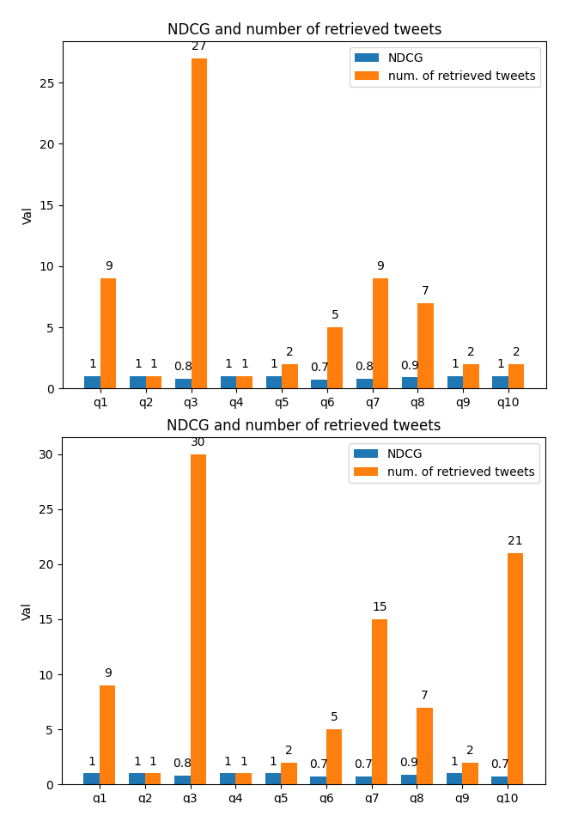
Query Expansion
Query n.7 returned 15 tweets (9 were returned without expansion) and the DCG is still decent
(NDCG is 0.7)

Slide 10
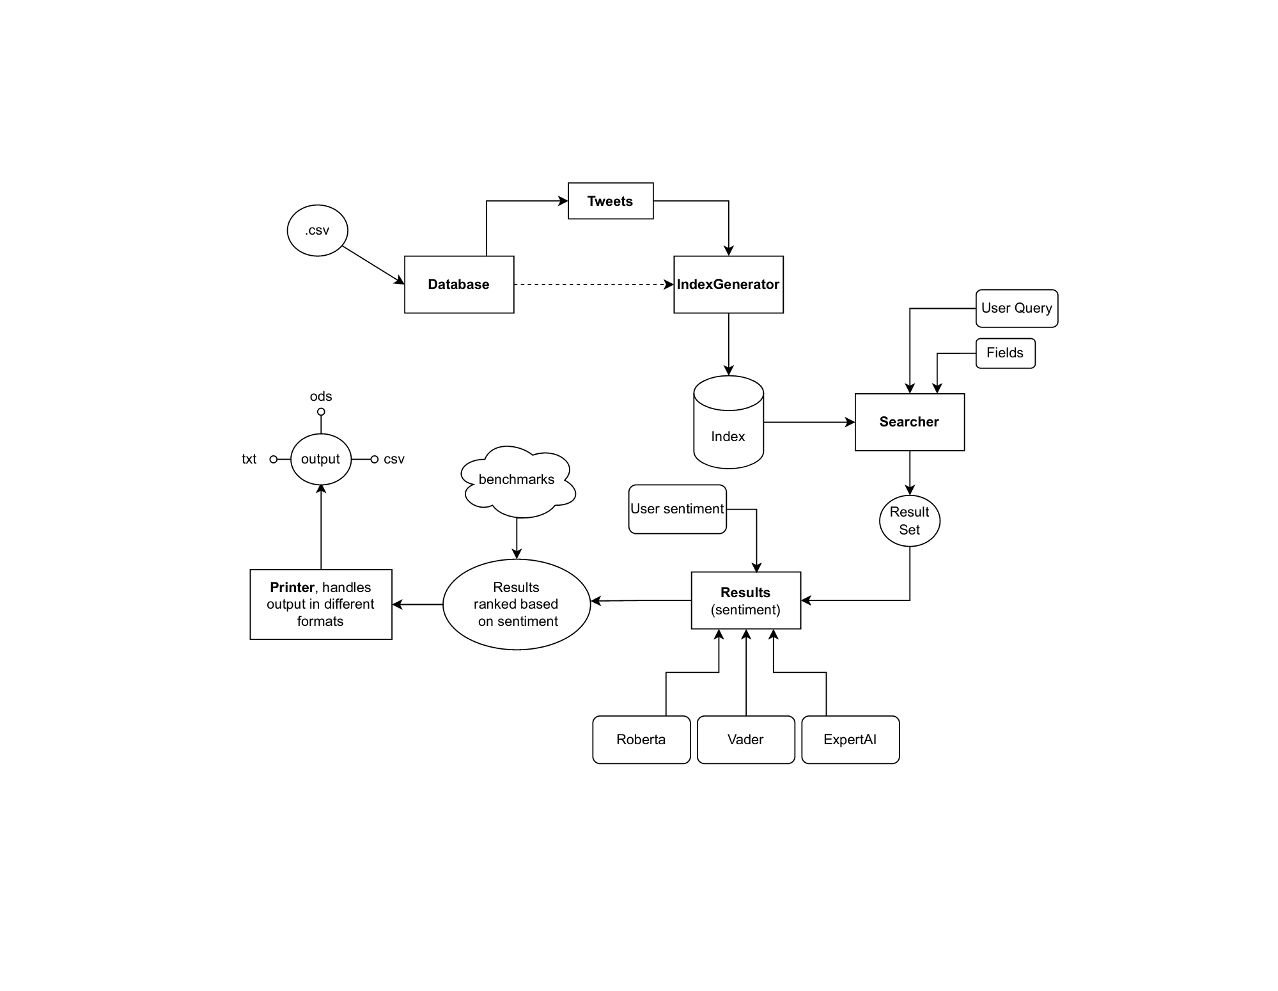

Slide 11

Vader
https://github.com/cjhutto/vaderSentiment
Lexicon and rule-based sentiment analysis tool;
Tuned for sentiment expressed on social media;
Returns a “compound” score between [0,1];
Fits well if a “global” ranking (based on all sentiment) is needed;
Prediction precision is approximately 50%;

Slide 12

More tools
ExpertIA
RoBERTa
https://docs.expert.ai/nlapi/v2/guide/sentiment-analysis/
Natural Language API;
Developed and trained by ExpertAI;
Cloud-based, a little slow for our needs;
https://huggingface.co/docs/transformers/model_doc/roberta
Based on Google’s BERT model released in 2018;
Offers easy-to-use pre-trained models;
According to our benchmarks, positive/negative classification precision is approximately 70%;
Requires a lot of computation, still slow even for small corpus;

Slide 13

BENCHMARK
We manually annotated a sample of 100 tweets, giving a score between [0,3] to each tweet for a total of 10 queries;
the chosen score is based on:
Sentiment
Pertinence

Slide 14

Evaluation, DCG & NDCG
DCG (and NDCG) are used;
We used a custom formula to calculate DCG;
This way the second element of the ranking has less impact on the overall score;

Slide 15
Ranking, normalized-weighted-average
Pertinence score given by the retrieval algorithm and sentiment score had to be combined to return a comprehensive score;
We use what we call normalized-weighted-average;
Given that sentiment score is [0-1], to have a balanced score it’s necessary to normalize the pertinence score given by whoosh;
A naive approach (i.e. using ps*ss) would cause a sentiment score of 0 to annul the whole score.

Slide 16
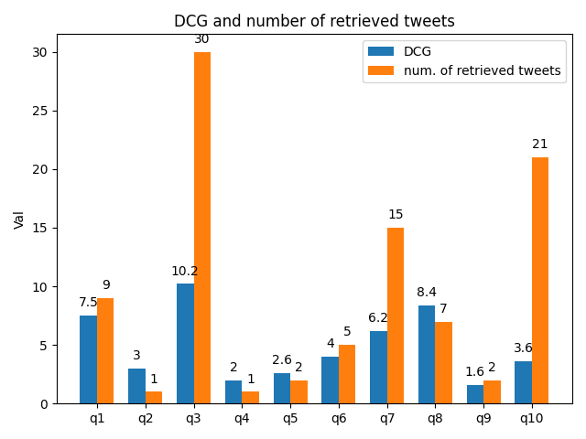
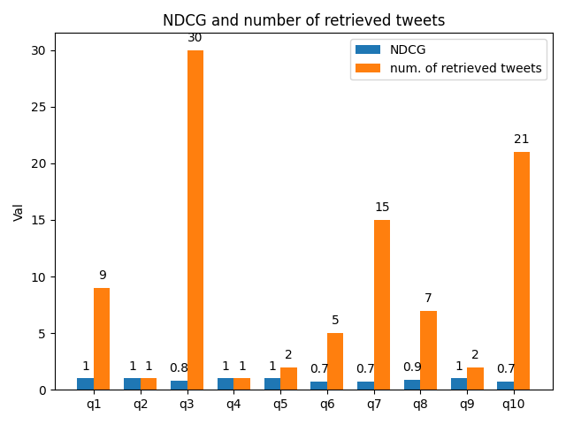

Slide 17
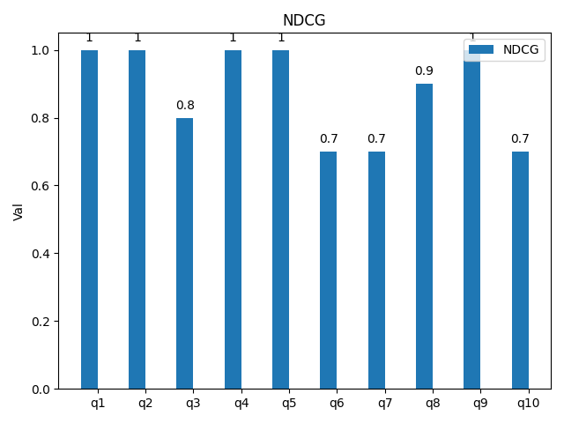
TF-IDF

Slide 18
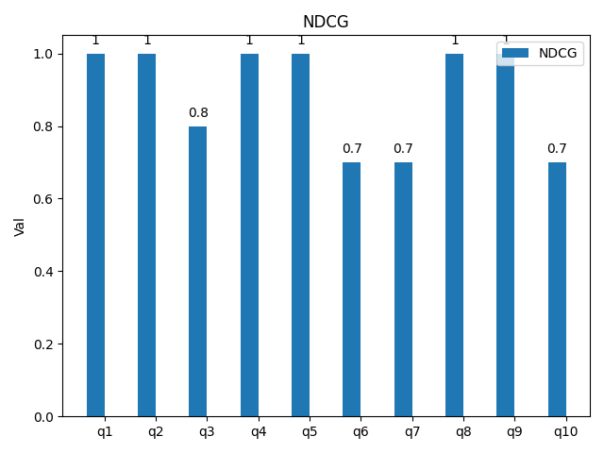
BM25F

Slide 19
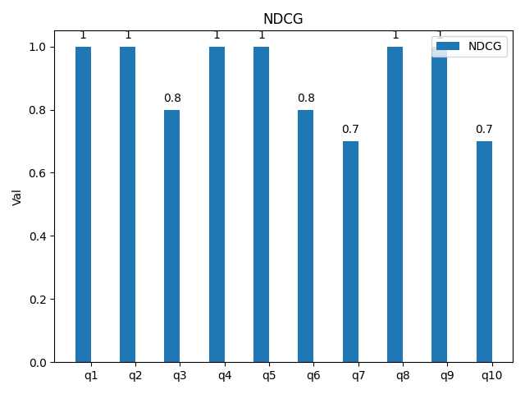
PL2

Slide 20
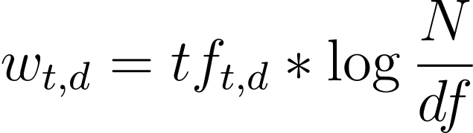
Modelling, TF-IDF
TF-IDF model performs well, similar to BM25 according to DCG evaluation;
Simple bag of words model;
Document length is not necessary, because tweets have similar length → BM25 requires extra computation and complexity;

Slide 21
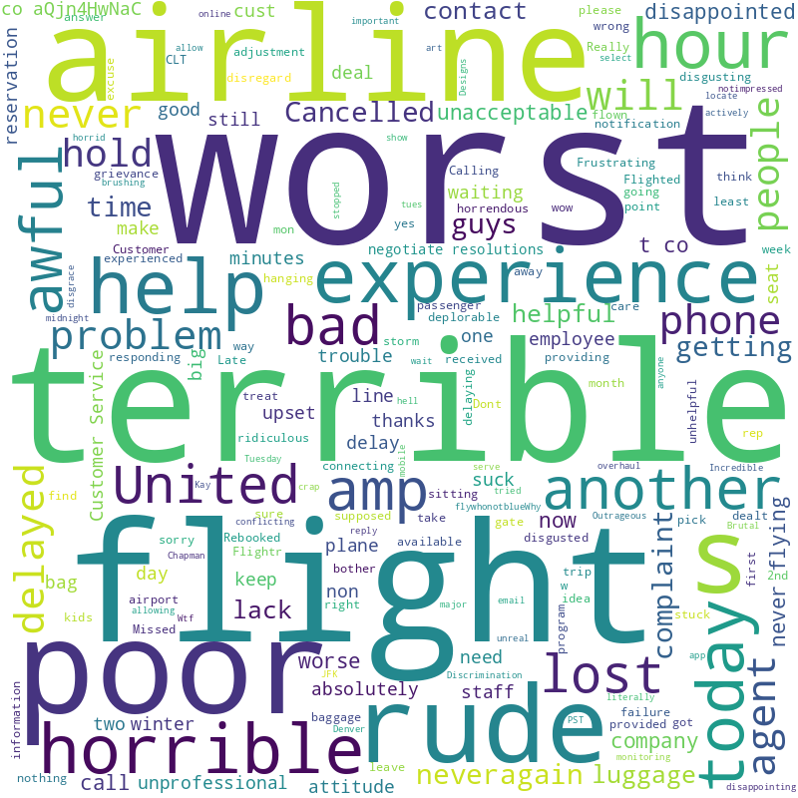
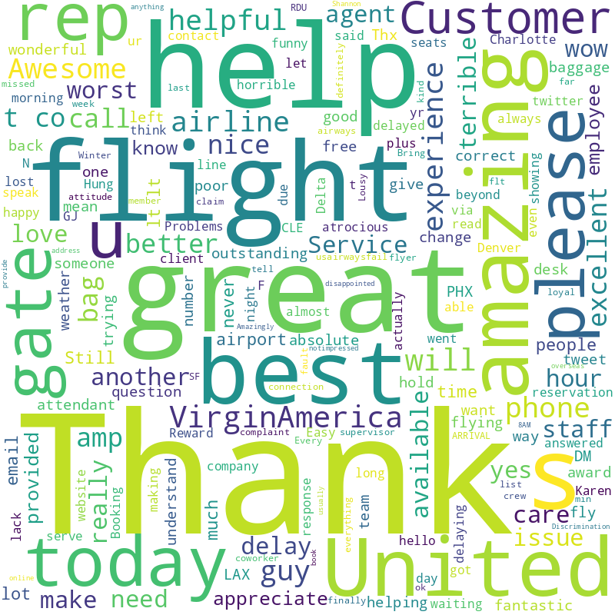
Wordcloud (negative vs positive sentiment)

