Slide 1

#LifeKoKaroLift
Lending Club Case Study
Group:
Hari Praveen Kumar
&
Shipra Agarwal
18-05-2022

Slide 2
Agenda
Problem Statement
Identify loan applicant from the given dataset and find the potential default and non-default applicants and summarise the results with Visualization.
18-05-2022

Slide 3


Lending Club: EDA Case Study
Load and Drop records with Null or empty data.
18-05-2022

Slide 4

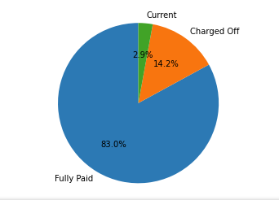
Lending Club: EDA Case Study
Identify Toal Applicants with Loan statuses
18-05-2022

Slide 5
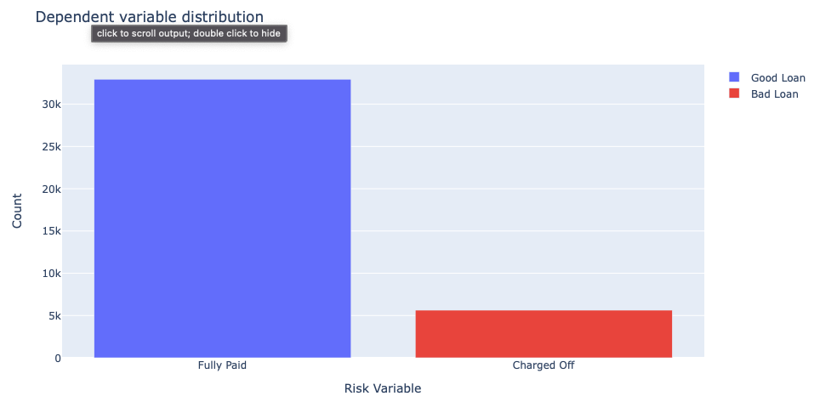
Lending Club: EDA Case Study
Compare total risk applicant against non risk applicants
18-05-2022

Slide 6
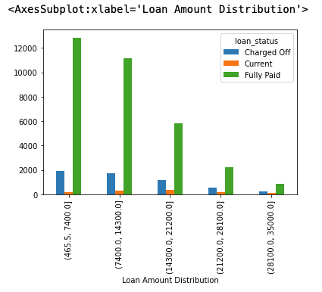
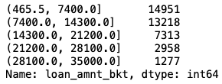
Lending Club: EDA Case Study
Loan distribution by amount Range
Divide the loan amounts with 5 equal ranges and identify various applicants falling in those ranges with bivariate plot
18-05-2022

Slide 7
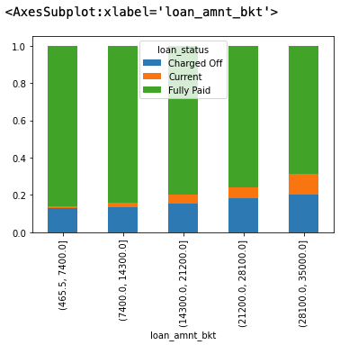
Lending Club: EDA Case Study
Bivariate plot including potential default, non-default and current applicants.
18-05-2022

Slide 8
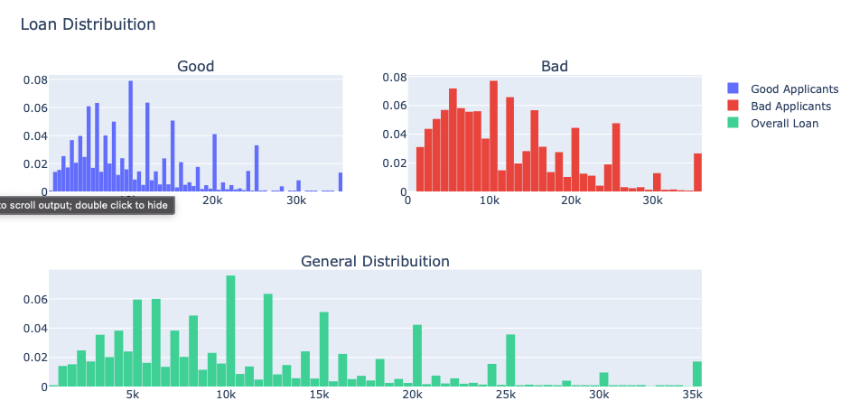
Lending Club: EDA Case Study
18-05-2022

Slide 9
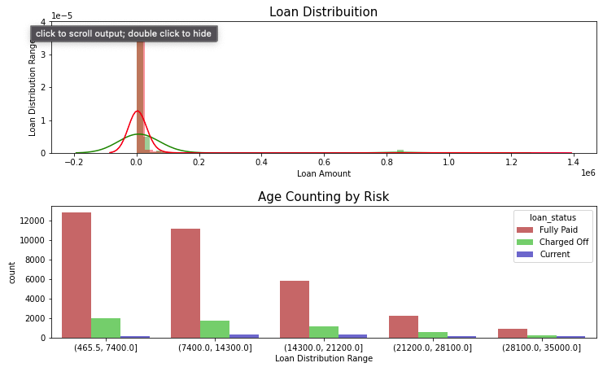
Lending Club: EDA Case Study
Bivariate plots for different loan applicants against loan point with different loan ranges
18-05-2022

Slide 10
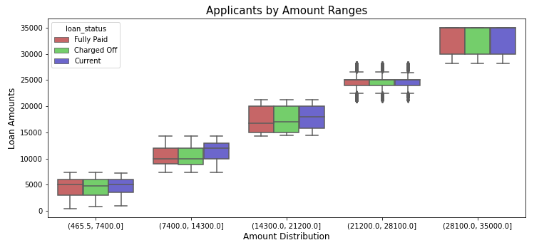
Lending Club: EDA Case Study
MultiVariate Plot for different Loan Applicants against Amount they applied
18-05–2022

Slide 11
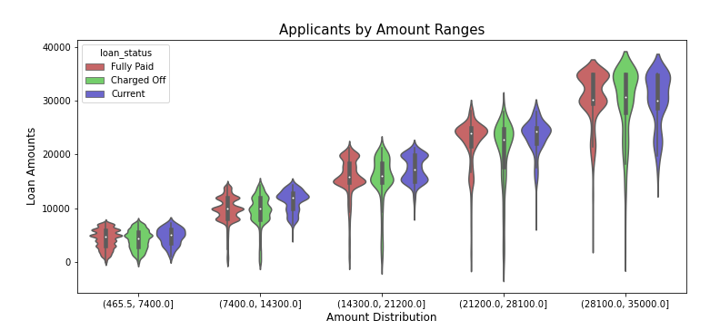
Lending Club: EDA Case Study
MultiVariate Plot for different Loan Applicants against Actual loan approved by Investor
18-05–2022

Slide 12
Thank You!
18-05–2022

