Slide 1
Building a Knowledge Graph Enriched With Large Language Models
Oğuzhan Güngör 24411006

Slide 2
Goal of the Presentation
To explain the current state of the project and present the deliverables.
The project is creating a knowledge graph and enhance the Large Language Model (LLM).
Using the knowledge graph to enrich the LLM and link it to DBpedia for enhanced semantic connections and information retrieval.

Slide 3
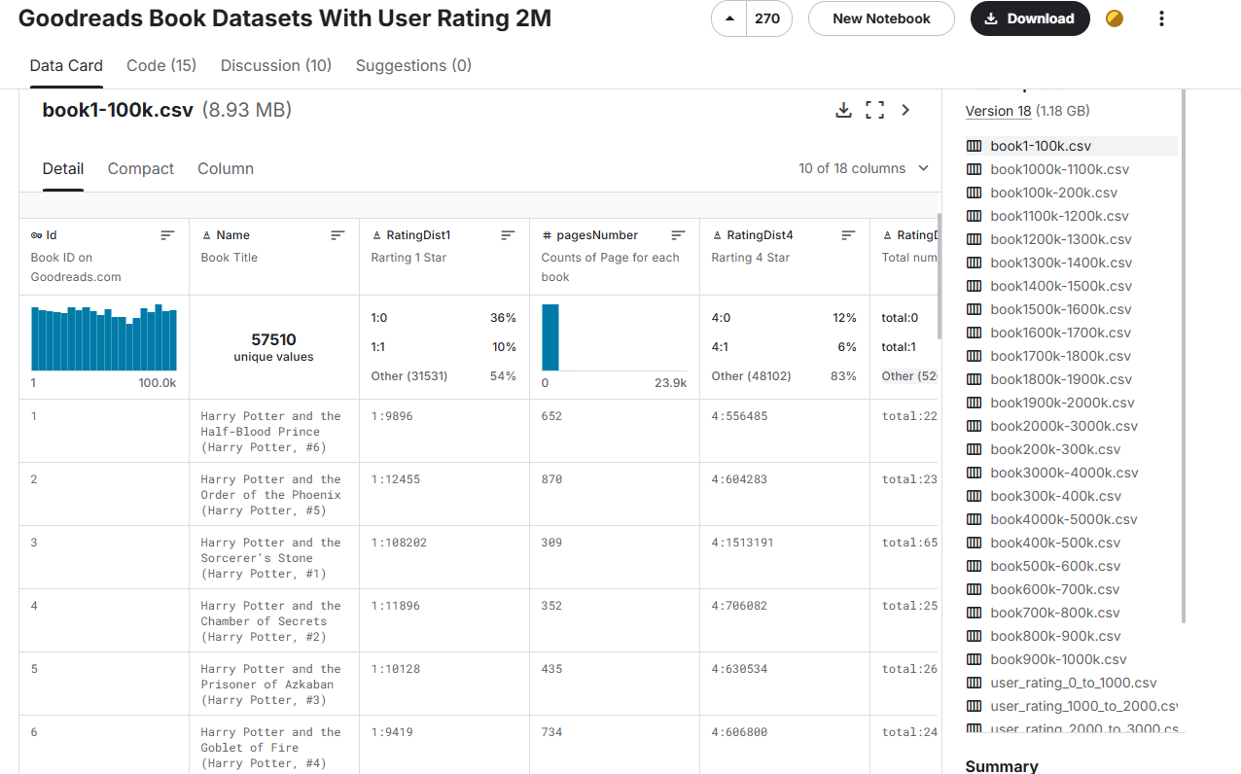
Data Preparation
In this project, Goodreads Book Dataset has been used for generating the initial database.

Slide 4
Data Pipeline Methods
There were 3 approaches when storing data from csv file to Neo4j graph database:
Utilizing Concurrency in Python
Utilizing Multiprocessing in Python
Utilizing Concurrency at Database Level

Slide 5
Data Pipeline Methods Pros and Cons
Concurrency in Python: It is fast. Comes with race conditions, managing connection pools is hard. Lacks data integrity.
Multiprocessing in Python: Easier solution. It is slow. Don’t need to manage connection pools. Data integrity is full.
Concurrency in Neo4j using APOC: It is fastest. Comes with race conditions therefore comes with failed insertions. Lacks data integrity. This method was picked due to its accuracy.

Slide 6
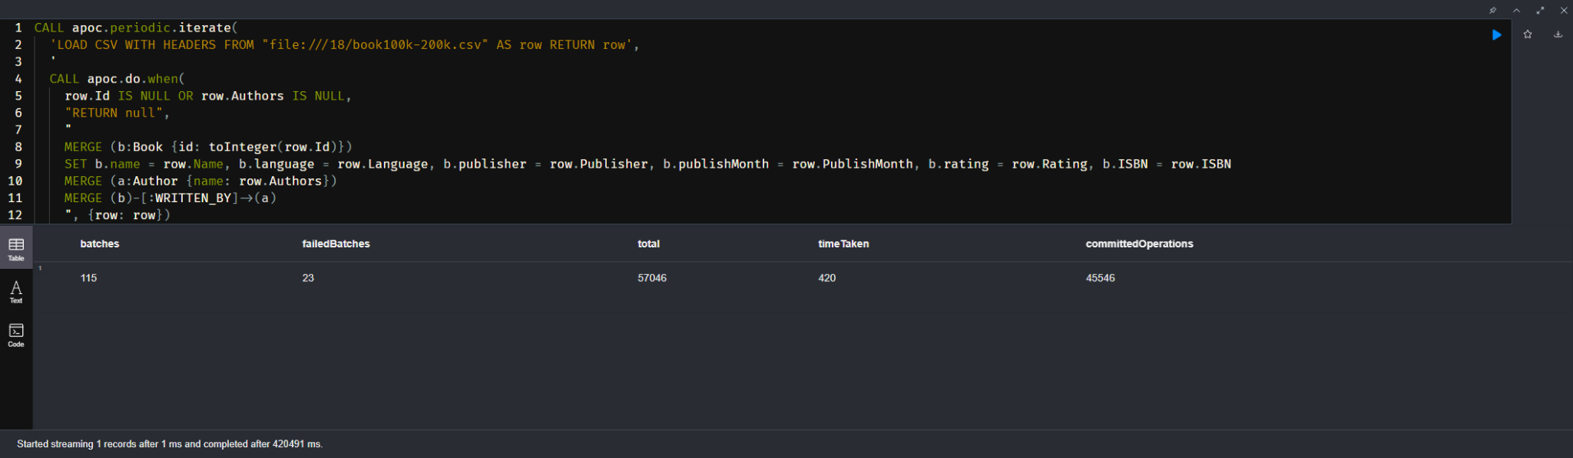
Data Pipeline Methods- APOC

Slide 7
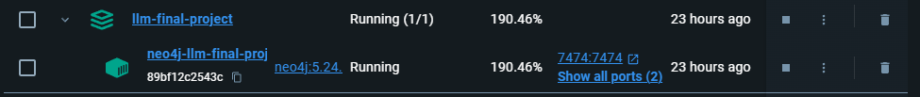
Environment Generation
For the development environment, Docker container has been utilized for easier deployment of Neo4j. For Python scripts, Python 3.12 has been picked due to speed benefits of Python 3.12.
For version control, Git and Github has been utilized. Since the project is a solo project with time constraints, no branch controls have been implemented.

Slide 8
Graph Version 1:
Generated With Only The Dataset
This version made with only using the contents of the data. In this version, graph database have meaningful connections but lacks the depth. Nodes: Books, Authors, Users Edges: WRITTEN_BY: Book -> Author REVIEWED_BY: Book -> User

Slide 9
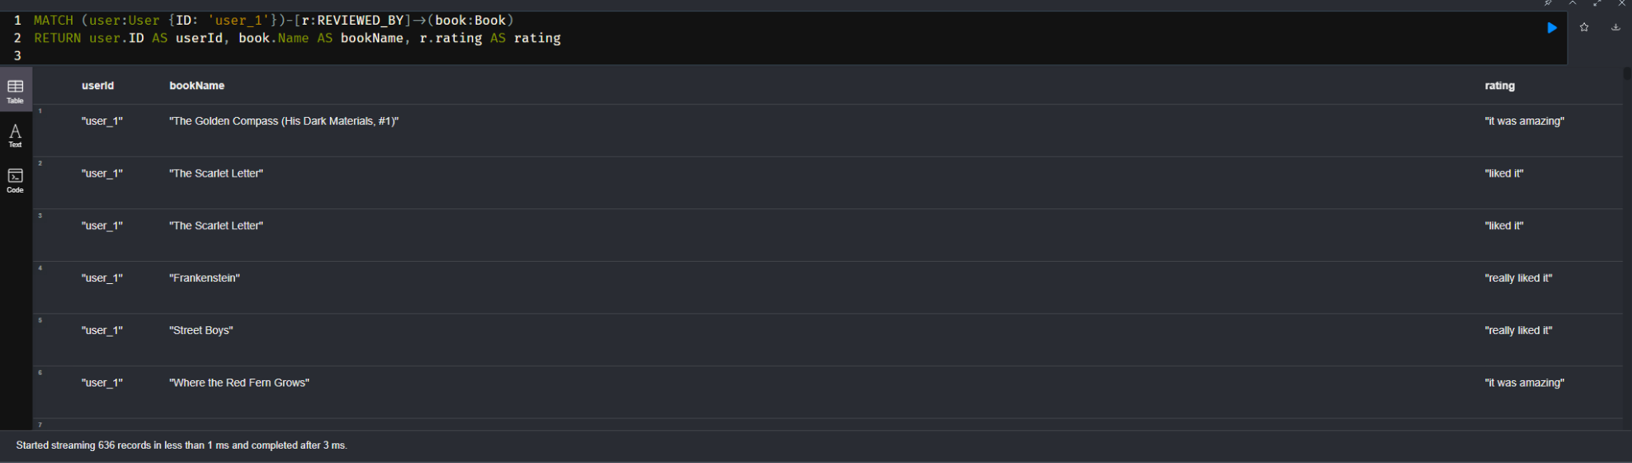
Graph Version 1:
Generated With Only The Dataset

Slide 10
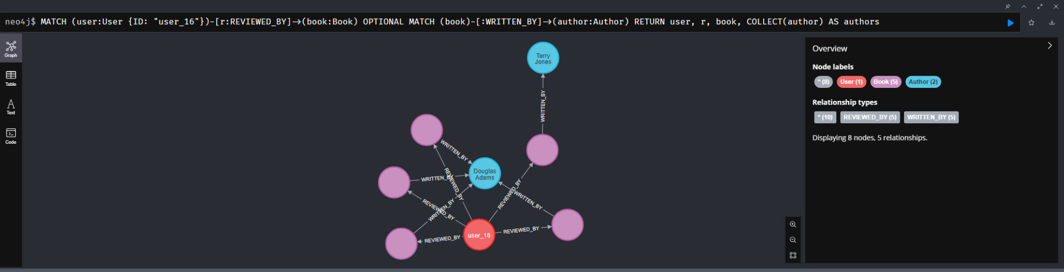
Graph Version 1:
Generated With Only The Dataset

Slide 11
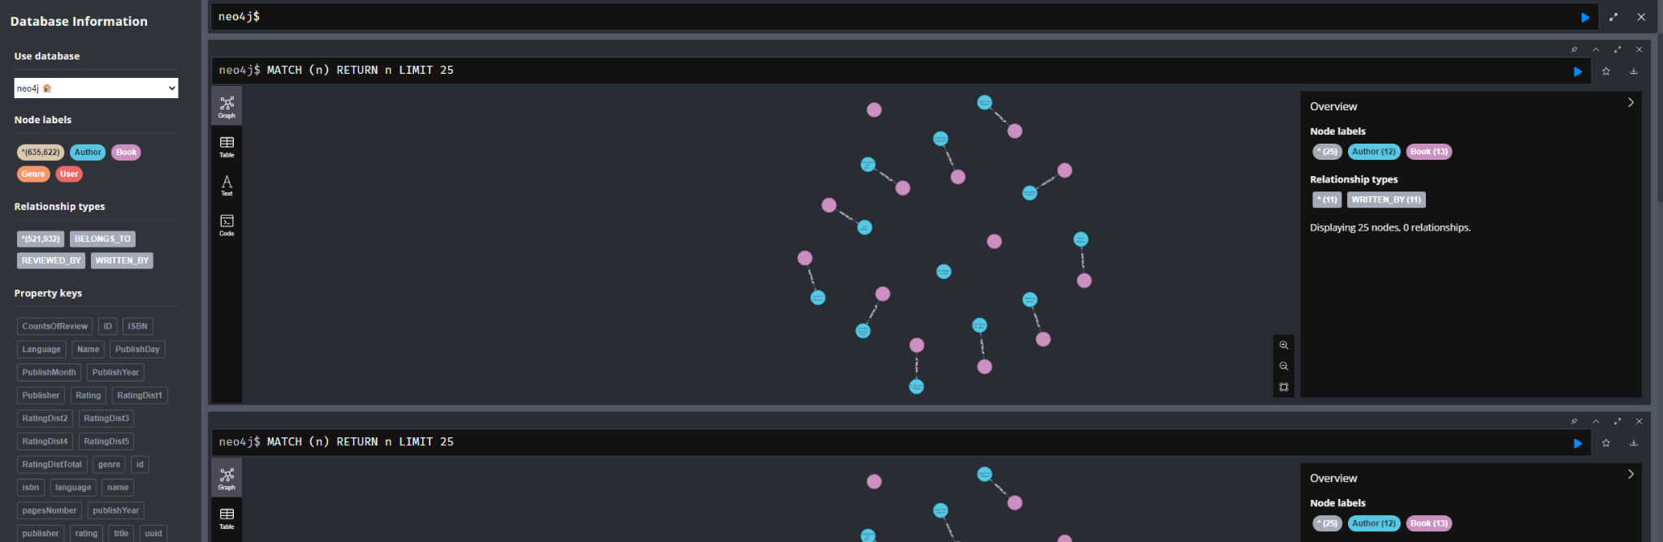
Graph Version 1:
Generated With Only The Dataset

Slide 12
DBpedia Integration
Since the data for books are lacking Genre of the books, the awards that author or the book got using DBpedia to obtain genres of the books was the solution for improving the graph database.

Slide 13
Graph Version 1I:
Improved Version With DBpedia
This version made with addition to DBpedia data. In this version, graph database have meaningful connections but still lacks the depth.
Improvements:
Added Genre, Award, Descriptions Nodes: Books, Authors, Users, Genre, Award Edges: WRITTEN_BY: Book -> Author REVIEWED_BY: Book -> User HAS_GENRE: Book -> Genre
HAS_AWARDS: Book -> Award

Slide 14
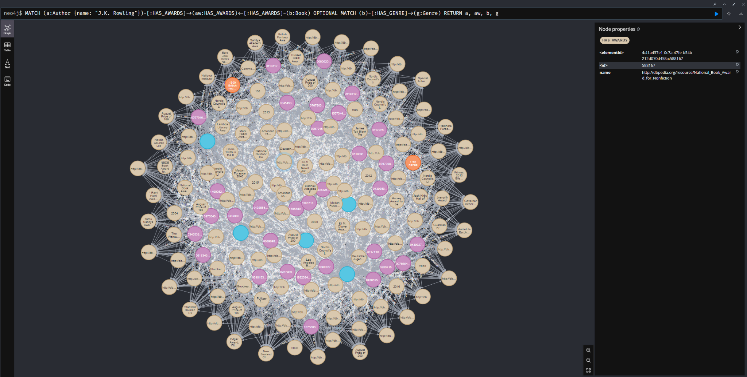
Graph Version 1I:
Improved Version With DBpedia

Slide 15
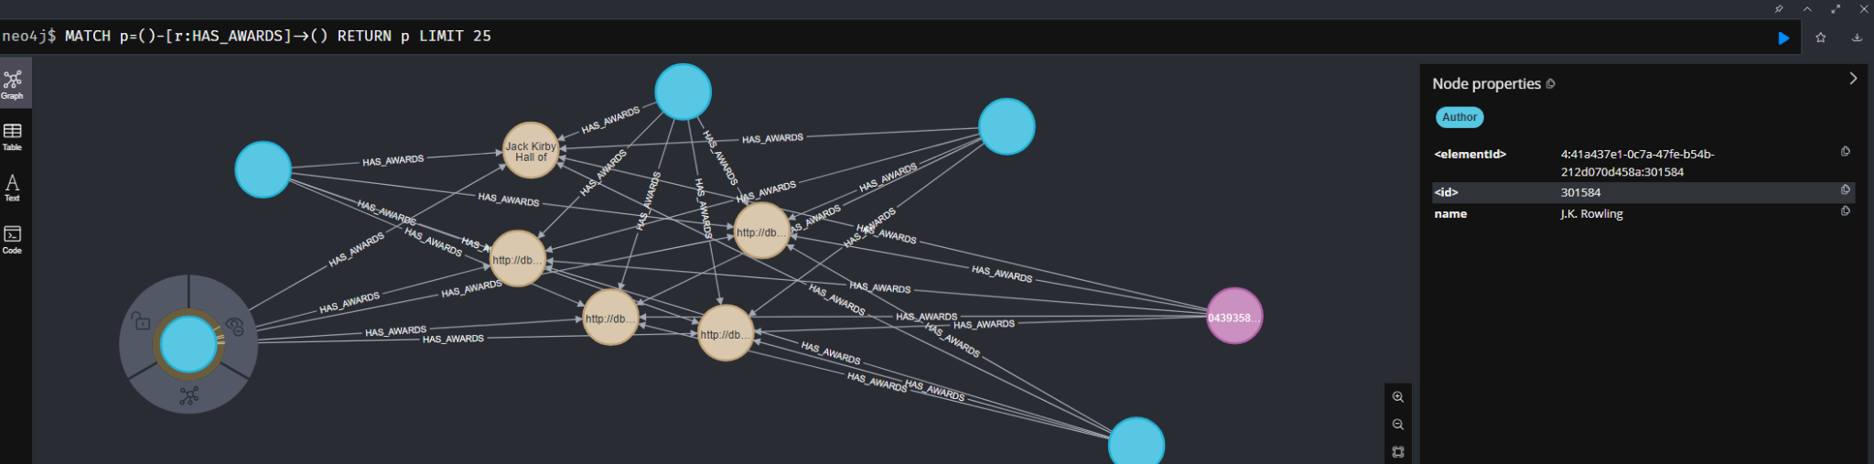
Graph Version 1I:
Improved Version With DBpedia

Slide 16
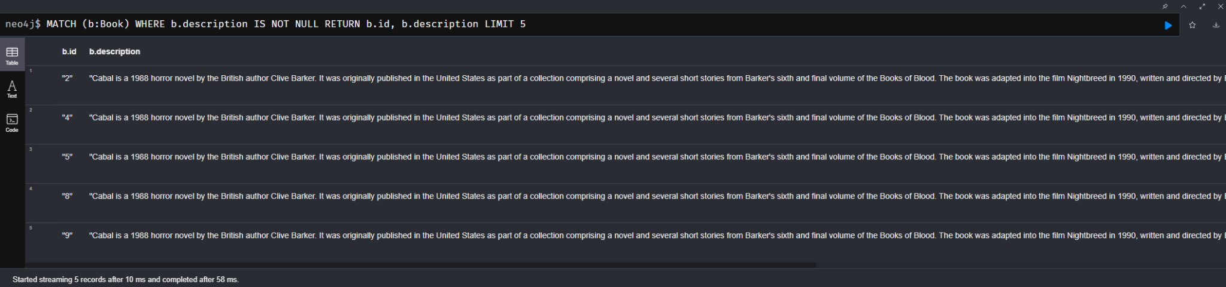
Graph Version 1I:
Improved Version With DBpedia
(Bugged Version)

Slide 17
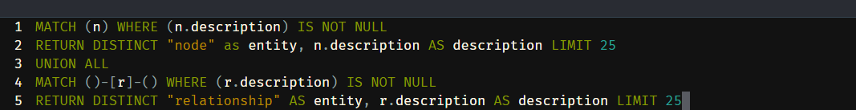
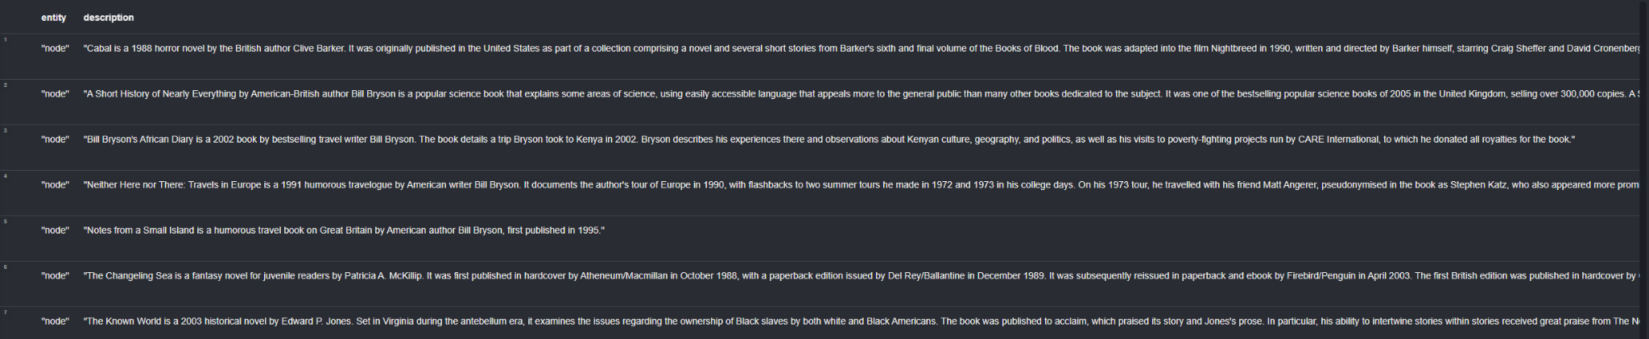
Graph Version 1I:
Improved Version With DBpedia
(Fixed Version)

Slide 18
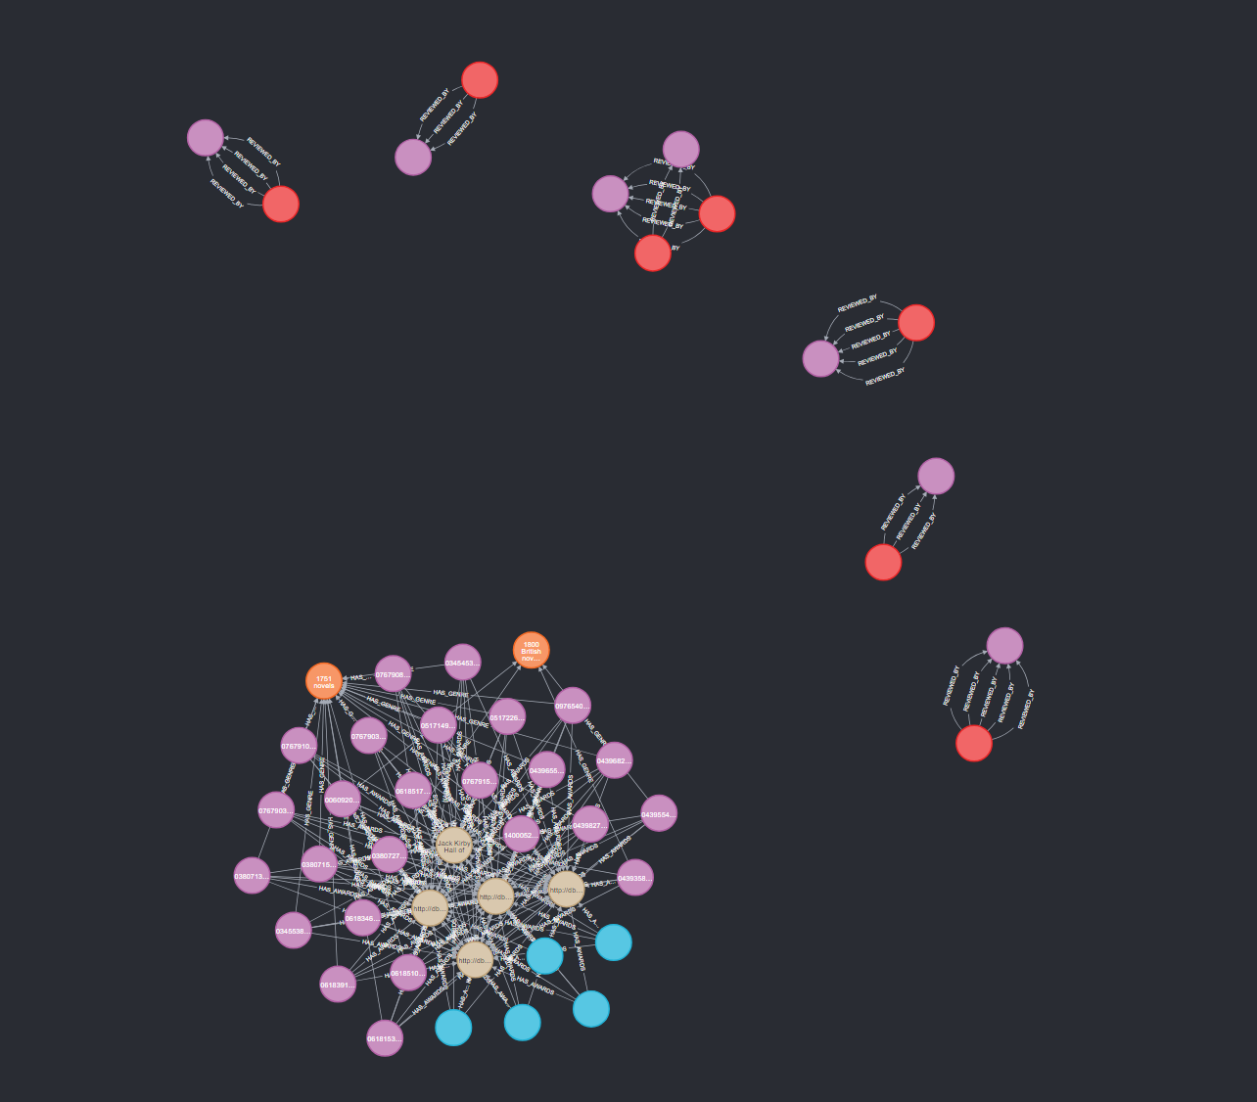
Graph Version 1I:
Improved Version With DBpedia

Slide 19
LLM Integration
Since the data for books are lacking semantic relationships with comments and other books, utilizing LLM to improve the graph database was crucial.
This step is work in progress at the moment. This step was missing the crucial connection between similar books.
In this step, sentiment analysis was performed using multiple LLMs, mainly BART and OpenAI. In the sentiment analysis, partial matching is also supported.

Slide 20
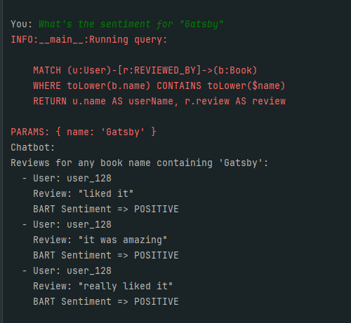
Graph Version III:
Improved Version With LLM Integration
BART Only

Slide 21
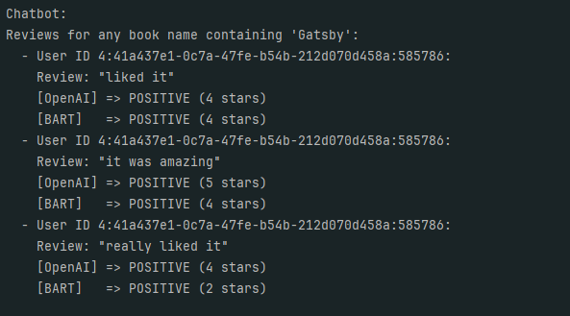
Graph Version III:
Improved Version With LLM Integration
BART and OpenAI

Slide 22

Storage

Slide 23
References
Goodreads Book Datasets With User Rating 2M

Slide 24
Thanks for listening

