Slide 1

MAMK-antiCheat
Yuri Yevstigneyeyev
Andrei Vykhodtcev
Mikkeli University of Applied Science
T5613SN
2016

Slide 2
About
A service tracking exam activity
A full exam-carrying system

Slide 3
Functions
Notify the supervisor on cheating suspicion
Block the PC of suspect
Monitor the activity of students answering questions

Slide 4
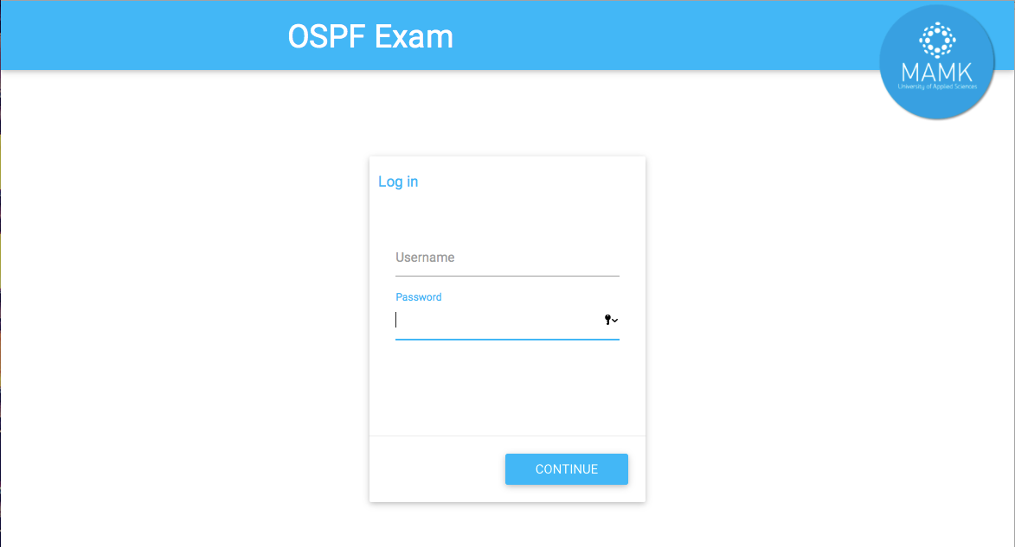

Slide 5
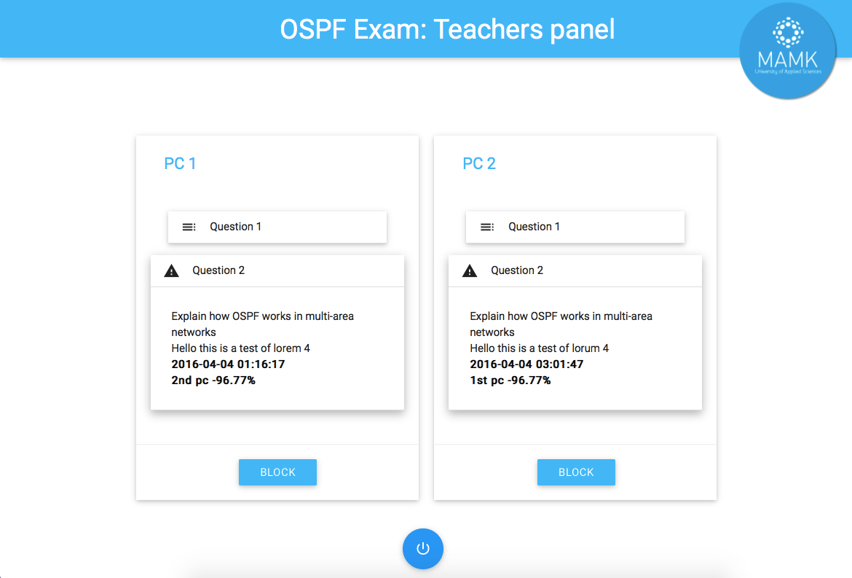

Slide 6
Opportunities
Prevent unfair exam results beforehand
Make the supervising easier
Teacher tracks all activity from desktop
All information is updated on-the-go
Possibility for further integration with Moodle
Commit students to learn material themselves

Slide 7
Demonstration
Now its is time to show the (partially)working prototype

Slide 8
On the backend side
Custom algorithm for comparison of answers
Compares whole structure (sentence -> word -> letter)
Takes predefined keywords in account
For the output — the similarity percentage
Secured DB exchange: no JS can be embed
Whole activity stays tracked until exam is checked

Slide 9
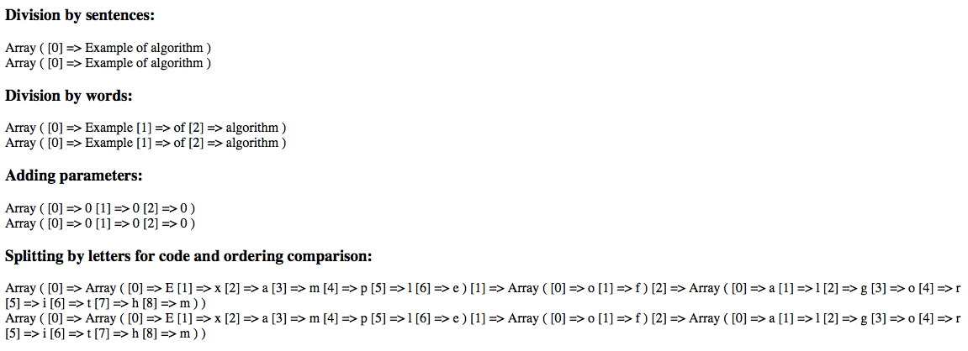
Our algorithm

Slide 10
What was used
Microsoft Azure for temporal server storage
PHP as a backend (will be switched to RubyOnRalils)
MySQL database
Google Material Design (Materialize framework)
Git for version control & server uploads (+webhooks)

Slide 11
Further roadmap
Polish the prototype
Advanced teacher dashboard (able to create exams)
Switch to Ruby (to ease complex server-based tasks)
Create a clutch with two separate servers (security)
Possibly extend Moodle & roll to big market

Slide 12
Thank you!

